Slide 1
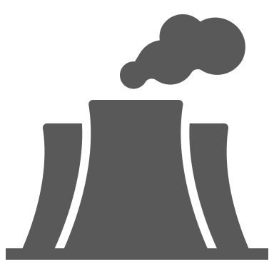
1 km
Biotest lake
Reference area
Warm
water outlet
Nuclear reactors
Cooling water intake

