Slide 1

Eventinsight
Project Supervisor: Dipl.-Ing. Alexander Rodiga

Slide 2
Subtasks
Lindner:
    Build and manage the admin interface.
    Display race-related data and sponsor images.
    Develop and maintain the backend.
    Create Login Portal
Sumann:
  Create the user interface.
  Implement the live-tracking application.
  Processing of RaceResult data

Slide 3
Current Status: Lindner
    Admin Login Portal
      Persistent login with token and username stored in local storage.
      Admins have restricted access to their assigned events only
    Prototype for Sponsorship Tool
      Supports picture uploads.
      Displays sponsorship content on the user home page.
    Search Function for Events on the LandingPage
      Users can view and access all events.
      Admins are limited to managing their assigned events.
    Optimized Routes and smoother Website
      Enhanced security for routes.
      Refined design for a better user experience.
    Total Work Effort: 116 hours

Slide 4
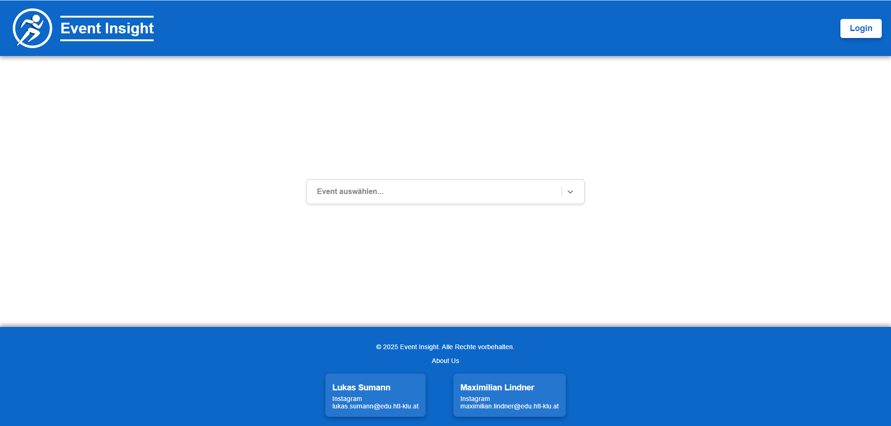
Landingpage

Slide 5
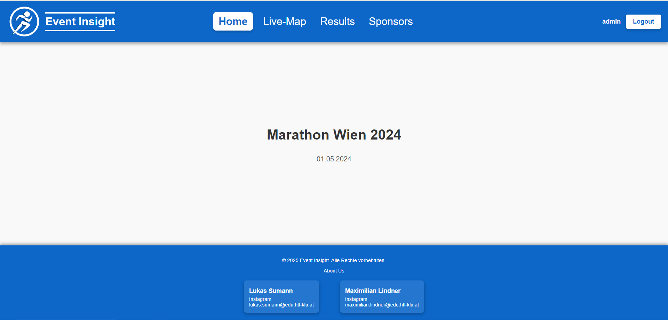
Admin Home

Slide 6
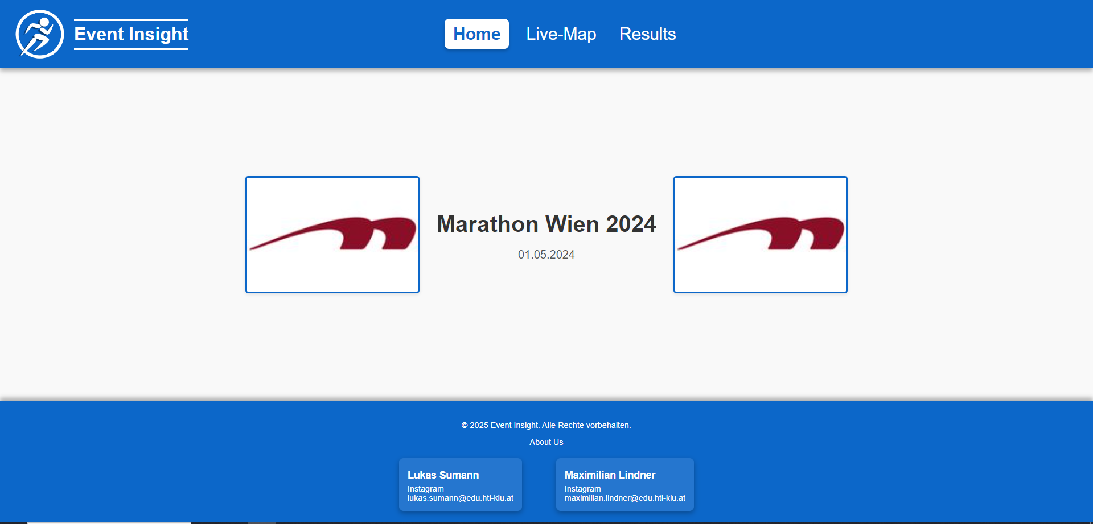
User Home

Slide 7
Goals for the next Sprint: Lindner
    Improve route security
      Address known bugs
    Tool to add text on the homepage of an event
      Add a tool for admins to add event info manually.
      Include an option to automatically get event info from an API
    Optimize sponsor tool
      Display sponsor pictures on all event pages.
      Ensure all sponsor images have uniform sizes
      Adjust their placement for better visibility.

Slide 8
Current Status: Sumann
    ResultTable
      The result table is now giving you the option to view the results either in male and female division or in Age divisions
    Participant Checkbox for the LiveMap
      Users can select which participants to display on the map.
      Includes a search bar to quickly find specific participants.
    Total Work Effort: 156 hours

Slide 9
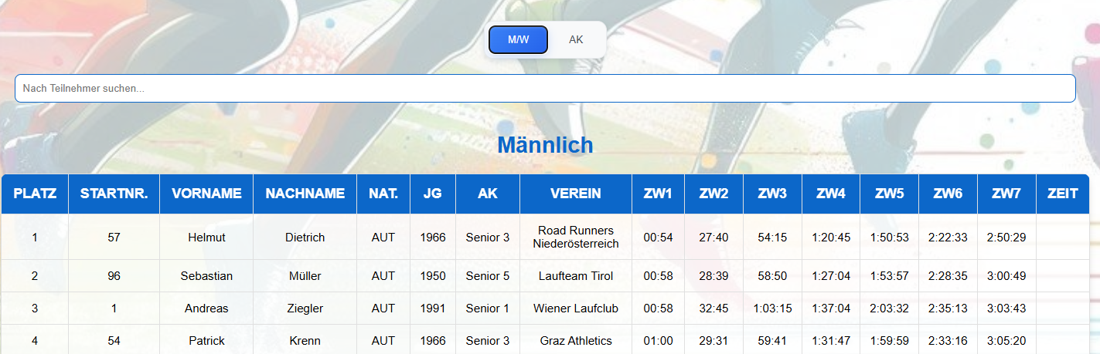
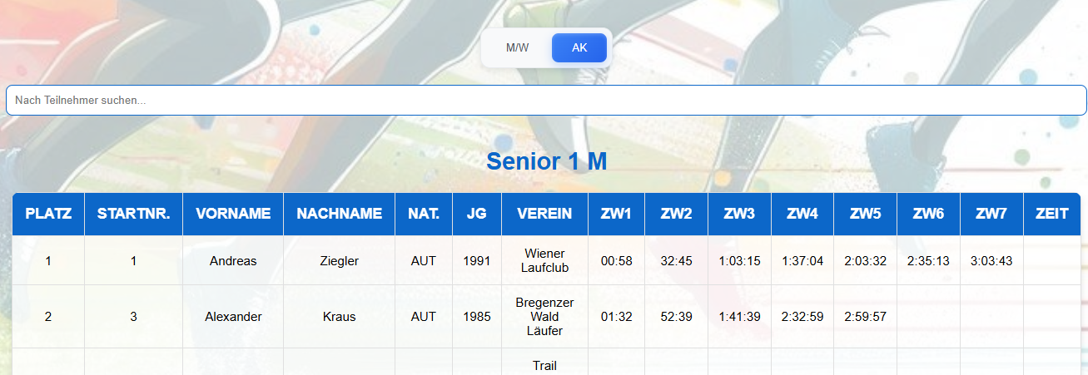
Result

Slide 10
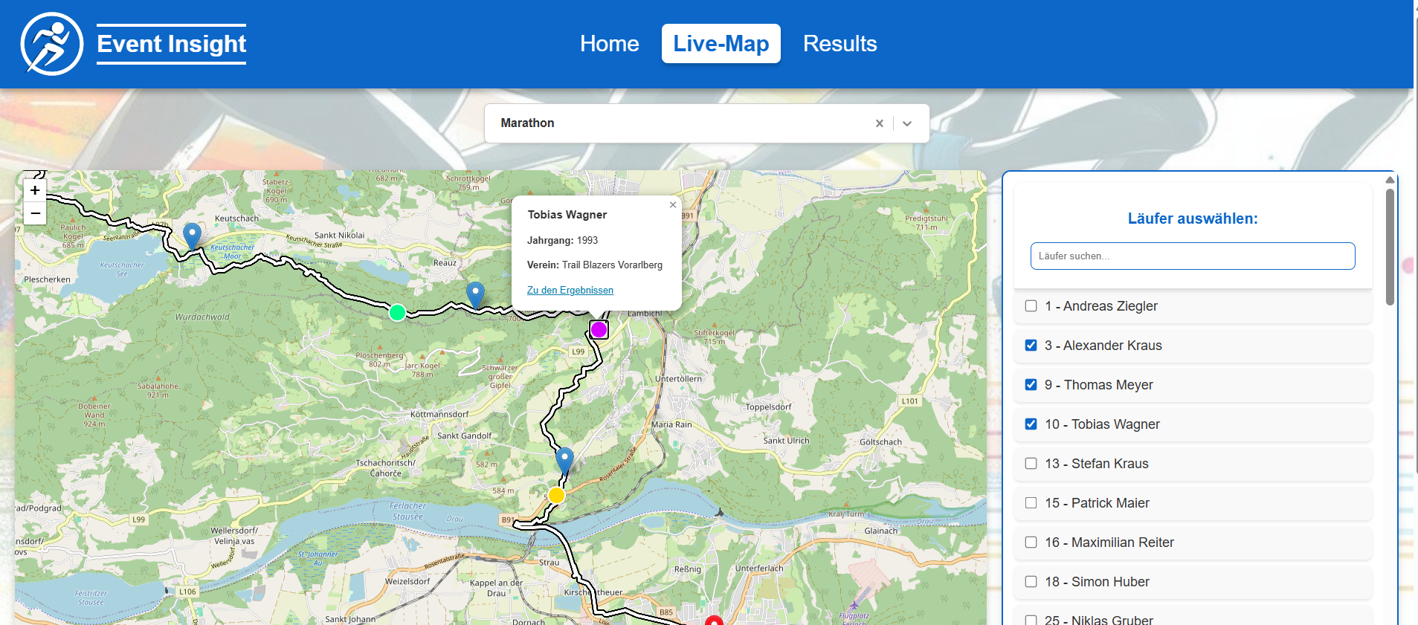
Live-Map

Slide 11
Goals for the next Sprint: Sumann
    Implement the tracking function
      Use API data to calculate and display participants' positions.
      Continuously update the position in real-time.
      Automatically remove participants from the live map once they finish the race.
    Finish the User-Designs
      Complete design elements like the footer and other UI details.

