Slide 1
Analysis of algorithms
The theoretical study of computer-program
performance and resource usage.
What’s more important than performance?
• modularity
• correctness
• maintainability
• functionality
• robustness
• user-friendliness
• programmer time
• simplicity
• extensibility
• reliability

Slide 2
Analysis of algorithms
Why study algorithms and performance?
• Algorithms help us to understand scalability.
• Performance often draws the line between what is feasible and what is impossible.
• Algorithmic mathematics provides a language for talking about program behavior.
• The lessons of program performance generalize to other computing resources.
• Speed is fun!

Slide 3
Running Time
• The running time depends on the input: an already sorted sequence is easier to sort.
• Parameterize the running time by the size of the input, since short sequences are easier to sort than long ones.
• Generally, we seek upper bounds on the running time, because everybody likes a guarantee.

Slide 4
Kinds of analyses
Worst-case: (usually)
• T(n) = maximum time of algorithm on any input of size n.
Average-case: (sometimes)
• T(n) = expected time of algorithm over all inputs of size n.
• Need assumption of statistical distribution of inputs.
Best-case:
• Cheat with a slow algorithm that works fast on some input.

Slide 5
Machine-Independent time
The RAM Model
Machine independent algorithm design depends on a hypothetical computer called Random Acces Machine (RAM).
Assumptions:
• Each simple operation such as +, -, if ...etc takes exactly one time step.
• Loops and subroutines are not considered simple operations.
• Each memory acces takes exactly one time step.

Slide 6

Machine-independent time
What is insertion sort’s worst-case time?
• It depends on the speed of our computer,
• relative speed (on the same machine),
• absolute speed (on different machines).
BIG IDEA:
• Ignore machine-dependent constants.
• Look at growth of
“Asymptotic Analysis”

Slide 7
Machine-independent time: An example
A pseudocode for insertion sort ( INSERTION SORT ).
INSERTION-SORT(A)
1 for j ← 2 to length [A]
2 do key ← A[ j]
3 ∇ Insert A[j] into the sortted sequence A[1,..., j-1].
4 i ← j – 1
5 while i > 0 and A[i] > key
6 do A[i+1] ← A[i]
7 i ← i – 1
8 A[i +1] ← key

Slide 8
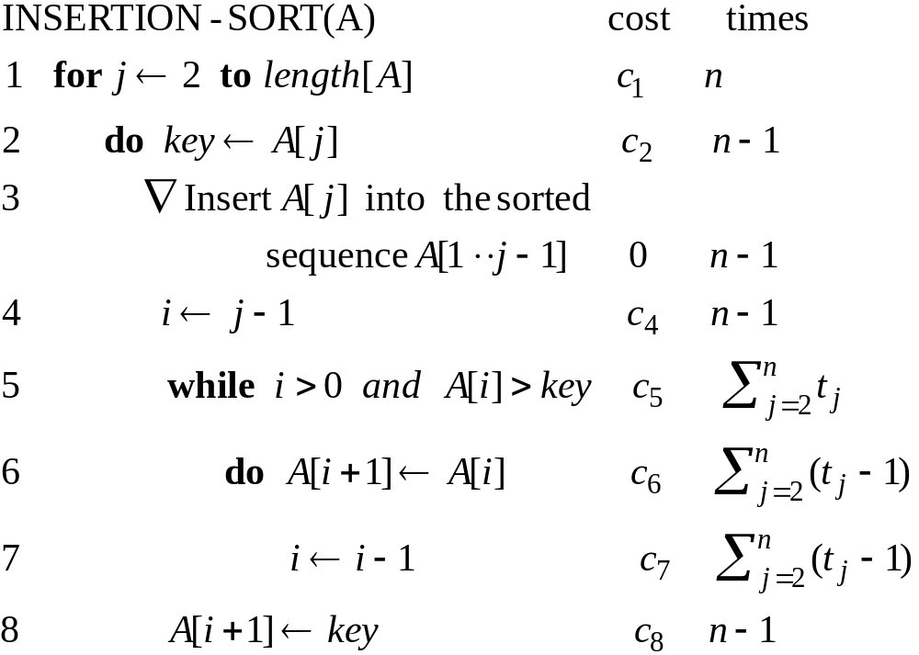
Analysis of INSERTION-SORT(contd.)

Slide 9
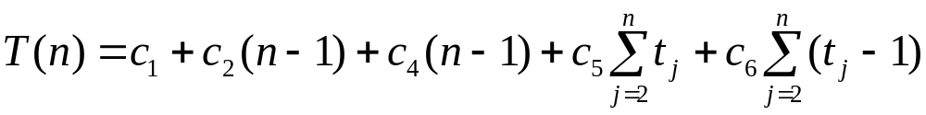
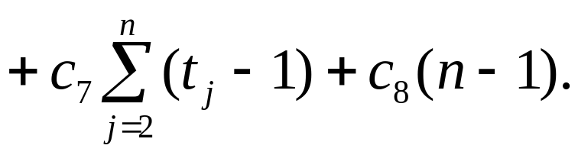
Analysis of INSERTION-SORT(contd.)
The total running time is

Slide 10
Analysis of INSERTION-SORT(contd.)
The best case: The array is already sorted.
(t_{j} =1 for j=2,3, ...,n)

Slide 11
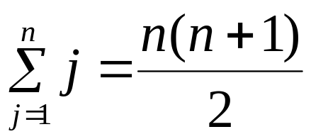
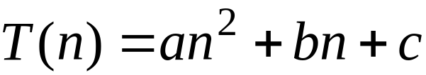
Analysis of INSERTION-SORT(contd.)
The worst case: The array is reverse sorted
(t_{j} =j for j=2,3, ...,n).

Slide 12
Growth of Functions
Although we can sometimes determine the exact running time of an algorithm, the extra precision is not usually worth the effort of computing it.
For large inputs, the multiplicative constants and lower order terms of an exact running time are dominated by the effects of the input size itself.

Slide 13
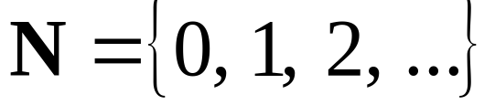
Asymptotic Notation
        The notation we use to describe the asymptotic running time of an algorithm are defined in terms of functions whose domains are the set of natural numbers

Slide 14


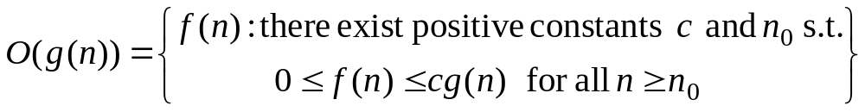



O-notation
For a given function , we denote by the set of functions
We use O-notation to give an asymptotic upper bound of a function, to within a constant factor.
means that there existes some constant c s.t. is always for large enough n.

Slide 15

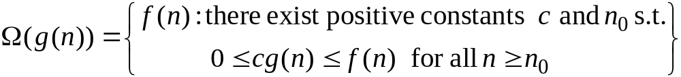


Ω-Omega notation
For a given function , we denote by the set of functions
We use Ω-notation to give an asymptotic lower bound on a function, to within a constant factor.
means that there exists some constant c s.t.
is always for large enough n.

Slide 16


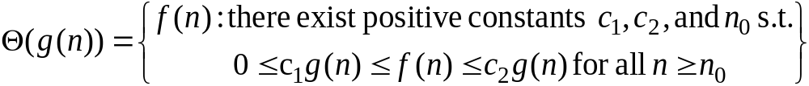







-Theta notation
For a given function , we denote by the set of functions
A function belongs to the set if there exist positive constants and such that it can be “sand- wiched” between and or sufficienly large n.
means that there exists some constant c₁ and c₂ s.t. for large enough n.

Slide 17
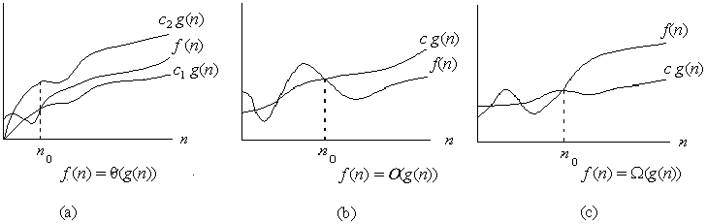

Asymptotic notation
Graphic examples of and .

Slide 18

Practical Complexity

Slide 19

Practical Complexity

Slide 20
Insertion Sort Is O(n²)
Proof
  Suppose runtime is an² + bn + c
    If any of a, b, and c are less than 0 replace the constant with its absolute value
  an² + bn + c ≤ (a + b + c)n² + (a + b + c)n + (a + b + c)
  ≤ 3(a + b + c)n² for n ≥ 1
  Let c’ = 3(a + b + c) and let n₀ = 1
Question
  Is InsertionSort O(n³)?
  Is InsertionSort O(n)?

Slide 21
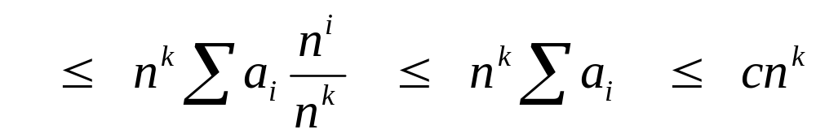
Big O Fact
A polynomial of degree k is O(n^{k})
Proof:
  Suppose f(n) = b_{k}n^{k} + b_{k-1}n^{k-1} + … + b₁n + b₀
    Let a_{i} = | b_{i} |
  f(n) ≤ a_{k}n^{k} + a_{k-1}n^{k-1} + … + a₁n + a₀

Slide 22

Theorem
For any two functions and , we have
if and only if

Slide 23
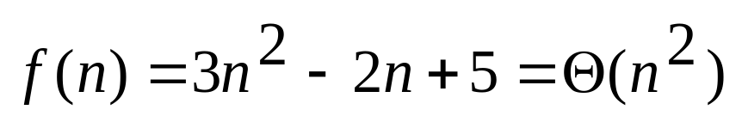
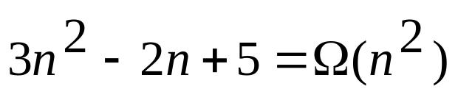
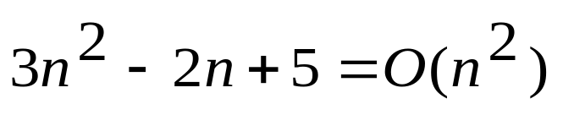
Example 2.
Because :

Slide 24
Example 3.

Slide 25
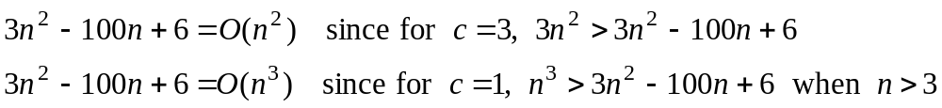
Example 3.

Slide 26
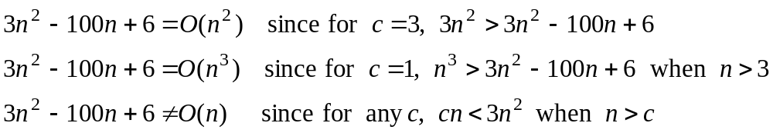
Example 3.

Slide 27
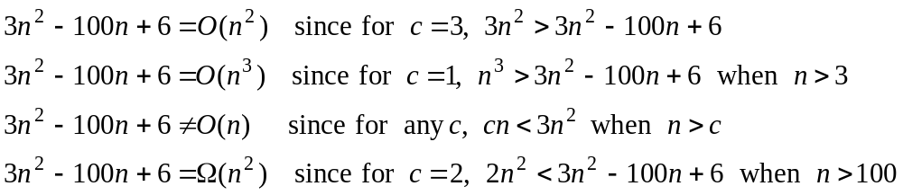
Example 3.

Slide 28
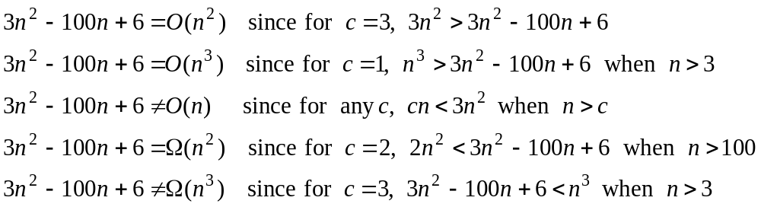
Example 3.

Slide 29
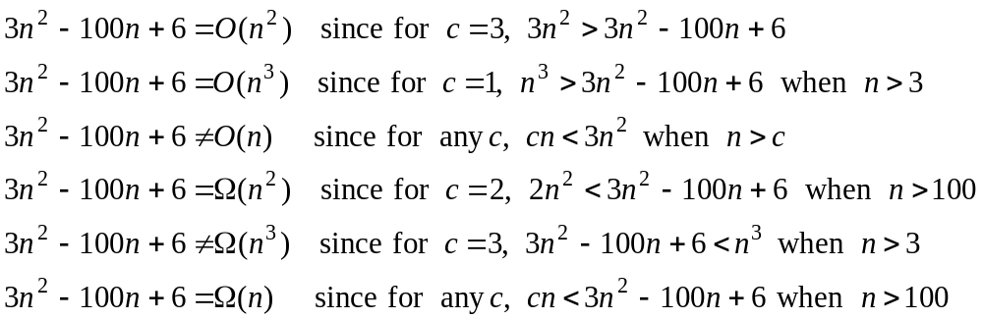
Example 3.

Slide 30
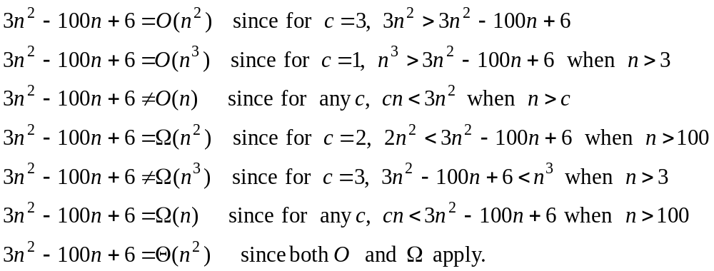
Example 3.

Slide 31
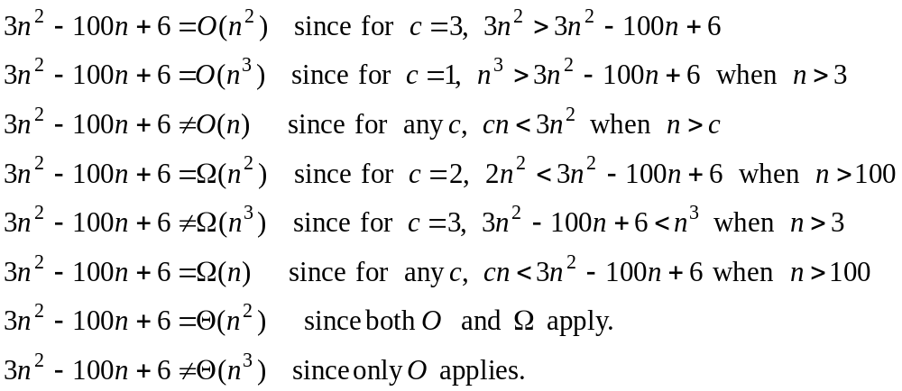
Example 3.

Slide 32
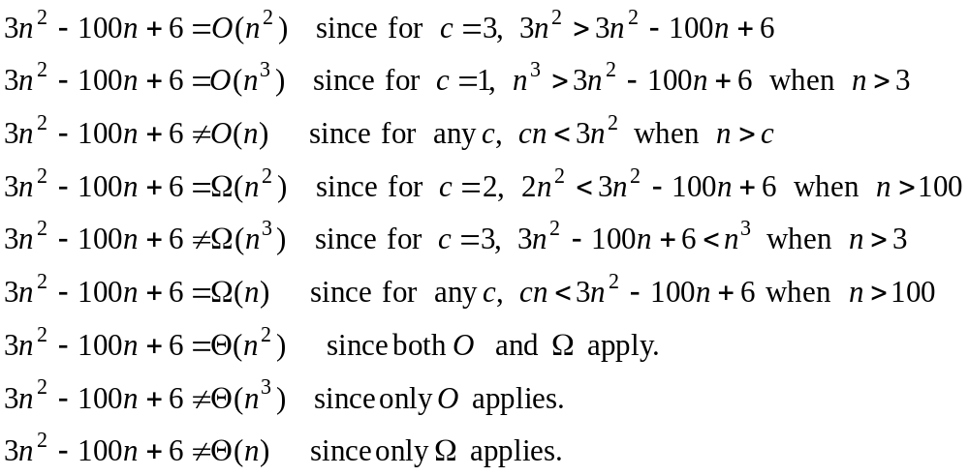
Example 3.

Slide 33
Other Asymptotic Notations
A function f(n) is o(g(n)) if for any positive constants c, ∃ n₀ such that
f(n) < c g(n) ∀ n ≥ n₀
A function f(n) is ω(g(n)) if for any positive constant c, ∃ n₀ such that
c g(n) < f(n) ∀ n ≥ n₀
Intuitively,
  o() is like <
  O() is like ≤
  ω() is like >
  Ω() is like ≥
  Θ() is like =

Slide 34
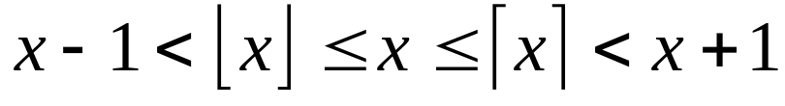
Standard notations and common functions
Floors and ceilings

Slide 35
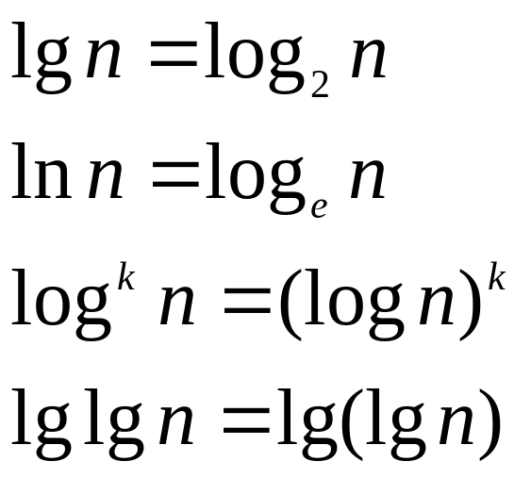
Standard notations and common functions
Logarithms:

Slide 36
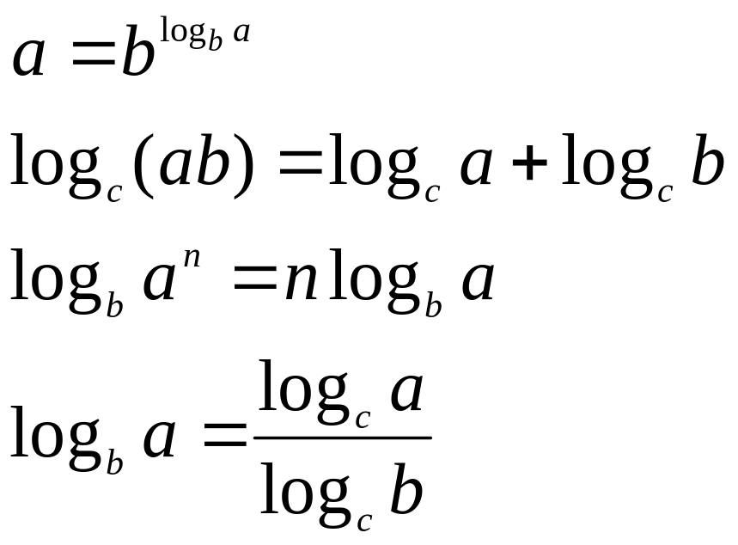
Standard notations and common functions
Logarithms:
For all real a>0, b>0, c>0, and n

Slide 37
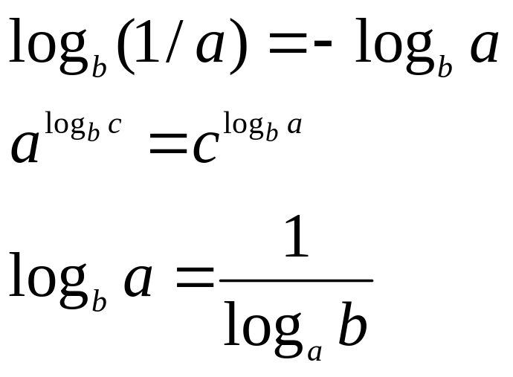
Standard notations and common functions
Logarithms:

