Slide 1
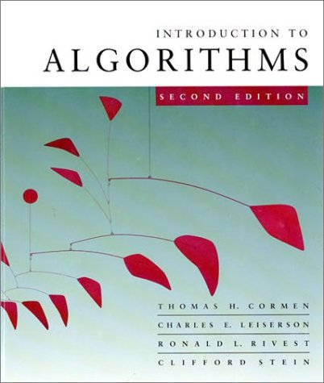
Introduction to Algorithms
Adapted from lectures of Prof. Shafi Goldwasser, Prof. Erik Demaine

Slide 2
Design and Analysis of Algorithms
Analysis: predict the cost of an algorithm in terms of resources and performance
Design: design algorithms which minimize the cost
L1.<number>

Slide 3
Our Machine Model
Generic Random Access Machine (RAM)
Executes operations sequentially
Set of primitive operations:
  Arithmetic. Logical, Comparisons, Function calls
Simplifying assumption: all ops cost 1 unit
  Eliminates dependence on the speed of our computer, otherwise impossible to verify and to compare
L1.<number>

Slide 4
Running time
The running time depends on the input: an already sorted sequence is easier to sort.
Major Simplifying Convention: Parameterize the running time by the size of the input, since short sequences are easier to sort than long ones.
  T_{A}(n) = time of A on length n inputs
Generally, we seek upper bounds on the running time, to have a guarantee of performance.
L1.<number>

Slide 5
Kinds of analyses
Worst-case: (usually)
  T(n) = maximum time of algorithm on any input of size n.
Average-case: (sometimes)
  T(n) = expected time of algorithm over all inputs of size n.
  Need assumption of statistical distribution of inputs.
Best-case: (NEVER)
  Cheat with a slow algorithm that works fast on some input.
L1.<number>

Slide 6
Machine-independent time
What is insertion sort’s worst-case time?
BIG IDEAS:
Ignore machine dependent constants,
otherwise impossible to verify and to compare algorithms
Look at growth of T(n) as n → ∞ .
“Asymptotic Analysis”
L1.<number>

Slide 7
Θ-notation
DEF:
Θ(g(n)) = { f (n) : there exist positive constants c₁, c₂, and n₀ such that 0 ≤ c₁ g(n) ≤ f (n) ≤ c₂ g(n) for all n ≥ n₀ }
Basic manipulations:
Drop low-order terms; ignore leading constants.
Example: 3n³ + 90n² – 5n + 6046 = Θ(n³)
L1.<number>

Slide 8
Asymptotic performance
When n gets large enough, a Θ(n²) algorithm always beats a Θ(n³) algorithm.
.
Asymptotic analysis is a useful tool to help to structure our thinking toward better algorithm
We shouldn’t ignore asymptotically slower algorithms, however.
Real-world design situations often call for a careful balancing
T(n)
n
n₀
L1.<number>

Slide 9
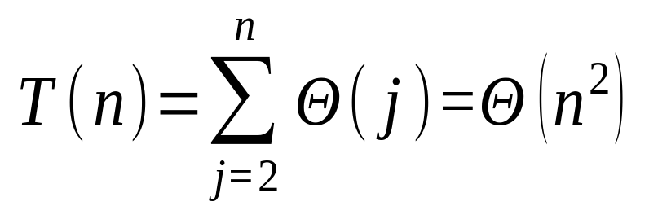
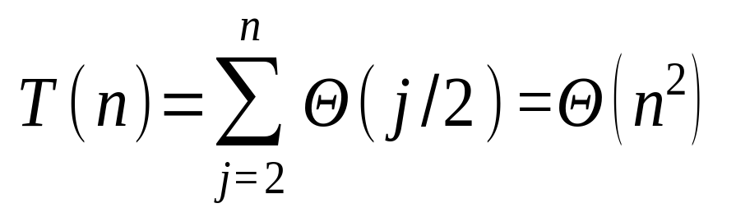
Insertion sort analysis
Worst case: Input reverse sorted.
[arithmetic series]
Average case: All permutations equally likely.
Is insertion sort a fast sorting algorithm?
Moderately so, for small n.
Not at all, for large n.
L1.<number>

Slide 10
Example 2:Merge sort
MERGE-SORT A[1 . . n]
If n = 1, done.
Recursively sort A[ 1 . . ⎡n/2⎤ ] and A[ ⎡n/2⎤+1 . . n ] .
“Merge” the 2 sorted lists.
Key subroutine: MERGE
L1.<number>

Slide 11
Merge Sort
p
q
r
1
2
3
4
5
6
7
8
Alg.: MERGE-SORT(A, p, r)
if p < r Check for base case
then q ← ⎣(p + r)/2⎦ Divide
MERGE-SORT(A, p, q) Conquer
MERGE-SORT(A, q + 1, r) Conquer
MERGE(A, p, q, r) Combine
Initial call: MERGE-SORT(A, 1, n)
5
2
4
7
1
3
2
6

Slide 12
Merge - Pseudocode
p
q
r
Alg.: MERGE(A, p, q, r)
Compute n₁ and n₂
Copy the first n₁ elements into L[1 . . n₁ + 1] and the next n₂ elements into R[1 . . n₂ + 1]
L[n₁ + 1] ← ∞; R[n₂ + 1] ← ∞
i ← 1; j ← 1
for k ← p to r
do if L[ i ] ≤ R[ j ]
then A[k] ← L[ i ]
i ←i + 1
else A[k] ← R[ j ]
j ← j + 1
1
2
3
4
5
6
7
8
2
4
5
7
1
2
3
6
n₁
n₂
p
q
L
2
4
5
7
∞
q + 1
r
R
1
2
3
6
∞

Slide 13
Merging two sorted arrays
20
13
7
2
12
11
9
1
L1.<number>

Slide 14
Merging two sorted arrays
20
13
7
2
12
11
9
1
1
L1.<number>

Slide 15
Merging two sorted arrays
20
13
7
2
12
11
9
1
20
13
7
2
12
11
9
1
L1.<number>

Slide 16
Merging two sorted arrays
20
13
7
2
12
11
9
1
20
13
7
2
12
11
9
1
2
L1.<number>

Slide 17
Merging two sorted arrays
20
13
7
2
12
11
9
1
20
13
7
2
12
11
9
20
13
7
12
11
9
1
2
L1.<number>

Slide 18
Merging two sorted arrays
20
13
7
2
12
11
9
1
20
13
7
2
12
11
9
20
13
7
12
11
9
1
2
7
L1.<number>

Slide 19
Merging two sorted arrays
20
13
7
2
12
11
9
1
20
13
7
2
12
11
9
20
13
7
12
11
9
20
13
12
11
9
1
2
7
L1.<number>

Slide 20
Merging two sorted arrays
20
13
7
2
12
11
9
1
20
13
7
2
12
11
9
20
13
7
12
11
9
20
13
12
11
9
1
2
7
9
L1.<number>

Slide 21
Merging two sorted arrays
20
13
7
2
12
11
9
1
20
13
7
2
12
11
9
20
13
7
12
11
9
20
13
12
11
9
20
13
12
11
1
2
7
9
L1.<number>

Slide 22
Merging two sorted arrays
20
13
7
2
12
11
9
1
20
13
7
2
12
11
9
20
13
7
12
11
9
20
13
12
11
9
20
13
12
11
1
2
7
9
11
L1.<number>

Slide 23
Merging two sorted arrays
20
13
7
2
12
11
9
1
20
13
7
2
12
11
9
20
13
7
12
11
9
20
13
12
11
9
20
13
12
11
20
13
12
1
2
7
9
11
L1.<number>

Slide 24
Merging two sorted arrays
20
13
7
2
12
11
9
1
20
13
7
2
12
11
9
20
13
7
12
11
9
20
13
12
11
9
20
13
12
11
20
13
12
1
2
7
9
11
12
L1.<number>

Slide 25
Merging two sorted arrays
20
13
7
2
12
11
9
1
20
13
7
2
12
11
9
20
13
7
12
11
9
20
13
12
11
9
20
13
12
11
20
13
12
1
2
7
9
11
12
Time = Θ(n) to merge a total of n elements (linear time).
L1.<number>

Slide 26
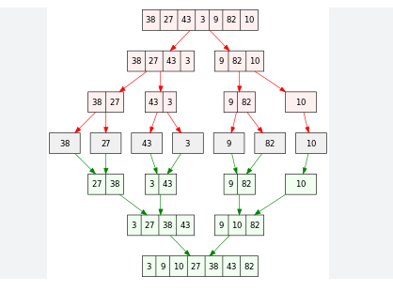
Merge Sort Example
Ref: Wikipedia

Slide 27
Analyzing merge sort
T(n)
Θ(1)
2T(n/2)
Θ(n)
MERGE-SORT A[1 . . n]
If n = 1, done.
Recursively sort A[ 1 . . ⎡n/2⎤ ] and A[ ⎡n/2⎤+1 . . n ] .
“Merge” the 2 sorted lists
Sloppiness: Should be T( ⎡n/2⎤ ) + T( ⎣n/2⎦ ) , but it turns out not to matter asymptotically.
L1.<number>

Slide 28
Recurrence for merge sort
Θ(1) if n = 1;
T(n) =
2T(n/2) + Θ(n) if n > 1.
We shall usually omit stating the base case when T(n) = Θ(1) for sufficiently small n, but only when it has no effect on the asymptotic solution to the recurrence.
L1.<number>

Slide 29
Conclusions
Θ(n lg n) grows more slowly than Θ(n²).
Therefore, merge sort asymptotically beats insertion sort in the worst case.
In practice, merge sort beats insertion sort for n > 30 or so.
L1.<number>

