Slide 1
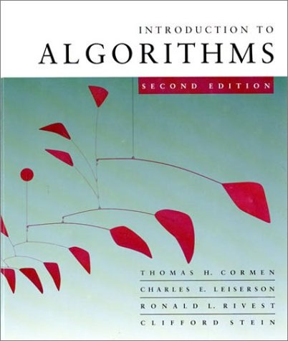
Theory of Algorithms
Elementary Graph Algorithms
9/23/2020
1
Notes:
1
1

Slide 2
Representation of graphs
2 representations of an undirected graph
Space Query: is (i,j) in E?
n-vertices m-edges
(b) Adjacency-list representation O(n+m) not O(1) time
(c) Adjacency-matrix representation O(n^2) O(1) time

Slide 3
2 representations of a directed graph
(b) Adjacency-list representation
(c) Adjacency-matrix representation

Slide 4
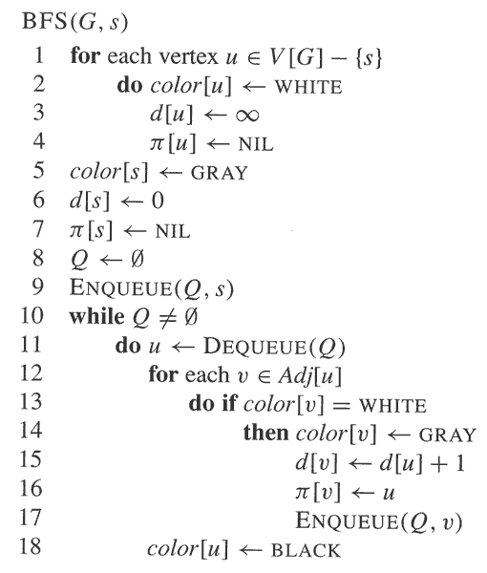
BFS pseudo-code

Slide 5
Breadth-first-search
BFS on an undirected graph. Compute into d(v) distance from source node s. Initially d(v)=‘infinity’. Shawn: queue Q in the beginning of an iteration, tree edges as produced by BFS (shaded), and d(v)
correction

Slide 6
Analysis: complexity
Method:
Charging each operation to a vertex or an edge
Upper bound the maximum number of charges per vertex and per edge
Since constant, adjacency-list input ➔ O(n+m) time.
u
u
u
u
s
s
s
s
s
u
u
(u,v)
(u,v)
v
v
v
v
u

Slide 7
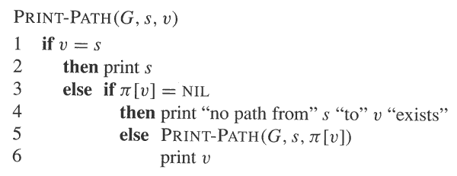
Reconstructing path from s to v: The BFS tree

Slide 8
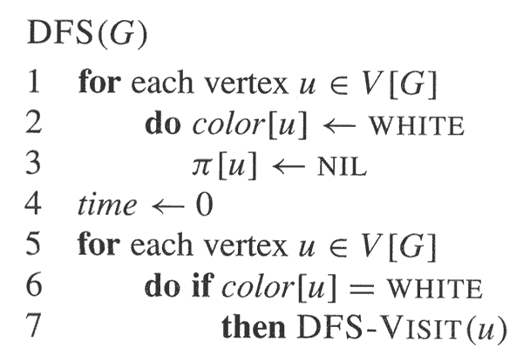
Dept-first search (DFS)
Initialize and initiate DFS

Slide 9
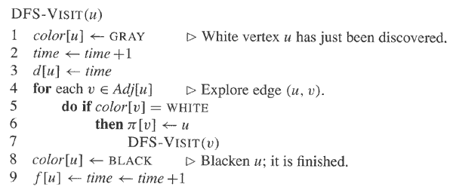
The recursive call
d(v) – discovery time
f(v) – finish time

Slide 11
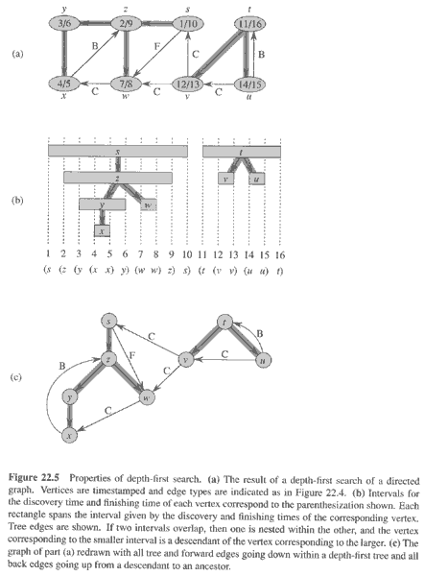
Properties of DFS
Undirected graphs -
2 types of edges:
- Tree edges
- Back edges
Directed graphs –
2 more:
Forward edges
Cross edges

Slide 12
Complexity
Revisit:
- Charging scheme
- Resulting complexity
O(n+m) time.

Slide 13
Strongly Connected Components
Every pair of vertices are reachable from each other
Graph G is strongly connected if, for every u and v in V, there is some path from u to v and some path from v to u.
Strongly Connected
Not Strongly Connected

Slide 14
Example
a
{ a , c , g }
g
c
d
{ f , d , e , b }
e
f
b

Slide 15
Finding Strongly Connected Components
Input: A directed graph G = (V,E)
Output: a partition of V into disjoint sets so that each set defines a strongly connected component of G

Slide 16
Algorithm
Strongly-Connected-Components(G)
call DFS(G) to compute finishing times f[u] for each vertex u. Cost: O(E+V)
compute G^{T} Cost: O(E+V)
call DFS(G^{T}), but in the main loop of DFS, consider the vertices in order of decreasing f[u] Cost: O(E+V)
output the vertices of each tree in the depth-first forest of step 3 as a separate strongly connected component.
The graph G^{T} is the transpose of G, which is visualized by
reversing the arrows on the digraph.
Cost: O(E+V)

Slide 17
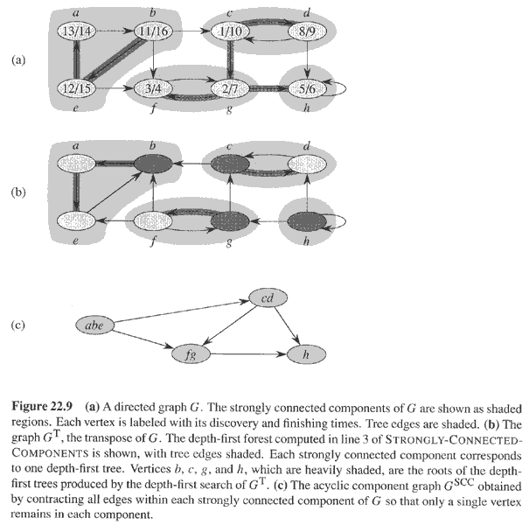
Example

Slide 18
Undirected connected graph G(V,E): Articulation points, bridges and biconnected components. Ex 22-2
Root of DFS is an articulation point if and only if it has at least 2 children in the DFS tree
Let v be a non-root of the DFS tree. v is an articulation point if it has a child s such that there is no back edge from s or any of its descendants to an ancestor of v.
low(v) is the minimum of: d(v) and d(w), where (u,w) is a back edge from a descendant u of v. How to compute low(v) for all nodes v in linear time?
The next slides explain why for this class bridges are also biconnected components
4. How to compute all articulation points in linear time?
5. How to compute all bridges in linear time?
6. Define biconnectivity* as a binary relation on edges: e₁Re₂ if they lie on a simple cycle, or e₁=e₂. Prove that R is an equivalence relation.

Slide 19
Clarification to definition of biconnected components
* The prior slide defines biconnectivity as a binary relation on edges, which is an equivalence relation. This extends to biconnected components by including all the vertices that touch on the edges of an equivalence class. This definition implies that a single bridge is an equivalence class of one edge (or a biconnected component of 2 vertices).
In contrast, Problem 22-2 in the textbook defines biconnected component as "a maximal set of edges such that any two edges in the set lie on a common simple cycle"; indeed item g seeks proof that the biconnected components of a graph partition only its non-bridge edges.
In ENEE641 students should follow the definition in the slides, or in Wikipedia http://en.wikipedia.org/wiki/Biconnected_component, but not the one in the text.

Slide 20
Euler tour
An Euler tour of a connected undirected graph G(V,E) is a cycle that traverses each edge of G exactly once.
Show that G has an Euler tour if and only if the degree of every vertex is an even number.
Describe an O(|E|) time algorithm to find the Euler tour of G if one exists.
Comments
1. Important routine for “next generation sequencing.
2. Euler tour for directed graphs is defined in Problem 22-3.

Slide 21
Transition Parallelism of graph algorithms
Also, why performance implementation is challenging and desirable
http://www.yarcdata.com/files/product-brief/Urika%20Product%20Brief.pdf

