Slide 1
Disjoint Sets Data Structure (Chap. 21)
A disjoint-set is a collection S={S₁, S₂,…, S_{k}} of distinct dynamic sets.
Each set is identified by a member of the set, called representative.
Disjoint set operations:
  MAKE-SET(x): create a new set with only x. assume x is not already in some other set.
  UNION(x,y): combine the two sets containing x and y into one new set. A new representative is selected.
  FIND-SET(x): return the representative of the set containing x.

Slide 2
An Application of Disjoint-Set
Determine the connected components of an undirected graph.
CONNECTED-COMPONENTS(G)
for each vertex v ∈V[G]
do MAKE-SET(v)
for each edge (u,v) ∈E[G]
do if FIND-SET(u) ≠ FIND-SET(v)
then UNION(u,v)
SAME-COMPONENT(u,v)
if FIND-SET(u)=FIND-SET(v)
then return TRUE
else return FALSE

Slide 3
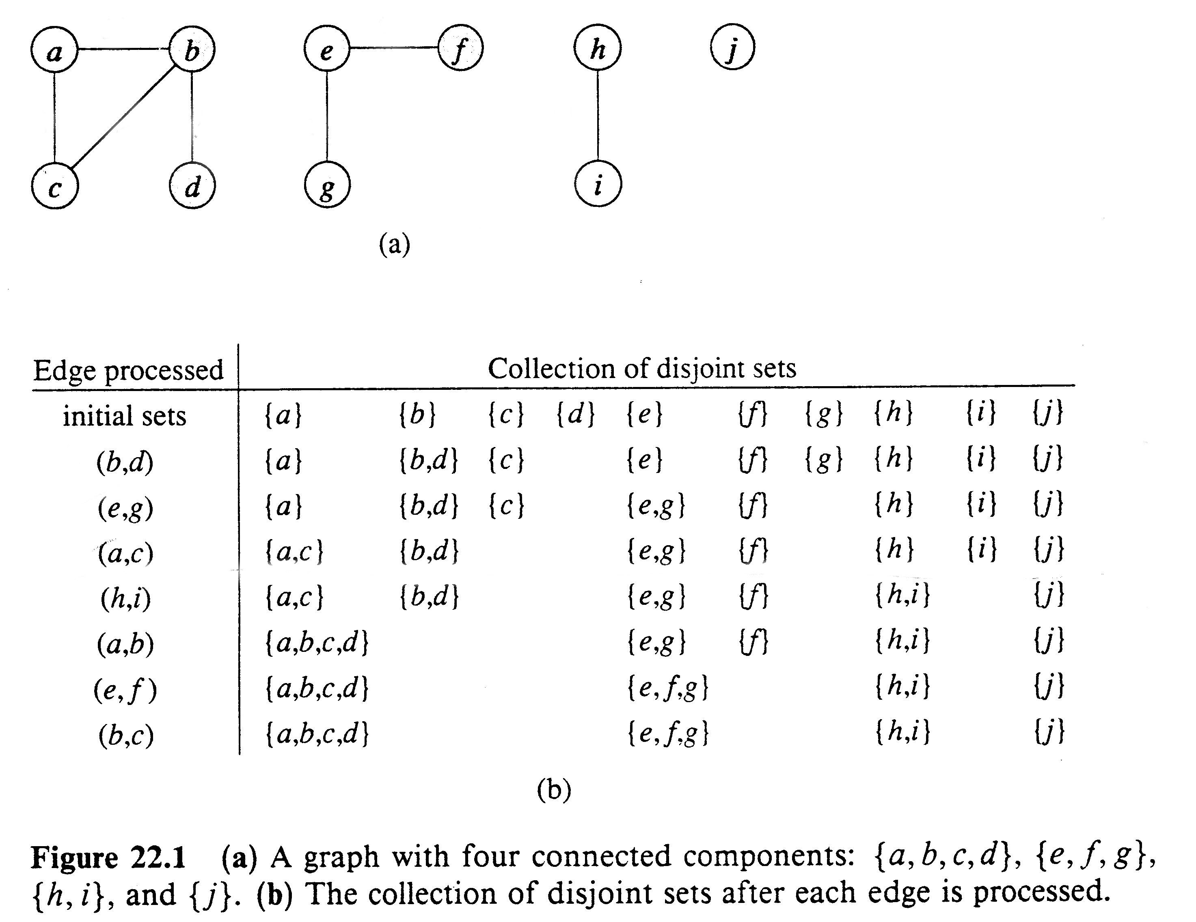
A graph consisting of four connected components
An illustration of how the disjoint sets are computed by CONNECTED-COMPONENTS

Slide 4
Linked-List Implementation
Each set as a linked-list, with head and tail, and each node contains value, next node pointer and back-to-representative pointer.
Example:
MAKE-SET costs O(1): just create a single element list.
FIND-SET costs O(1): just return back-to-representative pointer.

Slide 5
Linked-lists for two sets
Set {c,h,e}
c
h
e
head
tail
Set {f, g}
f
g
head
tail
UNION of
two Sets
f
g
c
h
e
head
tail

Slide 6
UNION Implementation
A simple implementation: UNION(x,y) just appends x to the end of y, updates all back-to-representative pointers in x to the head of y.
Each UNION takes time linear in the x’s length.
Suppose n MAKE-SET(x_{i}) operations (O(1) each) followed by n-1 UNION
  UNION(x₁, x₂), O(1),
  UNION(x₂, x₃), O(2),
  …..
  UNION(x_{n-1}, x_{n}), O(n-1)
The UNIONs cost 1+2+…+n-1=Θ(n²)
So 2n-1 operations cost Θ(n²), average Θ(n) each.
Not good!! How to solve it ???

Slide 7
Weighted-Union Heuristic
Instead appending x to y, appending the shorter list to the longer list.
Associated a length with each list, which indicates how many elements in the list.
Result: a sequence of m MAKE-SET, UNION, FIND-SET operations, n of which are MAKE-SET operations, the running time is O(m+nlg n). Why???
Hints: Count the number of updates to back-to-representative pointer
for any x in a set of n elements. Consider that each time, the UNION
will at least double the length of united set, it will take at most lg n
UNIONS to unite n elements. So each x’s back-to-representative pointer
can be updated at most lg n times.

Slide 8
Disjoint-set Implementation: Forests
Rooted trees, each tree is a set, root is the representative. Each node points to its parent. Root points to itself.
c
f
c
c
f
c
c
c
d
h
e
d
Set {c,h,e}
Set {f,d}
h
e
UNION

Slide 9
Straightforward Solution
Three operations
  MAKE-SET(x): create a tree containing x. O(1)
  FIND-SET(x): follow the chain of parent pointers until to the root. O(height of x’s tree)
  UNION(x,y): let the root of one tree point to the root of the other. O(1)
It is possible that n-1 UNIONs results in a tree of height n-1. (just a linear chain of n nodes).
So n FIND-SET operations will cost O(n²).

Slide 10
Union by Rank & Path Compression
Union by Rank: Each node is associated with a rank, which is the upper bound on the height of the node (i.e., the height of subtree rooted at the node), then when UNION, let the root with smaller rank point to the root with larger rank.
Path Compression: used in FIND-SET(x) operation, make each node in the path from x to the root directly point to the root. Thus reduce the tree height.

Slide 11
Path Compression
f
f
e
c
d
e
d
c

Slide 12
Algorithm for Disjoint-Set Forest
UNION(x,y)
1. LINK(FIND-SET(x),FIND-SET(y))
MAKE-SET(x)
p[x]←x
rank[x]←0
FIND-SET(x)
if x≠ p[x]
then p[x] ←FIND-SET(p[x])
return p[x]
LINK(x,y)
if rank[x]>rank[y]
then p[y] ←x
else p[x] ←y
if rank[x]=rank[y]
then rank[y]++
Worst case running time for m MAKE-SET, UNION, FIND-SET operations is:
O(mα(n)) where α(n)≤4. So nearly linear in m.

Slide 13
Analysis of Union by Rank with Path Compression
(by amortized analysis)
Discuss the following:
  A very quickly growing function and its very slowly growing inverse
  Properties of Ranks
  Proving time bound of O(mα(n)) where α(n) is a very slowly growing function.

Slide 14
A very quickly growing function and its inverse
For integers k≥0 and j ≥1, define A_{k}(j):
  A_{k}(j)= j+1 if k=0
  A_{k-1}^{(j+1)}(j) if k≥1
  Where A_{k-1}⁰(j)=j, A_{k-1}^{(i)}(j)= A_{k-1}(A_{k-1}^{(i-1)}(j)) for i ≥1.
  k is called the level of the function and
  i in the above is called iterations.
A_{k}(j) strictly increase with both j and k.
Let us see how quick the increase is!!

Slide 15
Quickness of Function A_{k}(j)’s Increase
Lemma 21.2 (Page 510):
  For any integer j, A₁(j) =2j+1.
  Proof:
    By induction on i, prove A₀^{i}(j) =j+i.
    So A₁(j)= A₀^{(j+1)}(j) =j+(j+1)=2j+1.
Lemma 21.3 (Page 510):
  For any integer j, A₂(j) =2^{j+1}(j+1)-1.
  Proof:
    By induction on i, prove A₁^{i}(j) =2^{i}(j+1)-1
    A₂(j)= A₁^{(j+1)}(j) = 2^{j+1}(j+1)-1.

Slide 16
How Quick A_{k}(j) Increase
Let us see A_{k}(1): for k=0,1,2,3,4.
  A₀(1)=1+1=2
  A₁(1)=2*1+1=3
  A₂(1)=2¹⁺¹(1+1)-1=7
  A₃(1)=A₂⁽¹⁺¹⁾(1)=A₂⁽²⁾(1)=A₂(A₂(1))=A₂(7)=2⁷⁺¹(7+1)-1=2⁸*8-1=2047
  A₄(1)=A₃²(1)=A₃(A₃(1)) =A₃(2047)=A₂⁽²⁰⁴⁸⁾(2047)
  >> A₂(2047) =2²⁰⁴⁸.2048-1 >2²⁰⁴⁸ =(2⁴)⁵¹² =(16)⁵¹²
  >>10⁸⁰ . (estimated number of atoms in universe)

Slide 17
Inverse of A_{k}(n):α(n)
α(n)=min{k: A_{k}(1) ≥n} (so, A_{α(n)}(1) ≥n )
α(n)= 0 for 0≤ n ≤2
1 n =3
2 for 4≤ n ≤7
3 for 8≤ n ≤2047
4 for 2048≤ n ≤A₄(1).
Extremely slow increasing function.
α(n) ≤4 for all practical purposes.

Slide 18
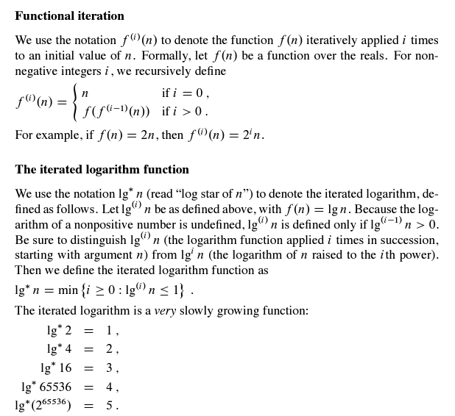
Another very slow increasing function

Slide 19
O(mα(n)) bound: Property of Ranks
Lemma 21.4 (page 511):
  For all nodes x, rank[x] ≤rank[p[x]], with strict inequality if x≠p[x].
Corollary 21.5 (page 511):
  As we follow the path from any node to the root, the node ranks strictly increase.
Lemma 21.6 (page 512):
  Every node had rank at most n-1.
    Proof: rank begins with 0, increase possibly with only LINK operations, which is at most n-1 time.
    In fact, at most ⎣log(n)⎦.

Slide 20
O(mα(n)) bound proof
Using amortized analysis (Chap. 17)
Using LINK instead UNION (every UNION is done by two FIND-SETs and one LINK)
Lemma 21.7 (page 512):
  Suppose converting a sequence S' of m' MAKE-SET, UNION, and FIND-SET operations into a sequence S of m MAKE-SET, LINK, FIND-SET by turning UNION to two FIND-SETs and one LINK, then if S runs in O(mα(n)), then S' runs in O(m'α(n)).
  Proof: because of m' ≤ m ≤3m' , thus m=O(m').

Slide 21
Potential Function
For each node x, assign a potential function φ_{q}(x) after q operations.
Then potential for entire forest, Φ_{q}=∑_{x}φ_{q}(x)
  Φ₀=0 at the beginning.
  Φ_{q} will never be negative.
φ_{q}(x)= α(n)⋅rank[x] if x is a root or rank[x]=0.
[α(n)-level(x)]⋅rank[x]-iter(x) otherwise.

Slide 22
level(x) and iter(x)
level(x)=max{k: rank[p[x]]≥A_{k}(rank[x])}
  0≤ Level(x)<α(n), since
    rank[p[x]]≥rank[x]+1=A₀(rank[x]) and
    A_{α(n)} (rank[x]) ≥ A_{α(n)} (1) ≥ n > rank[p[x]].
iter(x)=max{i: rank[p[x]]≥A_{level(x)}^{(i)}(rank[x])}
  1≤ iter(x) ≤ rank[x], since
    rank[p[x]]≥A_{level(x)}(rank[x])=A_{level(x)}⁽¹⁾(rank[x]) and
    A_{level(x)}^{(rank[x]+1)}(rank[x])=A_{level(x)+1}(rank[x])>rank[p[x]].

Slide 23
Relations among rank[p[x]], level(x) and iter(x)
Since rank[p[x]] monotonically increase over time, in order for iter(x) to decrease, level(x) must increase.
Or say another way, as long as level(x) remains unchanged, iter(x) must either increase or remains unchanged.

Slide 24
Properties for Potential Function φ_{q}(x)
Lemma 21.8 (page 514):
  For every node x, and for all q, 0≤ φ_{q}(x) ≤ α(n)⋅rank[x]
Proof:
  if x is a root or rank[x]=0, then correct by definition.
  Suppose x is not a root and rank[x]>0,
    φ_{q}(x)= [α(n)-level(x)]⋅rank[x]-iter(x) ≥ (α(n)-(α(n)-1))⋅ rank[x]-rank[x] =rank[x]-rank[x]=0.
    φ_{q}(x)= [α(n)-level(x)]⋅rank[x]-iter(x) ≤ [α(n)-0]⋅rank[x]-1= α(n)⋅rank[x]-1<α(n)⋅rank[x]

Slide 25
Potential Changes of Operations
Lemma 21.9 (page 515):
  Let x be a node that is not a root, and suppose qth operation is either LINK or FIND-SET. Then after the qth operation, φ_{q}(x) ≤ φ_{q-1}(x). Moreover, if rank[x] ≥ 1 and either level[x] or iter(x) changes due to the qth operation, then φ_{q}(x) ≤ φ_{q-1}(x)-1.
Proof:
  x not root → rank[x] not change
  n not change→ α(n) not change.
  If rank[x]=0, then φ_{q}(x) = φ_{q-1}(x)=0. suppose rank[x]>0.
  If level(x) not change,
    If iter(x) not change, φ_{q}(x) = φ_{q-1}(x), since all keep same
    If iter(x) increase, then at lease by 1, φ_{q}(x) will decrease at least 1.
  If level(x) increases (at least by 1), then (α(n)-level(x))⋅rank[x] drops at least by rank[x] .
    Suppose iter(x) drops, then, the drop is at most rank[x]-1. so φ_{q}(x) will drop at least rank[x]-(rank[x]-1)=1. Thus φ_{q}(x) ≤ φ_{q-1}(x)-1.

Slide 26
Amortized Costs of Operations
Lemma 21.10 (page 515):
  The amortized cost of each MAKE-SET operation is O(1).
Proof: create a single node x with rank 0, so φ_{q}(x) =0. no other change to the forest, so Φ_{q=} Φ_{q-1}. The left is the actual cost, which is O(1).

Slide 27
Amortized Costs of Operations (cont.)
Lemma 21.11 (page 515):
  The amortized cost of each LINK operation is O(α(n)).
Proof: (LINK(x,y) makes y the parent of x).
  Actual cost for LINK operation is O(1).
  Considering potential change:
    Three kinds of nodes: x, y, and the old children of y.
    By Lemma 21.9, the potential of y’s old children not increase.
    For x (changed to non-root from a root), φ_{q}(x)= [α(n)-level(x)]⋅rank[x]-iter(x) ≤ [α(n)-0]⋅rank[x]-1= α(n)⋅rank[x]-1<α(n)⋅rank[x]=φ_{q-1}(x).
    For y, rank[y] may stay same or increase by 1, so φ_{q}(y)=α(n)⋅rank[y]=φ_{q-1}(y) or φ_{q-1}(y)+α(n).
    Thus the potential increase due to the LINK operation is at most α(n).
  Thus the amortized cost is O(1)+O(α(n))=O(α(n))

Slide 28
Amortized Costs of Operations (cont.)
Lemma 21.12 (page 516):
  The amortized cost of each FIND-SET operation is O(α(n)).
Proof: suppose there are s nodes in the find path.
  The actual cost of FIND-SET is O(s).
  Root’s potential does not change and no other node’s potential increases (by Lemma 21.9).
  At least max(0,s-(α(n)+2)) nodes on the find path have their potential decrease by at least 1.
  Thus the amortized cost is at most O(s)-(s-(α(n)+2)) =O(α(n)).

Slide 29
Proof of Lemma 21.12 (cont.)
Proof that at lease max(0,s-(α(n)+2)) nodes on the find path have their potential decrease by at least 1.
  Let x be a node on the find path:
    rank[x]>0,
    followed somewhere by y that is not a root,
    and level(y)=level(x) just before FIND-SET.
  At most α(n)+2 nodes do not satisfy: 1th node, root node, the last node w for which level(w)=0,1,…, α(n)-1.
  Thus at least max(0,s-(α(n)+2)) nodes satisfy.
  Let us fix x, show x’s potential decreases by at least 1.

Slide 30
Proof of Lemma 21.12 (cont.)
Let k=level(x)=level(y), Just prior to path compression caused by FIND-SET, we have
  rank[p[x]]≥A_{k}^{(iter(x))}(rank[x]) (by iter(x)’s def.)
  rank[p[y]]≥A_{k}(rank[y]) (by level(y)’s def.)
  rank[y]≥ rank[p[x]] (since y follows x somewhere).
Let i=iter(x) before path compression, we have
  rank[p[y]]≥A_{k}(rank[y])
    ≥A_{k}(rank[p[x]]) (since A_{k}(j) is strictly increasing)
    ≥A_{k}(A_{k}^{(iter(x))}(rank[x]))
    =A_{k}^{(i+1)}(rank[x])
After path compression, rank[p[x]]=rank[p[y]], which not decrease, and rank[x] not change, so rank[p[x]]≥A_{k}^{(i+1)}(rank[x]).
  Which means that either iter(x) increases (to at least i+1), or level(x) to increase. Thus by Lemma 21.9, φ_{q}(x) ≤ φ_{q-1}(x)-1. that is x’s potential decreases by at least 1.
As a result, we prove the lemma 21.12.

Slide 31
Upper bound for Disjoint-sets
Theorem 21.14 (page 581):
  A sequence of m MAKE-SET, UNION, FIND-SET operations, n of which are MAKE-SET operations, can be performed on a disjoint-set forest with union by rank and path compression in worst cast time O(mα(n)).

Slide 32
Summary
Disjoint set
  Three operations
  Different implementations and different costs
Forest implementation:
  Union by rank and path compression
  Properties: rank, level, iter.
  Amortized analysis of the operations:
    Potential function.
A_{k}(j) funcion:
  A_{k}(j)= j+1 if k=0
  A_{k-1}^{(j+1)}(j) if k≥1
  Where A_{k-1}⁰(j)=j, A_{k-1}^{(i)}(j)= A_{k-1}(A_{k-1}^{(i-1)}(j)) for i ≥1.
  k is called the level of the function and
  i in the above is called iterations.
α(n)=min{k: A_{k}(1) ≥ n}

Slide 33
A typical example using Disjoint Set –
Kruskal's algorithm (Minimum Spanning Tree)
Idea
  sort the edges of G in increasing order by length
  keep a subgraph S of G, initially empty
  for each edge e in sorted order
    if the endpoints of e are disconnected in S
      add e to S
Code
  S=∅
  For each vertex v
    MAKE-SET(v)
  Sort edges in non-decreasing order by weights
  For each edge (u,v) from beginning to end
    If (FIND-SET(u)!=FIND-SET(v))
      S=S ∪ {(u,v)}
      UNION(u,v)
  Return S

