Slide 1
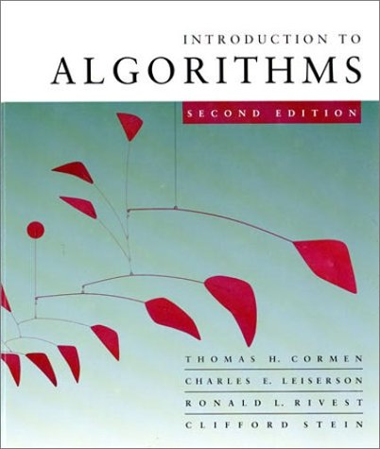
Theory of Algorithms
Minimum Spanning Trees
Chapter 23

Slide 2
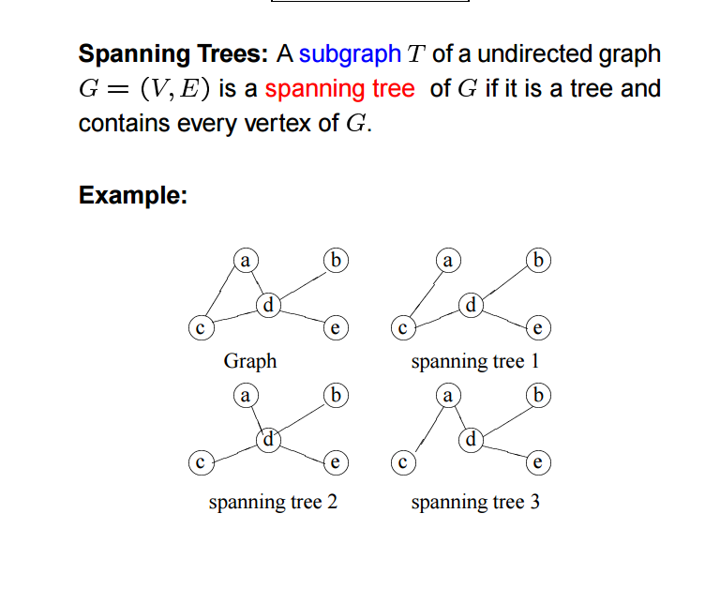
Spanning Trees

Slide 3
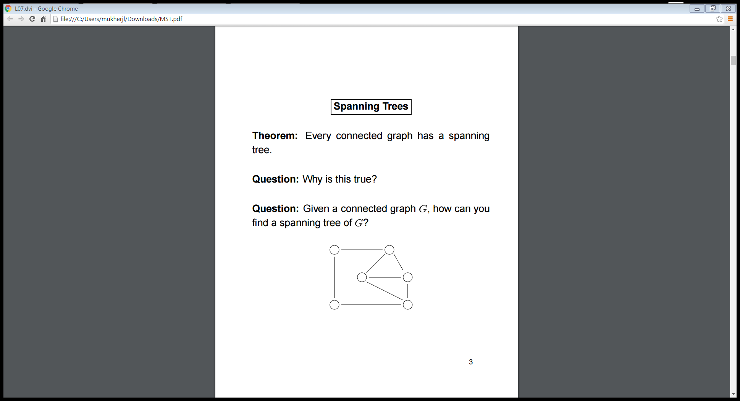
Spanning Trees

Slide 4
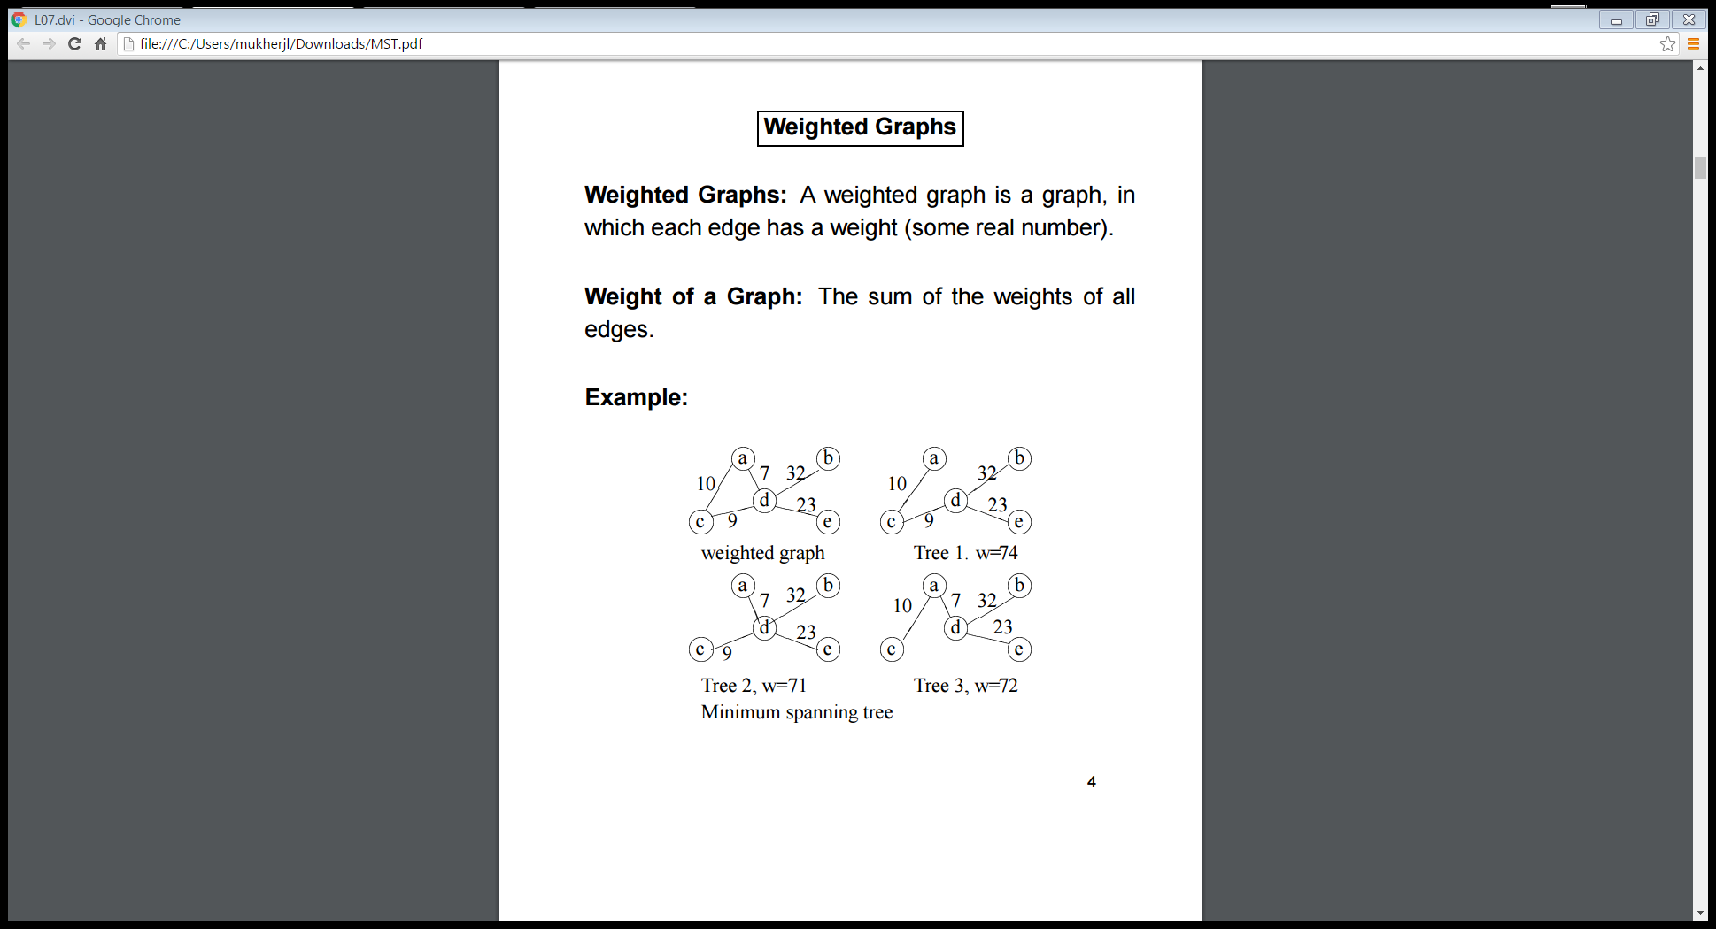
Spanning Trees

Slide 5
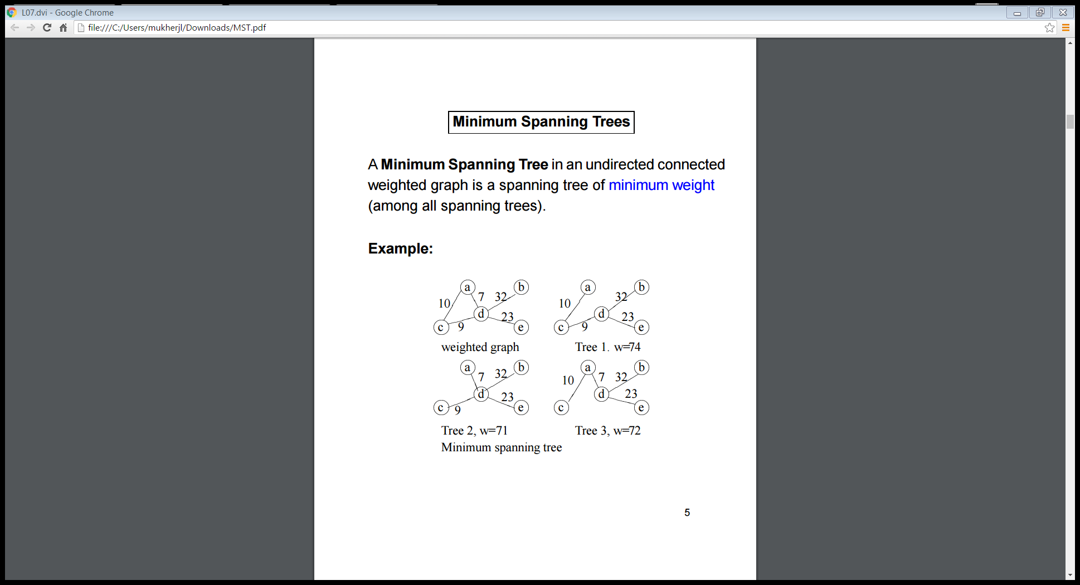
Minimum Spanning Trees

Slide 6
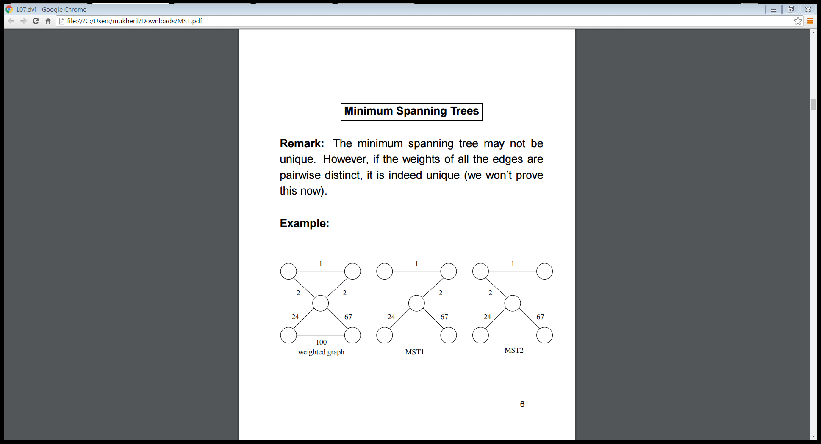
Minimum Spanning Trees

Slide 7
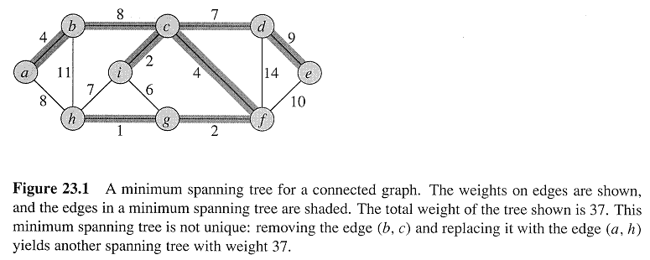
Copyright © The McGraw-Hill Companies, Inc. Permission required for reproduction or display.

Slide 8
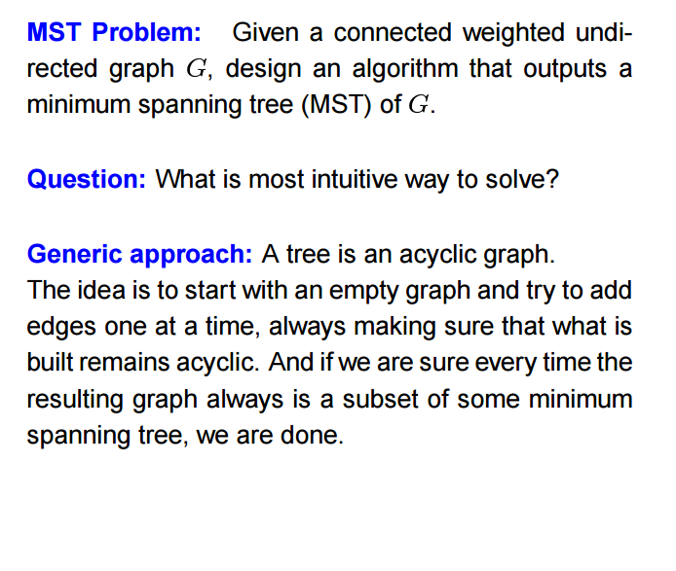
Minimum Spanning Tree Problem

Slide 9
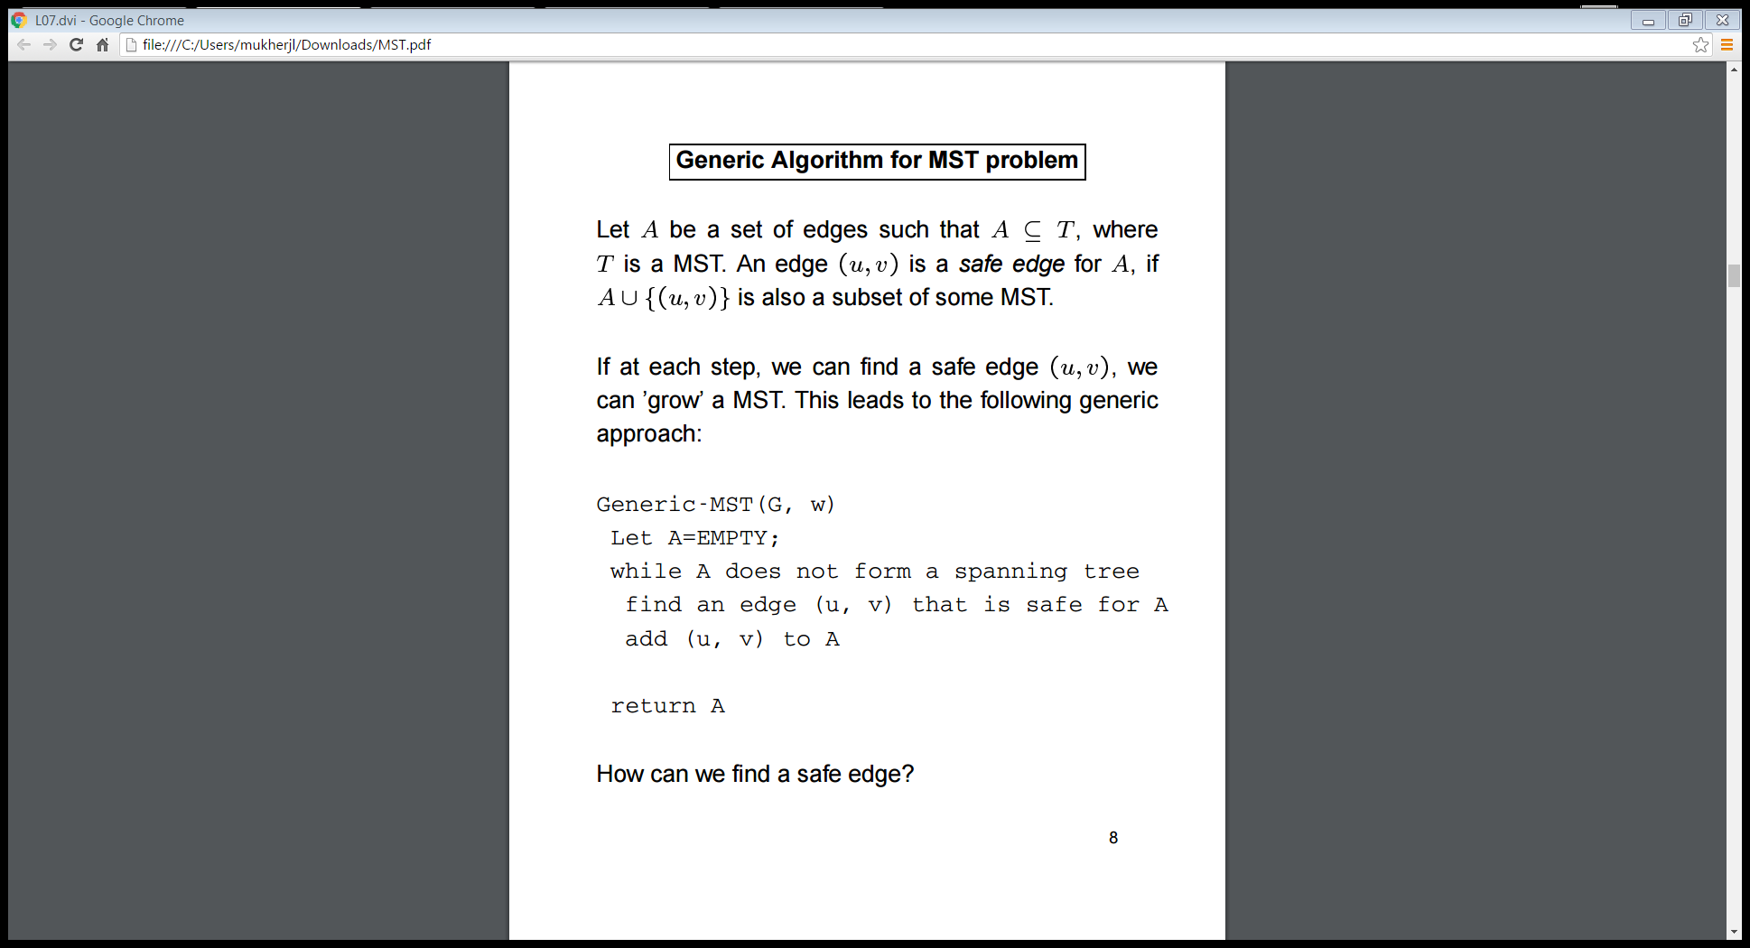
Minimum Spanning Trees

Slide 10
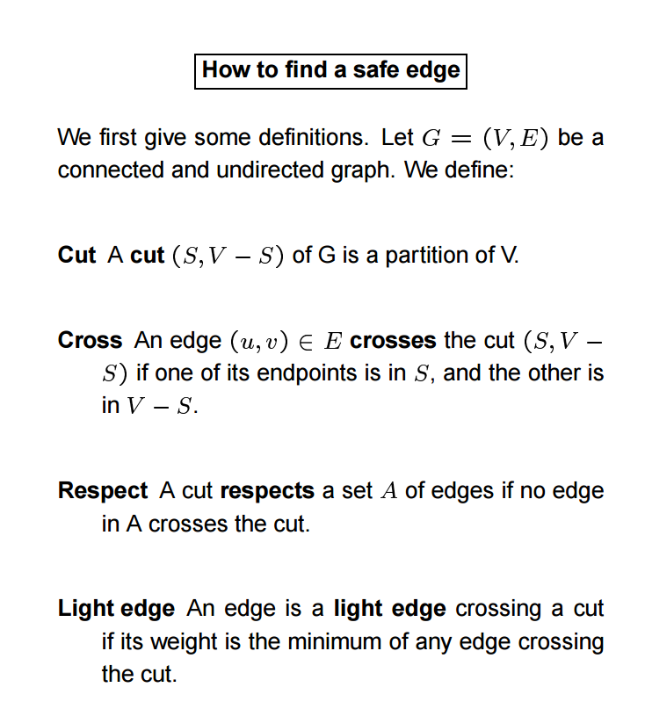
Minimum Spanning Trees

Slide 11
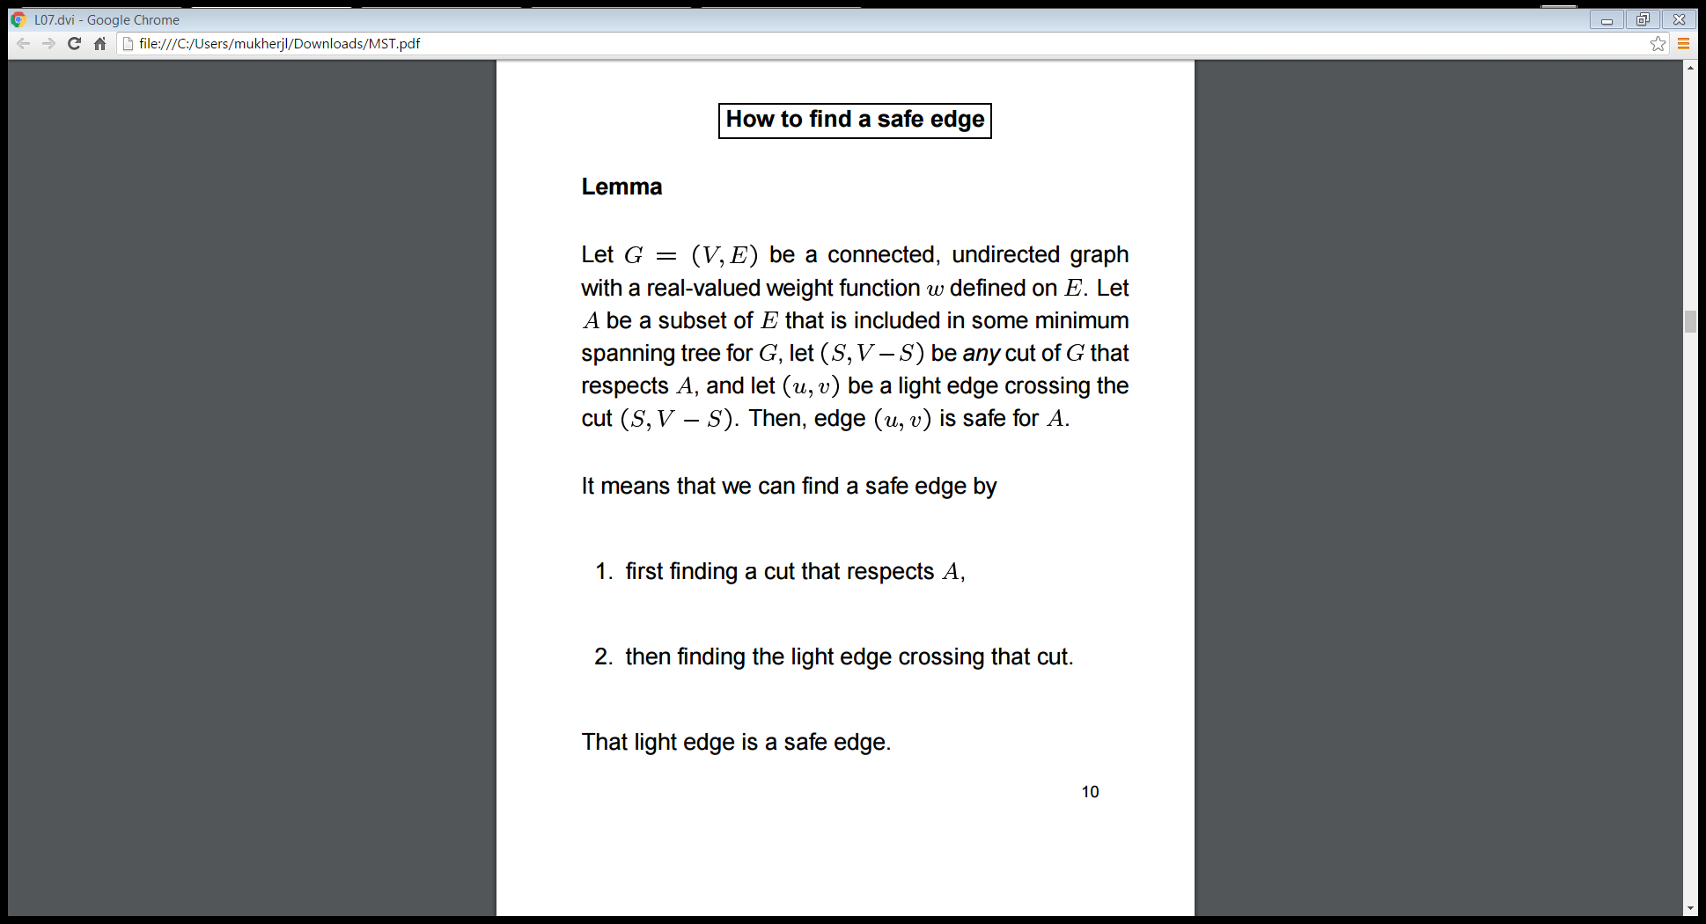
Minimum Spanning Trees

Slide 12
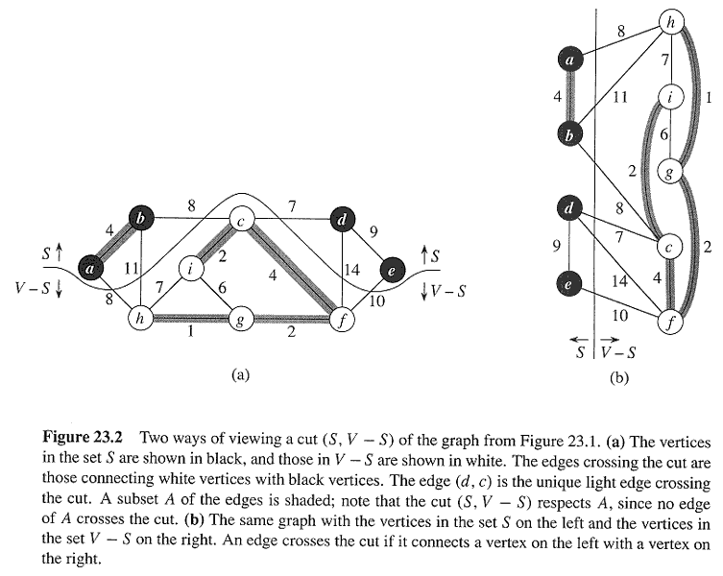
Copyright © The McGraw-Hill Companies, Inc. Permission required for reproduction or display.

Slide 13
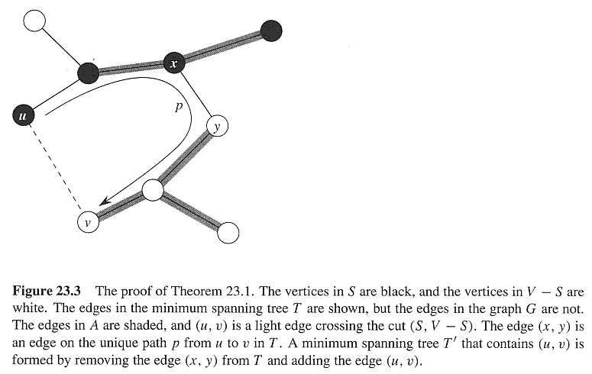
Copyright © The McGraw-Hill Companies, Inc. Permission required for reproduction or display.

Slide 14
Minimum Spanning Trees
Two algorithms
Prims algorithm
Kruskals algorithm

Slide 15
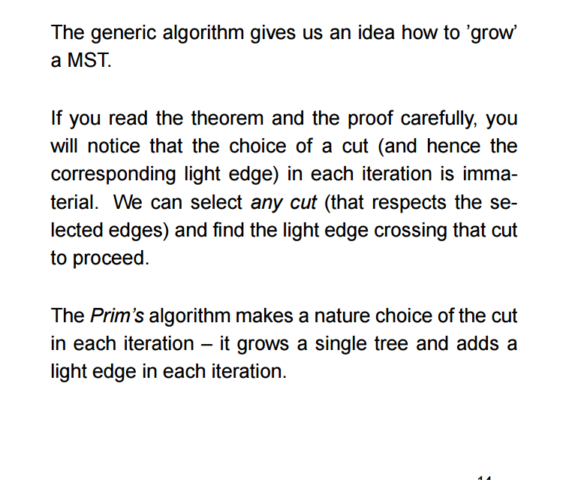
Prims algorithm

Slide 16
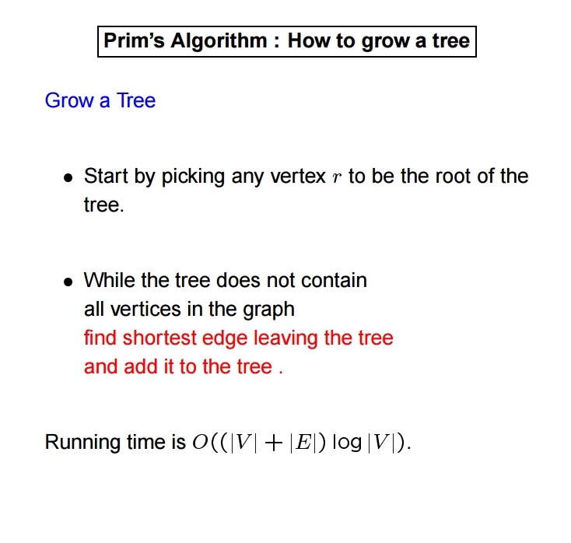
Prims algorithm

Slide 17
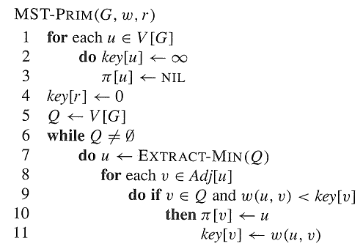
Copyright © The McGraw-Hill Companies, Inc. Permission required for reproduction or display.

Slide 18
Prims algorithm
The edges in the set A always make up a single tree.
The tree starts from an arbitrary root vertex r and grows until it spans all vertices in V.
Each step adds to the tree A a light edge that connects A to an isolated vertex (one on which no edge of A is incident)
This process this adds only edges that are safe for A, so that, at the end, A forms an MST.
The strategy is greedy, since at each step it adds to the tree an edge of minimum weight. the tree an edge of minimum weight.

Slide 19
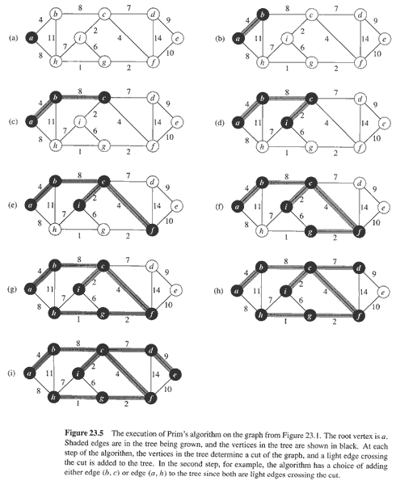
Copyright © The McGraw-Hill Companies, Inc. Permission required for reproduction or display.

Slide 20
Kruskals algorithm
We observe that the set A is a forest, whose vertices are all those of the given graph. A safe edge is added to A: it is always a least-weight edge that connects two distinct components
Work with edges, rather than nodes
Two steps:
Sort edges by increasing edge weight
Select the first |V| – 1 edges that do not generate a cycle

Slide 21
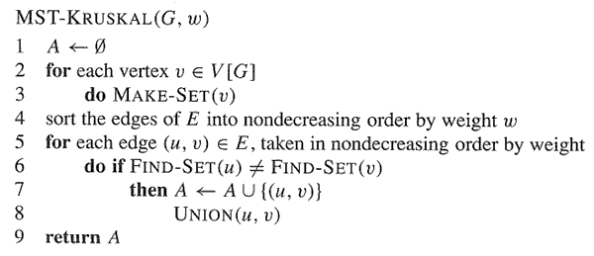
Copyright © The McGraw-Hill Companies, Inc. Permission required for reproduction or display.

Slide 22
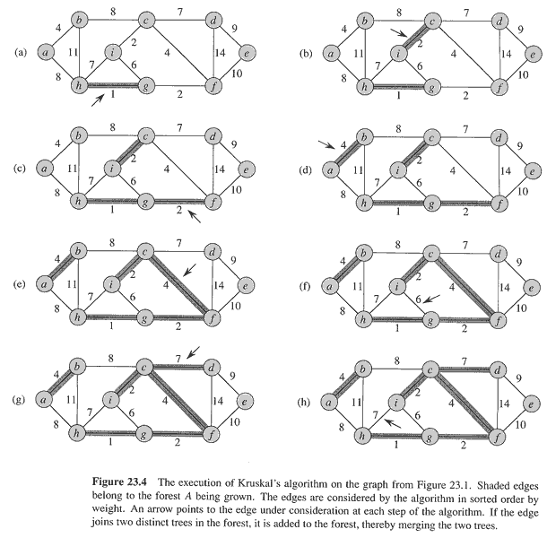
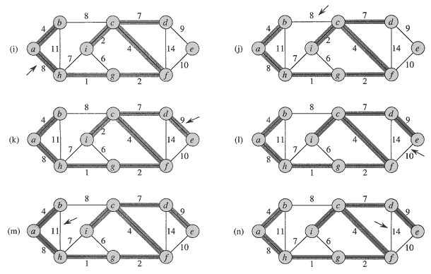
Copyright © The McGraw-Hill Companies, Inc. Permission required for reproduction or display.

