Slide 1
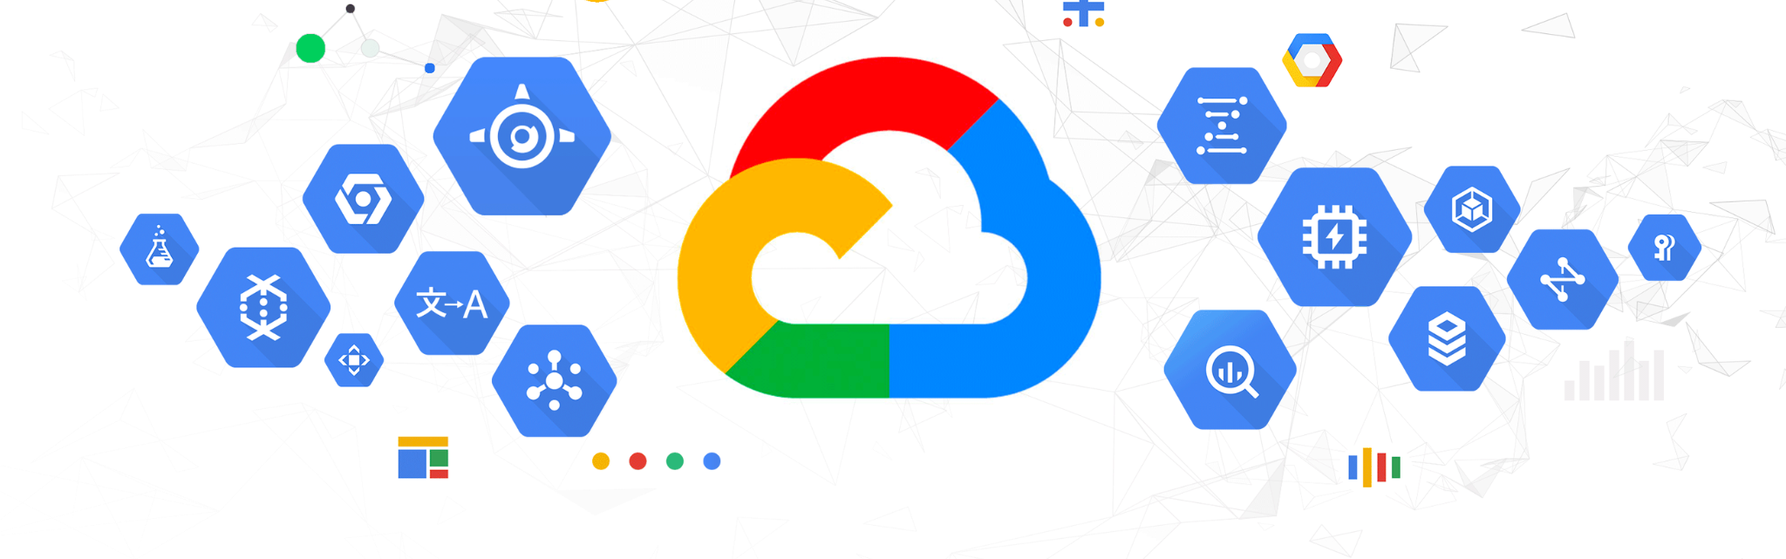
Building a Personal Finance Management (PFM) with Cloud Integration
CLOUD COMPUTING MS in Computer Science
CAO NGUYEN VU
Notes:
"Welcome, everyone. My name is [Your Name], and today I’m excited to present my project, Personal Finance Management System. This tool simplifies financial tracking and ensures secure data storage using cloud integration."

Slide 2

INTRODUCTION
Due to the growing complexity of financial data makes manual tracking inefficient.
This project aims to simplify data management by leveraging cloud-based storage and data analysis tools.

Slide 3

Motivation
Data and Project Objectives
To create a PFM tool that can store financial data securely, process transactions, and analyze investments using a cloud database.
Cloud storage allows for easy scalability, accessibility, and integration with data analysis tools for better decision-making

Slide 4

Methods
Code Overview
The Personal Finance Management (PFM) code is designed to manage and store financial data efficiently.
It provides functionality to capture various financial transactions, such as income, expenditures, and investments.

Slide 5
Background Information
Project Context
The technologies and platforms used : (Python, Google Cloud Storage)
This project was built using Python for logic and data processing, and Google Cloud Storage for secure, cloud-based data storage.
The role of Google Cloud Storage in the PFM system:
Google Cloud Storage enables reliable data storage, automatic backups, and integration with other cloud-based tools for enhanced data accessibility.

Slide 6
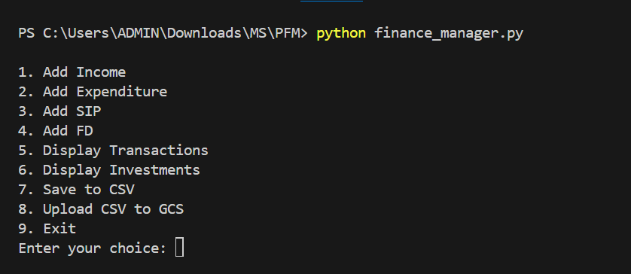
Code Overview
Key features
User Input Handling:
Add new income,
Add expenditure.
Add SIP (Systematic Investment Plan),
Add FD (Fixed Deposit)
Show Transaction
Show Investments
Save to CSV
Upload CSV
Notes:
The code is designed to handle user inputs for adding income, expenditures, and investments. These transactions are stored in a CSV file, which can then be uploaded to Google Cloud for secure storage.

Slide 7
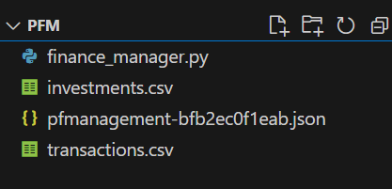
Code Overview
Data Collection: the code collects data through user input, which is parsed and stored in a structured format.
Data Export: A function to export transaction data to a CSV file, making it easy to store locally or upload to cloud services.
Notes:
Data processing is done using Python’s pandas library. This allows for efficient manipulation of transactions and easy conversion to CSV files for storage.

Slide 8
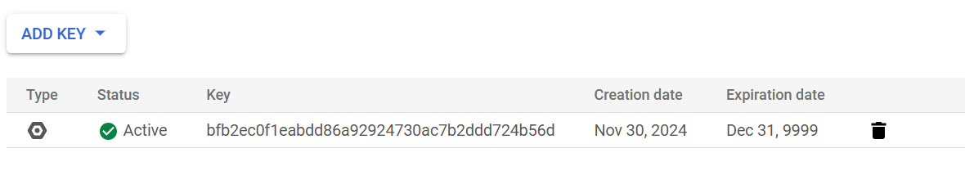
Service Account Credentials
Content
This create a unique identity for your project, allowing it to authenticate with Google Cloud securely.
I can use a Service Account designed for non-human interactions.

Slide 9
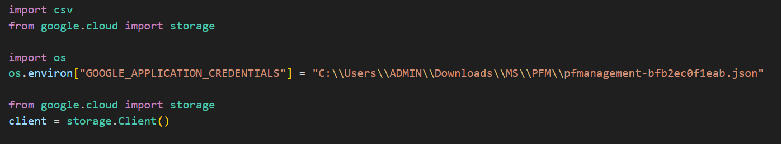
Cloud Integration
Content
The code uses the “google-cloud-storage” Python library to interact with Google Cloud Storage, facilitating the secure upload of CSV files.

Slide 10
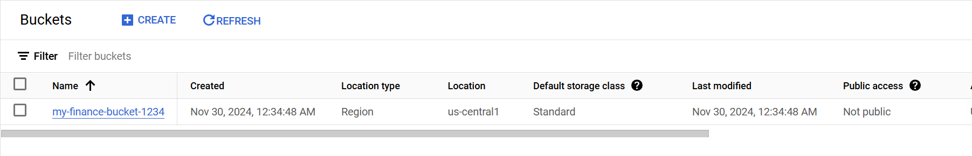
Setting Up Google Cloud Storage
Content
Google Cloud Storage is a scalable, secure, and high-performance object storage service. It allows users to store and access files like the financial CSV file generated by my program.

Slide 11
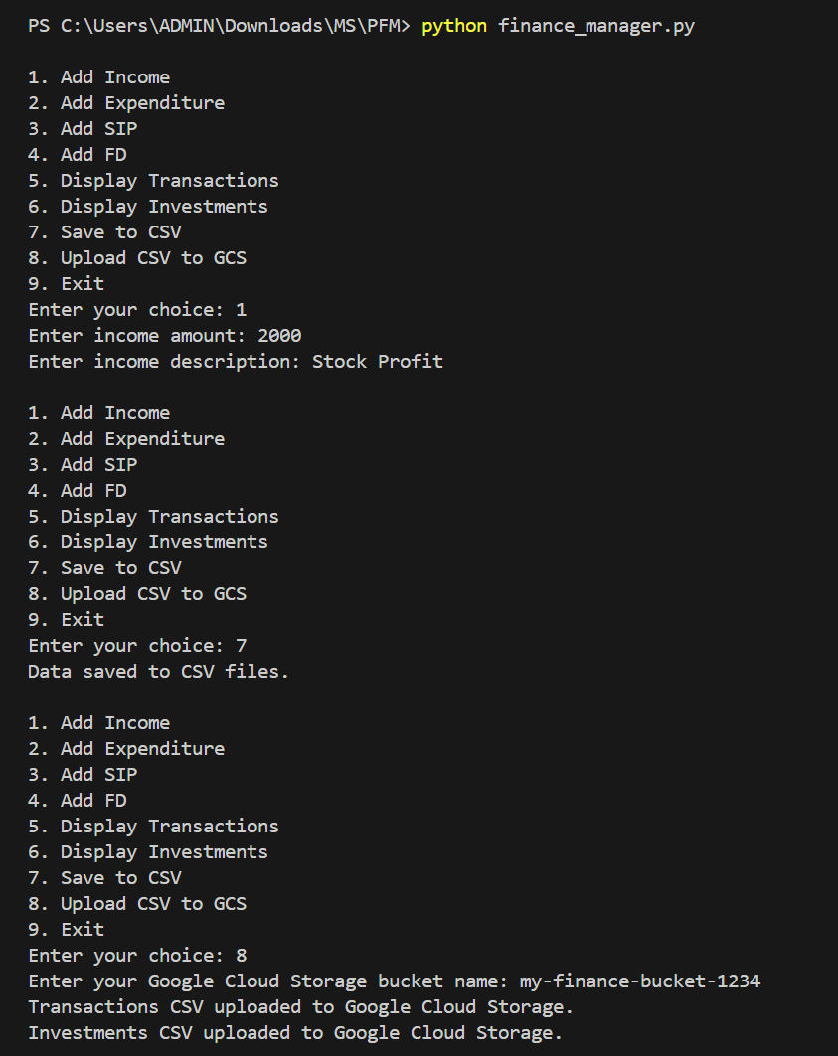

Key Results(Data Management)
The program successfully manages financial transactions, including income, expenditures, SIPs, and FDs.
All data is saved in a CSV file format, ensuring portability and easy access.
Notes:
Here are some results of the project. On the left, you can see the CSV file generated after entering some sample data.

Slide 12
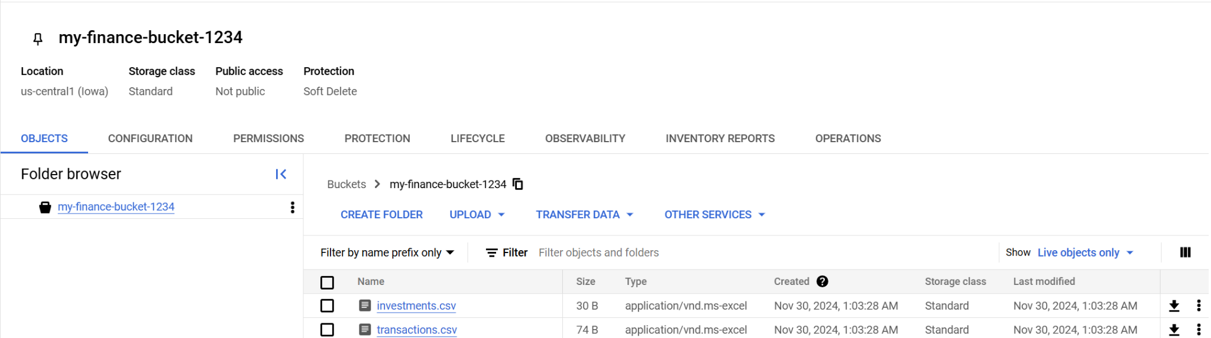
Key Results (Cloud Upload)
Content
CSV files are seamlessly uploaded to a Google Cloud Storage bucket.
The uploaded files can now be accessed securely and shared across systems.
Notes:
The confirmation of a successful upload to Google Cloud.

Slide 13

THANK YOU

