Slide 1
GlucoTwin
A hybrid digital twin that warns of glucose spikes and lows in Type 2 Diabetes before they happen, by fusing EHR, CGM and wearable data, validated on real patients
<Team Name> · <College / Incubator>
Digital Twin Challenge 2026 · Happiest Health · Reimagining & Reforming Healthcare in India Summit

Slide 2
THE PROBLEM
Diabetes in India is managed by looking backwards
• India has ~101 million adults with diabetes and ~136 million with prediabetes (ICMR-INDIAB, 2023).
• High-carbohydrate meals (rice, roti, dosa, biryani) drive sharp post-meal glucose excursions, linked to vascular damage even when HbA1c looks acceptable.
• HbA1c is measured every ~3 months: it averages away the daily spikes.
• CGMs show what already happened, not what is about to happen.
• Doctors see a patient for minutes every few months, with no way to test 'what if this patient walked after dinner?'
Our question
Can a personalised virtual replica of a patient, continuously updated from wearables and anchored in their health record, warn of a glucose spike early enough to act, and show which action would help?
GlucoTwin · <Team Name> · Digital Twin Challenge 2026

Slide 3
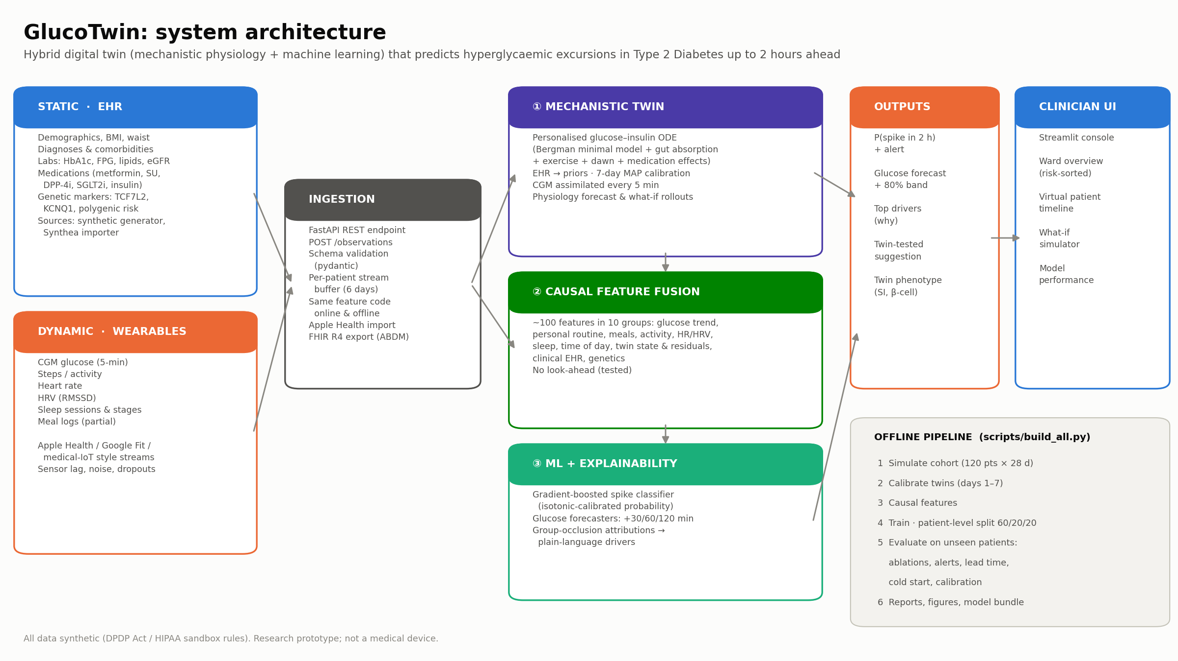
OUR SOLUTION
A three-layer hybrid digital twin
GlucoTwin · <Team Name> · Digital Twin Challenge 2026

Slide 4
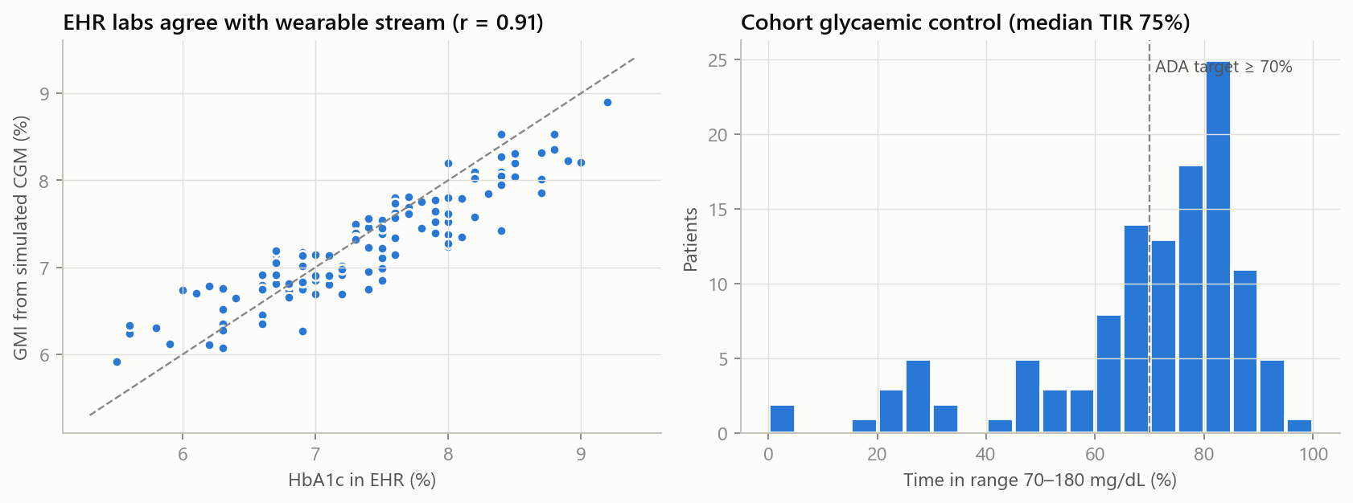
DATA
Sandbox-compliant data: a causally consistent synthetic cohort
• 120 synthetic Indian T2D patients × 28 days at 5-minute resolution (≈1M rows).
• Static EHR: demographics, labs, comorbidities, 6 drug classes, TCF7L2/KCNQ1 risk alleles, polygenic score.
• Dynamic streams: CGM, steps, heart rate, HRV, sleep stages, partial meal logs.
• Generated causally: genetics + meds → physiology → glucose → sensors and labs, so HbA1c agrees with CGM.
• Hidden drivers the model must infer: unlogged meals (≈1 in 3), stress (HR↑ HRV↓), sleep debt.
• Realistic noise: CGM lag, ~7% MARD, dropouts, sensor change, HRV gaps.
• Real-data path built and tested: Synthea EHR importer, Apple Health importer, FHIR R4 export.
GlucoTwin · <Team Name> · Digital Twin Challenge 2026

Slide 5
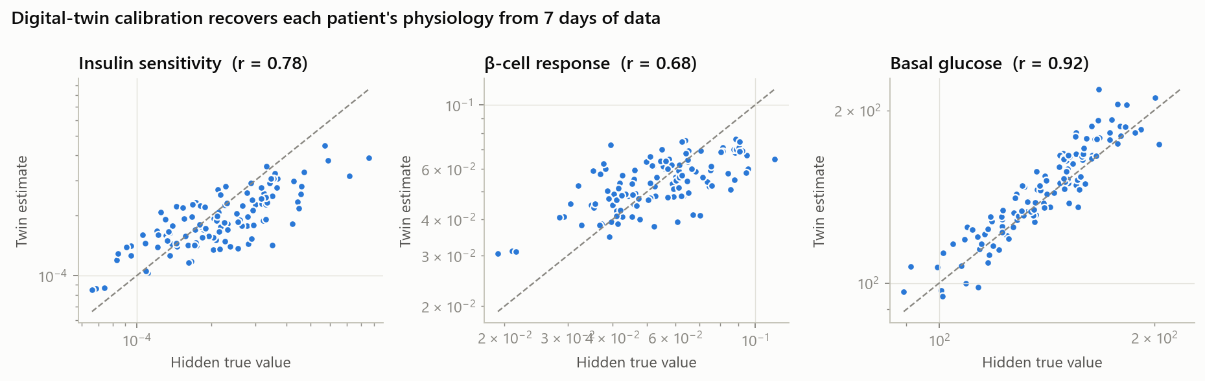
MECHANISTIC MODEL
Layer ①: a personalised physiological twin
dG/dt = −(SG + X·m)·G + SG·Gb + Ra(meals) + dawn − exercise − SGLT2 excretion · dX/dt = −p2·X + p2·SI·(I + I_exo) · dI/dt = −n·I + β·(G − Gb)⁺ + s0
EHR sets the priors (weight, FPG, BMI, duration, medications). One onboarding week of CGM + meals + steps personalises insulin sensitivity, β-cell response, basal glucose and dawn effect (MAP fit). CGM is assimilated every 5 minutes.
GlucoTwin · <Team Name> · Digital Twin Challenge 2026

Slide 6
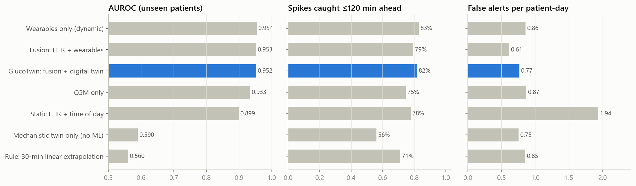
PERFORMANCE
Results on 24 patients the model never saw
0.952
82%
75 min
0.77
AUROC for predicting a spike
within the next 2 hours
of spikes warned about
in advance
median warning time
before the spike starts
false alerts per
patient-day
GlucoTwin · <Team Name> · Digital Twin Challenge 2026

Slide 7
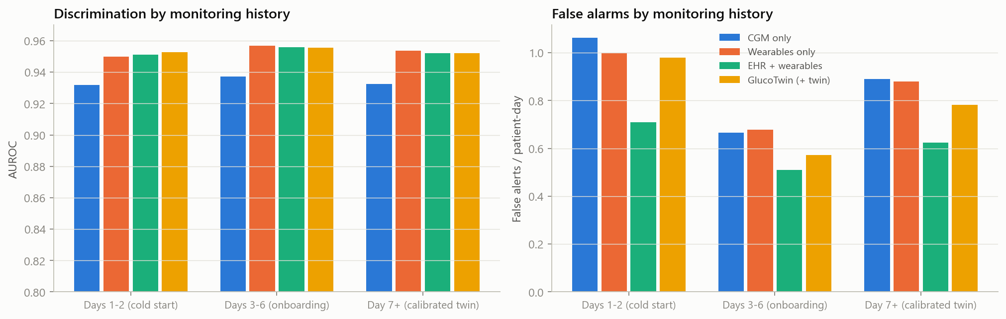
ABLATION
Why fuse? Each data stream earns its place
• CGM alone: AUROC 0.933, 0.87 false alerts/day. Adding meals, activity, sleep, HR/HRV and personal routine: 0.954 and 0.86/day (AUROC gain +0.020, 95% CI +0.013 to +0.026).
• Once wearable history exists, static EHR and twin features add no measurable discrimination (differences within ±0.002). The twin's role is simulation and explanation, not raw accuracy.
GlucoTwin · <Team Name> · Digital Twin Challenge 2026

Slide 8
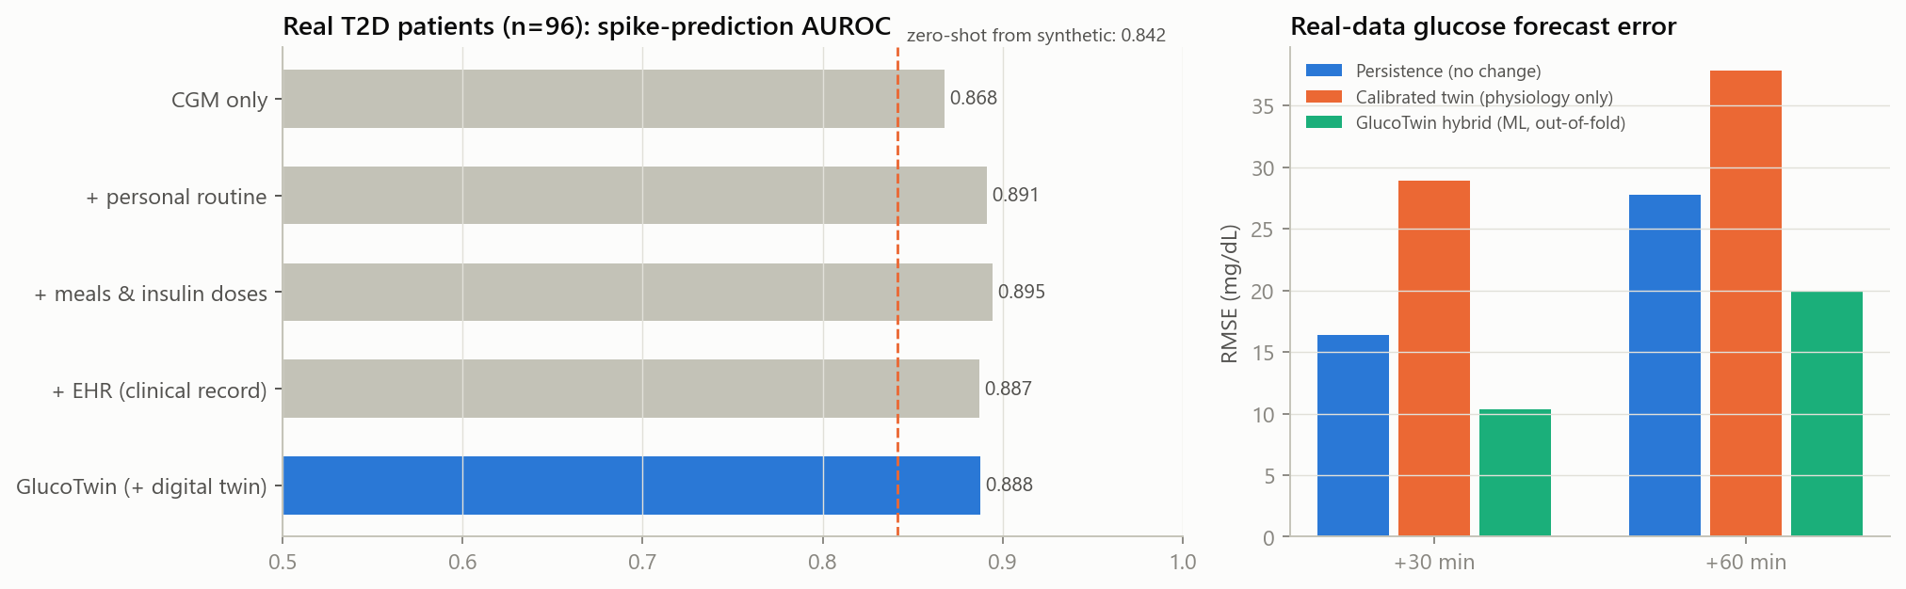
REAL-WORLD EVIDENCE
Validated on 96 real people with type 2 diabetes
ShanghaiT2DM (Sci Data 2023, CC BY 4.0): CGM + clinical record + meals + insulin doses. 5-fold cross-validation grouped by person.
Fusion beats CGM alone (+0.020 AUROC, 95% CI +0.012 to +0.031). Trained only on synthetic data: 0.842. Honest negatives: static EHR slightly hurt; the physics-only twin forecast is worse than 'no change' on these patients.
GlucoTwin · <Team Name> · Digital Twin Challenge 2026

Slide 9
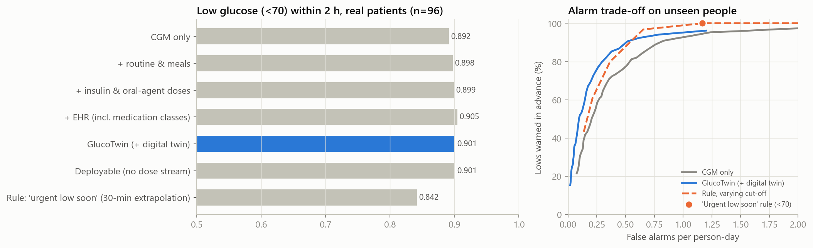
HYPOGLYCAEMIA
Both directions of danger: predicting lows on real patients
Lows (<70 mg/dL) are the dangerous side of treatment, especially with insulin or sulfonylureas. Trained and validated on 96 real people (343 low episodes), with person-grouped cross-validation.
GlucoTwin AUROC 0.901 vs 0.842 for the 'urgent low soon' rule that CGMs use. Mixed but useful: GlucoTwin catches more lows when alarms must be rare (alarm fatigue), the simple rule wins when alarms can be frequent, so we use both: the rule as a safety net, GlucoTwin for earlier, quieter warnings.
GlucoTwin · <Team Name> · Digital Twin Challenge 2026

Slide 10
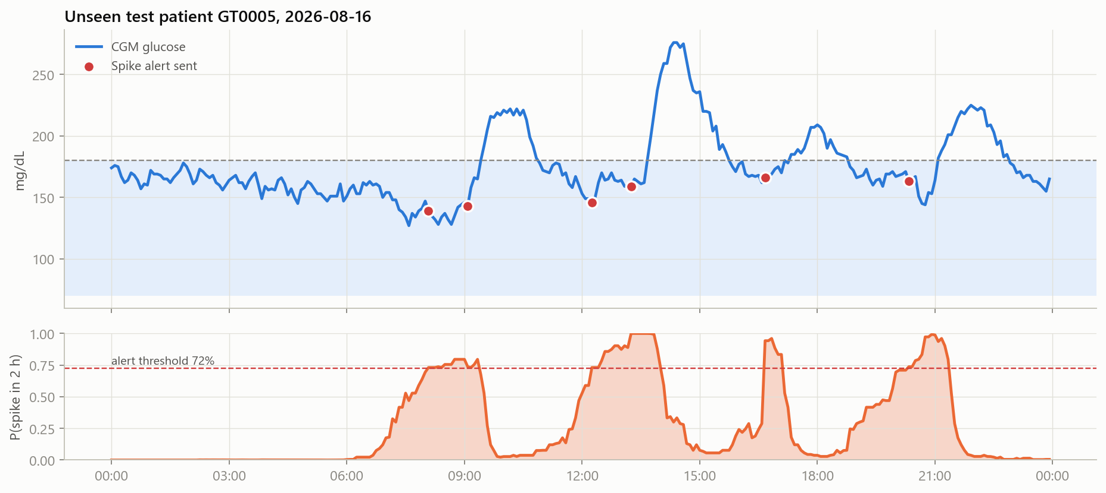
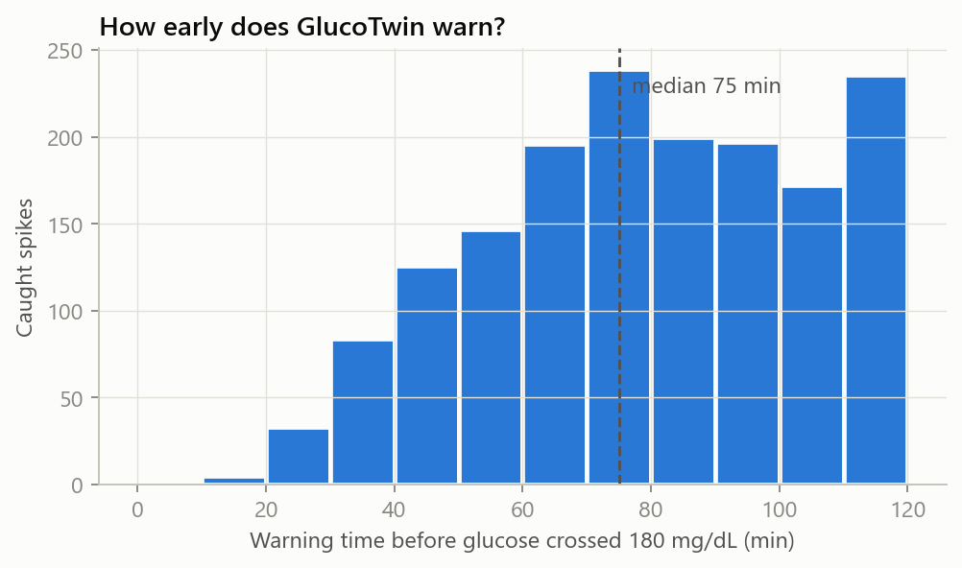
LEAD TIME
Early, actionable warnings
GlucoTwin · <Team Name> · Digital Twin Challenge 2026

Slide 11
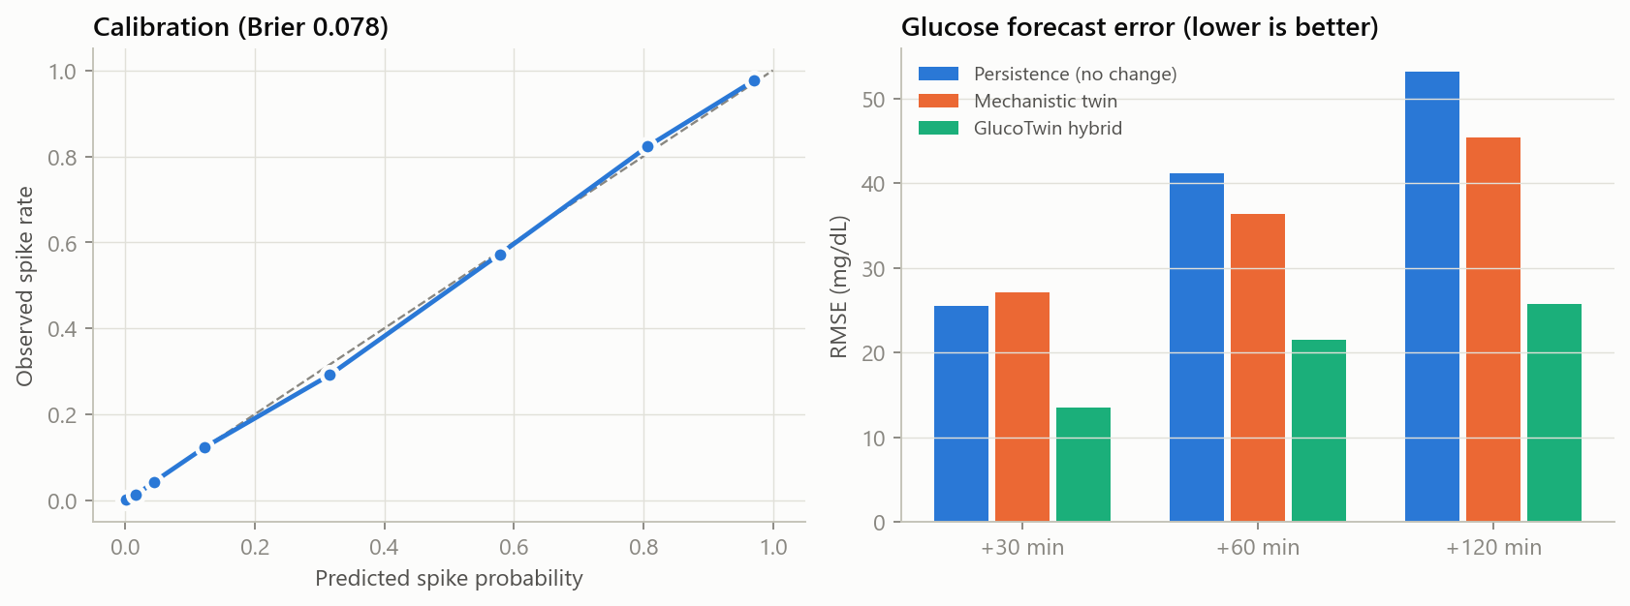
FORECASTING
Trustworthy numbers: calibrated risk and accurate forecasts
Hybrid forecast error at +30 / +60 / +120 min: 13 / 21 / 26 mg/dL, roughly half the error of the physiology-only twin or a 'no change' guess.
GlucoTwin · <Team Name> · Digital Twin Challenge 2026

Slide 12
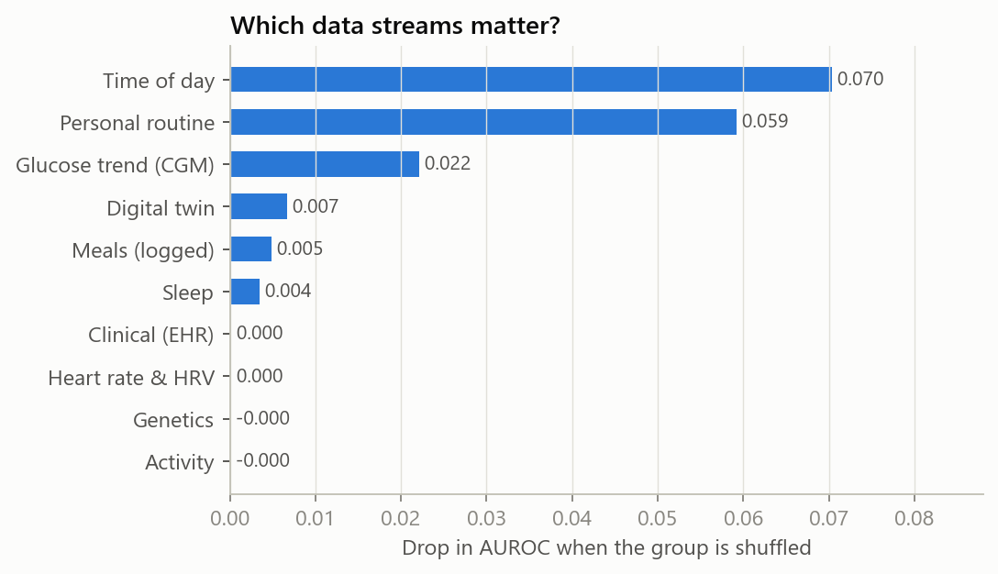
WHY DID IT ALERT?
Explainable by design
Every alert comes with its top drivers, for example:
▲ Personal routine: spiked above 180 around this time on 3 of the last 3 days
▲ Meals: 75 g carbs logged 20 min ago
▲ Digital twin: glucose 28 mg/dL above twin expectation, possible unlogged meal
▲ Sleep: slept 4.9 h last night (−1.8 h vs usual)
…plus a twin-tested suggestion, e.g. 'a 15-minute brisk walk now lowers the predicted peak by ~20 mg/dL'.
GlucoTwin · <Team Name> · Digital Twin Challenge 2026

Slide 13
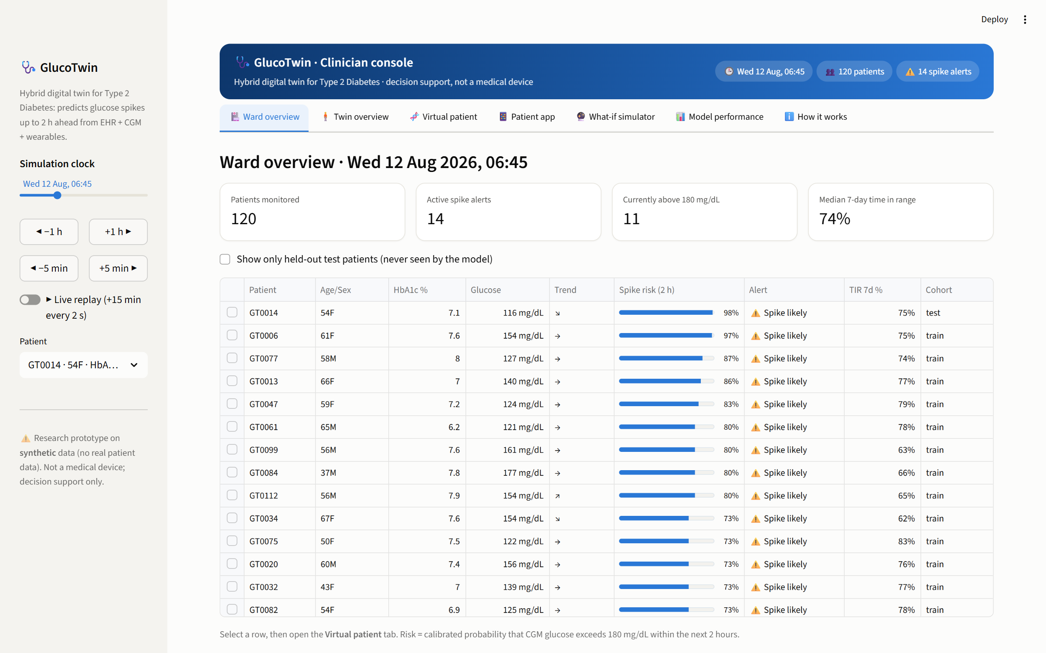
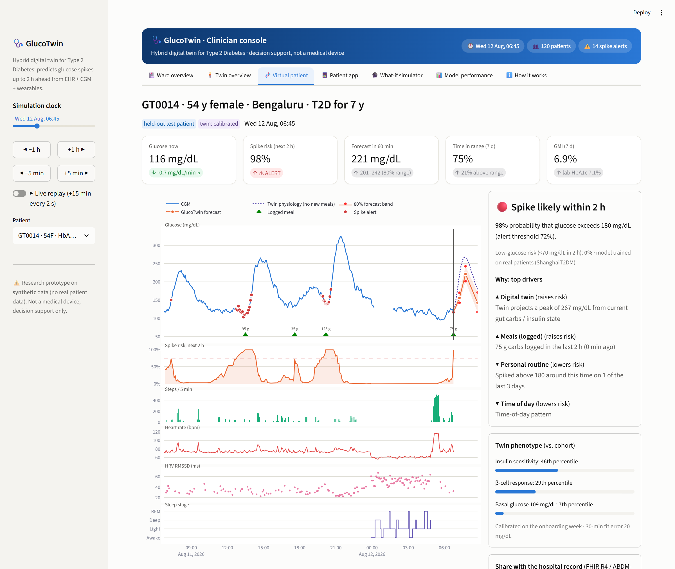
CLINICIAN DASHBOARD
How a doctor uses the twin
Ward overview (risk-sorted) → Virtual patient (CGM, forecast, risk, activity, HR/HRV, sleep, EHR, AGP, twin phenotype) → What-if simulator (Indian meal presets, carb quality, post-meal walk, sleep) → Model performance
GlucoTwin · <Team Name> · Digital Twin Challenge 2026

Slide 14
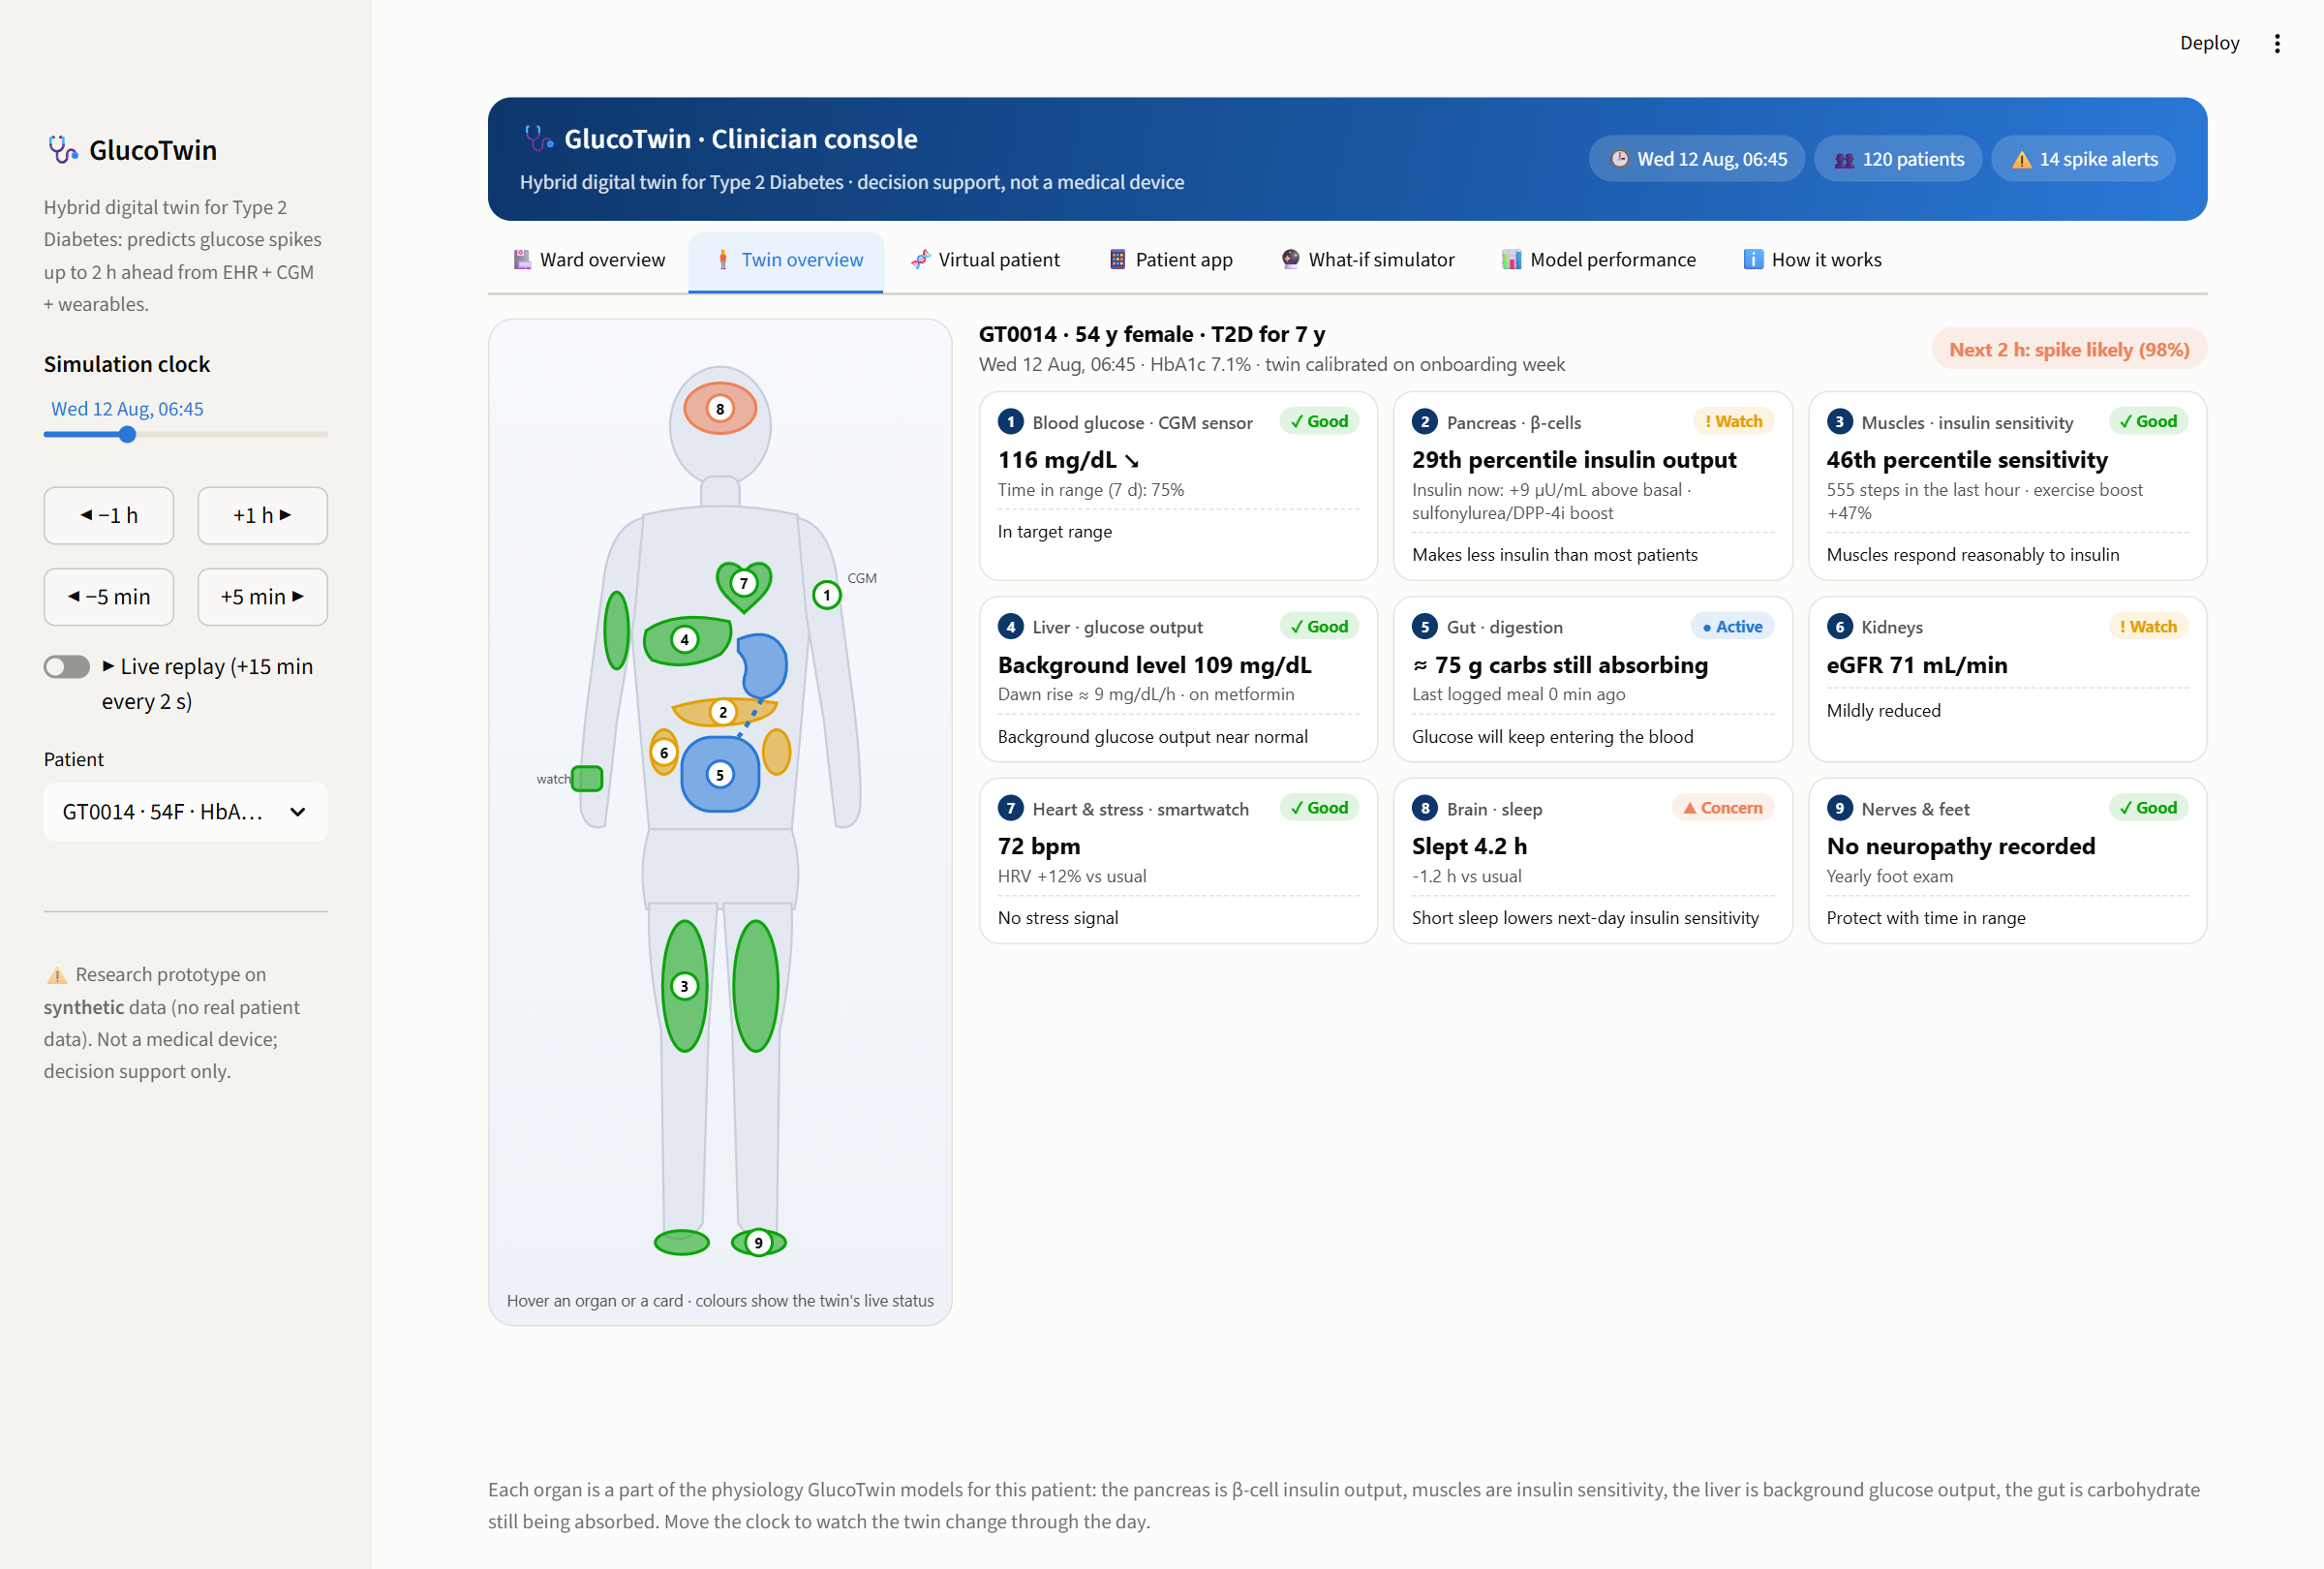
TWIN OVERVIEW
The twin at a glance: the patient's body, live
GlucoTwin · <Team Name> · Digital Twin Challenge 2026

Slide 15
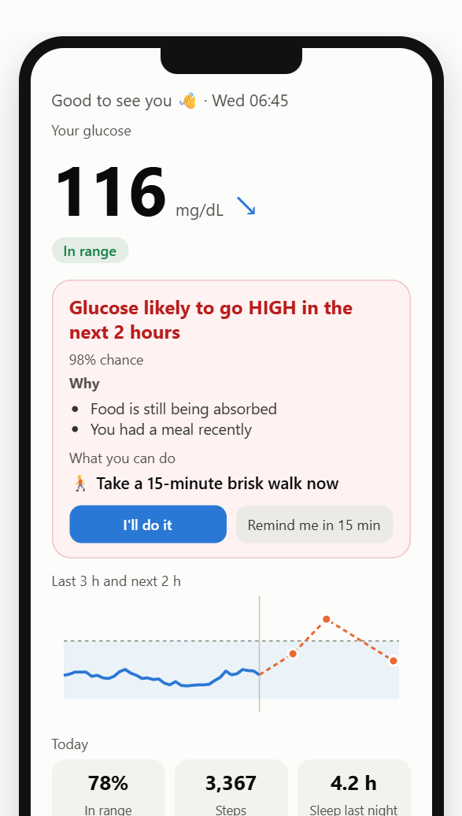
PATIENT APP
What the patient sees: one number, one reason, one action
The clinician gets the full console; the patient gets a phone screen:
• glucose now + trend
• the prediction in plain words (English or Hindi)
• the top reason, e.g. 'You had a meal recently'
• one action the twin has tested: a 15-minute walk
• lows take priority over highs
The 'I'll do it / Remind me' taps would feed adherence back to the care team.
GlucoTwin · <Team Name> · Digital Twin Challenge 2026

Slide 16
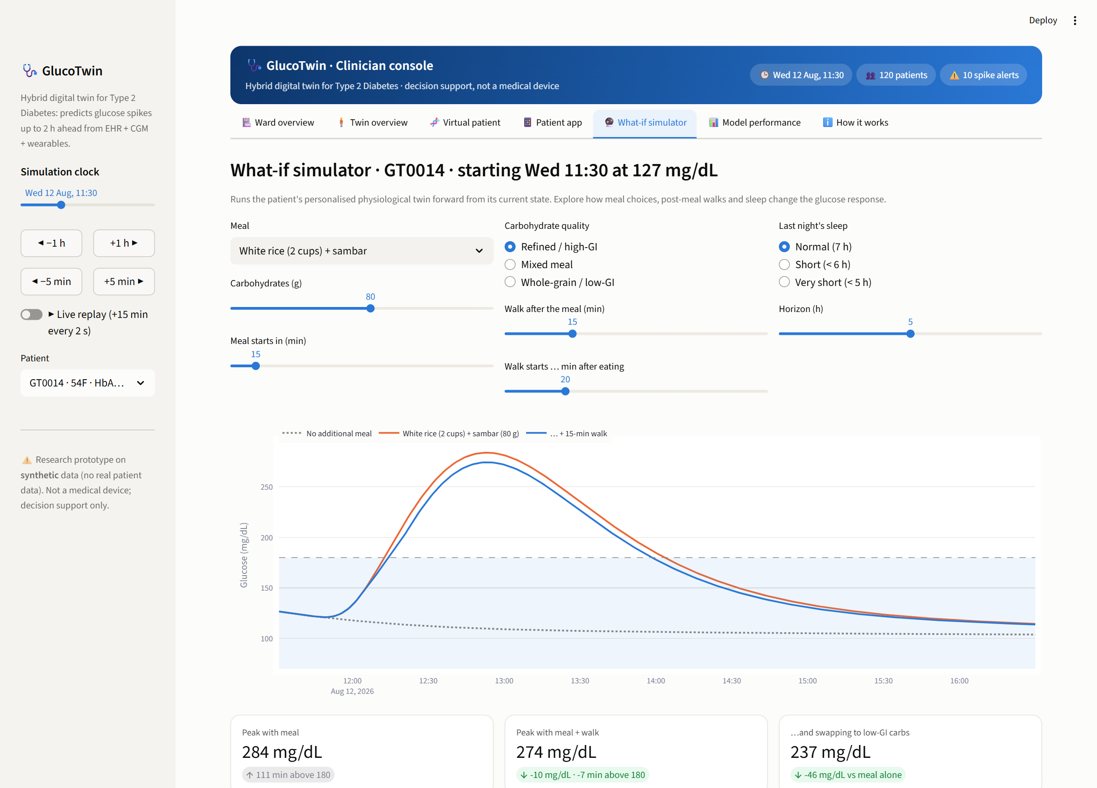
SIMULATION
What-if: personalised treatment exploration
The calibrated twin is run forward from the patient's current state:
• Which meal? (rice + sambar vs ragi mudde)
• Walk after dinner? How long, how soon?
• Effect of a short night's sleep
For counselling and shared decision-making, not dosing.
GlucoTwin · <Team Name> · Digital Twin Challenge 2026

Slide 17
ENGINEERING
Built like a product, not a notebook
• Real-time engine + FastAPI: POST observations → GET assessment / what-if
• Replay script streams a patient like a device gateway
• Identical feature code online and offline (tested to match)
• Leakage test: changing the future never changes today's features
• Patient-level train/val/test split; thresholds chosen on validation patients
• Alerts evaluated as real notifications (re-sent hourly while risk stays high)
• One command rebuilds everything: python scripts/build_all.py
• New-patient lifecycle over the API: register → stream → calibrate → FHIR RiskAssessment
• docker compose up runs dashboard + API
Stack
Python · NumPy · pandas · SciPy · Numba (ODE kernels) · scikit-learn (HistGradientBoosting, isotonic calibration) · FastAPI · Streamlit · Plotly · pytest
License: MIT
GlucoTwin · <Team Name> · Digital Twin Challenge 2026

Slide 18
HONEST ASSESSMENT
Limitations and next steps
Limitations
• Main results are synthetic; the real-data check (96 Chinese T2D patients, CGM but no other wearables) confirms the fusion gain but not the twin's forecasting.
• What-if simulations are not validated against real interventions.
• The low-glucose model is trained only on the real Shanghai cohort (lows are too rare in the simulation).
• The dawn-effect parameter is not identifiable from one week.
• Twin features add no measurable accuracy over the fused ML model, even when trained on only 6 patients; the twin's value is what-if simulation and interpretability.
• Once wearable history exists, static EHR adds little discrimination.
Next steps
• Prospective Indian cohort with CGM + smartwatch (steps, HR, HRV, sleep) to test the full fusion.
• Connect the FHIR R4 export to an ABDM health-information gateway (export itself is built).
• Validate the low-glucose model on Indian patients and add nocturnal-low alerts.
• Prospective pilot with clinicians, then the CDSCO SaMD pathway.
GlucoTwin · <Team Name> · Digital Twin Challenge 2026

Slide 19
Thank you
<Team Name> · <College / Incubator> · github.com/<your-org>/<repo>

