Slide 1
How SQL Database Engines Work
D. Richard Hipp
OpenSQL
2008-11-15

Slide 2
SQLite
How SQL Database Engines Work
with occasional comments on how the
operation of SQLite compares to other
SQL database engines.
D. Richard Hipp
OpenSQL
2008-11-15

Slide 3
Why Do You Care?
So you can better understand what your query is doing.
So that you can appreciate how much work the database is saving you.
So that you can fix things when they go wrong.
So that you can write better SQL that runs faster and uses less memory and disk space.

Slide 4
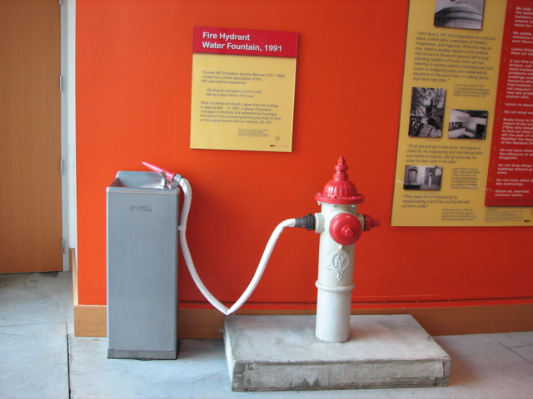

Slide 5
Key Concept
SQL is a peculiar programming language
  Each SQL statement is a separate program
  SQL describes what instead of how
An RDBMS consists of...
  Compiler to translate SQL into procedures
  Virtual Machine to evaluate the procedures

Slide 6
Example
SELECT * FROM table1;
Translates into:
Open database file containing table1
Rewind the file
while not at end-of-file
read all columns out of current record
return the columns to the caller
advance file to the next record
end-while
close the file

Slide 7
Imagine what this translates into:
SELECT eqptid, enclosureid
FROM eqpt
WHERE typeid IN (
SELECT typeid FROM typespec
WHERE attrid=(
SELECT attrid FROM attribute
WHERE name='detect_autoactuate'
)
AND value=1
INTERSECT
SELECT typeid FROM typespec
WHERE attrid=(
SELECT attrid FROM attribute
WHERE name='algorithm'
)
AND value IN ('sensor','wetbulb')
)

Slide 8
The Whole Point Of SQL...
A few lines of SQL generates the equivalent of hundreds of lines of procedural code.
By adding an index, entirely new procedures are used without recoding.
The SQL Query Optimizer is charged with picking the algorithm
  so that the application developer doesn't have to

Slide 9
Ins and Outs of SQL
SQL
Compile SQL
into a program
Prep'ed
Stmt
Run the
program
Result
Front Half
Back Half

Slide 10
Ins and Outs of SQL
SQL
Compile SQL
into a program
Prep'ed
Stmt
Run the
program
Result
See Aho & Ullman
The “Dragon Book”
Byte code
Tree of structures
Native machine code
Virtual Machine

Slide 11
Architecture Of SQLite
Tokenizer
Parser
Code Generator
Virtual Machine
B-Tree
Pager
OS Interface

Slide 12
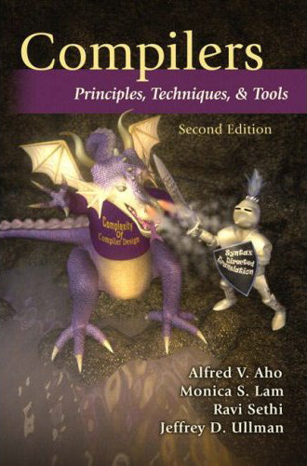
Architecture Of SQLite
Tokenizer
Parser
Code Generator
Virtual Machine
B-Tree
Pager
OS Interface

Slide 13
SQL
Compile SQL
into a program
Prep'ed
Stmt
Run the
program
Result
Tokenizer
Parser
Code Generator
Virtual Machine
B-Tree
Pager
OS Interface

Slide 14
SQL
Compile SQL
into a program
Prep'ed
Stmt
Run the
program
Result
Tokenizer
Parser
Code Generator
Virtual Machine
B-Tree
Pager
OS Interface

Slide 15
Architecture Of SQLite
Byte code interpreter
Big switch statement inside a for loop.
Other engines walk a tree of structures
Similar to JVM or Parrot or P-Code
Tokenizer
Parser
Code Generator
Virtual Machine
B-Tree
Pager
OS Interface

Slide 16
Architecture Of SQLite
Ordered key/value pairs with unique keys
O(logN) insert, seek, and delete
O(1) next and previous
Tokenizer
Parser
Code Generator
Virtual Machine
B-Tree
Pager
OS Interface

Slide 17
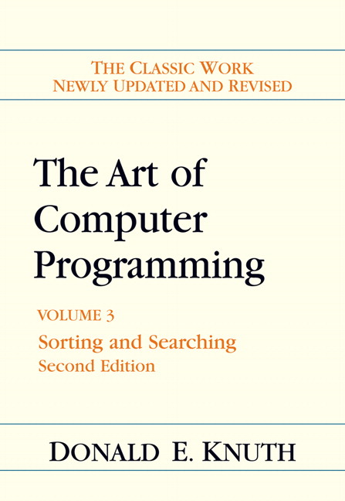
Architecture Of SQLite
Tokenizer
Parser
Code Generator
Virtual Machine
B-Tree
Pager
OS Interface

Slide 18
Architecture Of SQLite
Atomic commit and rollback
Uniform size pages numbered from 1
No interpretation of page content
Cache
Tokenizer
Parser
Code Generator
Virtual Machine
B-Tree
Pager
OS Interface

Slide 19
Architecture Of SQLite
Platform-specific interface to the OS
Run-time changeable
Portability layer
Tokenizer
Parser
Code Generator
Virtual Machine
B-Tree
Pager
OS Interface

Slide 20
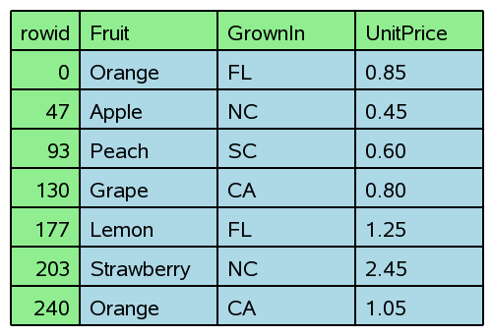
CREATE TABLE tab(
Fruit TEXT,
GrownIn TEXT,
UnitPrice REAL
);

Slide 21
CREATE TABLE tab(
Fruit TEXT,
GrownIn TEXT,
UnitPrice REAL
);
Key
Data

Slide 22
SELECT unitprice FROM tab WHERE fruit='Peach'

Slide 23
SELECT unitprice FROM tab WHERE rowid=93

Slide 24
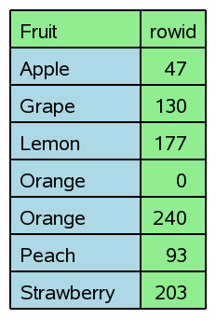
CREATE INDEX idx1 ON tab(fruit)
idx1
tab

Slide 25
CREATE INDEX idx1 ON tab(fruit)
1:1

Slide 26
CREATE INDEX idx1 ON tab(fruit)

Slide 27
CREATE INDEX idx1 ON tab(fruit)
+

Slide 28
SELECT unitprice FROM tab WHERE fruit='Peach'

Slide 29
SELECT unitprice FROM tab
WHERE fruit='Orange'
AND grownin='CA'

Slide 30
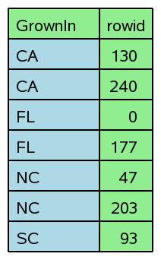
CREATE INDEX idx2 ON tab(grownin)
idx2
tab

Slide 31
SELECT unitprice FROM tab
WHERE fruit='Orange'
AND grownin='CA'

Slide 32
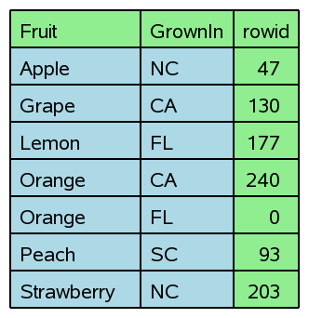
CREATE INDEX idx3 ON tab(fruit, grownin)
idx3
tab

Slide 33
CREATE INDEX idx2 ON tab(fruit, grownin)

Slide 34
CREATE INDEX idx2 ON tab(fruit, grownin)

Slide 35
SELECT unitprice FROM tab
WHERE fruit='Orange'
AND grownin='CA'

Slide 36
SELECT unitprice FROM tab
WHERE fruit='Orange'
AND grownin='CA'
4 ways to do this query
(so far...)

Slide 37
SELECT unitprice FROM tab
WHERE fruit='Orange'
AND grownin='CA'
1

Slide 38
SELECT unitprice FROM tab
WHERE fruit='Orange'
AND grownin='CA'
2

Slide 39
SELECT unitprice FROM tab
WHERE fruit='Orange'
AND grownin='CA'
3

Slide 40
SELECT unitprice FROM tab
WHERE fruit='Orange'
AND grownin='CA'
4

Slide 41
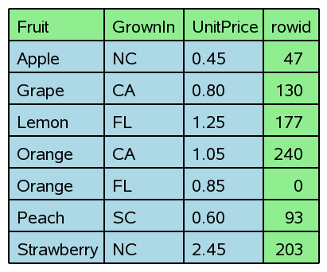
CREATE INDEX idx4 ON tab(fruit, grownin, unitprice)
idx4
tab

Slide 42
SELECT unitprice FROM tab
WHERE fruit='Orange'
AND grownin='CA'
5

Slide 43
SELECT unitprice FROM tab
WHERE fruit='Orange'

Slide 44
SELECT grownin FROM tab
WHERE fruit='Orange'
AND unitprice<1.00

Slide 45
SELECT grownin FROM tab
WHERE fruit='Orange'
AND unitprice<1.00

Slide 47
SELECT * FROM tab ORDER BY fruit
sorter

Slide 48
SELECT * FROM tab ORDER BY rowid

Slide 49
SELECT * FROM tab ORDER BY rowid DESC

Slide 50
SELECT * FROM tab ORDER BY fruit

Slide 51
SELECT * FROM tab ORDER BY fruit DESC

Slide 52
SELECT * FROM tab ORDER BY fruit

Slide 53
SELECT * FROM tab ORDER BY fruit DESC

Slide 54
SELECT * FROM tab ORDER BY fruit, grownin

Slide 55
SELECT * FROM tab ORDER BY fruit, grownin, unitprice

Slide 56
SELECT * FROM tab ORDER BY fruit DESC, grownin DESC

Slide 57
SELECT * FROM tab
ORDER BY fruit DESC, grownin DESC, unitprice DESC

Slide 58
SELECT * FROM tab ORDER BY fruit DESC, grownin

Slide 59
SELECT * FROM tab ORDER BY fruit, unitprice

Slide 60
SELECT * FROM tab ORDER BY grownin

Slide 61
SELECT grownin, unitprice FROM tab
WHERE fruit='Orange'
ORDER BY grownin

Slide 62
Index Column Order
SELECT x, y, z FROM t1 WHERE w=5 AND x=6 ORDER BY x, y;
CREATE INDEX t1i1 ON t1(w,x,y,z);

Slide 63
Index Column Order
SELECT x, y, z FROM t1 WHERE w=5 AND x=6 ORDER BY x, y;
WHERE clause terms first
CREATE INDEX t1i1 ON t1(w,x,y,z);

Slide 64
Index Column Order
SELECT x, y, z FROM t1 WHERE w=5 AND x=6 ORDER BY x, y;
ORDER BY terms second.
No gaps!
Can overlap WHERE clause.
CREATE INDEX t1i1 ON t1(w,x,y,z);

Slide 65
Index Column Order
SELECT x, y, z FROM t1 WHERE w=5 AND x=6 ORDER BY x, y;
Result set columns can appear
anywhere in the index. Gaps allowed
CREATE INDEX t1i1 ON t1(w,x,y,z);

Slide 66
SELECT unitprice FROM tab
WHERE fruit='Orange'
OR grownin='CA'
Pesky OR

Slide 67
SELECT unitprice FROM tab
WHERE fruit='Orange'
OR grownin='CA'

Slide 68
SELECT unitprice FROM tab
WHERE fruit='Orange'
OR grownin='CA'
UNION

Slide 69
SELECT unitprice FROM tab
WHERE fruit='Orange'
OR grownin='CA'
UNION
Sorter

Slide 70
SELECT unitprice FROM tab
WHERE fruit='Orange'
OR grownin='CA'
UNION

Slide 71
SELECT unitprice FROM tab
WHERE fruit='Orange'
AND grownin='CA'
6
INTERSECT

Slide 72
SELECT unitprice FROM tab
WHERE fruit='Orange'
AND grownin='CA'
4

Slide 73
SELECT unitprice FROM tab
WHERE fruit='Orange'
AND grownin='CA'
5

Slide 74
SELECT unitprice FROM tab
WHERE (fruit='Orange' AND grownin='CA')
OR grownin='NC'
UNION
INTERSECT

Slide 75
SELECT unitprice FROM tab
WHERE (fruit='Orange' AND grownin='CA')
OR grownin='NC'
grownin='NC'
OR
grownin='CA'
AND
UNION
INTERSECT
fruit='Orange'

Slide 76
Remember This:
SQL is a programming language
There is a compiler
There is a virtual machine
Indices are not magic – they need to make sense
Avoid too many indices
  The more options the optimizer has, the more chances it has to make a poor choice.

