Slide 1
The L of SOLID
The Liskov Substitution Principle
Maximilian Meffert

Slide 2
The Liskov Substitution Principle
Probably around since the late 1980’s
  Liskov, Barbara. Data Abstraction and Hierarchy. SIGPLAN Notices, 23,5 (May 1988)
  Barbara Liskov, Jeannette M. Wing: A Behavioral Notion of Subtyping. ACM Trans. Program. Lang. Syst. 16(6): 1811-1841 (1994)
What does it say?
  “If for each object o1 of type S there is an object o2 of type T such that for all programs P defined in terms of T, the behavior of P is unchanged when o1 is substituted for o2, then S is a subtype of T.” (Barbara Liskov)
  “Subtype Requirement: Let ϕ(x) be a property provable about objects x of type T. Then ϕ(y) should be true for objects y of type S where S is a subtype of T.” (Barbara Liskov, Jeannette M. Wing)
  “Subtypes must be substitutable for their base types.” (Robert C. Martin)
What does it mean?
  Subtypes have to retain behavior of its supertypes.
  Subtypes have to comply with the same expectations its supertypes comply with.
  Subtypes must not break expectations its supertypes comply with.

Slide 3
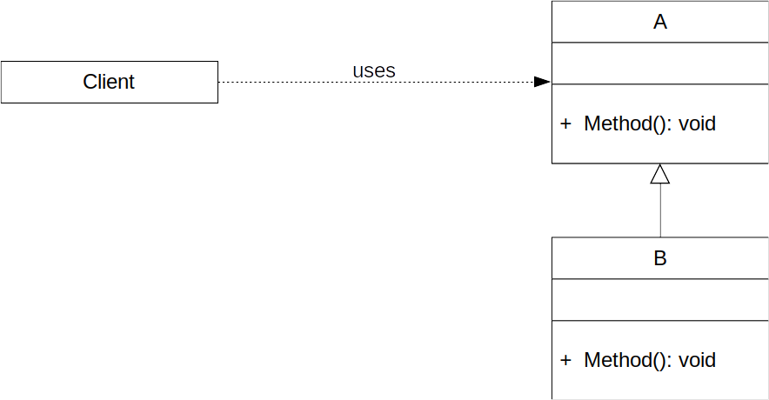
The Liskov Substitution Principle
Client is declared to use some method of A
Client can also be used with all subtypes of A
  See Open/Closed Principle
Client expects everything passed to it as A to behave like A
  No subtype is known at declaration time
Client cannot react to misbehaving subtypes of A without violating the Open/Closed Principle
  E.g. with instance-of checks

Slide 4
The Liskov Substitution Principle
Why is it a “good” thing to adhere to?
  Change of requirements is immanent through the life cycle of most software
  Decreases risk of regression because of hidden/indirect/behavioral coupling
  Facilitates correct application of the Open/Closed Principle
  Increases overall robustness

Slide 5
Modeling Inheritance
Usually inheritance is taught as Is-A relationship used for modeling taxonomic hierarchies:
  A circle is an ellipsis
  A square is a rectangle
  A set is a collection of elements
  A pledging protection account is a giro account
However, we tend to model Is-A relationships only considering syntactic traits or purposes:
  Major/Minor axes
  Right angles
  “[..] a gathering together into a whole of definite […] objects [...]” (Georg Cantor)
  System for managing money

Slide 6
Modeling Inheritance
The problem is: entities in a Is-A relationship may behave differently when mutated (through inherited methods)
  Circles: mutating axes
  Squares: mutating width/height
  Sets: adding elements
  Pledging protection accounts: withdrawing money
See Circle-Ellipse-Problem of inheritance in Object-Oriented Programming as case study of LSP violations

Slide 7
Modeling Inheritance
Software is about behavior:
  Inheritance imposes a semantic contract
  Inheritance should be thought of and modeled as Behaves-Like relationship

Slide 8
Avoiding LSP violations
Strategy 1: Design by Contract
  Bertrand Meyer. 1995. Object-oriented software construction, New York: Prentice Hall.
  {P} S {Q}: Every operation has pre- and postconditions (and invariants)
    Preconditions cannot be strengthened in a subtype.
    Postconditions cannot be weakened in a subtype.
    (Invariants of the supertype must be preserved in a subtype)
  Conditions should be documented:
    Write Tests: Each subtype has to pass all tests of its supertype

Slide 9
Avoiding LSP violations
Strategy 2: Avoid Inheritance
  Only use interfaces for polymorphism
  Interfaces only impose syntactic contracts which makes LSP violations more or less impossible
However,
avoiding something is the
best way to develop phobia

Slide 10
Examples

Slide 11
Thanks!

Slide 12
References
Liskov, Barbara. Data Abstraction and Hierarchy. SIGPLAN Notices, 23,5 (May 1988)
Barbara Liskov, Jeannette M. Wing: A Behavioral Notion of Subtyping. ACM Trans. Program. Lang. Syst. 16(6): 1811-1841 (1994)
Bertrand Meyer. 1995. Object-oriented software construction, New York: Prentice Hall.
Robert C. Martin. 2003. Agile Software Development, Principles, Patterns, and Practices, Prentice Hall.

