Slide 1
The O of SOLID
The Open/Closed Principle
Maximilian Meffert

Slide 2
The Open/Closed Principle
Probably around since the late 1980’s
  Bertrand Meyer, Object-Oriented Software Construction, 1st edition. Prentice-Hall 1988, ISBN 0-13-629031-0
What does it say?
  “Software entities (classes, modules, functions, etc.) should be open for extension, but closed for modification.
    A module will be said to be open if it is still available for extension. For example, it should be possible to add fields to the data structures it contains, or new elements to the set of functions it performs.
    A module will be said to be closed if [it] is available for use by other modules. This assumes that the module has been given a well-defined, stable description (the interface in the sense of information hiding)” (Bertrand Meyer)
  “You should be able to extend the behavior of a system without having to modify that system.” (Robert C. Martin)
What does it mean?
  Software entities should be both open for extension and closed for modification
  Open for Extension = It is possible to extend behavior
  Closed for Modification = It is not necessary to modify manifestation (i.e. source code, compilation, etc.)

Slide 3
The Open/Closed Principle
Why is it a “good” thing to adhere to?
  Change of requirements is immanent through the life cycle of most software
  Decreases change impact, i.e. number of modules to alter
    This number should tend to 0 since you are just add new modules (replacing others)
    Allows new features without the need to re-engineer / re-arrange exiting ones.
  Decreases risk of regression because of human error, i.e. developer faults
    Since change impact decreases
  Increases a software designs capability for adaption to change
    … uhm, “agile”?

Slide 4
Example
Plugin Architectures

Slide 5
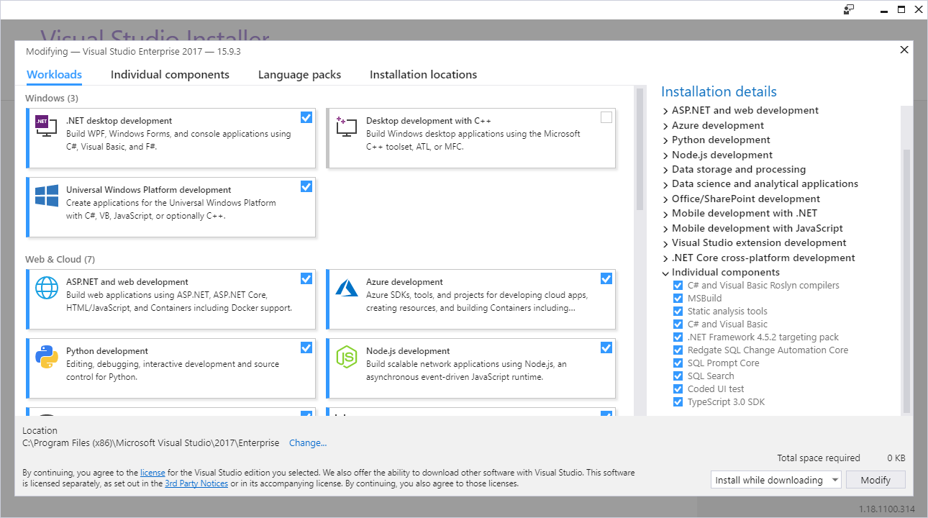
Example
Visual Studio

Slide 6
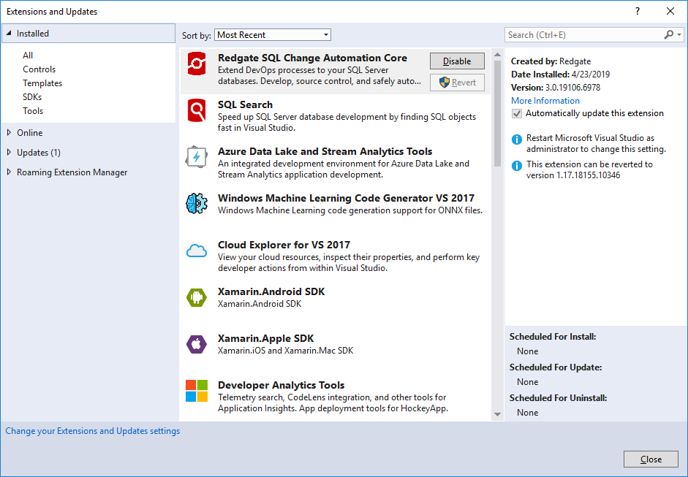
Example
Visual Studio (Marketplace)

Slide 7
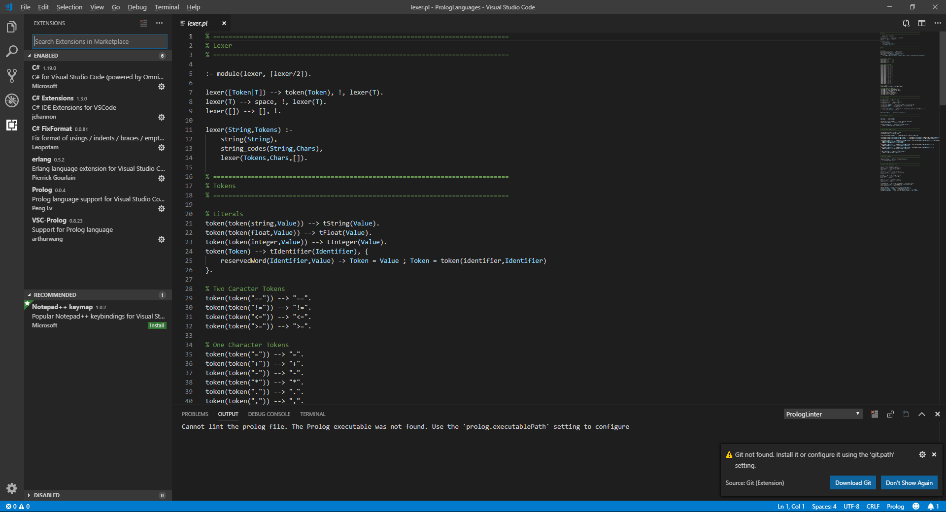
Example
Visual Studio Code

Slide 8
Example
Other (modern) IDEs also make heavy use of plugin architectures
  IntelliJ
  eclipse
  Rider
  ...

Slide 9
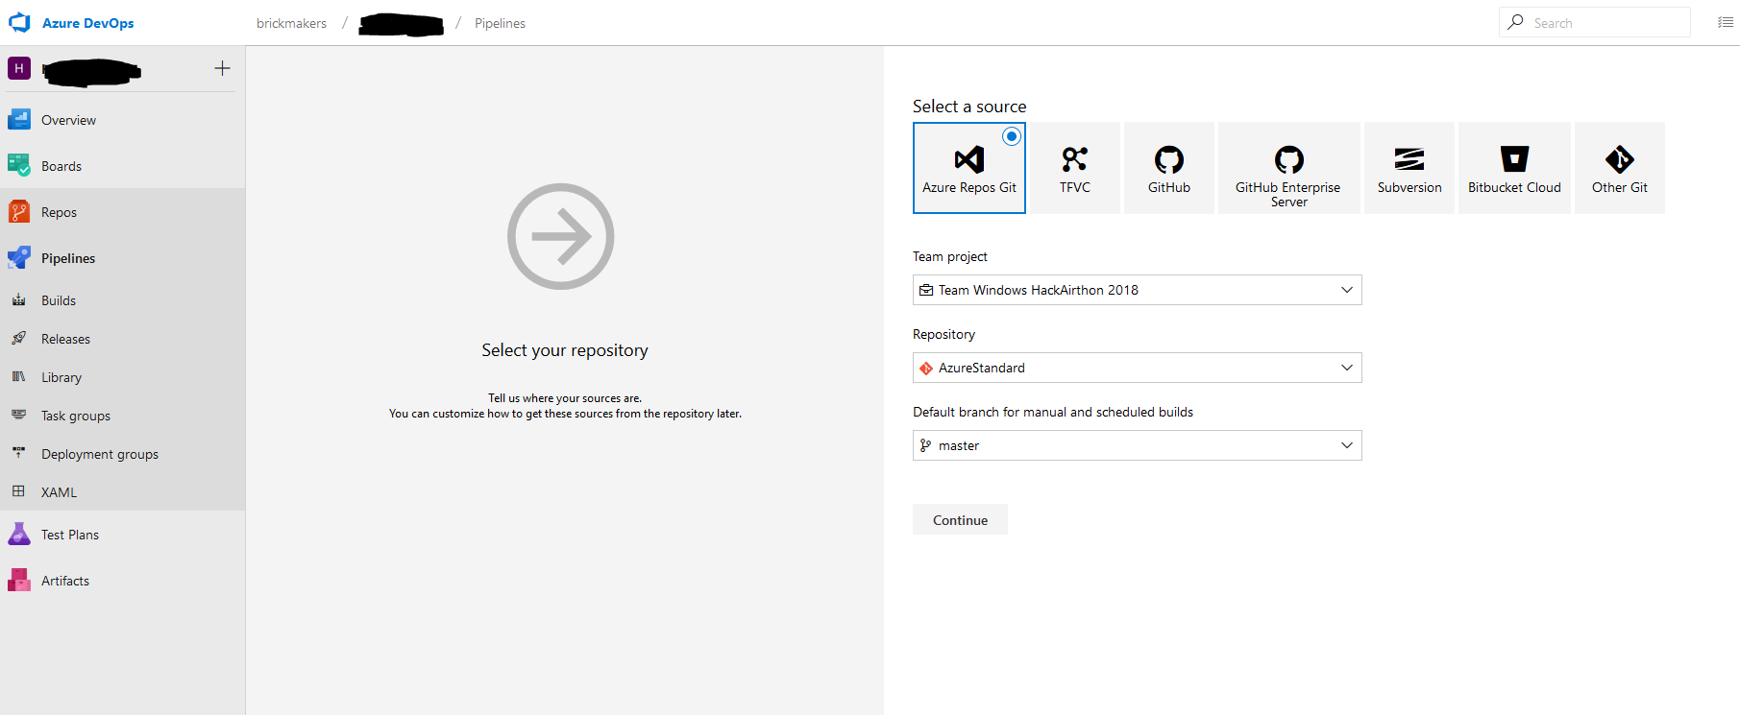
Example
Azure DevOps Build Pipelines: VCS

Slide 10
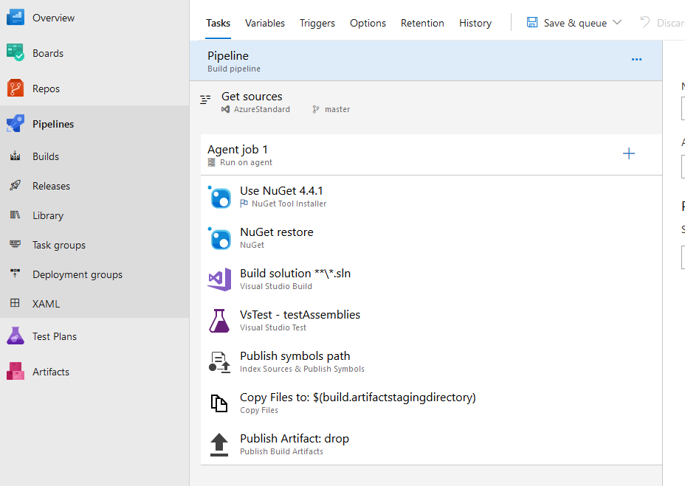
Example
Azure DevOps Build Pipelines: Agent Jos

Slide 11
Example
Higher-order functions

Slide 12
Example
const twice = (f, v) => f(f(v));
const add3 = v => v + 3;
twice(add3, 7); // 13
Func<Func<int,int>,Func<int,int>> twice = f => x => f(f(x));
Func<int,int> plusThree = x => x + 3;
Console.WriteLine(twice(plusThree)(7)); // 13
Higher-order functions

Slide 13
Example
A non-exclusive list of Open/Closed
Gang of 4 Patterns

Slide 14
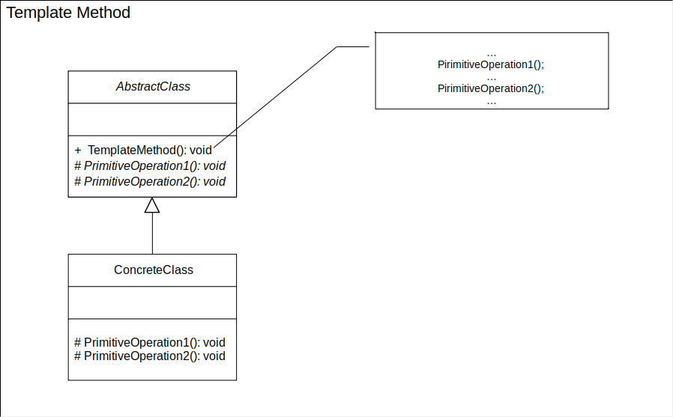
Example

Slide 15
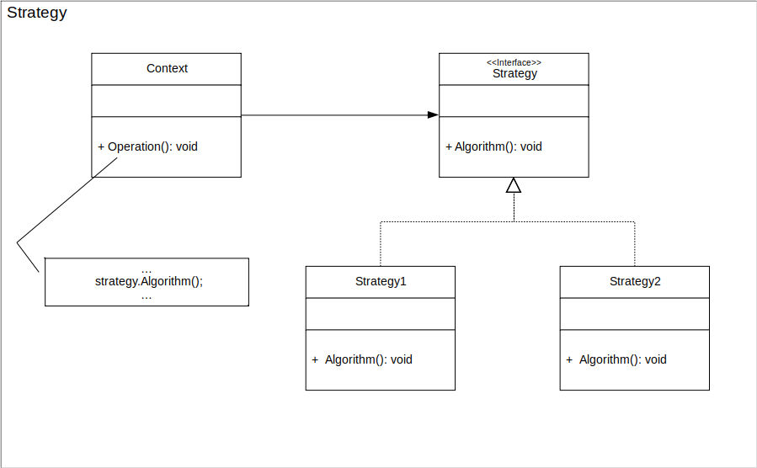
Example

Slide 16
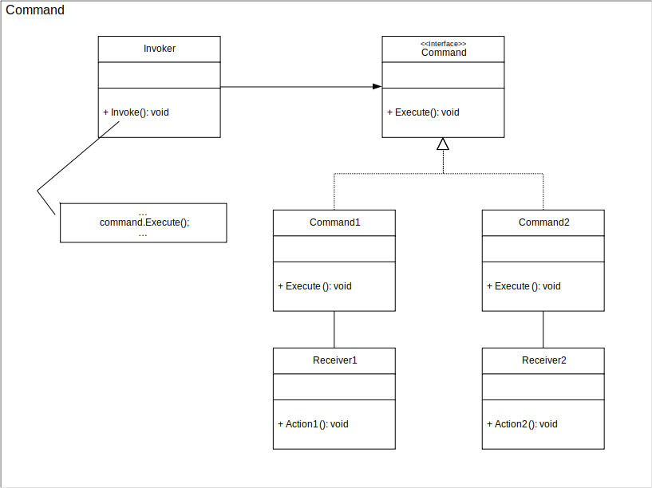
Example

Slide 17
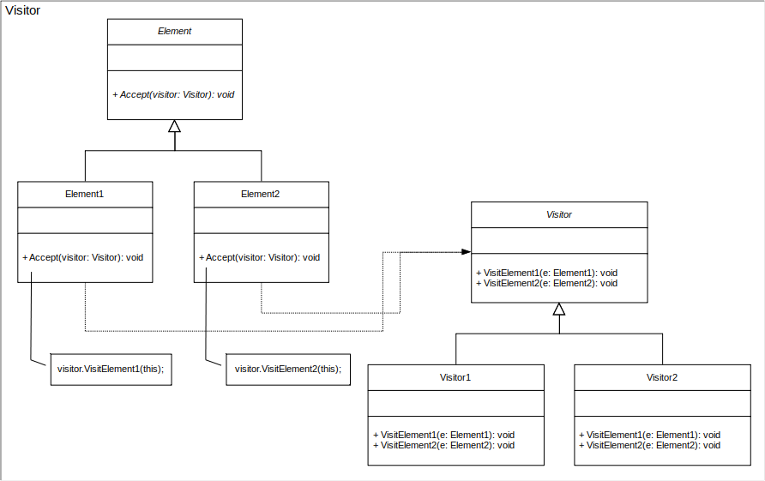
Example

Slide 18
Thanks!

Slide 19
References
Robert C. Martin. 2003. Agile Software Development, Principles, Patterns, and Practices, Prentice Hall.

