Slide 1
The S of SOLID
The Single Responsibility Principle
Maximilian Meffert

Slide 2
The Single Responsibility Principle
Probably around since the 1970’s
  David L. Parnas, On the Criteria To Be Used in Decomposing Systems into Modules. Commun. ACM 15(12): 1053-1058 (1972)
What does it say?
  A module / class should only have one responsibility
  A module / class should only have on reason to change (Robert C. Martin)
What does it mean?
  Separate things which are likely to change because of different reasons
  Group things together which are likely to change for the same reason

Slide 3
The Single Responsibility Principle
Why is it a “good” thing to do?
  Change of requirements is immanent through the life cycle of most software
  Decreases change impact, i.e. number of modules to alter
  Decreases risk of regression because of human error, i.e. developer faults
    … uhm, protects software against developers?
  Increases a software designs capability for adaption to change
    … uhm, “agile”?

Slide 4
The Single Responsibility Principle
What is a “reason to change”?
  Changes to software are necessary because…
    … requirements have literally changed
    … of bugs, where requirements have not been met
  Requirements originate from stake holders
  Stake holders are who software must respond to
    Hence: Responsibility Principle

Slide 5
Example:
The Acme Corp. Employee Management System

Slide 6
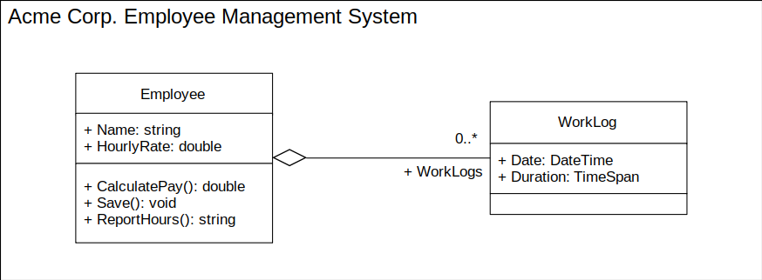

Slide 7
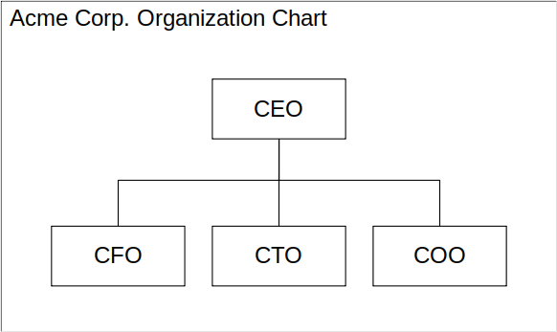

Slide 8
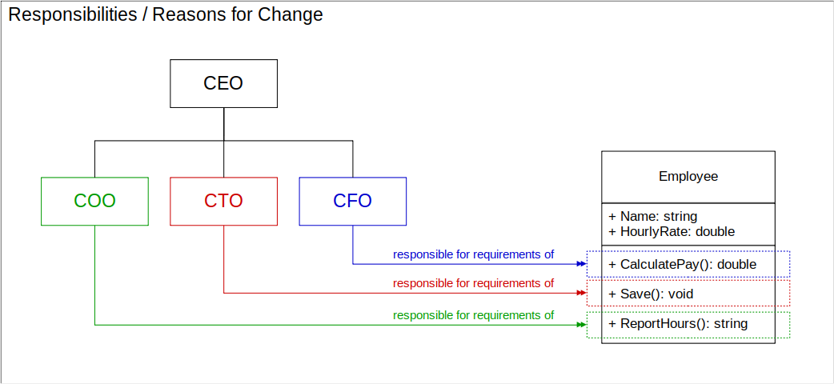

Slide 9
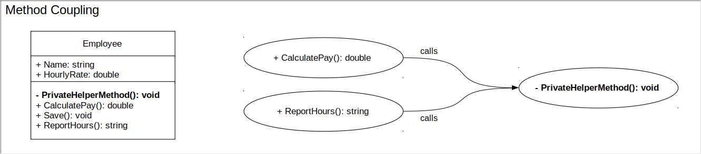
Aggregation of responsibility may lead to hidden coupling which facilitates human error / developer faults

Slide 10
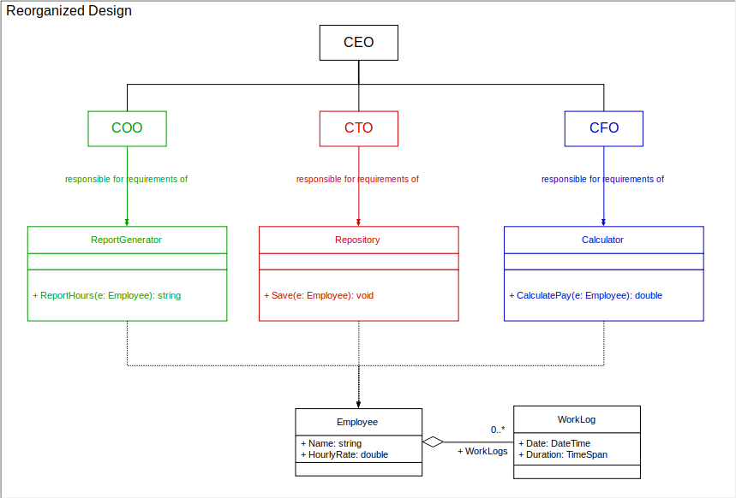

Slide 11
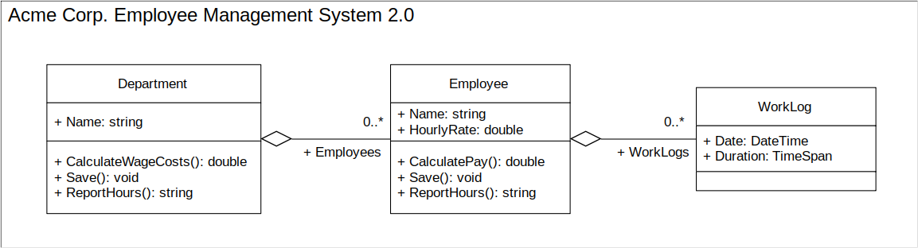

Slide 12
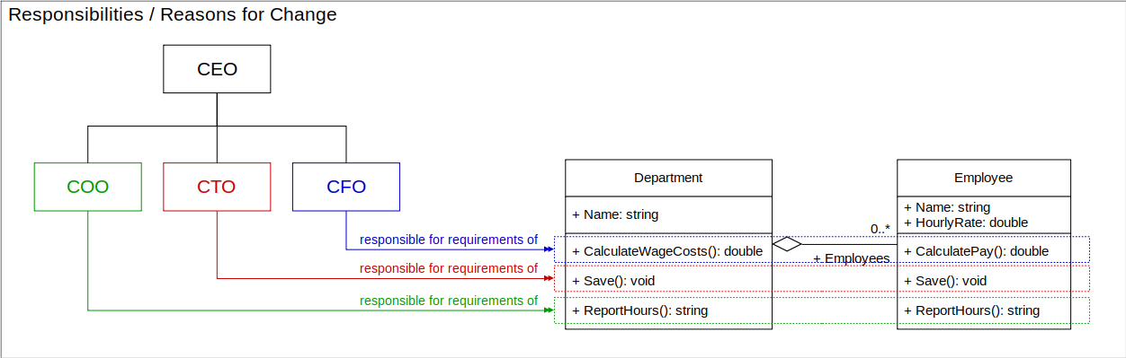

Slide 13
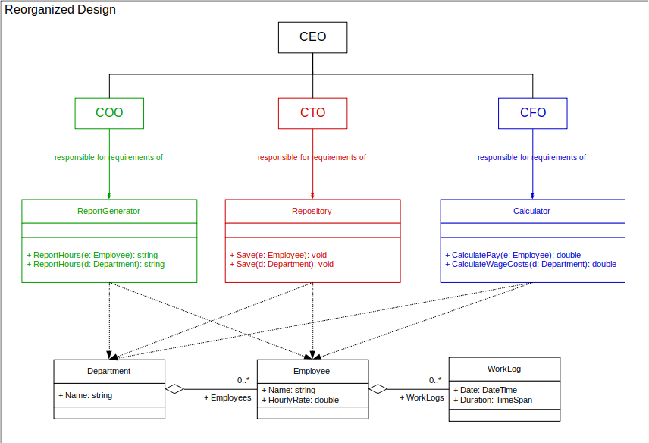

Slide 14
Thanks!

