Slide 1
Detection of Parkinson’s Disease Using Speech
by Max Melichov and Tomer Zamir

Slide 2
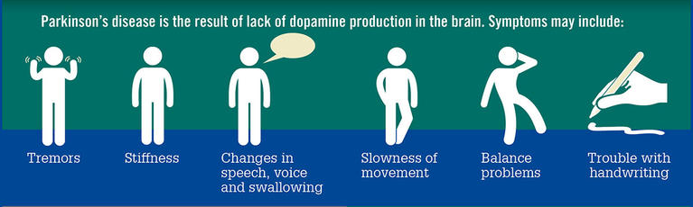
Introduction
Parkinson's disease (PD) is a progressive neurological disorder that affects movement and can cause changes in speech, including tremors, monotone speech, and a decrease in volume and pitch.

Slide 3
What we are here to do?
In this study, we aim to explore the potential of using machine learning to analyze changes in the voice that may be associated with PD. By analyzing features of the voice, we hope to build a model that can accurately diagnose the disease.

Slide 4
Research Questions
can machine learning be used to accurately diagnose Parkinson's disease based on changes in the voice?
Which acoustic features does PD affect the most?
What is the best method to diagnose PD?

Slide 5
Hypothesis
Our hypothesis is that by analyzing features of the voice, we can build a model that can accurately diagnose PD with a high level of accuracy. We expect that the model will be able to identify relevant patterns in the voice data that are indicative of PD and differentiate between individuals with and without the disease.

Slide 6
Road-Map
Building a Machine Learning Model
Data collection
EDA
Conclusions
1
3
5
7
2
4
6
Feature extraction
Data Preprocessing
Prediction

Slide 7
Variables and parameters
Independent variables | Dependent variables
Acoustic features | The diagnosis of PD based on the machine learning model.
hyperparameters | accuracy of the model

Slide 8
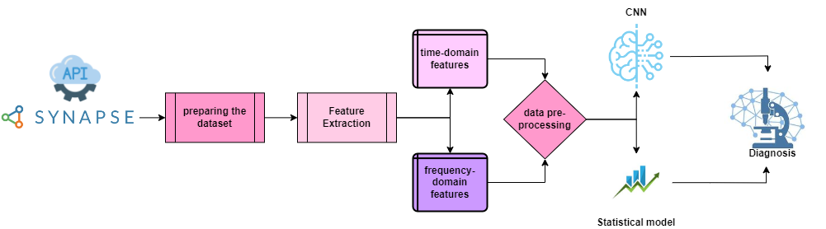
Design and Implemantation
Data:
Voice data will be collected from individuals with and without PD. This data will be collected through speech recordings and will include various samples of the individuals saying /a/ phoneme.
Feature extraction:
Features of the voice data, will be extracted from the recordings and analyzed.
Model development:
A machine learning model will be developed based on the analyzed voice data. This model will be trained to recognize patterns in the data that may be indicative of PD.
Model evaluation:
The developed model will be evaluated on a test dataset to assess its accuracy in diagnosing PD.

Slide 9
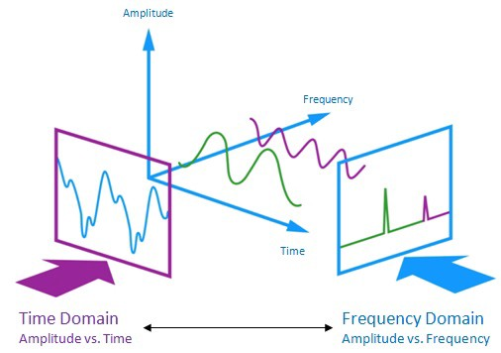
Audio Features
Time-Domain Features
Frequency-Domain Features
Time-domain features are based on the raw waveform of the audio signal, and include features such as duration, maximum pitch, minimum pitch, and mean pitch
We have also extracted some prosodic features, which capture information about the rhythm and timing of the audio, such as speaking rate, silences, and voice breaks.
Frequency-domain features are based on the frequency content of the audio signal, and include features such as total energy, energy frequency, and power.
Finally, we have extracted some features that are based on the spectral content of the audio, such as chroma features and MFCCs.

Slide 10
Targets
Developing a machine learning model that can accurately classify individuals as having or not having Parkinson's disease based on their voice data.
Determining the extent to which changes in the voice, such as pitch, loudness, and spectral characteristics, are indicative of Parkinson's disease.
Evaluating the potential of voice processing techniques as a diagnostic tool for Parkinson's disease.

Slide 11

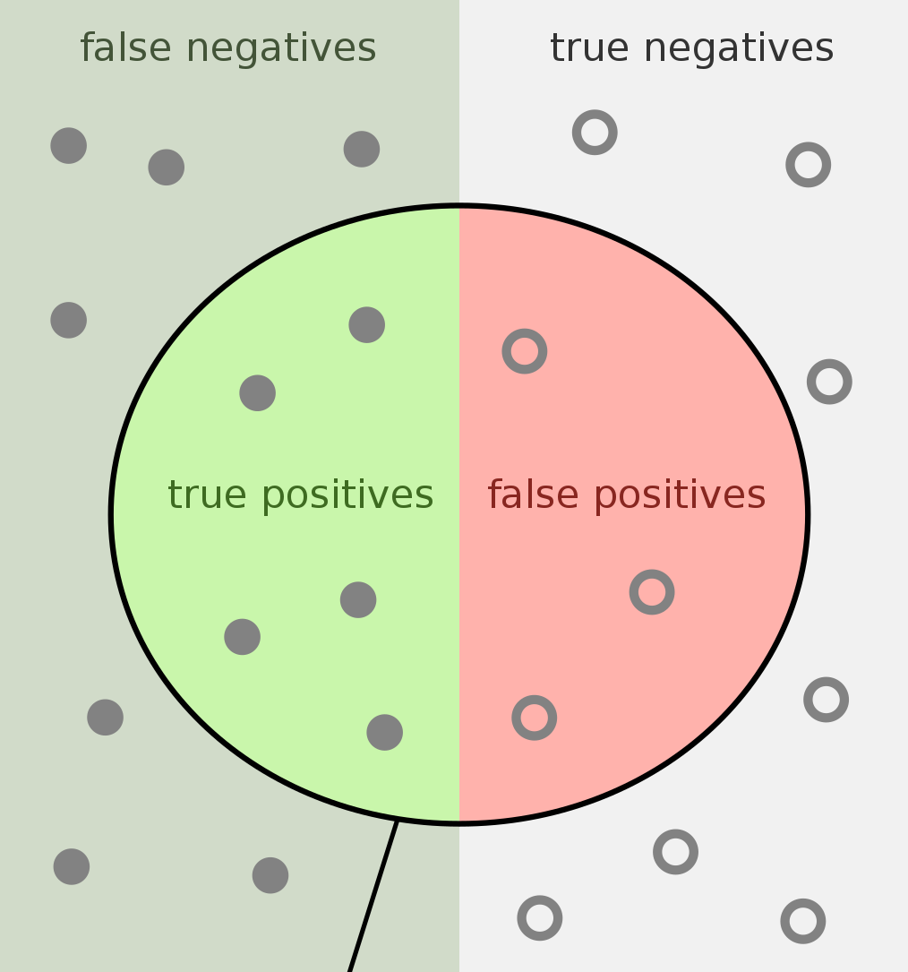
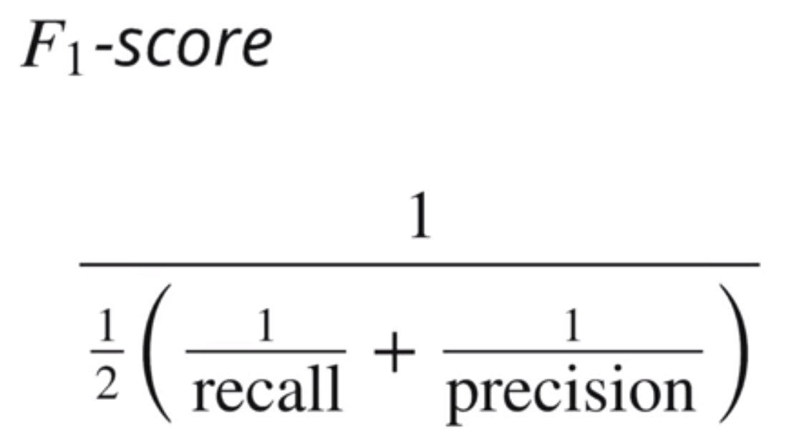
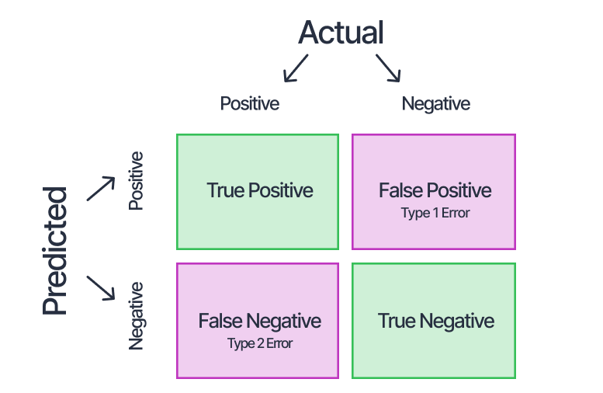
Measurements
Accuracy | Recall
 | Confusion matrix

Slide 12
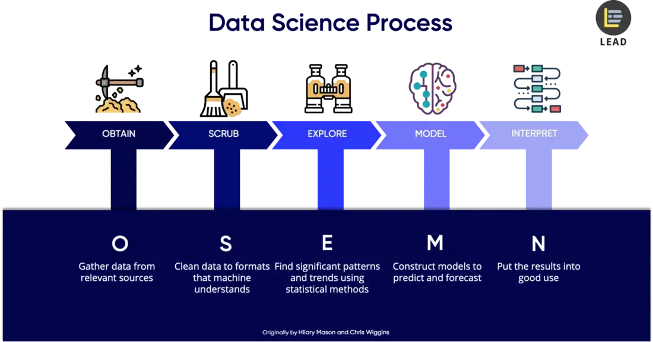

Slide 13
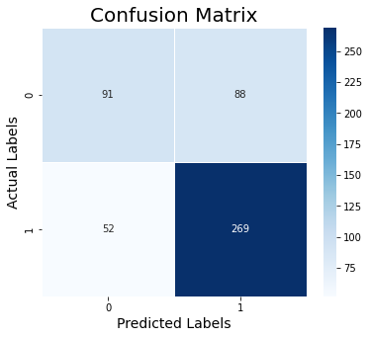
Results
We trained the models on 4000 recordings, used 1000 for validation and 500 additional as new data for evaluation
Statistical model
Out of 10 different models we tested, we chose CatBoostClassifier which gave the best result
 | Accuracy | Recall | F1
Validation | 0.72 | 0.83 | 0.788
test | 0.7 | 0.84 | 0.77

Slide 14
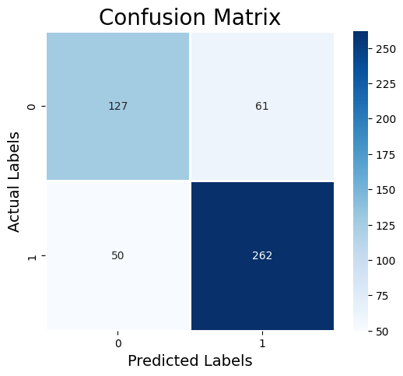
Results
We trained the models on 4000 recordings, used 1000 for validation and 500 additional as new data for evaluation
CNN model
 | Accuracy | Recall | F1
Validation | 0.875 | 0.9 | 0.9
test | 0.778 | 0.84 | 0.825

Slide 15
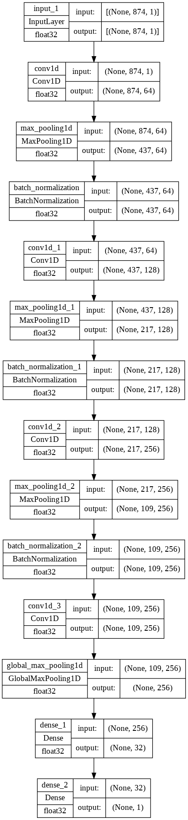
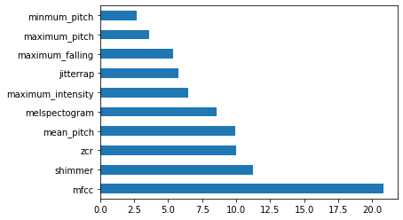
Conclusions
We found that MFCC Shimmer, ZCR, mean pitch etc were the most indicative voice feature for diagnosing PD in statistical models.
On the deep learning model we used Spectral features, Chroma_stft, MelSpectogram and more.
We found that the deep learning model achieved better result than other models we tested.

Slide 16

Summary
Our project has demonstrated the potential for using speech and machine learning algorithms for the diagnosis of Parkinson's disease.
We proved our hypothesis by building a working model that can accurately identify PD in voice.

Slide 17
Bibliography
Advances in Parkinson’s Disease detection and assessment using voice and speech: A review of the articulatory and phonatory aspects Laureano Moro-Velazquez, Najim Dehak (Center for Language and Speech Processing, Johns Hopkins University, Baltimore, USA) , Jorge A. Gomez-Garcia, Juan I. Godino-Llorente (Escuela T´ecnica Superior de Ingeniería y Sistemas de Telecomunicaci´ on, Universidad Polit´ecnica de Madrid, Madrid, Spain) , Julian D. Arias-Londono˜ (Department of Systems Engineering, Universidad de Antioquia, Medellín, Colombia).
Parkinson’s Disease Diagnosis Using Machine Learning and Voice Timothy J. Wroge (Department of Bioengineering, University of Pittsburgh, Pittsburgh, Pennsylvania, USA) , Yasin Ozkanca, Cenk Demiroglu (Department of Engineering, Ozye ¨ gin University, Istanbul, Turkey) , Dong Si (Division of Computing and Software Systems, University of Washington, Seattle, Washington, USA) , David C. Atkins and Reza Hosseini Ghomi (Department of Psychiatry and Behavioral Sciences, University of Washington, Seattle, Washington, USA).
Bot BM, Suver C, Chaibub Neto E, Kellen M, Klein A, Bare C, Doerr M, Pratap A, Wilbanks J, Friend S, Trister AD (Sage Bionetworks, Seattle, WA), Dorsey ER (Center for Human Experimental Therapeutics, University of Rochester Medical Center, Rochester, NY. The mPower Study, Parkinson disease mobile data collected using ResearchKit. Nature Scientific Data

Slide 18
Appendix
A mobile‑assisted voice condition analysis system for Parkinson’s disease: assessment of usability conditions Javier Carrón1 , Yolanda Campos‑Roca2 , Mario Madruga1 and Carlos J. Pérez1
speech-emotion-recognition-Kaggle
CNNs for Audio Classification

