Slide 1
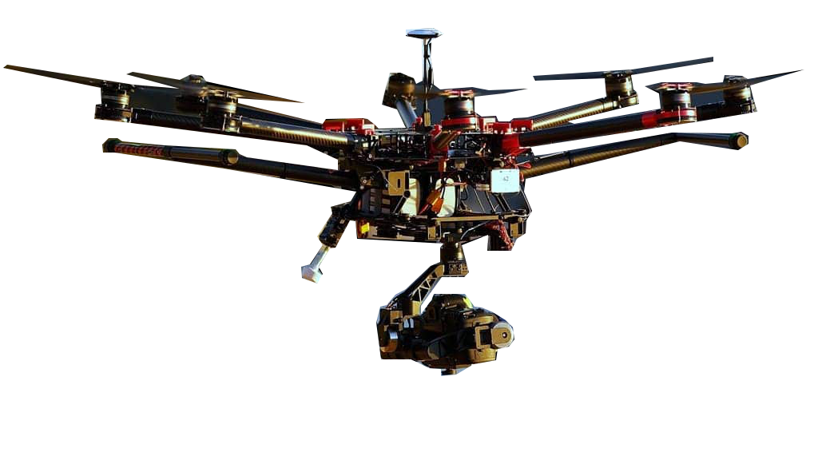
Introduction to Machine Learning
for
Hackers
v.0.0.2

Slide 2

Welcome! My name is
Juan Pablo Castillo
1
I’m here to lead this session & help you learn something new today!
2
I’m a recent grad from UC Berkeley and I’m currently working as a Computer Vision Scientist at BXB Digital.
3
My favorite programming languages are C++ & python and my favorite tools are openCV, jupyter notebook and tensorflow.
Notes:
What to Edit:
Add your name, photo, school info, and favorite programming tool or language.
What to Do:
Make attendees feel welcome by running a short Ice Breaker.
Go around the room and ask each person to answer the following questions:
Who are you?
What year are you in school and what is your major/field of study?
What is your favorite programming language or tool?
You should go first to demonstrate the exercise and introduce yourself

Slide 3

Today you will be learning:
1
What is Machine Learning?
2
What are the drawbacks of Machine Learning?
Machine Learning above & beyond.
3
4
Interactive introduction to modules and useful repositories of Machine Learning.
Notes:
What to Say:
Explain to participants what they will learn today.
Learning is a core part of being a hacker and today they are going to learn something new.
What to Do:
Get participants excited about the experience.

Slide 4
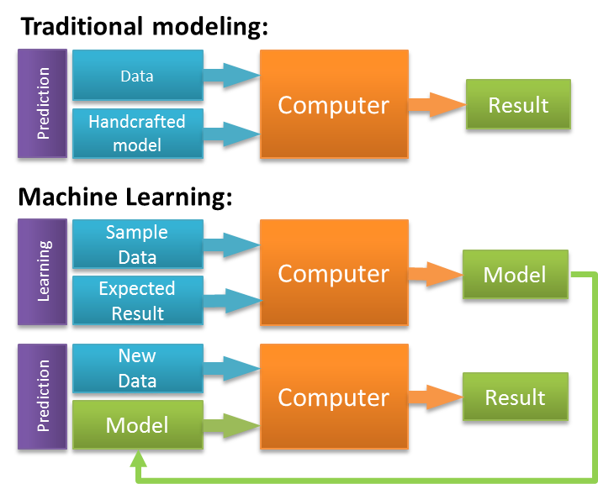
What is Machine Learning?
Machine Learning is the study of algorithms that learn from experiences (input data) instead of hard-coded instructions.

Slide 5


Imagine you want to write an algorithm that predicts if there’s a cat or a dog in an image.
Traditional Programming:
You may specify to look for pointy ears for a cat.
You could also instruct your algorithm to look for a longer muzzle for a dog.
And you can even consider size thresholds to differentiate the two.
Machine Learning:
We input pictures of dogs and cats and we let the algorithm learn to decide when a picture contains a dog or a cat.

Slide 6
ML in 5 easy steps with no math background!
Identify a problem where there are variables that vary from case to case that we need to use ML to learn to make decision for us.
1
2
Collect data to feed the model (algorithm).
3
Select model for training (learning) on data (experiences, cases).
4
Train model to learn from test data.
5
Test model on validation data set to see how well the model performs.

Slide 7
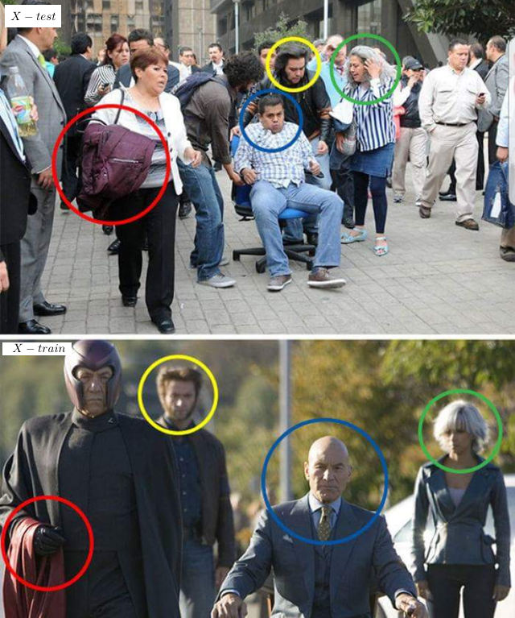
Why do we need data and how do we feed it to the model?
We need data because Machine Learning models learn to identify the most important aspects of this data.
Once the data is collected we split the data set in to two sets; training data set and validation or test data set.
How much data do we need though?!

Slide 8
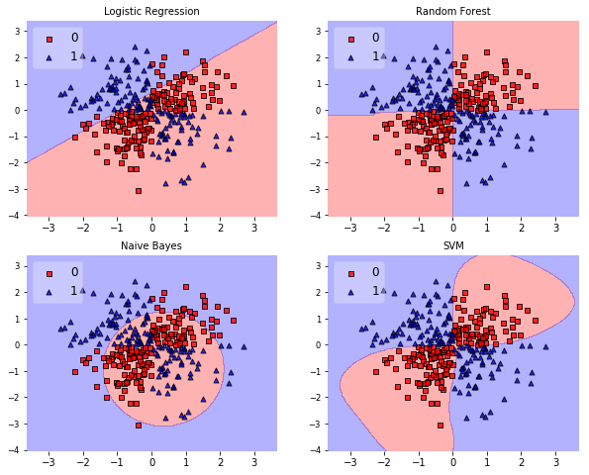
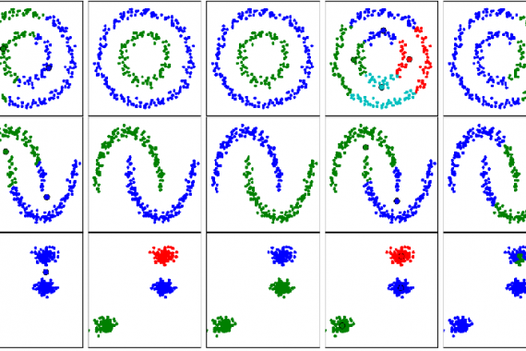
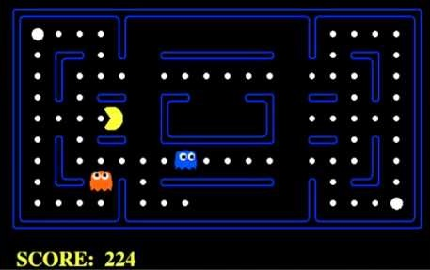
Selecting Machine Learning Model
Supervised Learning:
Labeled data
Unsupervised Learning:
Unlabeled data
Reinforcement Learning:
Labeled rewarded decisions
Labeled environment (for training in trail and error)
Common models :
Classifiers:
Spam detection
Costumer churn prediction
Regression:
House price prediction
Demand forecasting
Common models:
groupers/clustering:
Costumer segmentation
Common models
(optimal performers):
Markov Decision Process
Q-Learning
Distributed AI

Slide 9
Machine Learning has some drawbacks though!
Requires very expensive hardware.
Data acquisition can take a long time and a lot of preprocessing.
Parameter tuning for models can be very tedious.
Not enough data and model can perform very badly.
If data not processed correctly can lead to incorrect predictions down the road.
Notes:
What to Say:
Explain to participants what they will learn today.
Learning is a core part of being a hacker and today they are going to learn something new.
What to Do:
Get participants excited about the experience.

Slide 10
Machine Learning and further
As ML models get bigger training takes longer and performance is not as fast. We needed to come up with better solutions.
Deep Learning was born!
Notes:
What to Say:
An API is part of an application that allows it to interact with other applications, by requesting and sending information.
Travel applications are one example where an application might require information from many different applications such as those for different hotels and car rental services. The travel website that you’re using has to make requests to each of the services whose information it wants to display.
There are hundreds of public APIs available.
What to Do:
Ask the audience for examples of travel or other websites that get information from lots of places (like reposting your instagram pix to facebook - instagram is using the facebook API to do this)

Slide 11
Getting Started
Useful API’s
TensorFlow
Pytorch
Keras
Gluon
Notes:
What to Say:
What to Do:

Slide 12

Learning shouldn’t stop when the workshop ends...
Check your email for access to:
These workshop slides
Practice problems to keep learning
Deeper dives into key topics
Instructions to join the community
More opportunities from MLH!
Notes:
What to Say:
What to Do:

