Slide 1
Rent Cost Burden Predictor
Bay Area
Max, Tiffany, Brinda, Lynn, Aylin

Slide 2
Risk of homelessness based on current personal rent burden
Rent as percent of income
<30% 30% >50%
Cost Burdened
Severely Cost Burdened
How at risk am I in my current neighborhood ?
How will my risk develop in the coming years ?
 | Moderate under 15k | Severe under 15k | Moderate 15k-30k | Severe 15k-30k | Moderate 3k-45 | Severe 3k-45k | Moderate 45k-75k | Severe 45k-75k | Moderate over 75k | Severe over 75k | Moderate All | Severe All
SF, Oakland, Hayward | 14.2 | 72.5 | 20.7 | 63.3 | 35.8 | 43.2 | 47.0 | 12.7 | 11.9 | .6 | 21.9 | 23.7

Slide 3

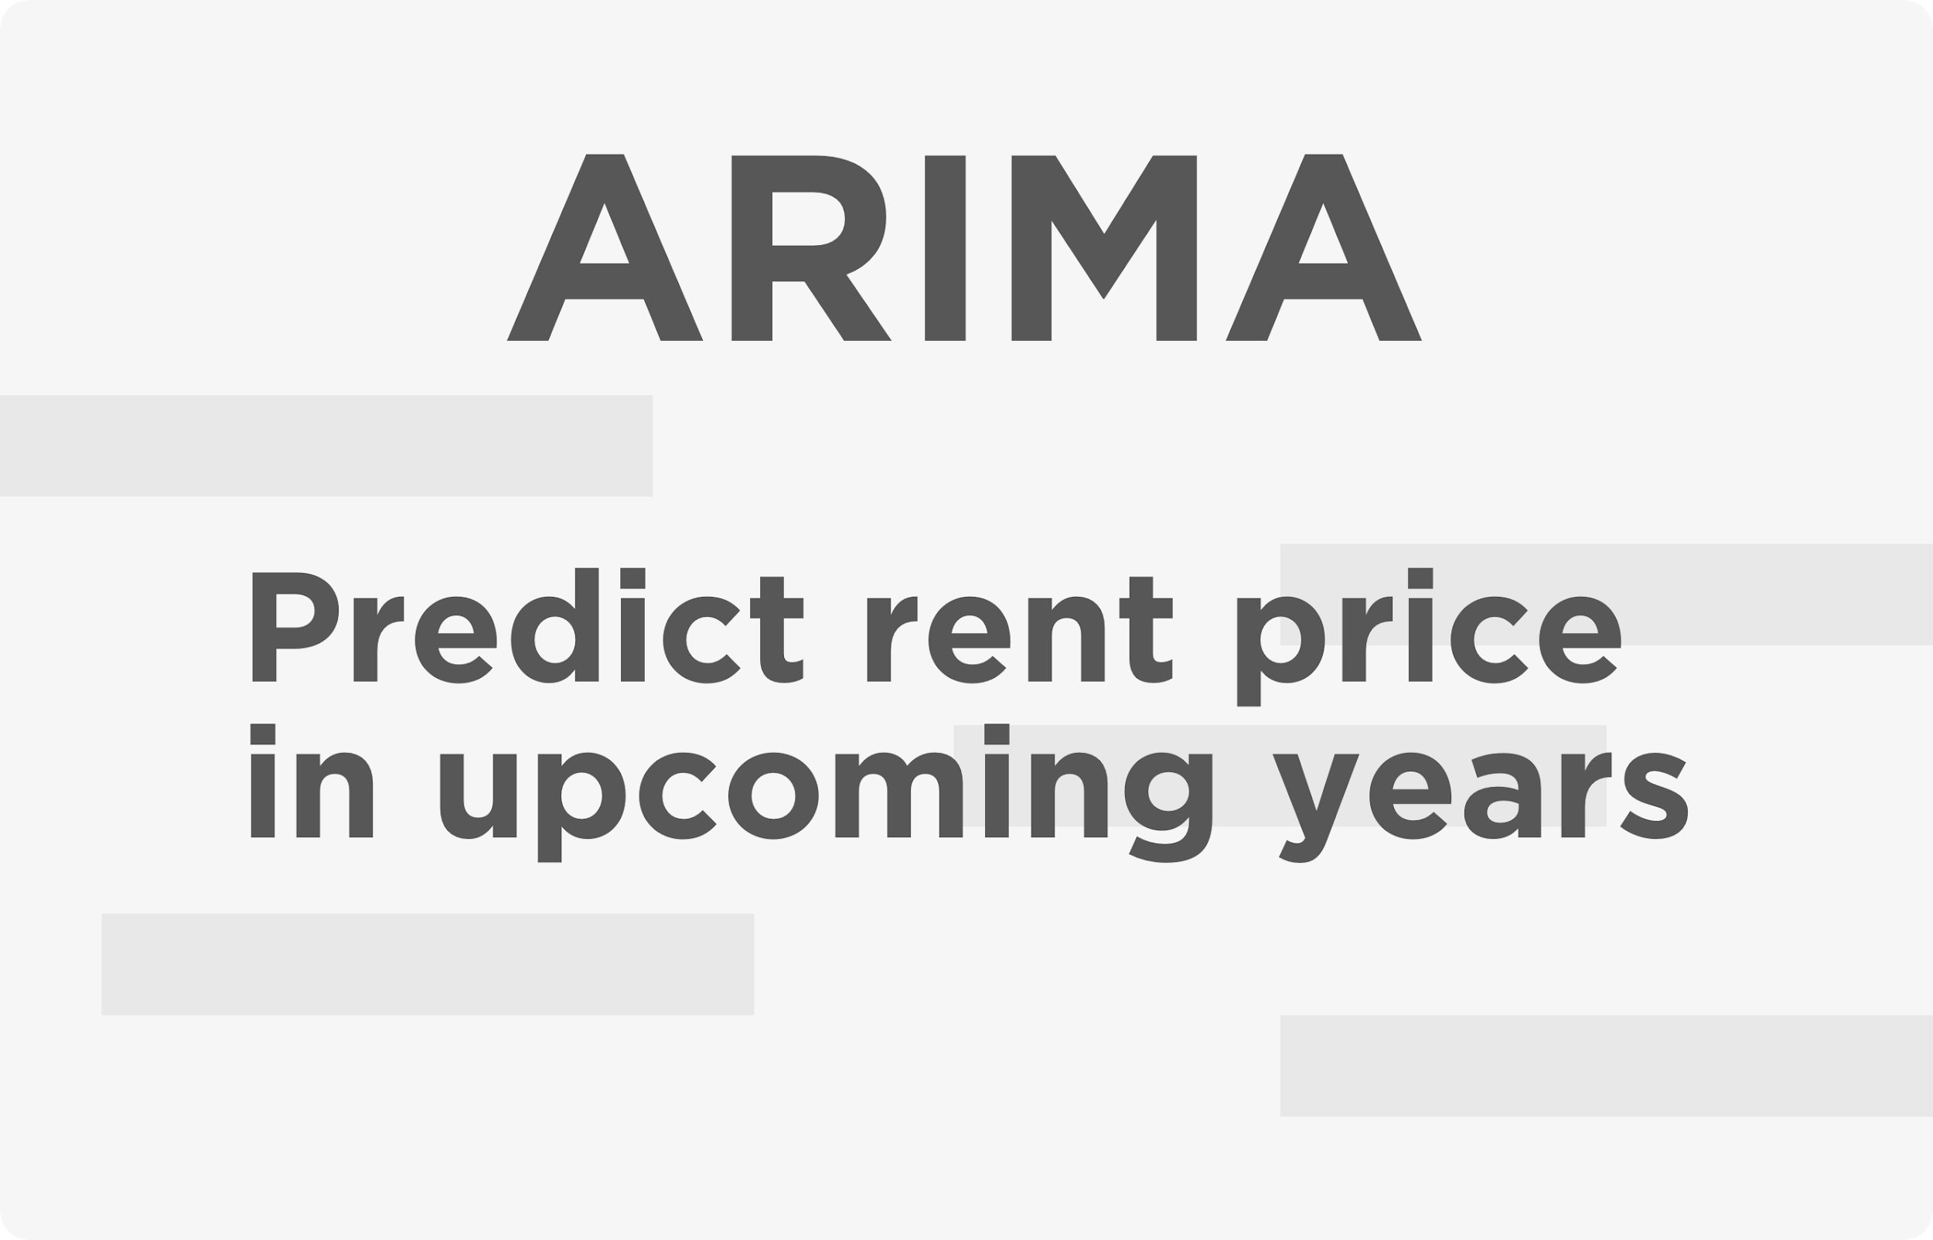
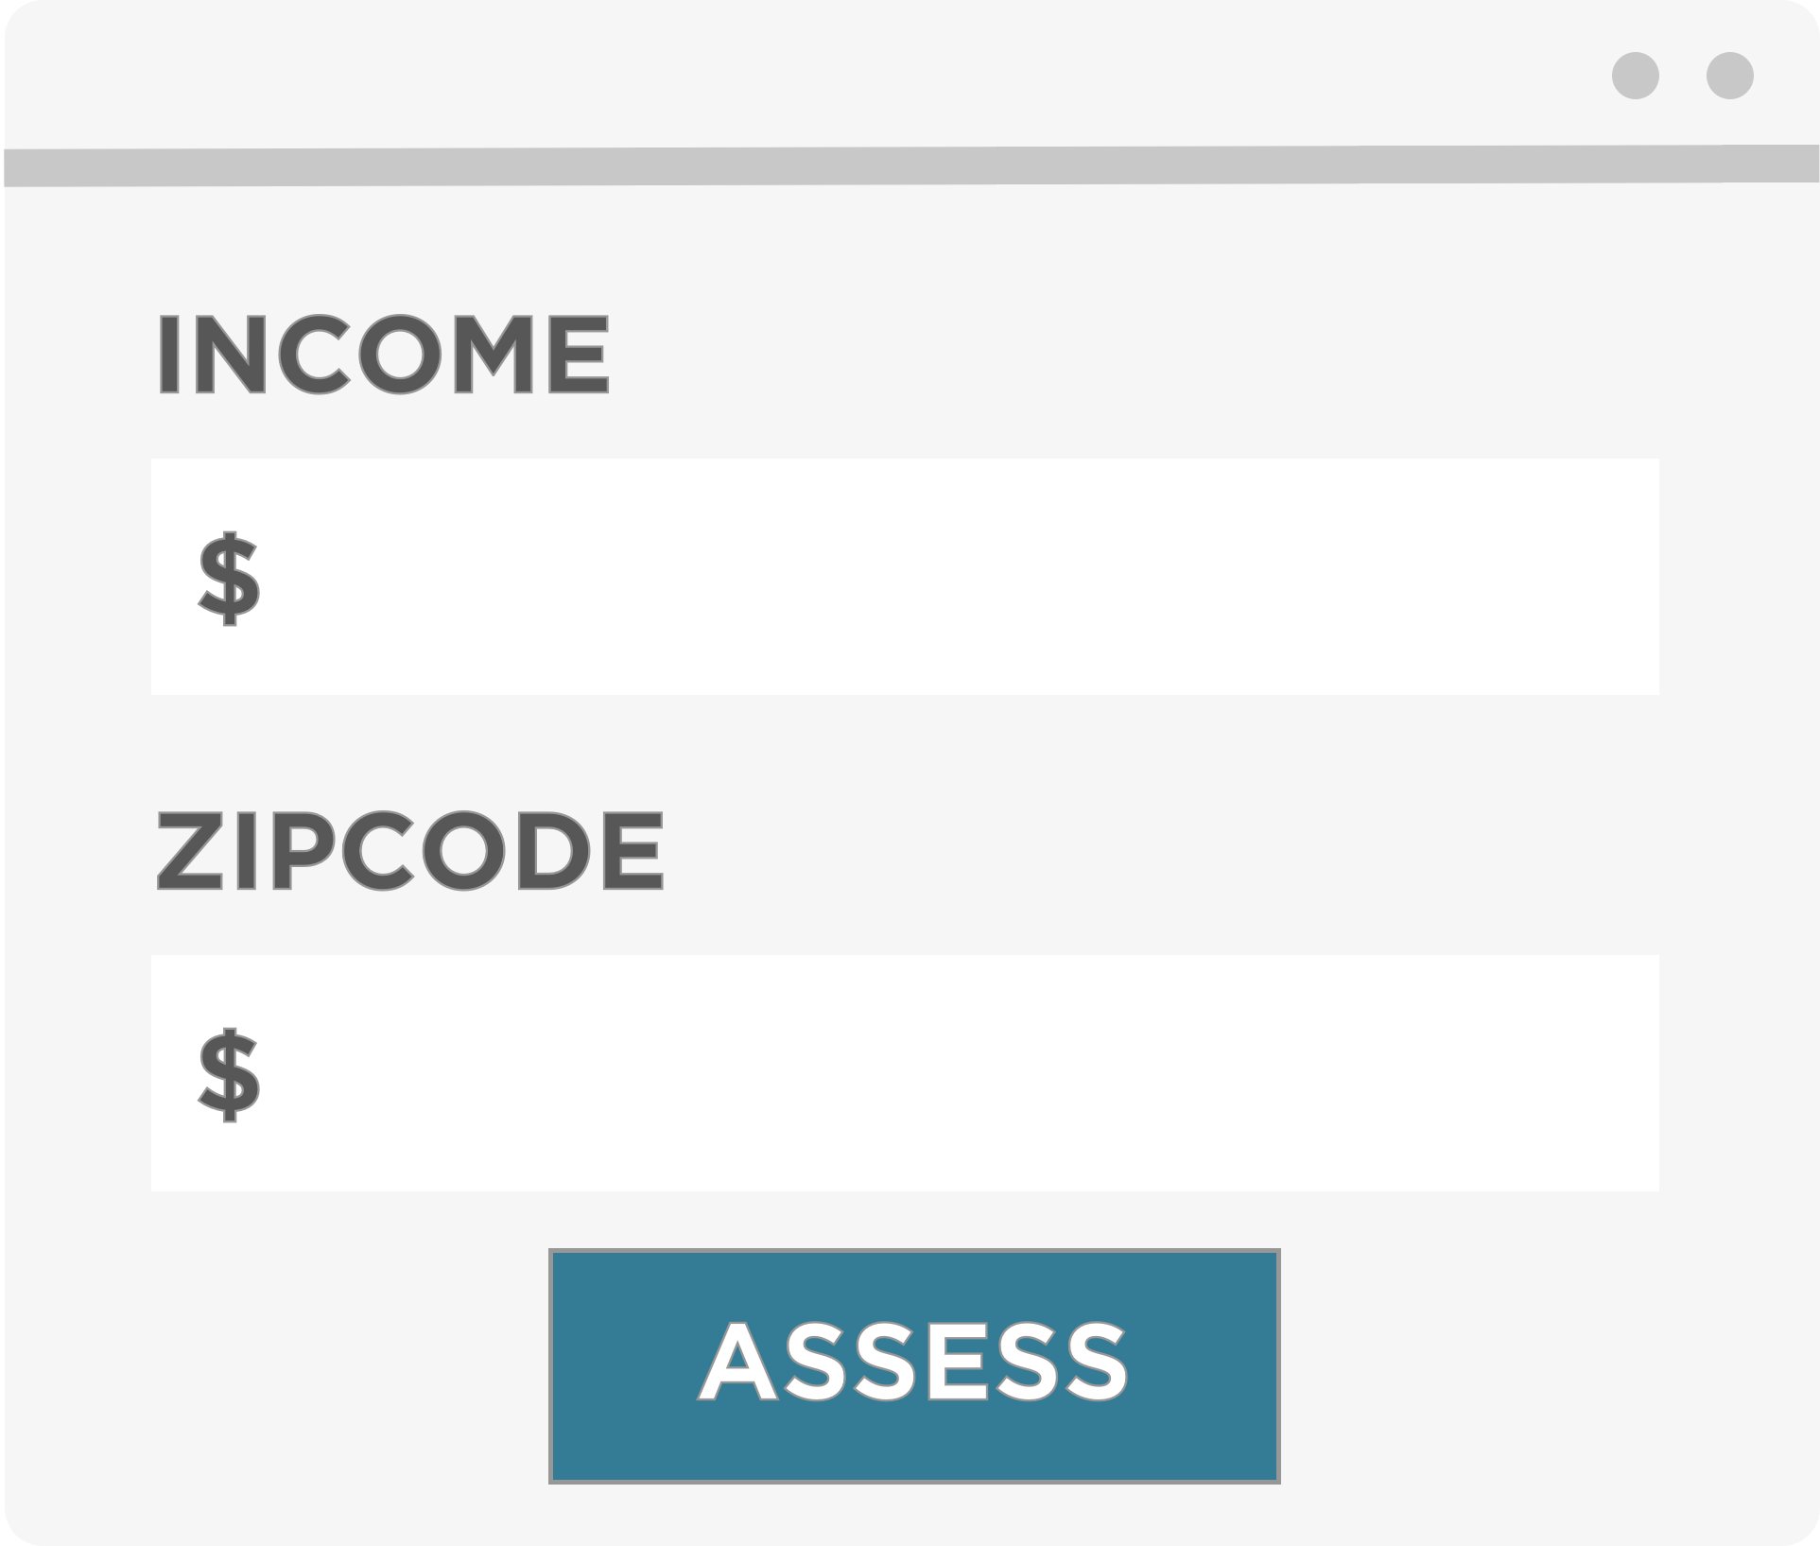
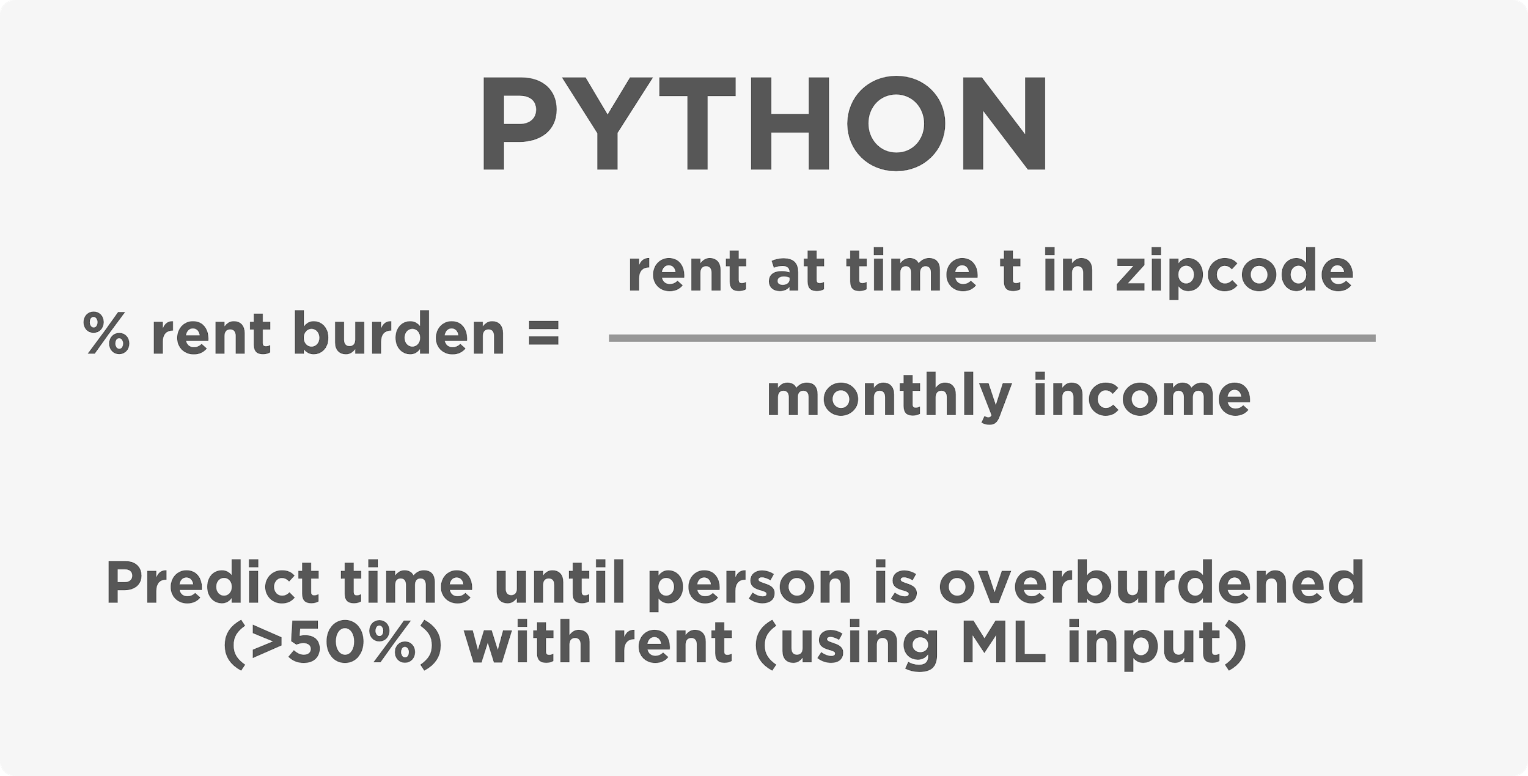
Input
User input
ML Algorithm

Slide 4
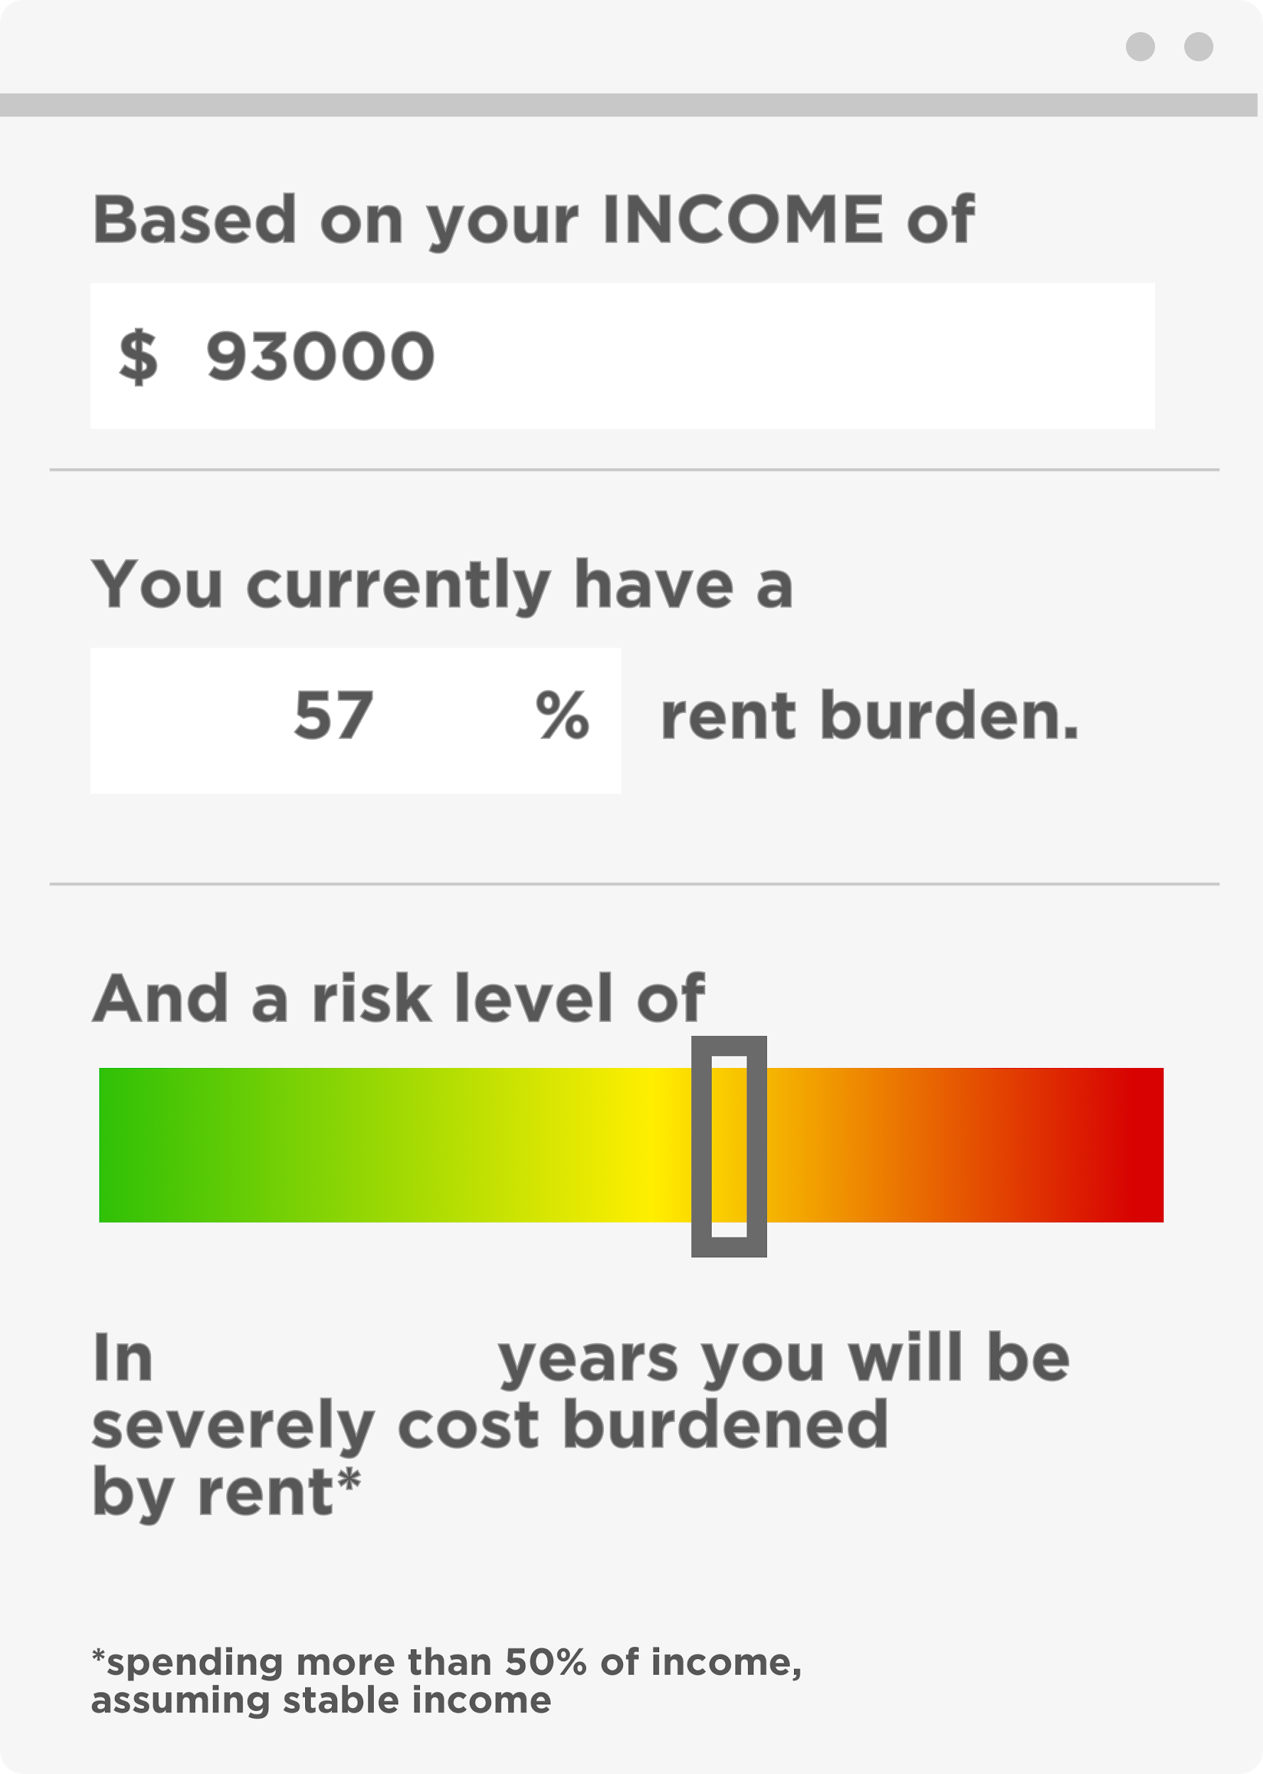
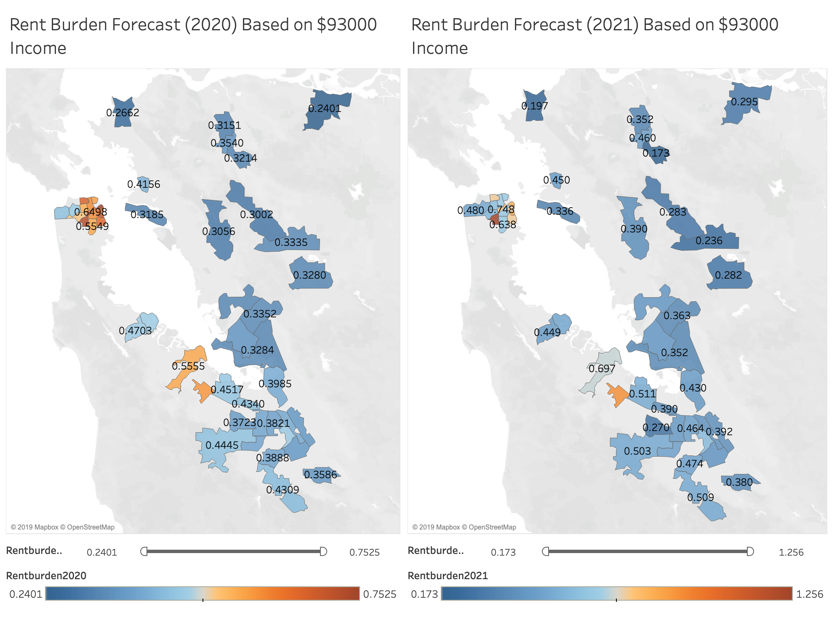
Output

Slide 5
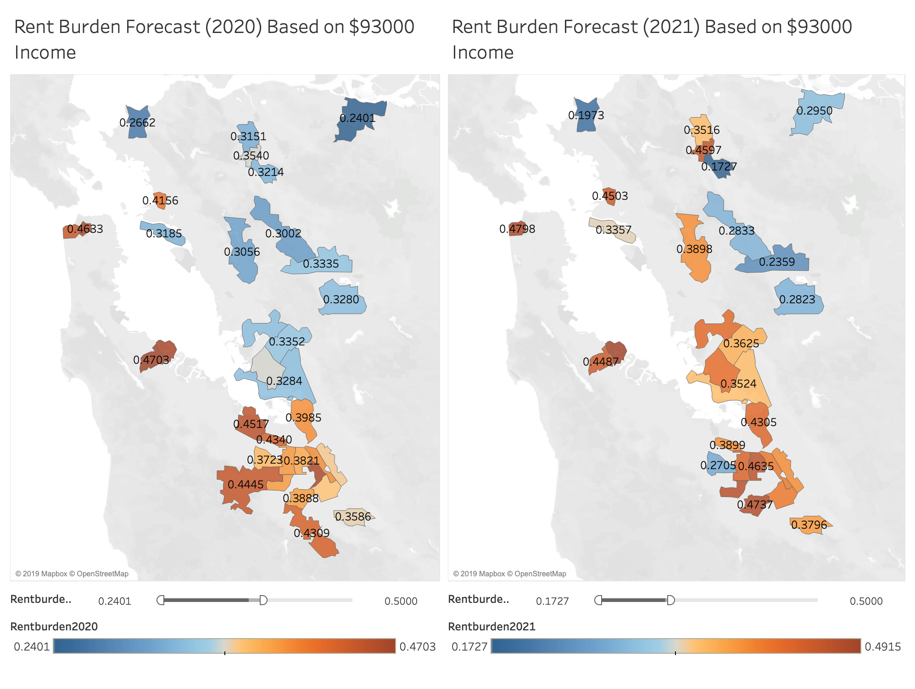
Where can I move with less than 50% rent burden?

Slide 6
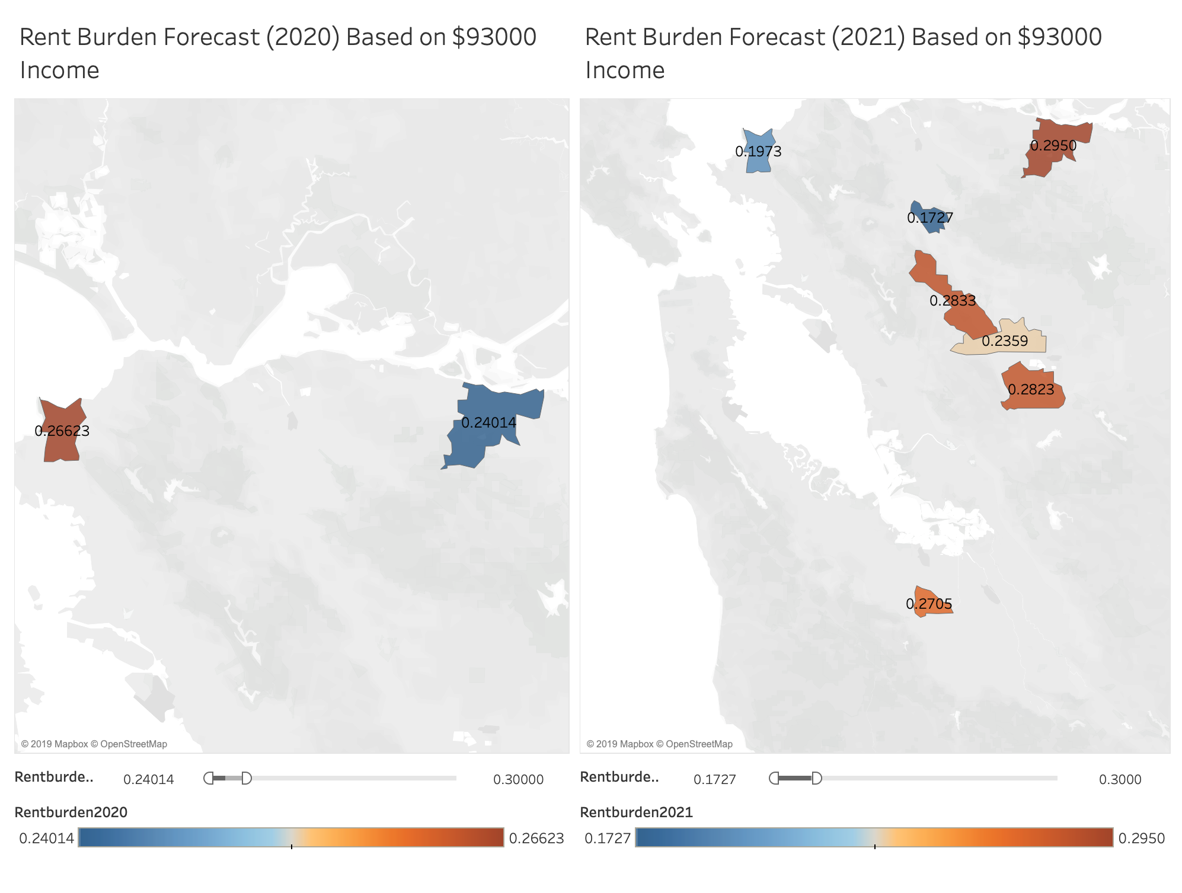
Where can I move with less than 30% rent burden?

Slide 7
Future Extensions
Model
Include data on whether building has rent control and eviction protection based on address input (include additional risk if not protected against eviction)
Features
Surrounding neighborhoods and Future predictions (3-5-10 years)
Additional metrics (Roommates, Bedrooms)
Policy
Helps provide tool for assessing rent burden, but does not solve underlying problem of rising prices
Could be used as a tool for improving policy/rent controls

