Slide 1
Predicting Performance of Integrated Circuits using Regression Analysis
DS6372: Project 2
Nikhil Gupta, Max Moro, Joanna Duran

Slide 2
Agenda
Introduction
Project 1 Review
Project 2 Objective and Approach
Research Methodologies
Exploratory Data Analysis
Model Results
Discussion
Conclusions

Slide 3

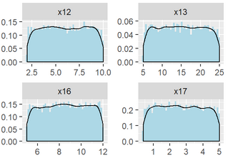
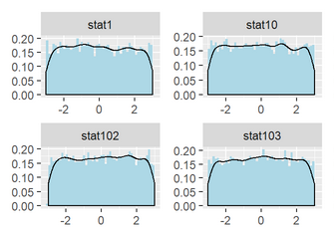

Introduction
Data has been sponsored and approved for use by Texas Instruments Inc.
10,000 rows capturing the performance of a circuit under various conditions.
240 features
x1 - x23: values that can be controlled by engineers to tune the performance
Wide range of values, some ranging from to 100, others are in the Nano or Micro range
stat1 – stat217: process variation parameters beyond human control
Range from -3 to 3, with mean of 0
Values represent sigma variation around mean
Output variable to target: y3 (most critical)
Data Collection Process
Engineer controlled variables were uniformly randomly selected
Statistical features were uniformly randomly sampled

Slide 4
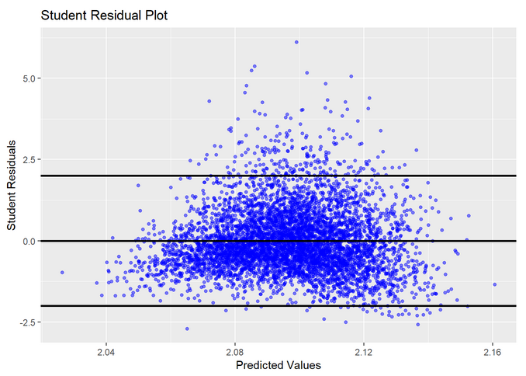
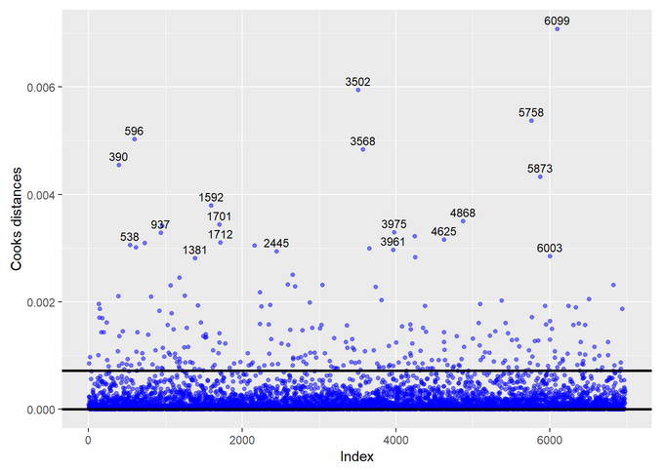

Project 1
Cleaned data
Exploratory data analysis on the target variable y3 and transformed variable to “y3.log”
After running the analysis, the correlation table and VIF values confirmed that there is no multicollinearity.
None of the features were highly correlated to the output, hence we had low prediction capability.
The full model analysis was performed. The adjusted $R^{2}$ is 0.2275 which is low and expected.
Full model suffers from assumption violations
The influence statistics were also analyzed and from the Cook’s D plot we notice that there are 288 points beyond the 4/n line). But there is no justification to remove them.
Could not perform 2-way interaction of variables.
Synopsis

Slide 5
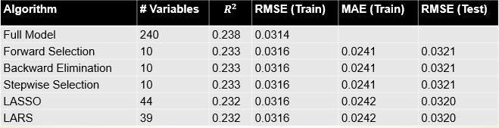
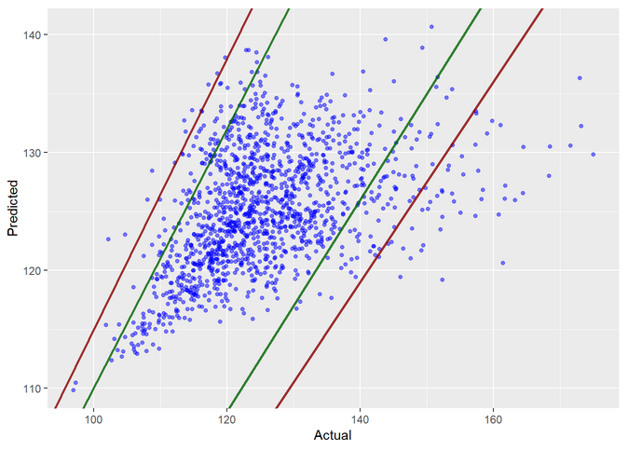
Project 1
The variable selection techniques that were used were
Forward Selection
Backward Elimination
Stepwise Selection
LASSO
LARS
We found that all techniques give essentially the same fit statistics. The best model is Backward Elimination based on low # predictors.
In analyzing the residuals, we conclude that the final model suffers from same assumption violations as the full model.
Synopsis - Continued

Slide 6
Project 2
Goal
Improve the model fit from Project 1 utilizing Principal Component Regression, Linear/Quadratic Discriminate Analysis or Logistic Regression.
Target accuracy of ±10% is desired, but ±15% would be acceptable.
Approach 1:
Principal Component Regression with intelligent feature engineering and selection
Approach 2:
Clustering based on High Cook’s D and using the cluster as a predictor in the regression model

Slide 7
Research methodologies
Modeling Approach 1
Performing intelligent feature engineering using semiconductor domain expertise, which included theoretical equations from semiconductor.
Created variables then performed 2-way interaction of all the variables.
Dimensionality reduction using Principal Component Analysis (PCA).
The reduced Principal Components (PCs) were then used to build a linear regression model.
Modeling Approach 2
From project 1 observations as high leverage or low leverage.
This data was then used to train various classification models including Linear/Quadratic Discriminate Analysis (LDA/QDA) and Logistic Regression models.
This class variable could then be used in the eventual linear regression model to improve predictions.

Slide 8
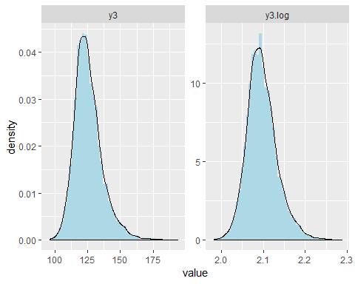
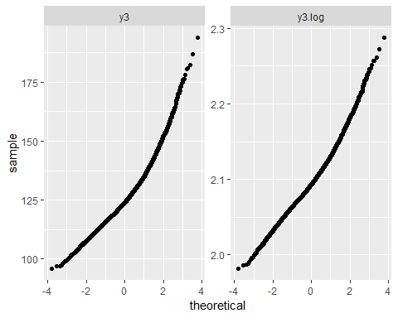
Exploratory Data Analysis
Data Prep
3020 NA values for y3
Output
Right skewness
Log transformed variable “y3.log”
Input Predictors
Derived from semiconductor theory
41 features created
Multicollinearity
All VIF values were < 10
Feature Engineering
## Variables VIF ## 1 stat204 1.063870 ## 2 stat175 1.063370 ## 3 stat66 1.062060 ## 4 stat105 1.062008 ## 5 x6 1.061394 ## 6 stat2 1.061388 ## 7 stat14 1.061212 ## 8 x7 1.060532 ## 9 stat216 1.060477 ## 10 stat142 1.060190 ## 11 stat154 1.059695 ## 12 stat32 1.059608 ## 13 stat141 1.059564 ## 14 stat138 1.059507 ## 15 stat73 1.059386
data$x2byx1 = data$x2/data$x1 data$x6byx5 = data$x6/data$x5 data$x9byx7 = data$x9/data$x7 data$x10byx8 = data$x10/data$x8 data$x14byx12 = data$x14/data$x12 data$x1sqinv = 1/(data$x1)^2 data$x5sqinv = 1/(data$x5)^2 data$x7sqinv = 1/(data$x7)^2 data$x8sqinv = 1/(data$x8)^2 data$x1log = log(data$x1) data$x20log = log(data$x20) data$x21log = log(data$x21) data$x22log = log(data$x22) data$x23log = log(data$x23) data$x11log = log(data$x11)

Slide 9

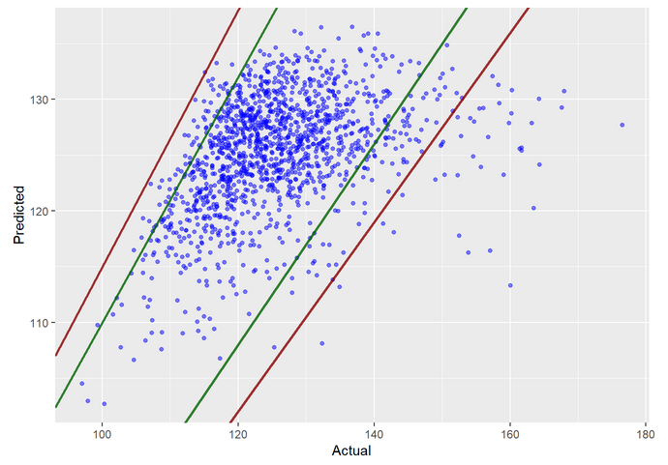
Model Results (Model 1)
Tried taking 2-way interactions of only the engineer-controlled variables (x1 – x23) amongst themselves along with the standalone statistical variables (Model ID 1).
Then performed Principal Component Analysis (PCA) and Regression (PCR).
However, did not improve the model fit compared to the best model from project 1.
Predicted vs. Actual Values (Project 1 best model)
ID # | Model (with PCA) | # VARS | Train R² | Test RMSE
1 | Full Model (2-way EC + Stat) | 164 | 0.266 | 9.45
Predicted vs. Actual Values (ID 1 - Full Model 2-way EC + Statistical variables)

Slide 10
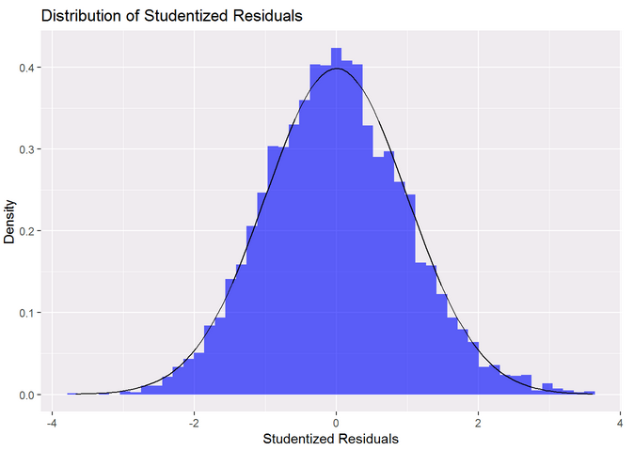
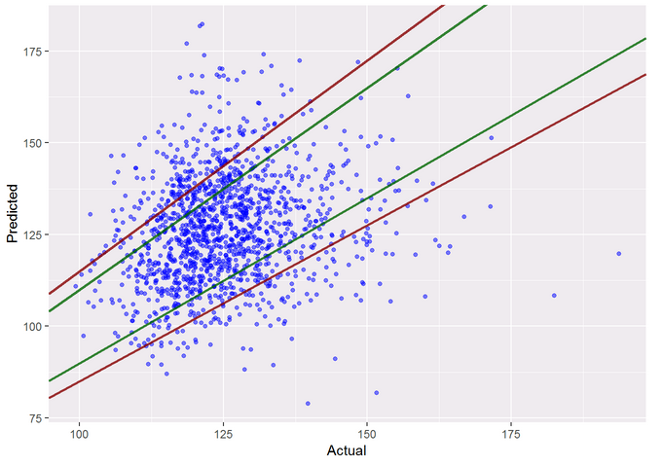
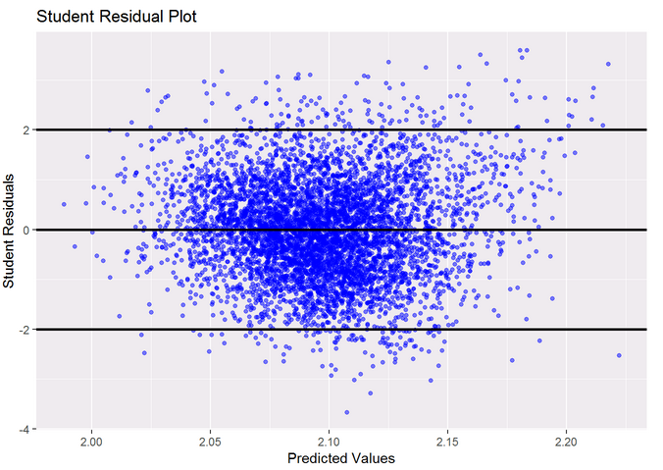
Model results (Model 2)
2-way interaction of all 240 predictors followed by PCA and PCR
Improvements to assumption violations: The residuals were normally distributed and showed equal variance
However, the model was overfitting as the test RMSE saw a degradation
ID # | Model (with PCA) | # VARS | Train R² | Test RMSE
1 | Full Model (2-way EC + Stat) | 164 | 0.266 | 9.45
2 | Full Model (2-way All) | 3,834 | 0.786 | 16.76
Histogram of Residuals
Studentized Residuals vs. Predicted Values
Predicted vs. Actual Values (ID 2 - Full Model 2-way interaction of all variables)

Slide 11
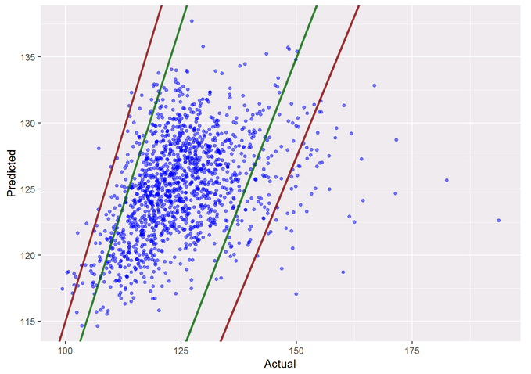
Model results (Models 3 and 4)
Using LASSO (ID 3) and LARS (ID4) for regularization, we were able to reduce overfitting
Two important conclusions
(1) Need to consider 2-way interaction of all variables, not just the engineer-controlled variables
(2) Variable selection and regularizations techniques were necessary to prevent overfitting.
ID # | Model (with PCA) | # VARS | Train R² | Test RMSE
1 | Full Model (2-way EC + Stat) | 164 | 0.266 | 9.45
2 | Full Model (2-way All) | 3,834 | 0.786 | 16.76
3 | LASSO (2-way All) | 3,834 | 0.139 | 9.91
4 | LARS (2-way All) | 3,834 | 0.139 | 9.91
Predicted vs. Actual Values (ID 3 - LASSO 2-WAY ALL)

Slide 12
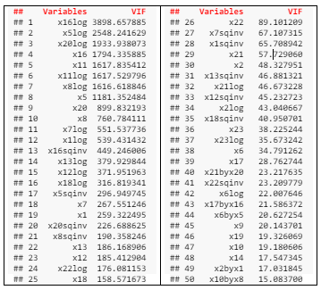
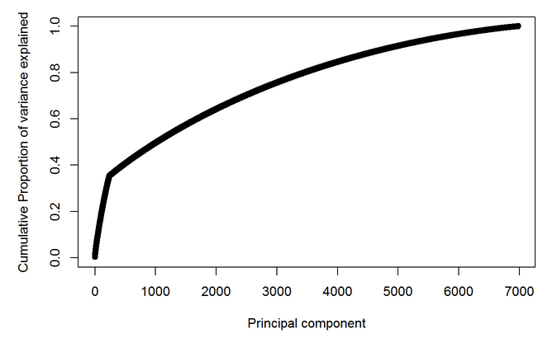
Further Improvements
Used the intelligent feature engineered variables along with the original variables.
New dataset showed considerable multicollinearity since many features were derived from the others.
Performed a 2-way interaction of all the features with each other which increased predictors from 240 to 39,340.
PCA transformed the correlated inputs into a set of non-correlated linear combinations which resolved the multicollinearity issue.
3,455 principal components accounted for 80% of the variability in the predictors
Top 50 variables by VIF show multicollinearity
Scree plot showing cumulative variance explained by the first 7000 principal components

Slide 13
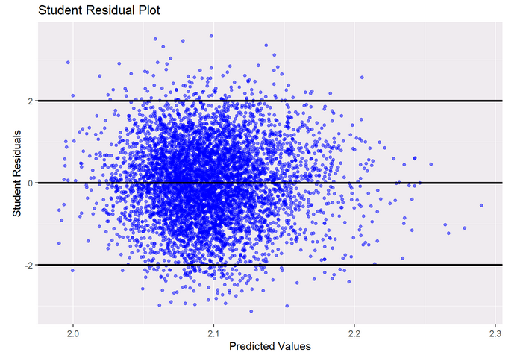
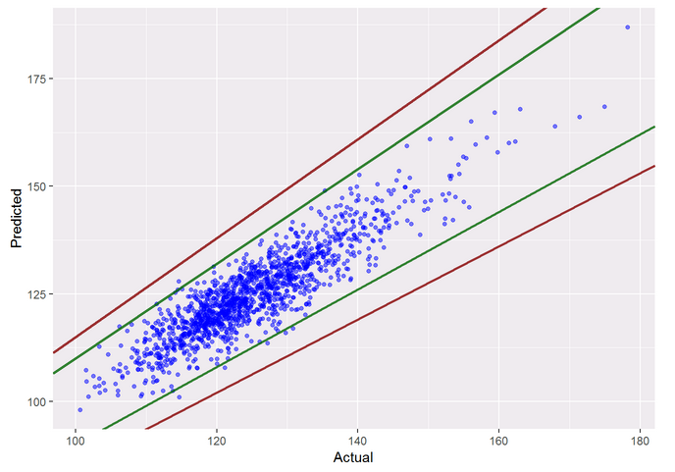
Model Results (Model 5)
Full model with these 3455 PCs and log(y3) as the output
The residuals were normally distributed as shown by the histogram and the studentized residuals also show almost constant variance,
The model exhibited very good fit statistics with an adjusted R² of 0.938 (R² = 0.976).
Test RMSE also showed improvement (to 4.59) pointing to a good fitting model
Studentized Residuals vs. Predicted Values
ID # | Model (with PCA) | # VARS | Train R² | Test RMSE
1 | Full Model (2-way EC + Stat) | 164 | 0.266 | 9.45
2 | Full Model (2-way All) | 3,834 | 0.786 | 16.76
3 | LASSO (2-way All) | 3,834 | 0.139 | 9.91
4 | LARS (2-way All) | 3,834 | 0.139 | 9.91
5 | Full Model (Feat Eng. 2-way All) | 3,455 | 0.976 | 4.59
Predicted vs. Actual Values (ID 5 - Full Model Feat Eng. 2-way All)

Slide 14
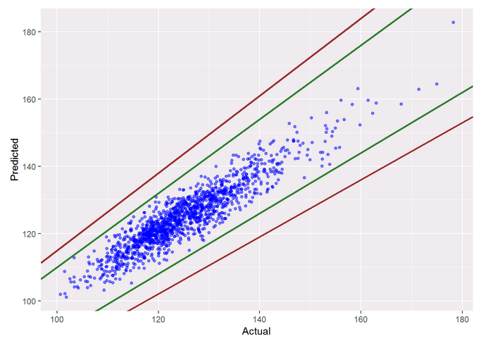
Model Results (Model 6 and 7)
Variable selection and regularization on the full model to remove any scope of overfitting.
LASSO & LARS:
Both these models provided similar performance metrics on the tests set
Both offered some improvement in the test RMSE compared to the full model
Given Test RMSE, we choose the LASSO model as our final model.
Predicted vs. Actual Values (ID 5 - Full Model Feat Eng. 2-way All)
ID # | Model (with PCA) | # VARS | Train R² | Test RMSE
1 | Full Model (2-way EC + Stat) | 164 | 0.266 | 9.45
2 | Full Model (2-way All) | 3,834 | 0.786 | 16.76
3 | LASSO (2-way All) | 3,834 | 0.139 | 9.91
4 | LARS (2-way All) | 3,834 | 0.139 | 9.91
5 | Full Model (Feat Eng. 2-way All) | 3,455 | 0.976 | 4.59
6 | LASSO (Feat Eng. 2-way All) | 3,455 | 0.864 | 3.84
7 | LARS (Feat Eng. 2-way All) | 3,455 | 0.864 | 3.85
Predicted vs. Actual Values (ID 6 - LASSO Feat Eng. 2-way All)

Slide 15
Discussion - Approach 1
We were able to achieve the prediction goal set out for this project
We recognize the method has some issues in terms of scalability.
Performing PCA and variable selection is extremely computation intensive.
Model development failed to run on a laptop with 4 multithreaded cores with 16GB of RAM.
Model ran on more powerful machine (32 cores and 256 GB of memory) and even then, it took over 6 hours of compute time (for PCA, LASSO and LARS combined) with RAM usage peaking at over 60GB.
Stepwise variable selection was not performed since it ran for more than 7 days on this machine (without completing).
Suggestion:
Use cloud computing platform such as Amazon Web Service, or algorithms that allow parallelization

Slide 16
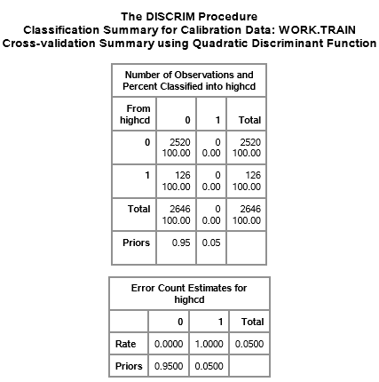
Discussion- Approach 2
Clustering based on High Cook’s D and using the cluster as a predictor in the regression model
From project 1, we classified observations as high leverage or low leverage.
This data was then used to train various classification models including Linear/Quadratic Discriminate Analysis (LDA/QDA) and Logistic Regression models
Issue:
Could not obtain good accuracy of classification with any approach
More importantly, labels (influence statistic) were a subjective choice
Identification can itself vary and depend on the fit of the original model.
A good exercise in theory, this would not be of practical significance when implementing a predictive system at scale.
Cross Validation Results from QDA showing Specificity = 0

Slide 17
conclusions
Even though semiconductor physics offers a highly non-linear design space, can still use linear regression techniques to obtain a reasonable model fit
The key to this process is incorporating intelligent domain specific feature engineering
Challenges: Computation requirements
Future Recommendations
Other non-parametric tree-based models (such as Random Forest, XGBoost) or Artificial Neural Networks could also be trained on this dataset

