Slide 1
Price Optimization for Revenue Maximization at Scale
Team: Kay Ayala, Nikhil Gupta, Max Moro,
Advisor: Dr. Bivin Sadler

Slide 2
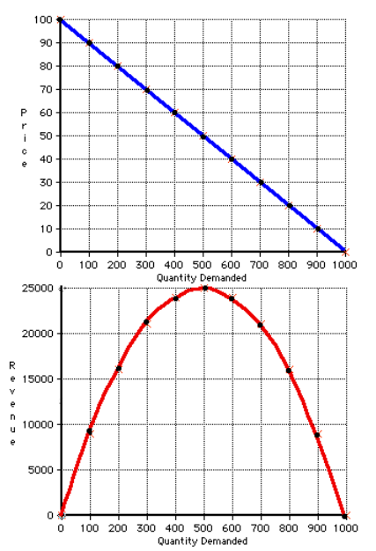
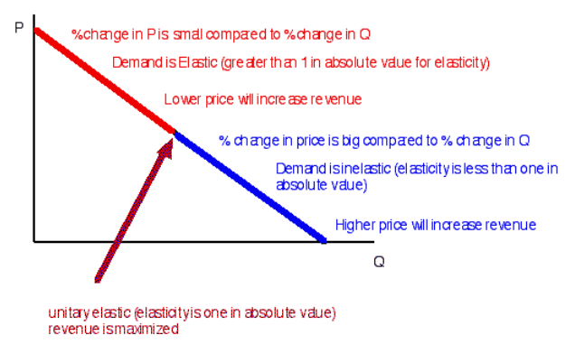
Demand Elasticity | Concept
https://www.pcecon.com/notes/elasticity.html

Slide 3
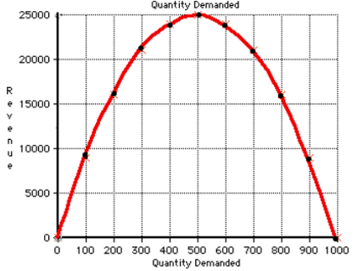






Revenue Optimization
Granular Demand
Curves
Maximize Revenue
Hypothetical Example: 3 Chains, 2 Products
Date | Price | Chain | Product | … | Quantity
Jan ’19 | 99.5 | A | 1 | … | 1.3
Jan ’19 | 45.0 | A | 2 | … | 1
Feb ’19 | 97.5 | A | 1 | … | 1.5
Feb ’19 | 95.0 | B | 1 | … | 0.5
Mar ‘19 | 96.0 | A | 1 | … | 1.6
Mar ‘19 | 93.0 | B | 1 | … | 2.3
Mar ‘19 | 47.5 | C | 2 | … | 5.4
Apr ‘19 | 96.5 | A | 2 | … | 1.6
Apr ’19 | 47.5 | B | 2 | … | 0.9
Apr ’19 | 92.5 | C | 1 | … | 2.5
… | … | … | … | … | …
$$Price_{max⁡_rev}$$
Granular Models
Chain | Product | Best Model
A | 1 | VAR
A | 2 | NN
B | 1 | LSTM
B | 2 | NN
C | 1 | ARIMA
C | 2 | Baseline
… | … | …
$$Price_{max⁡_rev}$$
$$Price_{max⁡_rev}$$
$$Price_{max⁡_rev}$$
$$Price_{max⁡_rev}$$
$$Price_{max⁡_rev}$$
Scale using AutoML to all Chains and Products!!!

