Slide 1
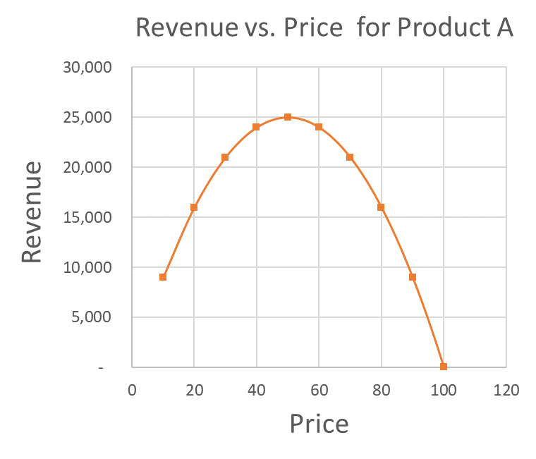
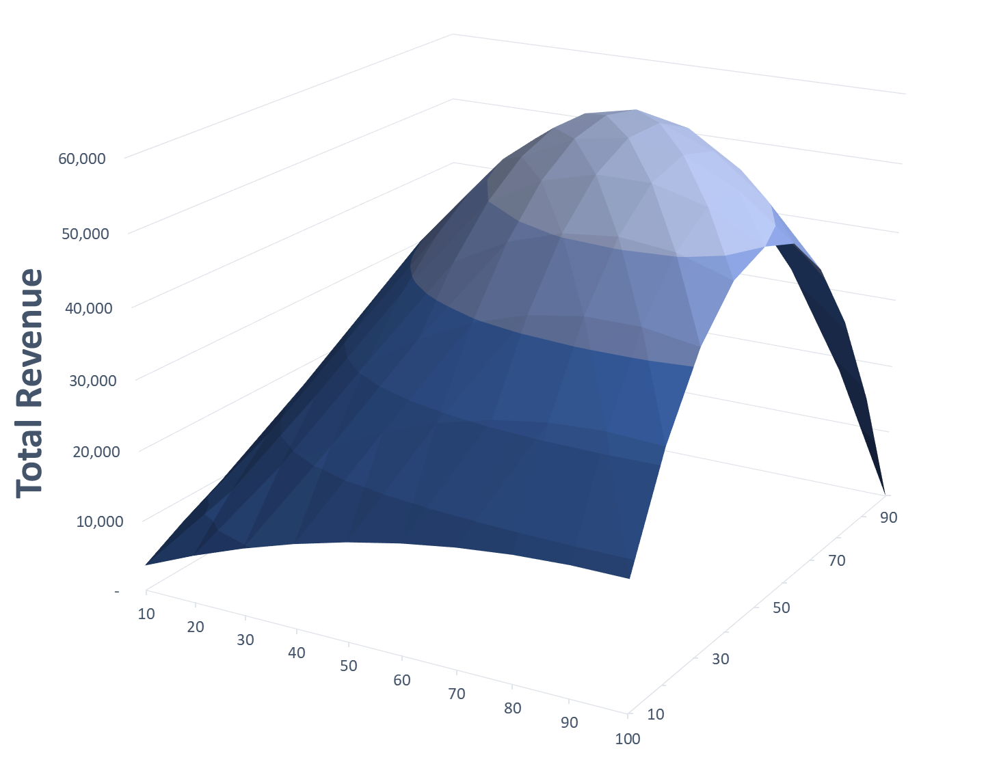




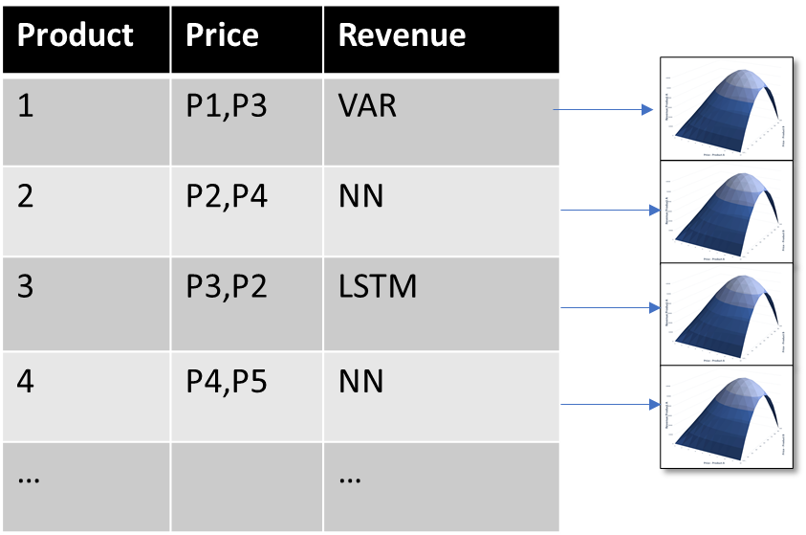


Multivariate Demand Elasticity | Concept
Global Price Optimization for Revenue Maximization at Scale
Multivariate Revenue Model
Cross Cannibalization
$50
Global Price Optimization | This Work
Revenue Forecast
Revenue
Price Optimizer
Our Contribution:
Modeling Cannibalization
High Dimensionality (4k products)
Limited/Sparse Data (max 84 obs/product)
$$Rev_{max} | P_{1}^{′}, P_{2}^{′}, P_{3}^{′}, …$$
Revenue is Maximized!

Slide 2
Uniqueness of this work
Models take into account Cross-Cannibalization
Needs to consider hundreds of similar products
Sparse Customer data need to be clustered appropriately

Slide 3
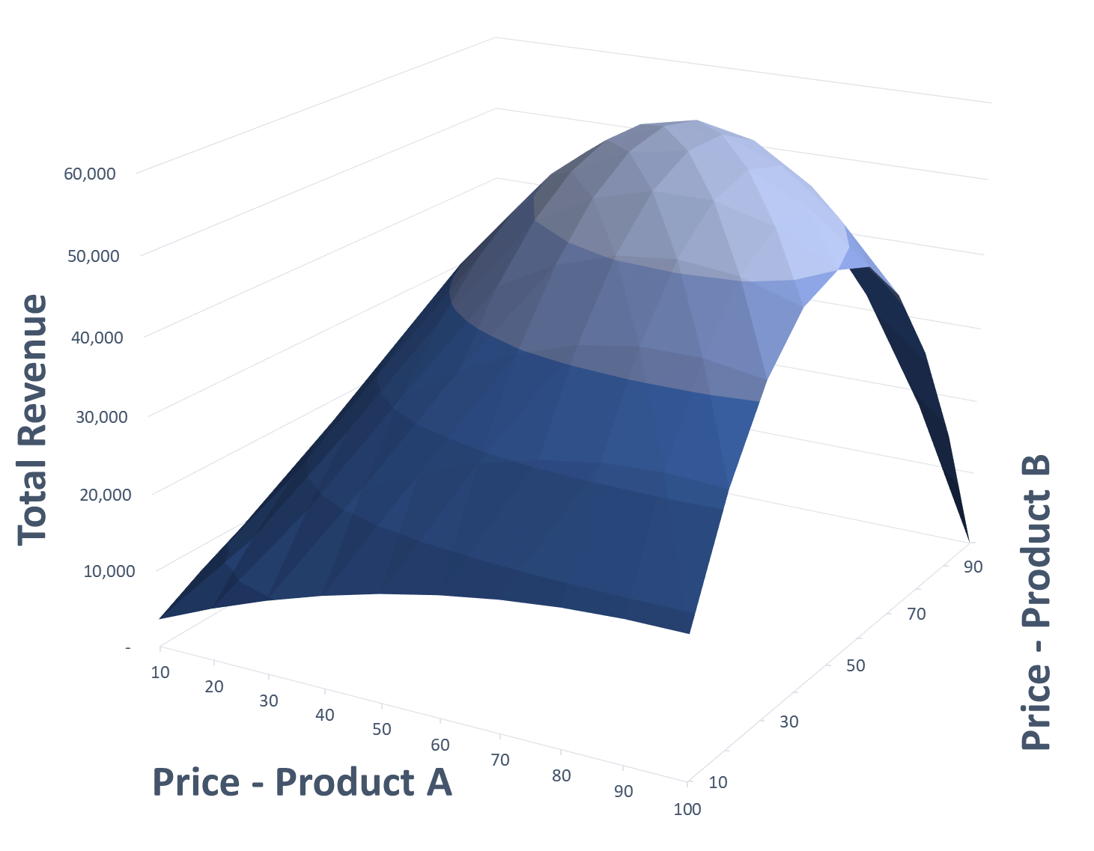
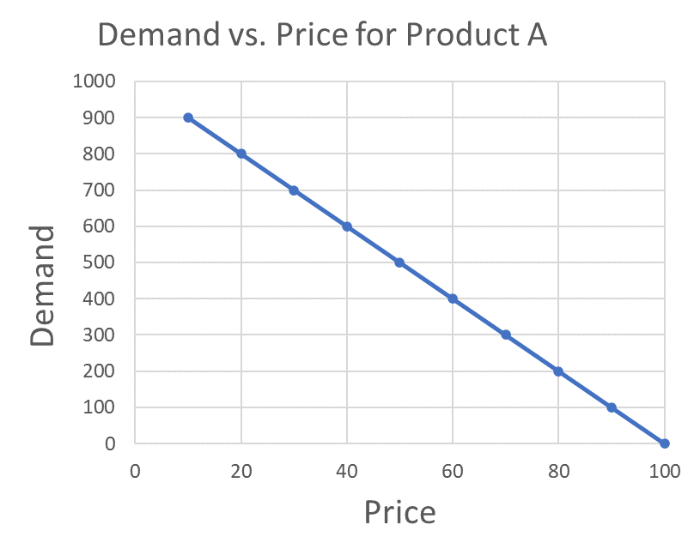

Multivariate Demand Elasticity | Concept
Price Optimization for Revenue Maximization at Scale
Cross Cannibalization
Multivariate Revenue Model
$50
Global Price Optimization | This Work
Demand Forecast
Revenue
Price Optimizer
Our Contribution:
Modeling Cannibalization
Across 100s of products
Handling sparse data
$$Rev_{max} | P_{1}^{′}, P_{2}^{′}, P_{3}^{′}, …$$
Notes:
Switch Q and Price… use Price insteof femand.. Color code
Different curves

Slide 4
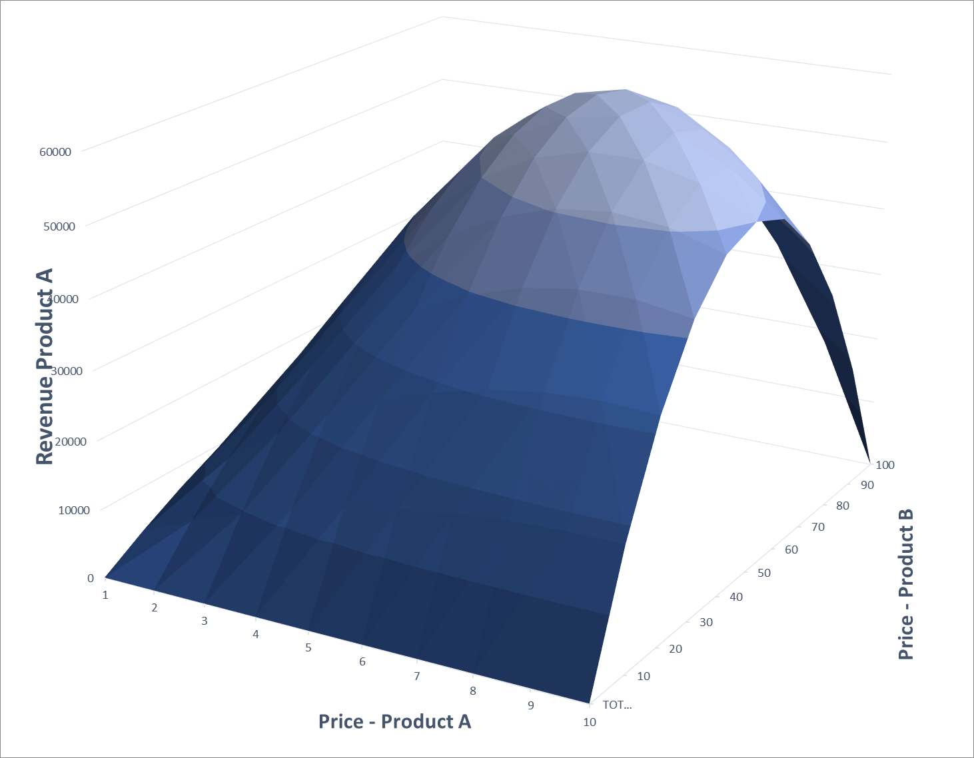
Revenue Optimization
Hypothetical Example: 3 Chains, 2 Products
Date | Price | Chain | Product | … | Quantity
Jan ’19 | 99.5 | A | 1 | … | 1.3
Jan ’19 | 45.0 | A | 2 | … | 1
Feb ’19 | 97.5 | A | 1 | … | 1.5
Feb ’19 | 95.0 | B | 1 | … | 0.5
Mar ‘19 | 96.0 | A | 1 | … | 1.6
Mar ‘19 | 93.0 | B | 1 | … | 2.3
Mar ‘19 | 47.5 | C | 2 | … | 5.4
Apr ‘19 | 96.5 | A | 2 | … | 1.6
Apr ’19 | 47.5 | B | 2 | … | 0.9
Apr ’19 | 92.5 | C | 1 | … | 2.5
… | … | … | … | … | …
Demand Modeling (Customer + Products + Price => Demand)
Product | Price | Revenue
1 | P1,P3 | VAR
2 | P2,P4 | NN
3 | P3,P2 | LSTM
4 | P4,P5 | NN
… |  | …
Scale using AutoML to all Chains and Products!!!

