Slide 1

ERP Dashboard
Value Proposition by Max Mueller

Slide 2
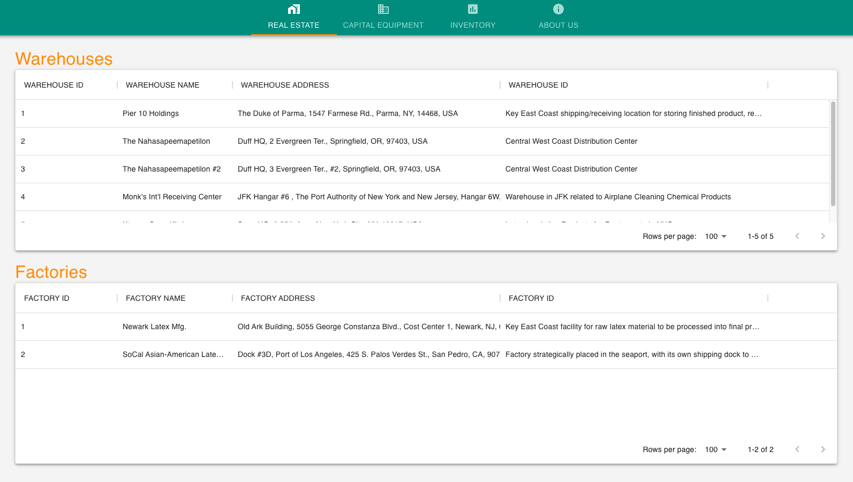
Easy to view, sort, and filter locations.
One convenient screen.
Integrated with Warehouses and Factories API Endpoints.
Extensible to different real estate asset types.

Slide 3
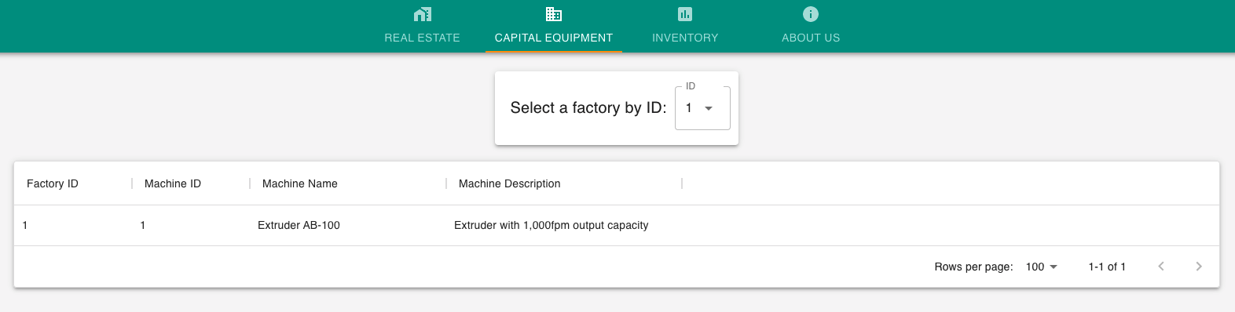
Updated Capital Equipment. Every time.
Quick access to each factory’s machines.
Sort, filter, hide/show columns.
Notes:
Good: machines are per factory, easy to identify, with a machine key and a factory key,
Bad: the route is dependent on factories. It can be made its own API.
Opportunities:
1) create a new machine API so that this module can be extracted and use independently from the real estate endpoint.
2) Have a status indicator of machine being “active”, “need service soon”, “needs repair”

Slide 4
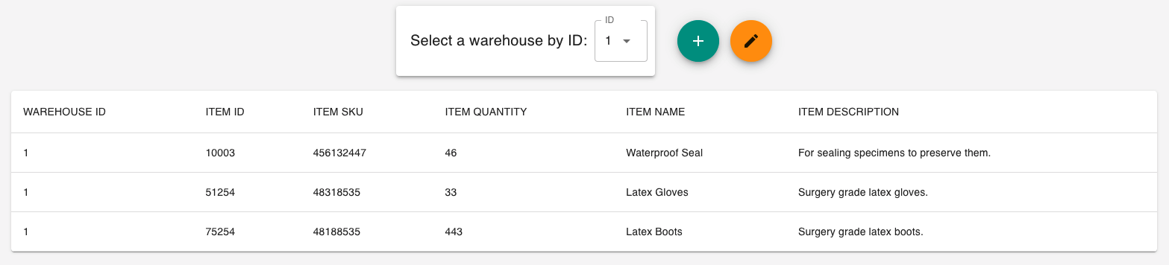
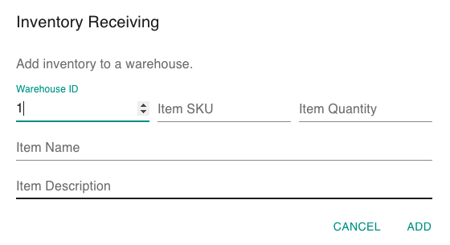
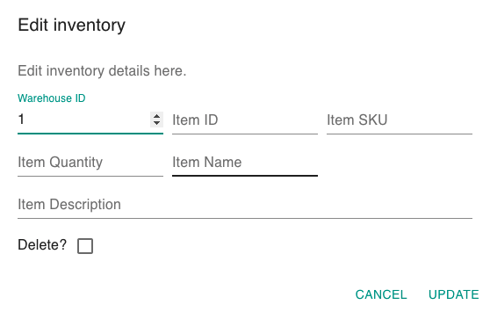
Inventory Management
Notes:
Good: proper InventoryItem model
Bad: unnecessary models for update, it should take an Inventory and a Warehouse
Opportunity:
Bulk update for warehouse: one warehouse receives x number items with their corresponding id’s and z quantity of each.
Inventory alerting system: ”delivered”, “low inventory” “reorder”
Inventory tracking

Slide 5
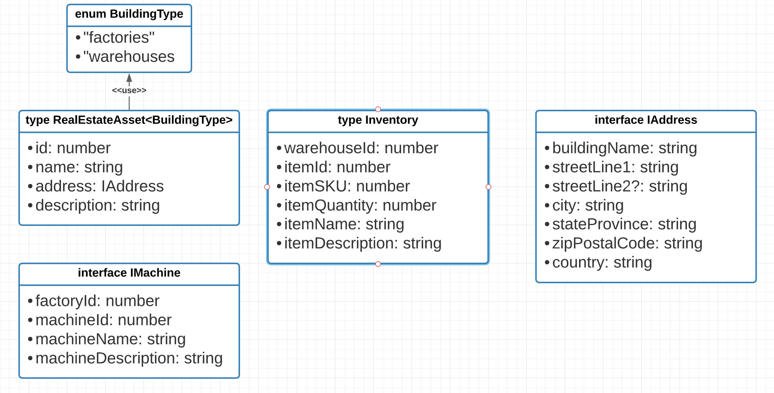
Models

Slide 6
Opportunities
New Machine API, with statuses per Machine.
Decouple inventory update model from warehouses, introduce some sort inventory tracking system.
Notes:
Introduction of data analysis, especially around machine servicing and inventory tracking.

