Slide 1
GA502 - Level Design 2
Level and environment design theory
Game development production cycle
Advanced UE4 usage:
  Blueprints & scripting
  Advanced material and shader networks
  Level optimization and performance
Introduction to Unity3d Development:
  Unity3d workflow & asset pipeline
  Unity3d C# scripting

Slide 2
Grading:
  Assignments: 70%
  Final Project: 30%
Final Project will be a portfolio quality interactive level which will showcase your skills the topics covered in this course.
All course materials will be available on github.
  https://github.com/maxmurder/GA502-LevelDesignII

Slide 3
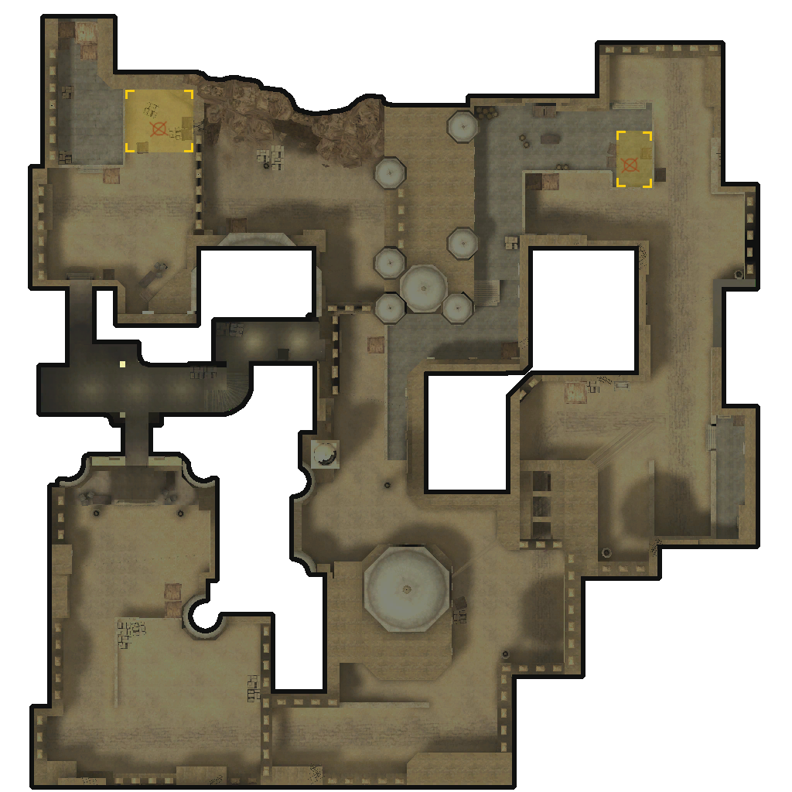
de_dust2

Slide 4
de_dust2
Context
  Counter Strike
    Competitive multiplayer
    “Realistic” first person shooter
    Source Engine
  Bomb Defusal
    Asymmetrical
    Objectives

Slide 5
de_dust2
Layout
  Considerations:
    Asymmetrical teams and objectives
    LOS, Grenades, penetration and other mechanics
Pacing
  Considerations:
    Rounds are 1m 55s
    Bomb fuse is 40s
    Player movement speed

Slide 6
de_dust2
Discussion
  Is it balanced?!

Slide 7
Unreal Development Resources
Read the #@%&’n manual!
  https://docs.unrealengine.com
  https://wiki.unrealengine.com/
    Extremely well documented and maintained
    Huge amount of resources freely available
While you’re at it, read the #@%&’n EULA!
  https://www.unrealengine.com/eula
    Epic takes 5% of revenue after $3000(USD)
    Video/Streaming content, and contracting work is exempt
    UE4 is open source!
      https://github.com/EpicGames/UnrealEngine

Slide 8
Open Source!
GNU Image Manipulation Program (GIMP)
  https://www.gimp.org/
Blender
  https://www.blender.org/
AwesomeBump
  http://awesomebump.besaba.com/
Inkscape
  https://inkscape.org/

