Slide 1
MDLdroidLite
A Release-and-Inhibit Control Approach to Resource-Efficient Deep Neural Networks on Mobile Devices
Yu Zhang
RMIT University, AU
Tao Gu
Macquarie University, AU
Xi Zhang
RMIT University, AU

Slide 2
Overview
Introduction
Problem, Motivation
Setup
Results
Discussion

Slide 3
What is this Paper about?
New approach?
Less redundant?
Less wasteful?
A Release-and-Inhibit Control Approach to Resource-Efficient Deep Neural Networks on Mobile Devices
Computationally less intensive?

Slide 4
Machine Learning, Directly on Mobile
Privacy!
Continual learning
Low-latency inference
BUT:
Resource constraints
Computational overhead

Slide 5
What are some common workarounds for these problems?
How do ML apps overcome the limitations of the mobile device? At what cost?

Slide 6



Workarounds
Pre-trained model deployment (one size fits all?)
Client-server process (latency)
Commonality:
No training on mobile (resource-intensive)
Potential latency issues
Accuracy > resource consideration

Slide 7
Motivation
Rapid development of wearable and mobile devices
Increased demand in Personal Mobile Sensing (PMS)
Activity recognition
Personal health monitoring
Sensitive Data
Scenario changes → Continual learning and adaptation
Real-time responses
Lack of publicly available sensory datasets, most private

Slide 8
Most important problem: Resources
On-device training: computationally too intensive
Pruning, only for pre-trained, over-parametrized models (inefficient)
Why?
Conventionally complex Deep Neural Network design
Millions of heavy parameters
Huge memory footprint
Large number of floating number operations (FLOPs)

Slide 9
What do the authors suggest as a solution to complex DNNs?
What does MDLdroidLite do differently?

Slide 10
Proposed Solution
Growth training
Avoid heavy redundancy
Currently very simple, inefficient, slow, with large redundancy between layers
Release-and-Inhibit Control (RIC)
Layer-level growth management
Layers grow independently and efficiently
→ Efficient on-device training and inference

Slide 11
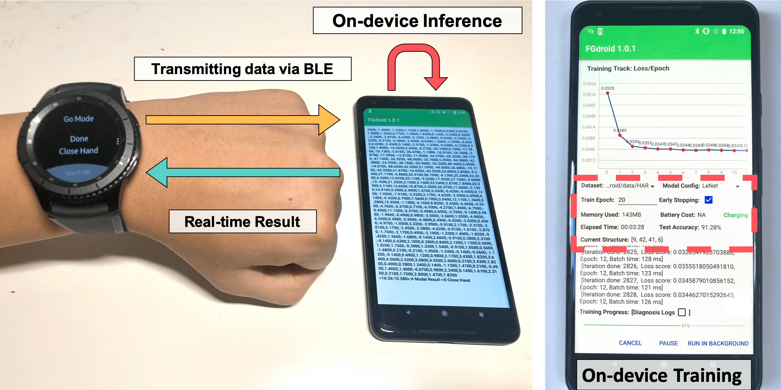
Implementation
2 Deep Learning Libraries, modified RIC source code
DL4J 1.0.0-SNAPSHOT
PyTorch 1.4.0
Application on 3 off-the-shelf Android smartphones
Hand gesture recognition using smartwatch
4 PMS datasets (daily health behavior, gestures)

Slide 12
Results
Increased training speed: 2.84× – 4.88×
Parameter reduction: 28× to 50×
FLOPs reduction: 4× to 10×

Slide 13
Discussion
Universal MDL resource control approach
From scratch
Continual
Resource efficiency with good accuracy
Insufficient training data?

