Slide 1
GPU-resident material evaluation for explicit dynamics:
a NEML2–MOOSE nodal-force interface
Authors — affiliation (INL / …)
WCCM 2026 · [session] · [date]
Notes:
SPINE = method/architecture-first: the NEML2–MOOSE explicit coupling is the contribution; the Taylor slug is the proof; verification vs MOOSE J2 is the credibility check. ~15 slides / 20 min. Audience: general comp-mech, MOOSE/NEML2-naive.

Slide 2
The capability gap
• MOOSE: mature implicit multiphysics — boundary conditions, contact, parallel domain decomposition
• Missing: GPU-accelerated explicit dynamics driven by modern (auto-differentiated, tensor) constitutive models
• High-rate events (impact, blast; advanced-reactor safety analysis) are bottlenecked by per-point material evaluation
• This talk: how we closed that gap — and kept MOOSE's infrastructure
Notes:
HOOK = capability-gap-first (chosen). Add ONE sentence of broader stakes (why a non-MOOSE attendee should care) so it doesn't under-motivate. Reactors are the high-consequence application, not the whole pitch.

Slide 3
MOOSE — multiphysics finite-element framework
• Open-source FE framework for coupled multiphysics (INL)
• Robust infrastructure: boundary conditions, contact, parallel domain decomposition, adaptivity
• Strong implicit-solver heritage (Newton + PETSc)
• Extensible: physics added as modular C++ objects
Notes:
Audience is MOOSE-naive — keep to ~1 min. Just enough that 'we extended MOOSE' lands.

Slide 4
NEML2 — tensor constitutive-model library
• Constitutive models composed from small reusable operators
• Automatic differentiation → exact consistent Jacobians
• libTorch (PyTorch C++) backend → device-independent: CPU / CUDA / MPS
• Batched evaluation: all material points as one tensor operation
Notes:
The 'GPU-capable, batched, AD' points set up the whole method. Device-independence is real in code (torch::Device plumbing).

Slide 5
Why explicit dynamics
• High-rate regime: impact, wave propagation, short timescales
• No global linear/nonlinear solve — march node-by-node
• Conditionally stable: timestep bounded by CFL (Δt ≤ Δt_crit)
• Lumped (diagonal) mass → trivial M⁻¹; cost shifts to the constitutive update
• ⇒ making the material model fast/cheap is the whole game
Notes:
This frames the contribution: in explicit dynamics the per-element constitutive evaluation dominates, so GPU-resident batched evaluation is the lever.

Slide 6
Contribution — two pillars
• ExplicitMixedOrder: a mixed-order explicit time integrator (our work, MOOSE solid_mechanics)
• NEML2 nodal-force path: internal forces assembled inside NEML2
– NEML2StressDivergence + NEML2 userobjects (interpolation / assembly)
– constitutive state kept resident in NEML2 between steps
• Built on MOOSE's existing BC / contact / parallel-DD infrastructure
Notes:
ATTRIBUTION (verified): ExplicitMixedOrder authored by us (2025-04, now upstreamed); NEML2 force path by the team (2025-06). BOTH built for this project. Name it 'ExplicitMixedOrder', NOT 'central difference' — the generic CentralDifference predates us and a MOOSE-literate questioner knows it. This is a MOOSE+NEML2 talk; do NOT introduce Marlin (it's just the dev sandbox).

Slide 7
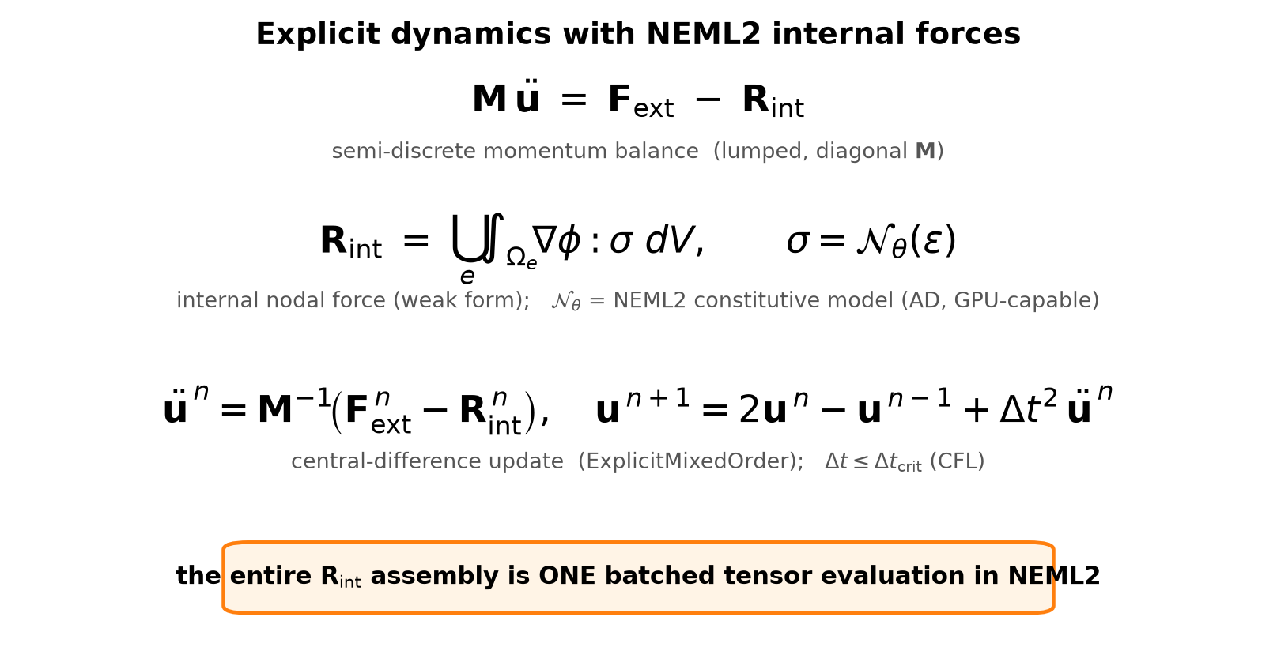
Formulation
Notes:
Core figure framing = weak-form equation-first (chosen). The gold box is the punchline: R_int assembly is ONE batched NEML2 tensor op.

Slide 8
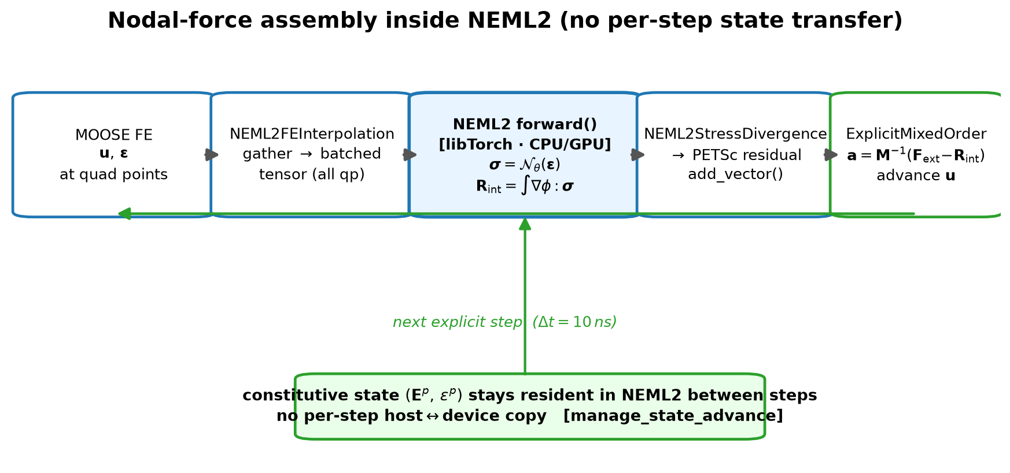
Nodal forces assembled inside NEML2
Notes:
The actual novelty: NEML2StressDivergence::forward() builds base_sum(dphi*stress)+inertia in libTorch under torch::InferenceMode and add_vector()'s straight into the PETSc residual. Code: moose/modules/solid_mechanics/src/neml2/NEML2StressDivergence.C:57-88.

Slide 9
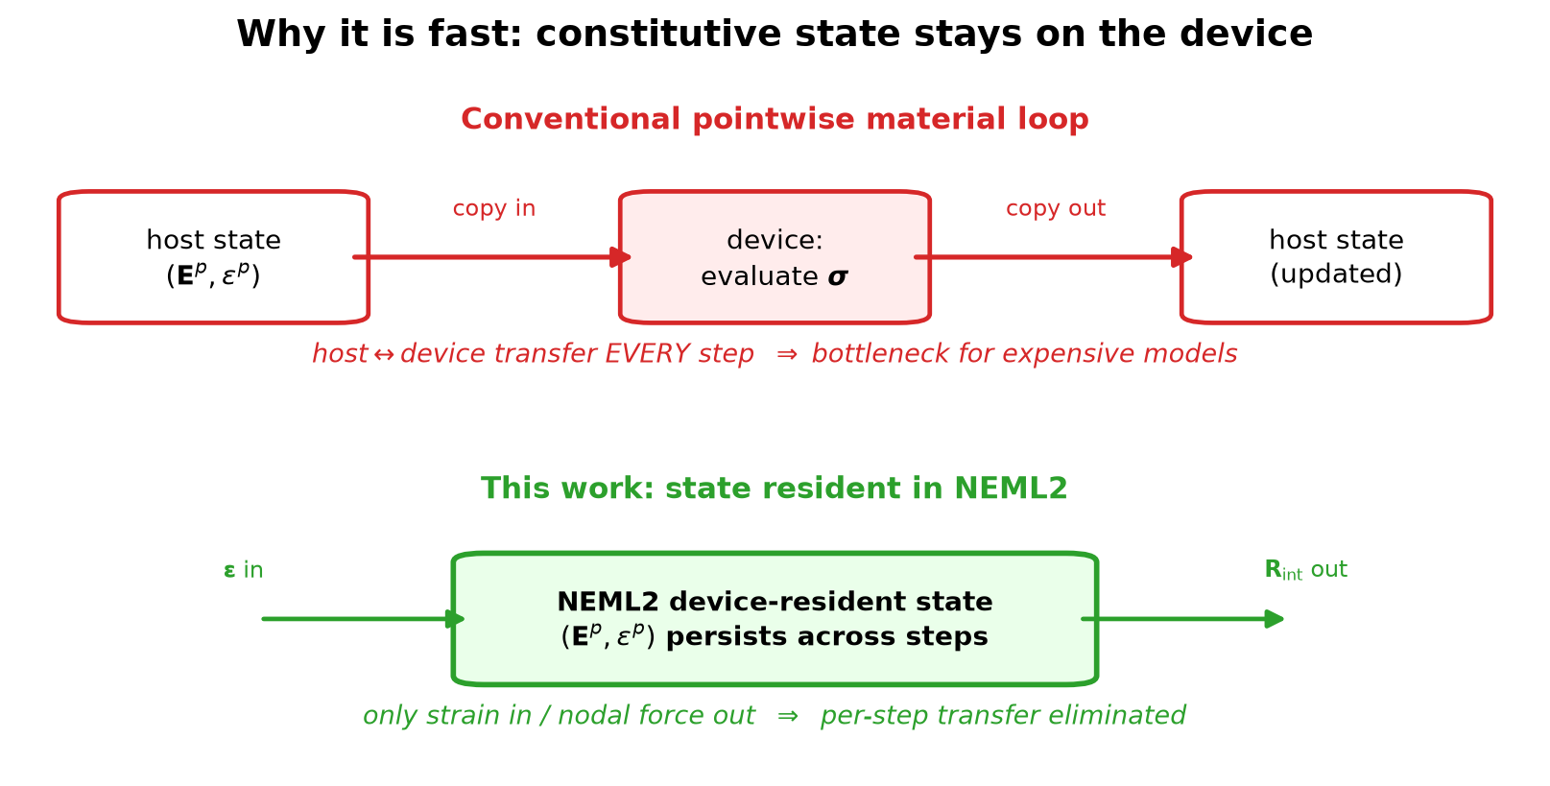
No per-step state transfer
Notes:
manage_state_advance=true keeps (Ep, ep) resident in NEML2. This is the efficiency lever and the cleanest part of the 'why fast' argument. Keep the precise object graph as a backup slide for Q&A.

Slide 10
Performance: material-evaluation throughput
• Frame around throughput: material-point evaluations / second on the device
• Where does the bottleneck move once material eval is GPU-resident?
• Roofline view: batched constitutive kernel vs memory traffic
[ insert throughput / roofline plot ] ⚠ NEEDS a real GPU run + elements/s instrumentation
Notes:
⚠ ACTION ITEM (heaviest open): every impact run is compute_devices='cpu' today — no GPU run, no timing exists. Perf framing chosen = roofline/throughput (not a single speedup bar). Must measure before the talk. If data doesn't materialize, fall back to a qualitative architecture argument and label perf as in-progress.

Slide 11
3D Taylor anvil impact — setup
• OFHC copper slug: Ø 0.3 in × 1.5 in, flat-on impact at 235.9 m/s
• ExplicitMixedOrder integrator + NEML2 Johnson-Cook (inverted form), Δt = 10 ns
• JC params: A=99.7 MPa, B=262.8 MPa, n=0.23, C=0.029, m=0.98
• Rigid wall: penalty Neumann BC (architecture compatible with MOOSE contact — future)
Notes:
CONTACT (decision): forward 'compatible with MOOSE contact' claim only — NOT demonstrated. The anvil is a penalty FunctionNeumannBC, CONTACT module is off. Backup answer for 'show me': the NEML2 force path plugs into MOOSE's contact system unchanged; contact demo is future work.

Slide 12
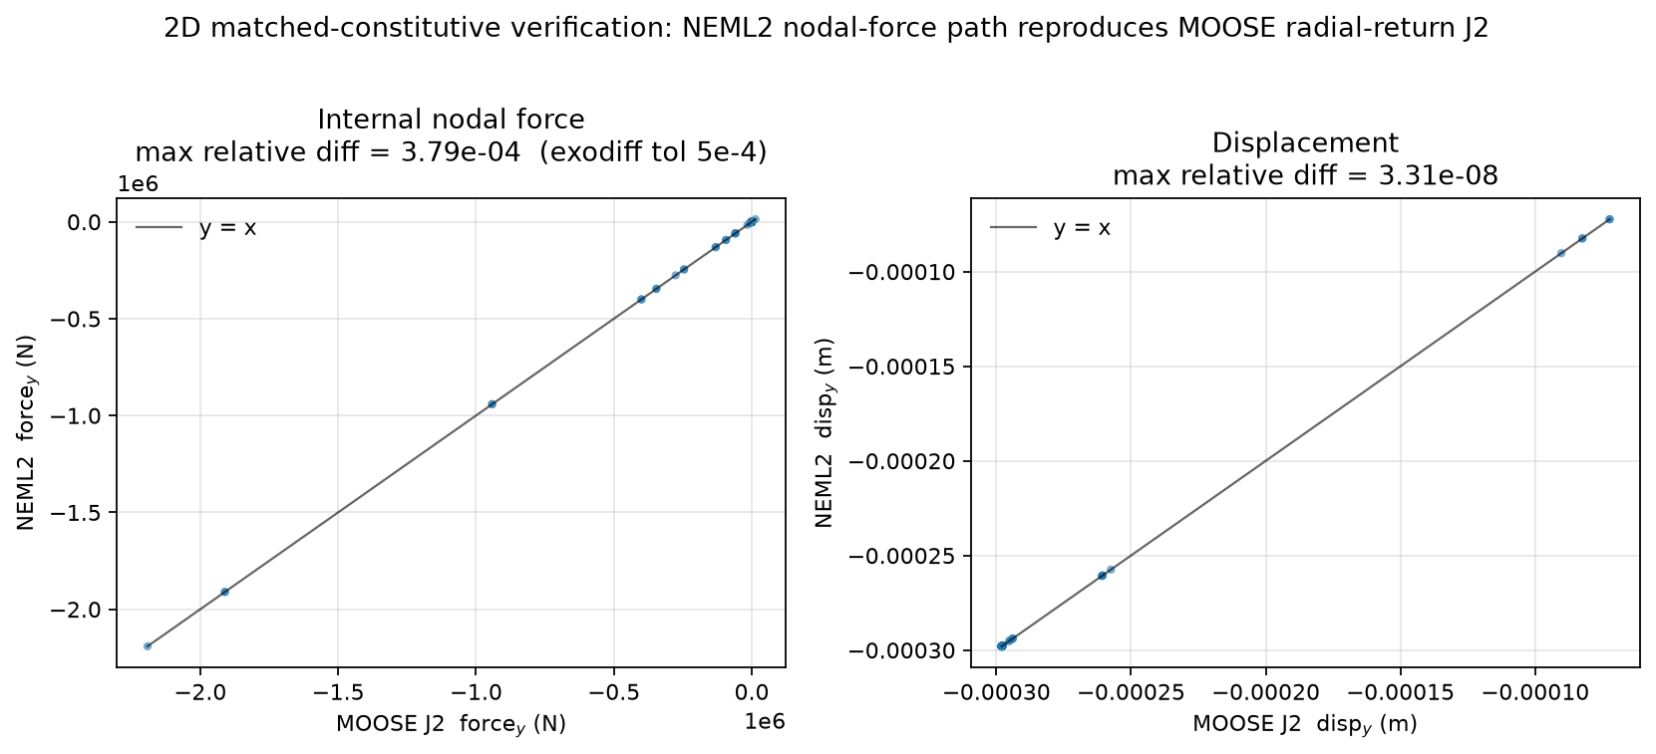
Verification vs MOOSE native J2
• Matched constitutive (NEML2 vs MOOSE radial-return J2) — isolates the force-assembly implementation
• Forces agree to 3.8×10⁻⁴; displacement to 3×10⁻⁸. 3D dynamic-history companion also available.
Notes:
WORDING FIX (decision): say 'verified against MOOSE's native J2 stress update' — NOT 'vs implicit'. The committed comparison is explicit-vs-explicit. Figure generated from test/tests/impact gold vs NEML2 output. The 3D companion (verification.png) mixes J2-vs-JC models, so label it as model-to-model, peak L2 ~3.6%.

Slide 13
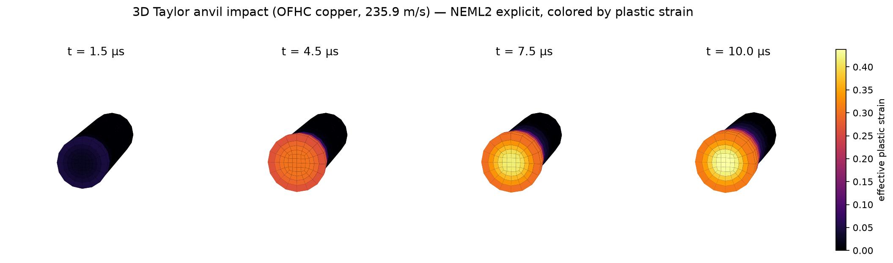
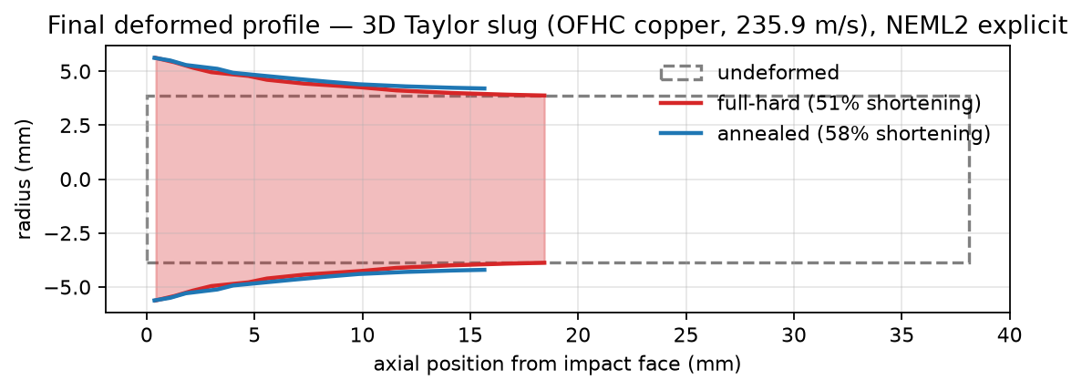
3D Taylor impact — results
• Plastic strain localizes at the impact foot (peak ≈ 0.44) as the mushroom forms
• Deformed profile: full-hard 51% vs annealed 58% axial shortening (temper sensitivity captured)
Notes:
Demo visual (decision) = static field snapshots. Validation vs experimental STL scans is INTENTIONALLY OUT (sim under-predicts mushroom flare ~36%; would be a liability). Present as a capability demo, not a validation claim.

Slide 14
Coupled thermomechanical: temperature from plastic work
• Adiabatic Taylor-Quinney heating: ρc_p Ṫ = β σ_vm ε̇_p (β ≈ 0.9)
• Integrated inside NEML2 — no heat-conduction PDE, no extra module
• Justified: diffusion length √(αt) ≈ 0.11 mm ≪ element size (~2 mm) over 120 µs
• Expected peak ΔT ≈ 40–50 K at the mushroom (≈3–4% flow-stress softening)
[ insert temperature-field snapshot ] ⚠ NEEDS the coupled run — see johnson_cook_neml2_thermal.i + THERMOMECHANICAL_SCOPING.md
Notes:
⚠ ACTION ITEM: generate the coupled run (draft input + scoping doc are in slide_assets/). One runtime risk: initialize old_state/T to 300 K. Slide WORDING: 'adiabatic temperature rise from plastic work (Taylor-Quinney)'. Don't oversell — ~40 K is real but secondary at this velocity.

Slide 15
Conclusions & future work
• Contribution: ExplicitMixedOrder integrator + NEML2 nodal-force path
• GPU-resident, batched material evaluation; constitutive state stays in NEML2 (no per-step transfer)
• Verified against MOOSE native J2 (forces to 1e-4); 3D Taylor impact demonstrated
• Future work:
– GPU throughput at scale
– integration with MOOSE contact
– Bayesian calibration / UQ of constitutive parameters
– experimental validation
Notes:
Recap the two pillars + the efficiency lever. Future-work bullets absorb the items cut from this talk (UQ/Bayesian, validation, contact) so the abstract's full scope is acknowledged as roadmap.

