Slide 1
WCCM 2026
Author Name & Co-authors
Idaho National Laboratory
Accelerated Explicit Dynamics Simulations of Impact Problems Using GPU-Enabled Material Models in MOOSE
A NEML2 nodal-force interface for high-rate solid mechanics

Slide 2
Advanced reactors bring dynamic-loading questions
2 / 22
TIMESCALES OF AN IMPACT EVENT
Transportable microreactors, pebble-bed cores, accident scenarios: components must be qualified under impact and other high-rate loads
These events are wave-dominated and fast. Stress waves traverse the part in microseconds, with severe, localized plasticity
Predictive fidelity requires modern constitutive models. Rate- and temperature-dependent, with evolving internal state
Simulating them means explicit time integration with a material-model evaluation at every quadrature point, every step
event duration
~100 µs
wave transit through part
~1–10 µs
stable explicit step
~10 ns
⇒ steps to simulate
10⁴–10⁵
Many steps × expensive material updates: high-rate simulation is compute-hungry in a very particular way.

Slide 3
Two mature ecosystems and a gap between them
3 / 22
MULTIPHYSICS FE FRAMEWORKS (MOOSE)
MODERN MATERIAL LIBRARIES (NEML2)
Boundary conditions, contact, parallel domain decomposition
Coupled-physics machinery, in-situ output, meshing, restart
But: materials evaluated point-by-point on CPU inside the element loop
?
Composable constitutive models with automatic differentiation
Batched tensor evaluation on GPU or CPU (libTorch backend)
But: no mesh, no boundary conditions, no solver. Not a simulation code
per-point calls,
per-step copies
This talk: an interface where NEML2 assembles the nodal internal forces itself, batched and device-resident, while MOOSE keeps doing everything else.

Slide 4
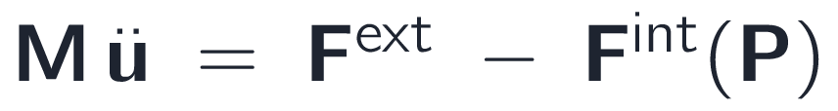
Governing equations of explicit solid dynamics
4 / 22
balance of linear momentum on the reference domain
total-Lagrangian weak form. Every integral is on the reference configuration
discretize in space: semi-discrete momentum equation
internal force from the first Piola–Kirchhoff stress at each quadrature point
Reference-domain integrals: shape functions, weights, and dof maps never change during the run. All material physics enters through the stress P at the quadrature points.

Slide 5

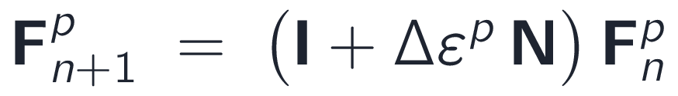
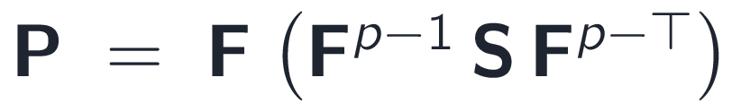
The material model I: finite-strain kinematics
5 / 22
multiplicative split: Fᵖ carries the crush, elastic strain stays small
trial state: plastic flow frozen at the old Fᵖ
radial return on the trial elastic strain, one scalar unknown
linearized exponential-map plastic update
pull-back to the reference configuration, giving the PK1 stress of the weak form

Slide 6
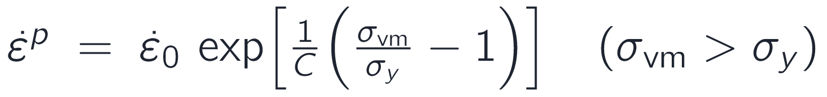
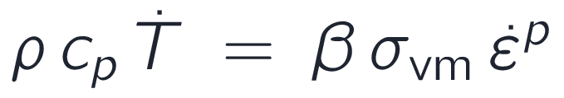
The material model II: Johnson–Cook flow and adiabatic heating
6 / 22
OFHC COPPER (CuH04 SHOT)
E, ν
117 GPa, 0.34
flow stress: strain hardening × thermal softening; prior cold work ε₀ᵖ sets the temper
ρ, cₚ
8960 kg/m³, 385 J/kg·K
β, m
0.9, 0.98
A
104 MPa
rate form (inverted Johnson–Cook): smooth viscoplastic overstress law
B
329 MPa
n
0.43
C
0.025
adiabatic Taylor–Quinney heating, integrated inside the model (β = 0.9)
ε₀ᵖ
0.12 (H04 temper)
green = Bayesian-calibrated against two recovered specimens (later in this talk)
Internal state (εᵖ, Fᵖ, T) advances inside the model every step.

Slide 7
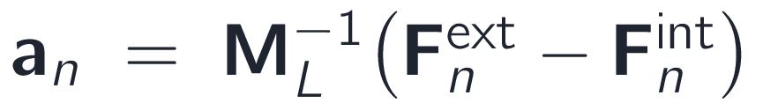
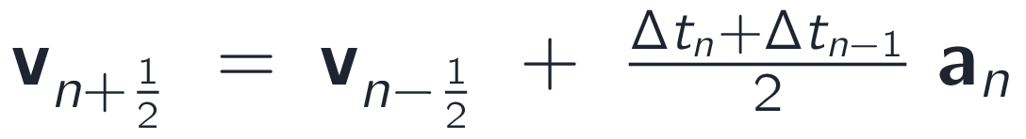
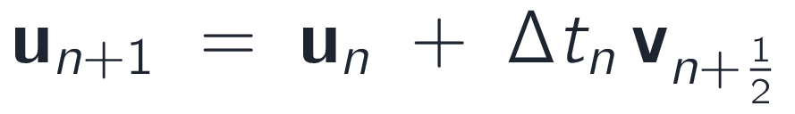
Explicit time integration: ExplicitMixedOrder
7 / 22
Central difference, as implemented in our ExplicitMixedOrder MOOSE integrator
MIXED ORDER
pointwise divide, no solver
Displacements: central difference
First-order fields (temperature): forward Euler on the rate
variable-Δt midpoint velocity update
Both advance in the same update loop.
displacement update
No Newton iterations, no global linear solve, no Jacobian. Each step is one residual evaluation plus vector updates.
Developed for this work and upstreamed: part of MOOSE solid mechanics today.

Slide 8
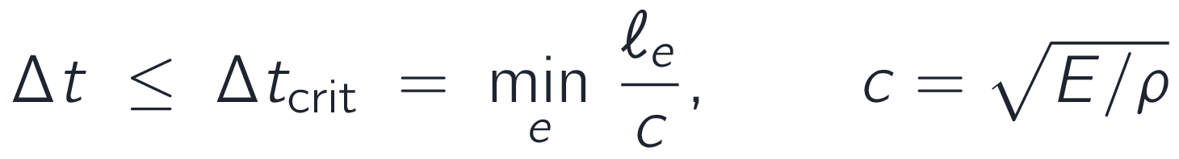
Stability sets the step; the material sets the cost
8 / 22
Conditional stability (CFL): the step must resolve the fastest stress wave
ANATOMY OF ONE EXPLICIT STEP
element length over elastic wave speed
constitutive update dominant
Millimeter elements: Δt ≈ 10 ns ⇒ 10⁴–10⁵ steps for a 100 µs event
Each step needs no solve. The runtime is the residual, and the residual is the constitutive update at every quadrature point
Advanced models (rate/temperature-dependent plasticity, internal state) make each of those updates expensive
force assembly + scatter
time advance, BCs, output
schematic; plasticity dominates the step cost
Explicit runtime ≈ steps × material-update cost.

Slide 9
MOOSE: the multiphysics host
9 / 22
Open-source multiphysics FE framework (Idaho National Laboratory). We keep all of this for free
Boundary conditions
Contact
Parallel execution
full BC library, incl. the penalty and pressure BCs used in this work
mortar and node-face algorithms, architecture-compatible with this interface
MPI domain decomposition, scalable assembly and solves
Coupled physics
Meshing & output
Ecosystem
heat conduction, neutronics, porous flow, ... in one input file
mesh generators, adaptivity, in-situ Exodus/CSV output
NQA-1 quality assurance; large application family (BISON, Grizzly, ...)
Everything in a high-rate simulation that is not the material update already exists here, parallel and production-tested.

Slide 10
NEML2: the material engine
10 / 22
New Engineering Material model Library v2 (ANL, open source). Constitutive models as composable tensor programs
A MODEL = SMALL OPERATORS, COMPOSED
ONE CALL, ALL POINTS
elasticity
flow rule
hardening
rate
sensitivity
state
update
declared in an input file; exact derivatives by automatic differentiation
σ = model(ε, state) over the whole batch
Batched: all quadrature points evaluated in one batched call
Device-portable: libTorch (PyTorch C++) backend runs the same model on CPU or GPU
NEML2 library benchmark: 42,500 s (NEML, CPU) → 68 s on one GPU
GPUs want exactly this shape of work: wide, uniform, no per-point branching
NEML2 evaluates material models as batched tensor programs. It has no mesh, boundary conditions, or assembly. MOOSE does.

Slide 11
What we built: two pillars, one force path
11 / 22
1
ExplicitMixedOrder integrator
2
NEML2 nodal-force interface
Explicit central-difference integrator with mixed-order multiphysics (2nd-order mechanics + 1st-order fields)
Lumped mass via matrix tag. Zero linear iterations per step
Variable step size (Abaqus-style midpoint velocity averaging)
Upstreamed to MOOSE solid_mechanics
NEML2 computes internal nodal forces itself, not just stress, for the whole mesh in batched tensor ops
Constitutive state lives on the device and advances in place between steps
Plugs into the explicit solve as a residual contribution. MOOSE BCs, outputs, and MPI are unchanged
Foundation, unchanged: MOOSE boundary conditions · parallel domain decomposition · meshing & output · contact (architecture-compatible)
All of it is open source in the MOOSE framework and solid-mechanics module; the NEML2 force path is verified against conventional MOOSE on CPU and CUDA.

Slide 12
One explicit step through the NEML2 force path
12 / 22
DEVICE (libTorch) · same code on CPU / CUDA
MOOSE
solution vector
(PETSc)
one upload / step
NEML2FE
Interpolation
gather u, ∇u at
all quad points
NEML2Def
Gradient
F = I + ∂u/∂X
whole batch
NEML2Model
Executor
P = model(F, state)
one batched call
NEML2Stress
Divergence
Rᵉ = Σ ∇φ·P JxW
all elements at once
residual →
ExplicitMixed
Order
advance u
one download / step
built once, cached on device: shape functions φ, ∇φ, DOF maps, weights JxW. Rebuilt only on mesh change
next explicit step (Δt ≈ 10 ns)
The interior force computation never touches an element loop: a short sequence of batched tensor ops.

Slide 13
Constitutive state never leaves the device
13 / 22
CONVENTIONAL COUPLING · state round-trips through MOOSE every step
HOST
state in MOOSE material properties
age state: old ← current
state copied down and back up every step. Traffic scales with model complexity
DEVICE
batched stress + state update
THIS WORK · state advances in place on the device (manage_state_advance)
HOST
solution u
nodal forces F
per step: one solution upload, one force download. Independent of model complexity
DEVICE
state (Eᵖ, εᵖ, T, ...) advances in place
State stays where it is computed. Transfer volume does not grow with model complexity.

Slide 14
Speed against an implicit twin
14 / 22
The same impact problem, about one million degrees of freedom, run for the same number of steps at the same timestep.
IMPLICIT TWIN
EXPLICIT PATH
Newmark-beta with the exact NEML2 tangent
Full integration with F-bar
MUMPS direct solve on 32 MPI ranks
Central difference, batched NEML2 force assembly
Reduced integration with hourglass control
One CPU core and one GPU
45×
faster with the explicit path on one CPU core and one GPU than the implicit twin on 32 CPU cores
hardware: Intel Xeon Platinum 8592+ CPU cores, NVIDIA L4 GPU
Each implicit step pays Newton iterations, a global Jacobian, and a distributed direct solve. The explicit step is one batched residual.

Slide 15
The method, in one slide
15 / 22
1
Explicit runtime ≈ steps × material-update cost
CFL fixes the step count; the constitutive update is the only lever
2
ExplicitMixedOrder advances mechanics + first-order fields, no solver
lumped mass, zero linear iterations; upstreamed to MOOSE
3
NEML2 assembles the internal nodal forces on the device
batched over all elements; state advances in place; one upload + one download per step
4
MOOSE keeps BCs, parallelism, outputs unchanged
and the path is verified to match conventional MOOSE assembly (CPU and CUDA test suite)
Up next: the experiment · Taylor impact simulation · calibration against the scanned specimen

Slide 16
The experiment
16 / 22
Specimen
OFHC copper slug, Ø 7.62 mm × 38.1 mm, H04 full-hard temper
Shot
▶
235.9 m/s impact against a rigid anvil
high-speed video placeholder
Recovered geometry
laser-scanned to a 46k-triangle surface mesh
Role in this talk
the scan is the calibration and validation target
impact and rebound of shot CuH04, high-speed camera

Slide 17
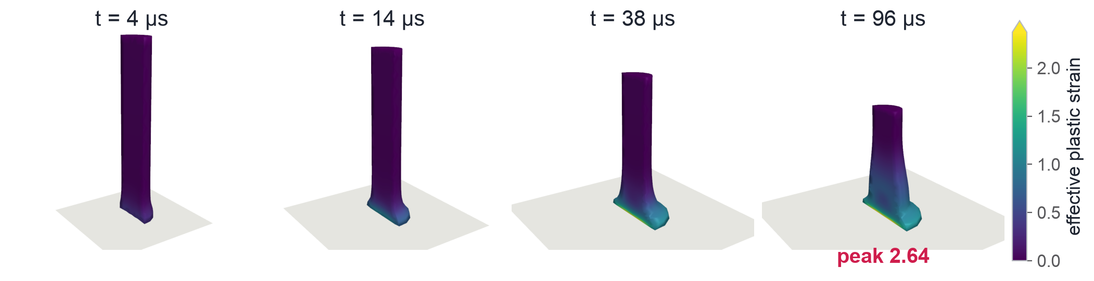
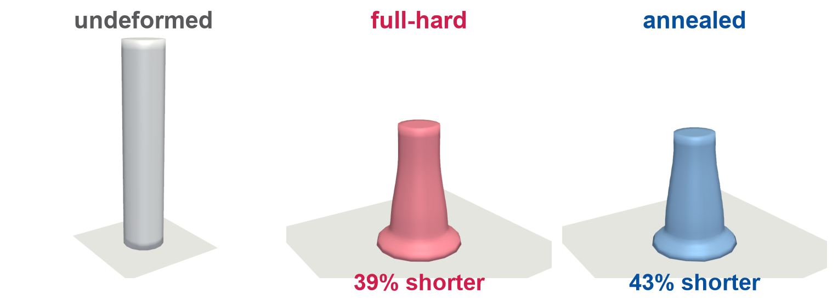
Taylor anvil impact, end to end
17 / 22
OFHC copper slug at 235.9 m/s · calibrated multiplicative Johnson–Cook · reduced integration · Δt = 10 ns · 9,600+ explicit steps
cutaway views (near half removed). Plastic strain localizes at the impact foot. The gray plane is the rigid anvil
Same mesh, BCs, integrator. The temper is swapped by one NEML2 parameter: the prior cold work (initial plastic strain)
Full-hard 39% vs annealed 43% axial shortening

Slide 18
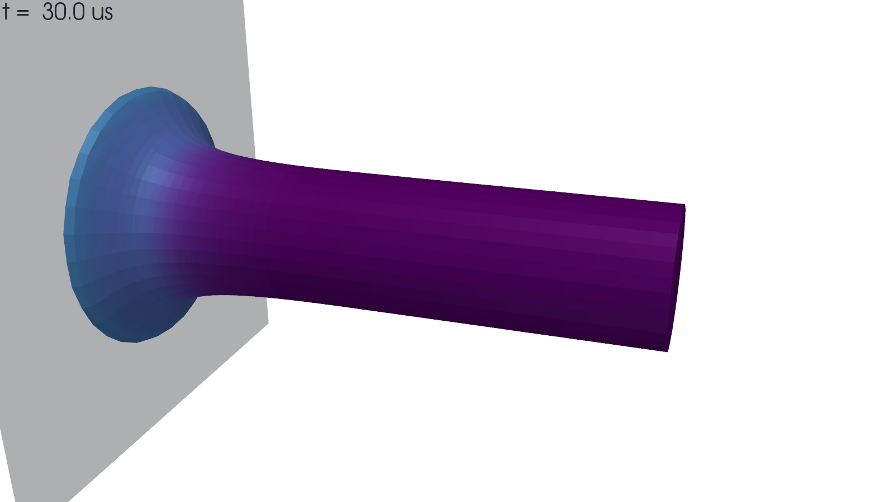
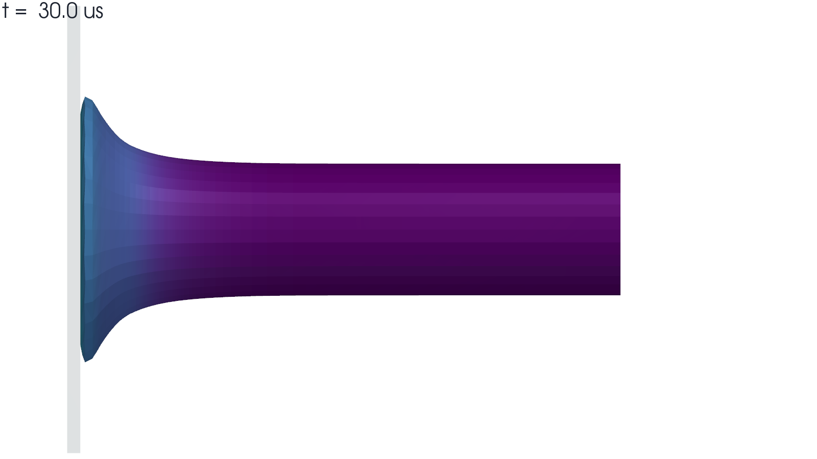
The simulated impact
18 / 22
perspective view
side profile, the high-speed camera framing
Calibrated model, run to rebound at 96.7 µs. Color is effective plastic strain.

Slide 19
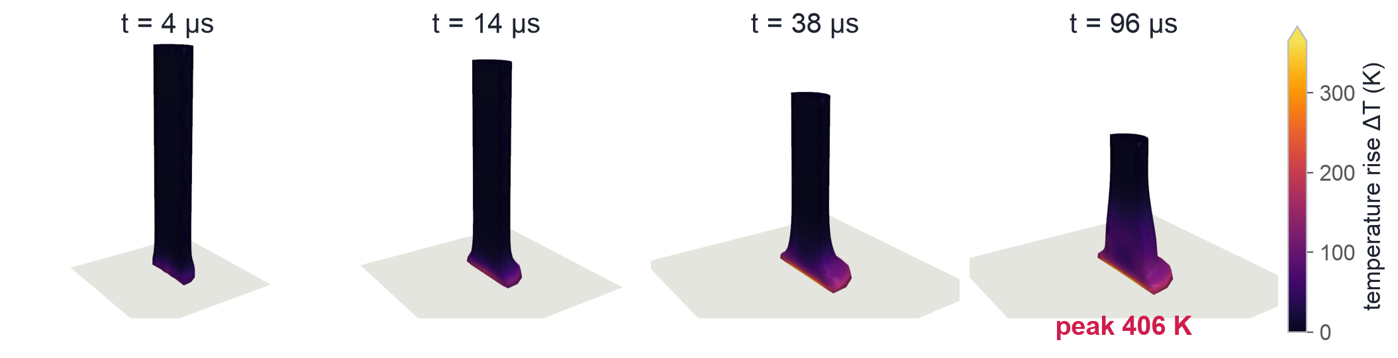
Coupled thermo-mechanics: heating from plastic work
19 / 22
The run you just saw is coupled. Temperature is integrated inside the NEML2 model (adiabatic Taylor–Quinney heating, β = 0.9)
temperature rise above 300 K, cutaway views. Run to rebound at 96 µs with >99% of the impact kinetic energy dissipated
Feeds back into the flow stress
Adiabatic by physics, not assumption
Three extra NEML2 model blocks
the hot foot softens (Johnson–Cook Θ = 1 − T*ᵐ) and flows more easily
diffusion length √(αt) ≈ 0.1 mm ≪ element size over the ~100 µs run. No heat-conduction PDE needed
no new MOOSE modules, no new transfers. Temperature state lives on the device like everything else

Slide 20
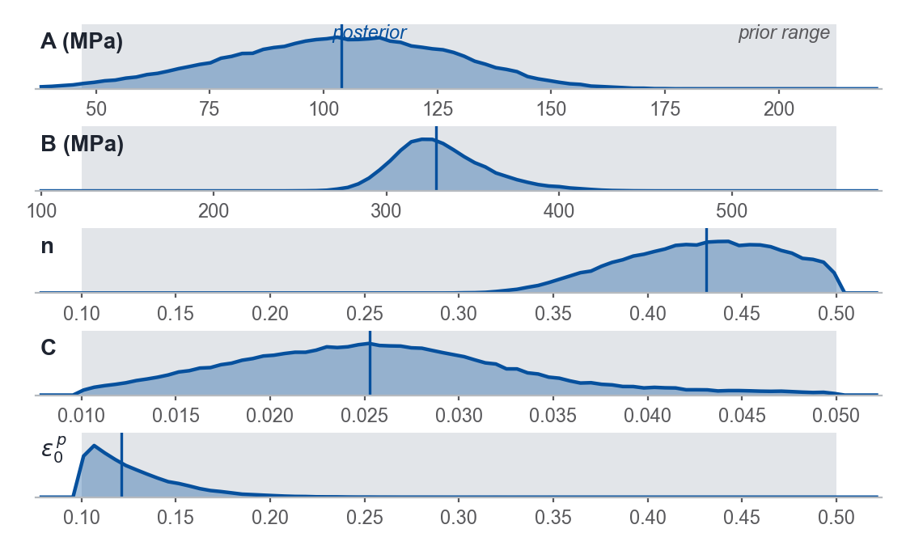
Bayesian calibration of the material parameters
20 / 22
Unknowns: θ = (A, B, n, C, ε₀ᵖ) plus a model-discrepancy scale σ_{d}. Two shots, 235.9 and 132.3 m/s, are fit jointly. The forward model in the loop is the production simulation itself.
Priors
96-run Sobol design per shot
Gaussian-process emulator
MCMC posterior
A, B lognormal, ×/÷ 2 at 90% around literature values. n ∈ [0.1, 0.5], C ∈ [0.01, 0.05], ε₀ᵖ ∈ [0.1, 0.5] uniform. Discrepancy half-normal (0.15 mm).
one production simulation per point and velocity (~21 min each)
PCA of the outer profile, one GP per mode. Cross-validated to 0.03 mm.
emcee over parameters and discrepancy. The posterior median is re-run through the true model.
posterior over parameters and discrepancy
Gaussian over ~40 profile stations, final length, and foot radius, per shot

Slide 21
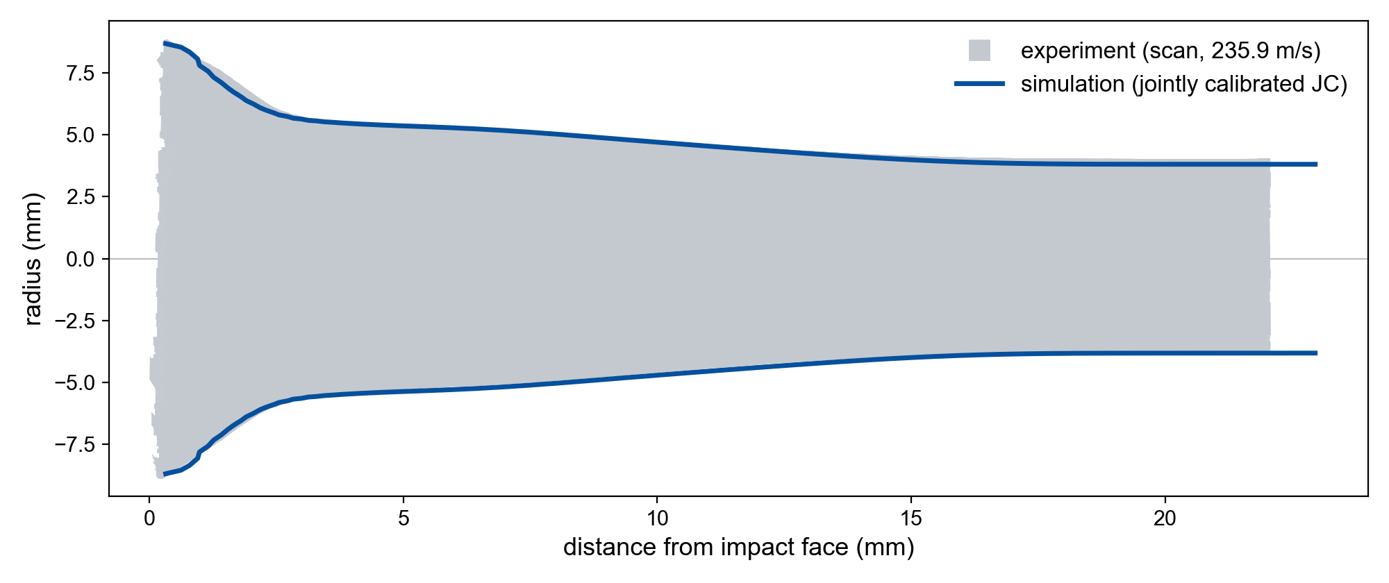
Validation: the first shot
21 / 22
The jointly calibrated model at the first shot velocity of 235.9 m/s.
77 µm profile RMS
final length 22.96 mm vs 22.41 ± 0.44 scanned
final deformed profile, production model at the calibrated posterior median

Slide 22
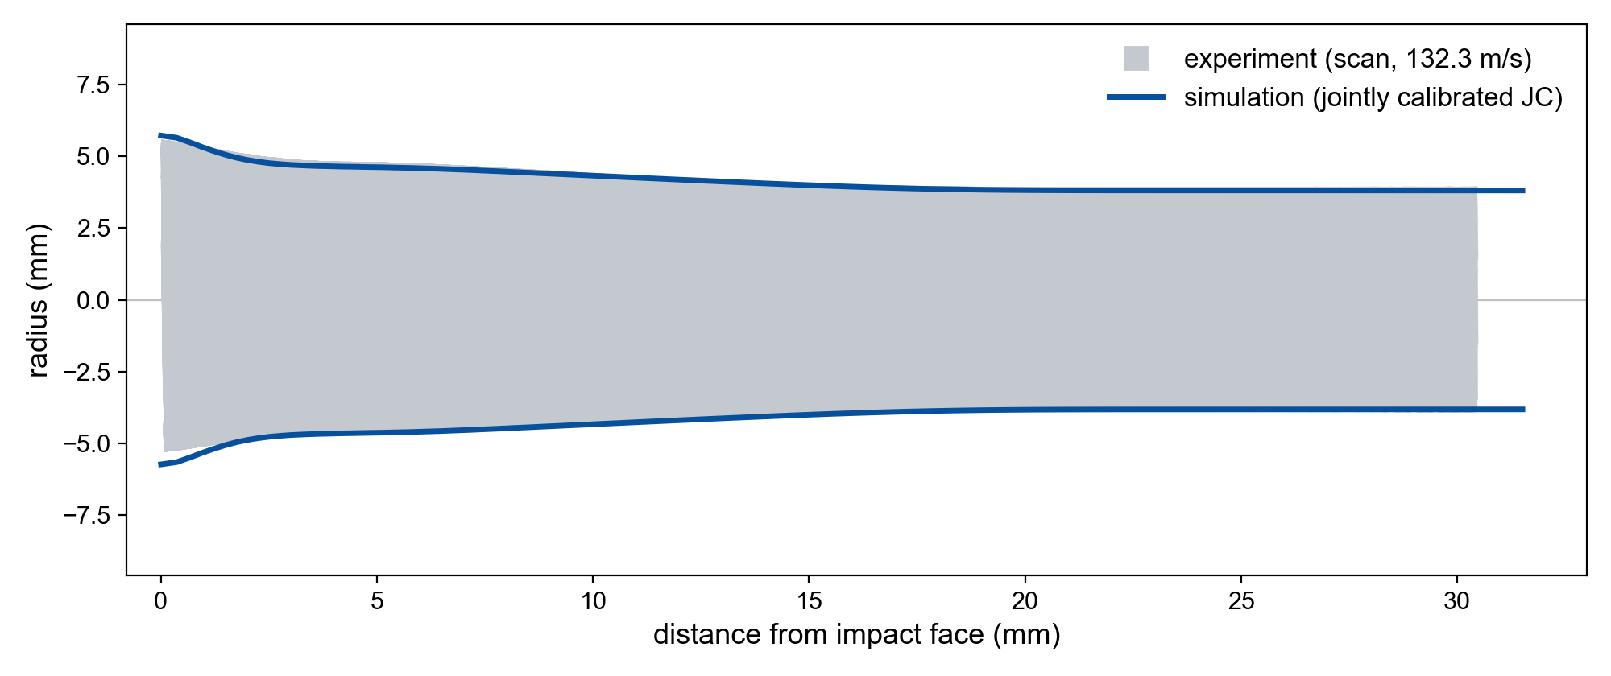
The second shot
22 / 22
The same parameter set, run at the second shot velocity of 132.3 m/s.
74 µm profile RMS
at a velocity 44% below the first shot, and a much lower strain range
Why two velocities matter
One shot cannot separate rate sensitivity from strain hardening. The second velocity resolves the trade-off and pulls every parameter to the interior of its prior.
final deformed profile, production model at the calibrated posterior median

