Slide 1
Team GNU – It’s Not Radio
Walker Frank, Quyen Nguyen, Max Oakes, Nick Wagner, Quentin Ward

Slide 2
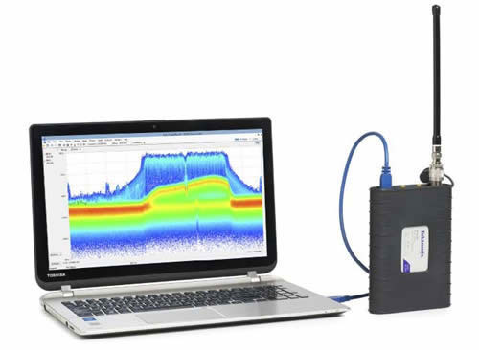
Project Overview
The Tektronix RSA series are Real-time Spectrum Analyzers(RSA) that can be over 15 times cheaper than a conventional RSA and can weigh less than 2 lbs.
Our project seeks to connect these RSAs to GNURadio, an open source coding library.

Slide 3
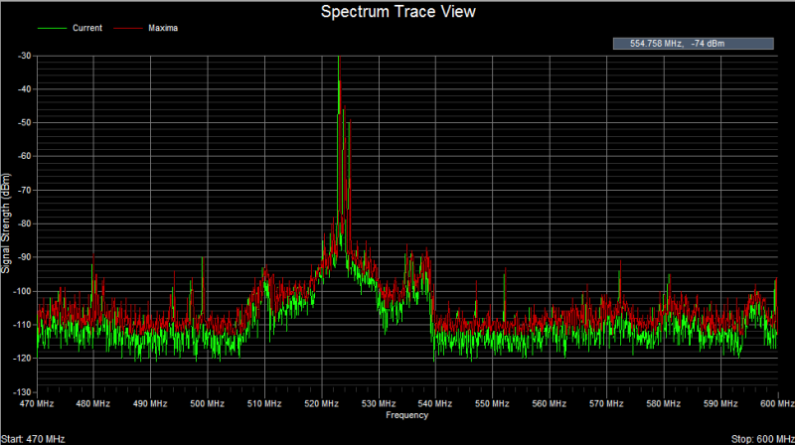
What is an RSA?
A real-time spectrum analyzer (RSA) measures the magnitude of an input signal versus frequency within the full frequency range of the instrument.
The primary use is to measure the power of the spectrum of known and unknown signals.

Slide 4
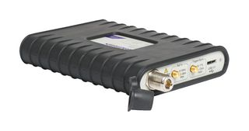

What our Project Does
The RSA traditionally used to output the collected data into a Tektronix provided program, SignalVu.
SignalVu only allows the user to observe the waveform.
The goal of our project was to create a “block” of code for GNU Radio that allows the data to be read from the RSA.
Using GNU Radio enables the user to perform signal processing and implement a software defined radio, allowing limitless possibilities.
Our GNURadio Block

Slide 5
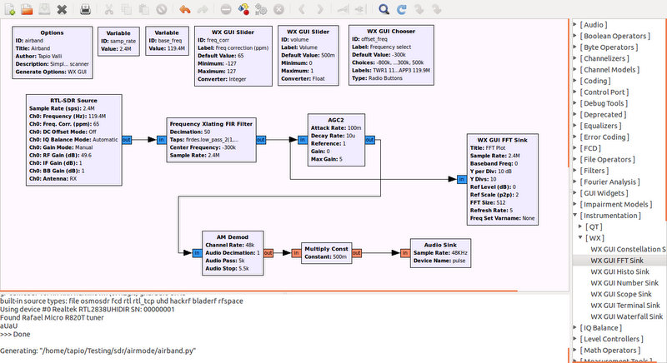
What is GNURadio?
GNURadio is used to implement software defined radios (SDR).
A software defined radio is radio system where the components are implemented in software rather than hardware
It can be used with external RF hardware, like the RSA306, to create SDRs or without hardware to create simulations.
GNURadio Companion (GRC)

Slide 6
Why GNURadio?
GNURadio is a free, powerful resource in the RF and Communication Engineering Field
One software defined radio can be used for a variety of applications, opening the door to limitless applications.
Filters
Demodulators
Decoders
And more!

Slide 7
Design Process
Tektronix provided a document with essential and desired capabilities:
IQ Block capability
IQ Stream capability
IF Stream capability

Slide 8
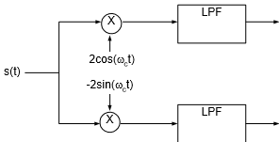
What is IQ Data?
I – Inphase component
Q – Quadrature component
When you combine I and Q components, you get the complex envelope:
S(t) = x(t) + j*y(t)
This allows for demodulation and extracting the intended information from the carrier signal
x(t)
(I)
y(t)
(Q)

Slide 9
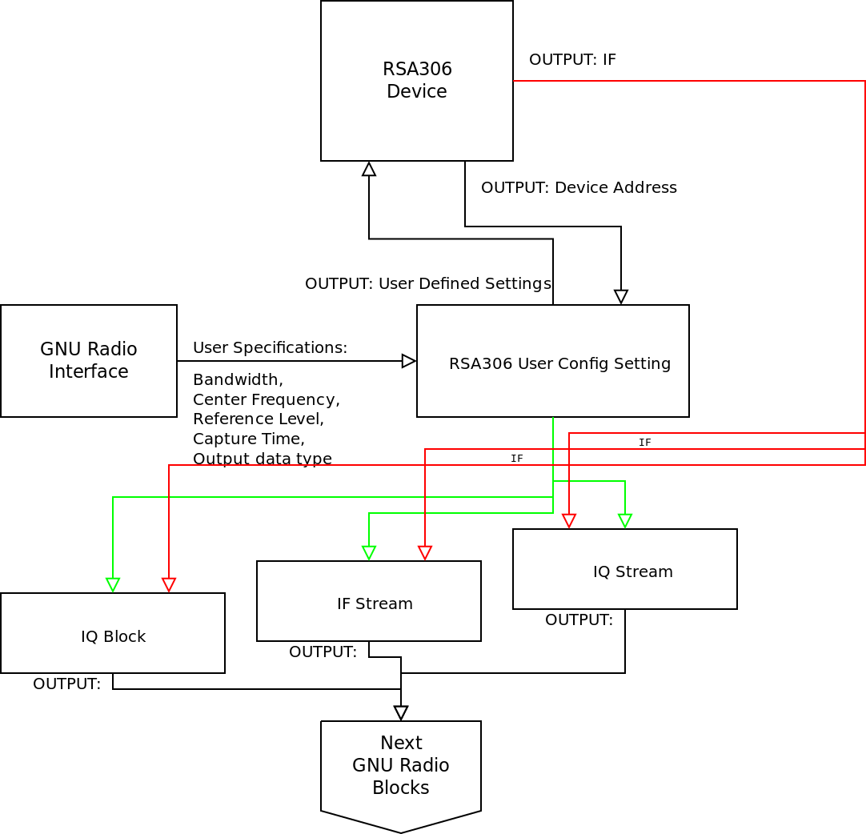
High-level diagram of the custom GNU radio block for the RSA

Slide 10
Results/Conclusions
We successfully completed the following requirements:
GNURadio style compliance
Deployment for Ubuntu 15
Successful implementation of IQ block and IQ stream capabilities
Unable to implement IF streaming capabilities:
Tektronix needed to update the RSA’s API to allow us to include IF streaming however, the API is still in development.

Slide 11
Demonstrations
Key Fob
Wi-Fi Signal
FM Radio

Slide 12
Potential Uses for Our Project
Corporate Research
Wireless technology research and simulation
GPS (Garmin, Magellan, Motorola, etc.)
Wi-Fi (Internet service providers)
RFID (credit card companies)
Cell phone signals (cell phone companies)
Military Research and Development
Future University of Portland Senior Design Projects
Next year’s senior design project on triangulating position
Amateur Hobbyist Activities

Slide 13
Acknowledgements
Faculty Advisors: Dr. Joseph Hoffbeck and Instructor James Schmidt
Industry Advisor: Kyle Bernard, Tektronix
Dean Sharon Jones for funding our project
Tektronix for lending us the RSA306, RSA506 and technical support
And thank you to Sandia National Laboratories and Shiley School of Engineering for additional borrowed equipment

Slide 14
Citations
"What Is GNU Radio and Why Do I Want It?." WhatIsGR - GNU Radio. GNU Radio, n.d. Web. 06 Mar. 2017.
"USB Spectrum Analyzer." Tektronix, n.d. Web. 08 Mar. 2017.

Slide 15
Questions?

