Slide 1
Project: Doomed
Milestone 1

Slide 2
Tasks
Setup of the application and OpenGL
Basic phong shading
GUI to control scene elements for debugging
Loading of objects and textures
Basic scene

Slide 3
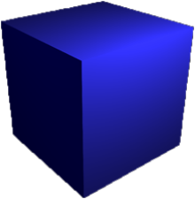
Phong Shading
Start with debug objects and materials defined in code
Next step: load everything from file

Slide 4
GUI

Slide 5
World Object Hierachy
MazeNode
single scene, lights
Model
grouped meshes
Mesh
openGL interface
Maze
global world properties
graph-like
MazeNode
single scene, lights
Model
grouped meshes
Mesh
openGL interface
MazeNode
single scene , lights
Model
grouped meshes
Mesh
openGL interface

Slide 6


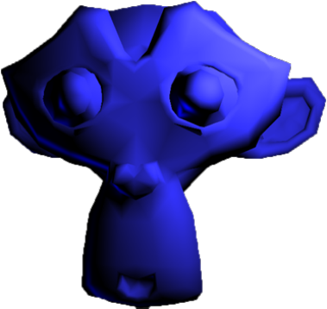
Loading Objects and Textures
Using Assimp
First load simple models without hierarchies

Slide 7
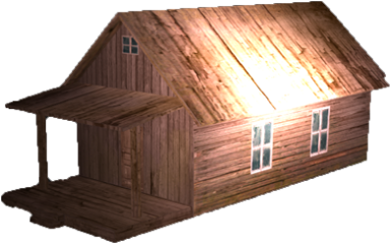
Loading Objects and Textures
Add texture loading using stb_image
Extend object loading with hierarchies
A lot of debugging

Slide 8
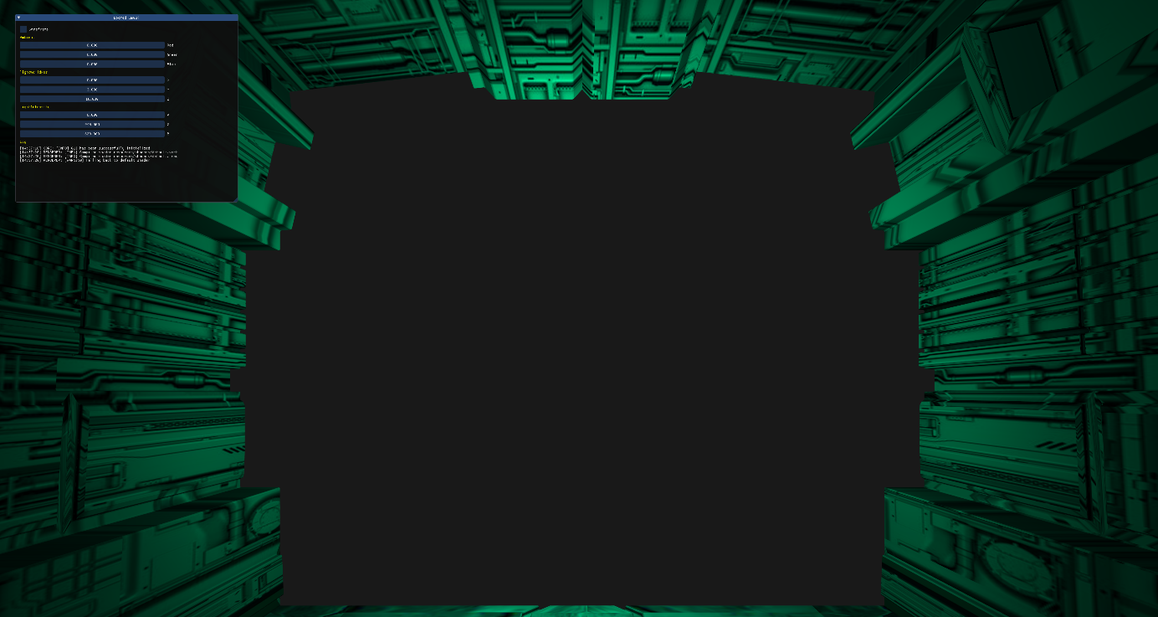
Scene
Scene

