Slide 1
Project: Doomed
Milestone 1

Slide 2

Phong Shading
Start with debug objects and materials defined in code
Next step: Load objects from file

Slide 3
GUI

Slide 4
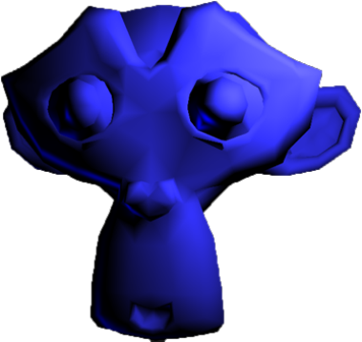
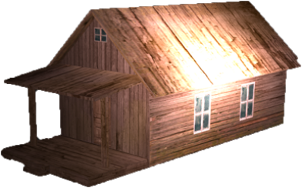
Loading Objects and Textures

Slide 5
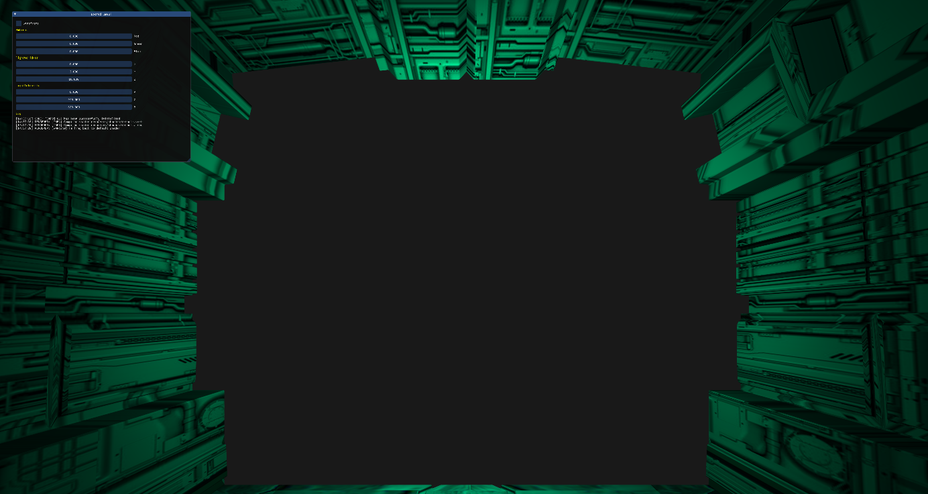
Scene
Scene

