Slide 1
Containers (with emphasis on Docker)
Jakub Daněk
Yoso Czech s.r.o.
mailto: jakub.danek@yoso.fi

Slide 2
What are containers?
Abstraction of applications from the actual runtime environment
Consistent deployment independent on system
    Cloud
    Laptop
    Own servers

Slide 3
What are containers?
Benefits of Consistency
  Run anywhere
    Relatively easy to run on many different platforms
  Same environment in dev, test and production
    → easier transmission from one to another
    → less bugs introduced by environment differences

Slide 4
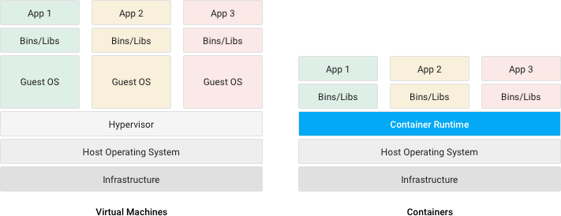
Container vs Virtual Machine
Src: https://cloud.google.com/containers/

Slide 5
Container vs Virtual Machine
Virtual Machines
Hardware virtualization → one physical server becomes many virtual servers
Each VM contains full operating system
Each VM has own (possibly different kernel)
Each VM has to boot during start (init scripts, systemd...)
Src: https://cloud.google.com/containers/

Slide 6
Container vs Virtual Machine
Containers
Process-level virtualization → each container runs as process group in host OS
All containers on single host use the same kernel
Process startup is much faster than VM boot (generally)
Enabled by multiple kernel features for process constraint and isolation
Src: https://cloud.google.com/containers/

Slide 7
Cgroups
Control groups
Linux kernel feature allowing setting resource limits for a process group
Tree-structure
Each process belongs to exactly one cgroup
  All threads spawned by a process belong to the same cgroup as the parent process

Slide 8
Namespaces
Means of isolation of processes running on the same host.
Tree structure
Processes in one namespace do not see resources of another namespace
  But processes in parent namespace can see resources in child namespaces

Slide 9
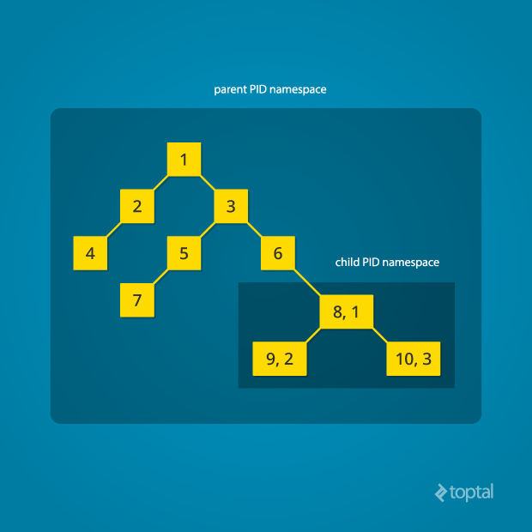
Namespaces - PID
Process has different ID for each PID namespace to which it belongs
Src: https://www.toptal.com/linux/separation-anxiety-isolating-your-system-with-linux-namespaces

Slide 10
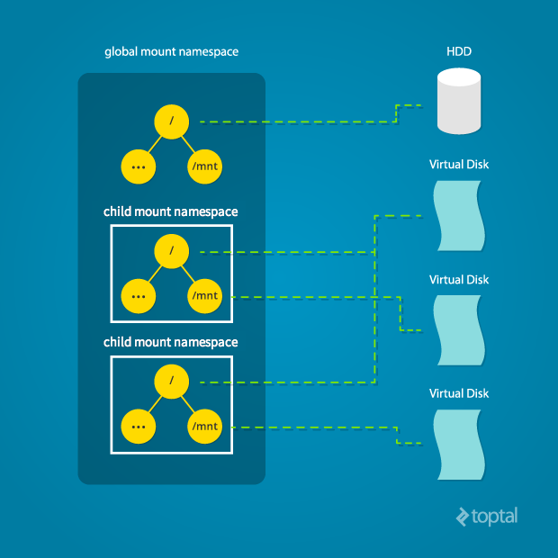
Namespaces - Mount
When isolated process mounts new disk/partition, it affects only its namespace
Src: https://www.toptal.com/linux/separation-anxiety-isolating-your-system-with-linux-namespaces

Slide 11
Namespaces - types
cgroups
user IDs (UID)
network
mount points
interprocess communication (IPC)
process IDs (PID)
hostname (UTS)

Slide 12
And some more
Seccomp
  Preventing processes from making particular system calls
Capabilities
  Permissions to certain actions generally allowed only to privileged users (root)
  Can be enabled per-thread for unprivileged processes
Apparmor and SELinux
  Some more program restricting :)

Slide 13
More reading
Linux Man pages:
  http://man7.org/linux/man-pages/man7/capabilities.7.html
  https://www.kernel.org/doc/Documentation/cgroup-v2.txt
  http://man7.org/linux/man-pages/man7/namespaces.7.html
Under the hood of Docker:
  https://pasztor.at/blog/under-the-hood-of-docker
Namespaces:
  https://www.toptal.com/linux/separation-anxiety-isolating-your-system-with-linux-namespaces
Rami Rosen (the page is not pretty, but contents are awesome):
  http://ramirose.wixsite.com/ramirosen

Slide 14
LXC
API for creating linux containers
In general, the containers run full OS
  Including init, cron, syslog…
→ similar result as with VMs, but implemented as containers
  Keeps flexibility of VMs
  Keeps speed and lower overhead of containers

Slide 15
LXD
Container manager built with LXC
Provides common images in remote repository
Scalability, security, resource management
Easy to get into (comparing to low-level LXC API)
  https://linuxcontainers.org/lxd/try-it/

Slide 16
Docker
Another container engine
Younger than LXC
Different approach: single-application deployment
  → docker containers do not run full OS
  → provide isolated environment for single-application runtime

Slide 17
Docker
First Class Citizens:
  Image - binary form of the runtime environment
    identified by id, name and tag (version)
  Container - running environment based on an image
    identified by unique ID and name
Images are stored in a repository (private, public, local)
  similar mechanism to Maven - if you do not have an image locally, docker will download it for you from remote repositories

Slide 18
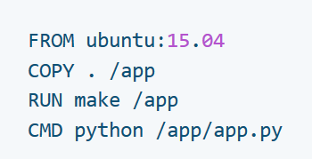
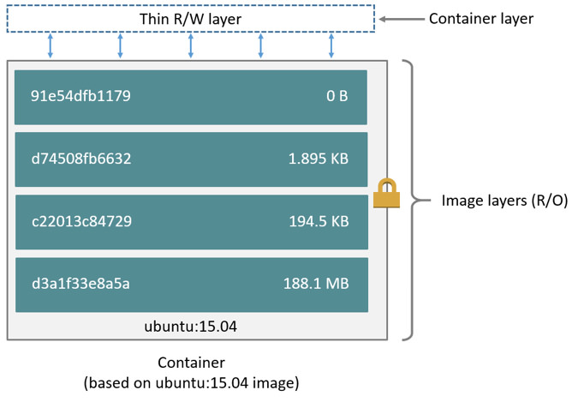
Building Docker Images
Images defined by text specification (Dockerfile)
Images are built of a series of filesystem layers
Src: https://docs.docker.com/storage/storagedriver/#images-and-layers

Slide 19
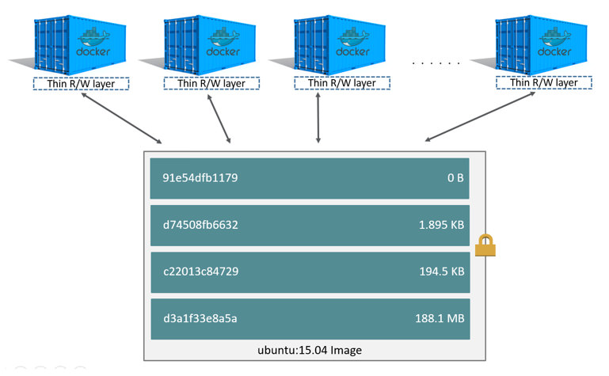
Building Docker Images
Containers have own R/W layer → can share same image
Src: https://docs.docker.com/storage/storagedriver/#images-and-layers

Slide 20
Docker Containers
State of container (changes to the R/W layer) can be commited to create new image
Until then they need to be considered transient
  → not good for storing application data
Filesystem layers introduce increased complexity to the filesystem implementation
When an update is needed, new image is built and new container started (and old one is killed)
  → different philosophy to LXC or VMs where updates are done in runtime

Slide 21
Docker – Storage Options
Bind Mounts
  older way of storing persistent data
  mount a folder on host system to a folder inside container
  -> you need to know which folder you want to mount
    it must exist before starting the container
Example: C:\\Users\danekja\mysql -> /var/lib/mysql
  When container runs mysql and it stores data, they can be found on host filesystem

Slide 22
Docker – Storage Options
Volumes
  Volumes are created on host filesystem and mounted to a path inside the container
  Difference to bind mounts: volumes are created by docker in space managed by docker (usually in /var/lib/docker on Linux hosts)
    on Windows hosts this is a bit complicated because Docker actually runs in Linux VM

Slide 23
Docker – Storage Options
Volumes
  Volumes can be created independently of containers
    as most Docker objects are identified by hash ID and a name
  -> Volumes can be shared among multiple containers
  Volumes can be remote

Slide 24
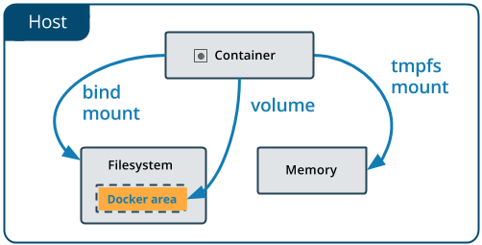
Docker – Storage Options
Src: https://docs.docker.com/storage/volumes/

Slide 25
Docker - networking
Docker provides multiple networking options
  Full overview: https://docs.docker.com/network/
  All manipulate host‘s network configuration (by adding network devices, manipulating iptables) to:
    create internal networks
    connect containers to the internet
    make containers to look like a physical device to the host OS
We will discuss only Bridge networks

Slide 26
Docker - networking
Bridge network
  Created in terms of one local docker daemon (not for clusters)
  Containers within same bridge network can communicate with each other
  Containers in different networks cannot communication with each other
  Containers can call each other either with IPs or their names
  Default bridge network is created when Docker starts
    All new containers are assigned to it unless specified otherwise
    In the default bridge network containers may communicate only via IPs

Slide 27
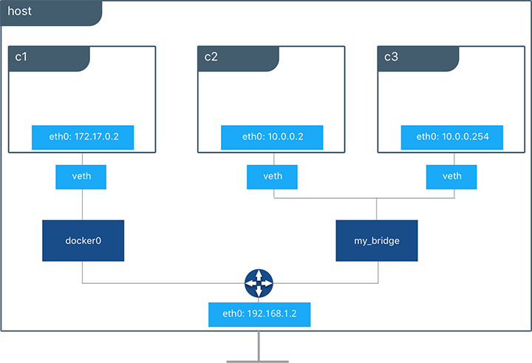
Docker - networking
src: https://success.docker.com/article/networking

Slide 28
Docker - networking
By default, all containers within a network expose all their ports to each other, but no ports to the outside world
-> unless you specifically allow it, containers cannot be reached from the outside world
Ports are exposed by binding HOST ports to container port

Slide 29
Docker - networking
Ports are exposed by binding HOST ports to container port
Example:
  Server hostname: myserver.com
  Container running tomcat on port 8080
  Port mapping 80 -> 8080
  -> calls to http://mysever.com/ will reach the Tomcat inside the container
  -> calls to http://myserver.com:8080/ will respond with „Server not available“

Slide 30
Some more reading
https://www.docker.com/resources/what-container
https://linuxcontainers.org/lxc
https://linuxcontainers.org/lxd/
https://pasztor.at/blog/lxc-vs-docker
https://goto.docker.com/rs/929-FJL-178/images/IDC-containerplatform-wp.pdf
https://success.docker.com/article/networking

Slide 31
Dockerizing Application
Application needs to be configurable via environment variables
    in theory it is possible to load configuration files into container via bind mounts, but that becomes somewhat complicated when running in cluster
That‘s it, you are good to go :)
General rule is to have one process per docker container
  can be resolved by custom shell script or projects like http://supervisord.org/
  but generally recommended approach is one process per container

Slide 32
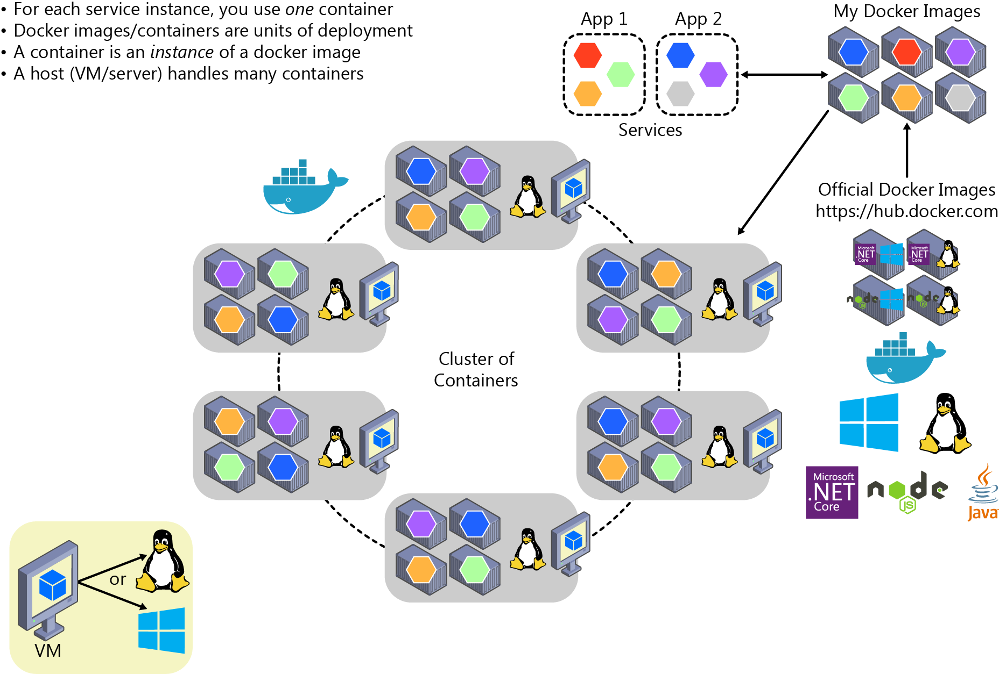
Dockerizing Application
src: https://docs.microsoft.com/en-us/dotnet/standard/containerized-lifecycle-architecture/design-develop-containerized-apps/orchestrate-high-scalability-availability

Slide 33
Container Orchestration
main strength of Docker ecosystem comes with easy creation of multi-service deployment and high-availability setup
Many projects approach this
  Docker Compose
  Kubernetes, Docker Swarm
  AWS, Google Cloud, Azure...

Slide 34
Docker Compose
Tool for orchestrating containers based on single configuration file
Easy to setup, easy to learn
  Can be used to configure services, networking, volumes, environment variables...
  Good for development
  Can be used for production on a small scale (single host)
    No load-balancers
    Needs OS tools to support restart in case of crash/server reboot
  On larger scale, must be used together with Docker Swarm

Slide 35
Docker Swarm
Cluster mode from Docker
  Connects multiple Docker nodes into a cluster and allows their manipulation via single-point-of-entry API
    Developers use same commands (or docker-compose configuration) to deploy containers to the cluster
    Swarm handles deployment of individual container replicas to nodes

Slide 36
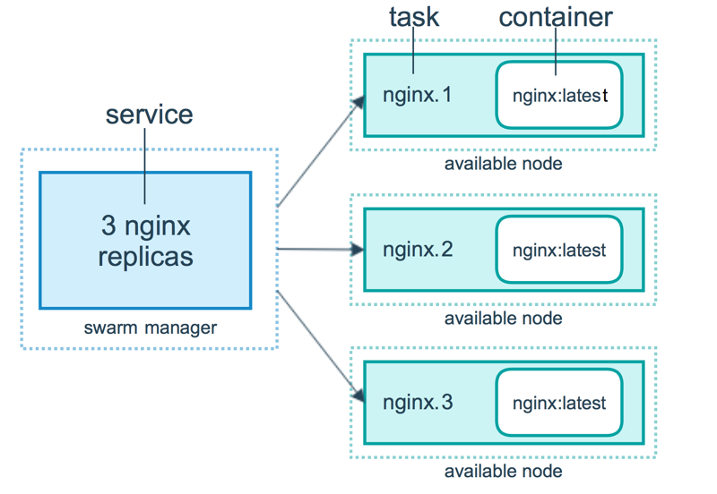
Docker Swarm - Services
https://docs.docker.com/engine/swarm/how-swarm-mode-works/services

Slide 37
Docker Swarm - Services
Swarms runs internal DNS server
Each service is given a record in DNS via which it can be reached
Swarm handles load-balancing between the running replicas
Configurable health-checks on service level
This is a common approach provided by most of the orchestration tools
  -> load-balancing out-of-the-box

Slide 38
Kubernetes
More mature, based on Google‘s experience with containers
  also more widely used -> easier to find information
Provides extended features comparing to Docker Swarm
  auto-scaling, health-checks on container-level
  is not restricted to Docker API (unlike Swarm which has to have the same API as Docker engine)

Slide 39
Kubernetes vs Docker Swarm
Kubernetes cons
  Do-it-yourself installation is rather complex
    But there is a simple minikube tool for running on workstations and testing configurations
  Need to learn another tool
Docker Swarm pros
  Simpler, same API as Docker
Still, Kubernetes is widely used and supported by main cloud providers

Slide 40
Openshift, GappEngine, AWS...
Where can you host your Docker clusters?
Own VMs/servers
  -> awfull lot of work if you are serious about your data and availability
Openshift (IBM - RedHat)
  Cloud platform built on top of Kubernetes
  Significant changes/improvements - support for builds, Jenkins integration, image registry and management
  Very good visualisation
  But: vendor lock-in

Slide 41
Openshift, GappEngine, AWS...
Where can you host your Docker clusters?
Google Cloud, AWS, Azure
  all provide options to run either plain Docker images with custom deployment configurations for the particular cloud
  or they provide Kubernetes cluster hosting
Main con of all (including Openshift): price is much higher than with regular VMs

Slide 42
Final Thoughts
Note 1: The whole ecosystem evolves quickly, always check for the newest information
  Official documentation is your friend
Note 2: There is no such thing as silver bullet
  Not every application is suitable to run in container
  But most of the time it is great at least for prototyping integration scenarios
Note 3: With the momentum given, containers seem to be the future, pay attention to them
  (this is author‘s personal opinion)

Slide 43
Some more reading
https://kubernetes.io/
https://cloud.google.com/kubernetes-engine/
https://aws.amazon.com/eks/
https://azure.microsoft.com/en-us/services/kubernetes-service/

Slide 44
Questions?

