Slide 1
Deployments, Operations
Jakub Danek
Yoso Czech s.r.o.
mailto:jakub.danek@yoso.fi
https://www.linkedin.com/in/danekja/

Slide 2
Motivation
Deployment significantly influences application´s behaviour
  Security
  Performance
  Downtime during upgrades
Current trend is to minimize distance between development and operations → DevOps

Slide 3
Topics
What types of environments we have
How can we deploy applications?
Who is actually responsible for application deployments?
Operations – backups, monitoring
Examples – load-balanced and high-availability environments

Slide 4
Environments
Several different environments can be used during development cycle
Each has different requirements on
  Hardware (performance)
  Security
  Stability
Each has different purpose

Slide 5
Environments - Development
Used by developers to test the application outside of their workstation
Performance requirements: low
Stability requirements: low
  → developers can update the deployment several times a day, as much as needed
Security requirements: low
  No real data

Slide 6
Environments - Testing
Used by testers/product owners to validate/verify the implementation
Performance requirements: low-medium
  Needs to respond in reasonable time, but very few users
Stability requirements: medium
  Testers/product owner need time to test new deployments, shouldn‘t change without notice
  Sudden downtime does not cause any serious issues though
Security requirements: medium
  No real data, but setup should be production-like as much as possible

Slide 7
Environments - Pre-production
Used by testers/operations to test deployment in production-like environment, performance testing, security testing etc.
Performance requirements: high
  Should copy production environment as much as possible
Stability requirements: med-high
  Tests deployment in production-like environment → deployments should happen based on predetermined schedule
  Any issues causing downtime are a serious threat at this stage of development
Security requirements: high
  No real data, but same requirements as in production environment

Slide 8
Environments - Production
Used by customer
Performance requirements: high
  Performance issues cause unhappy users
Stability requirements: high
  Deployments happen only at predetermined times
  Users do not experience any downtime vs. down-time must be well communicated to users
Security requirements: high
  Real data, security vulnerabilities represent a serious threat

Slide 9
Environments - Other
Special testing environments can exist as well, e.g.:
  Performance testing
    Maintaining production-like setup for testing can be expensive
      → special cloud-based environment started only during the test-runs
  Big feature test-env
    Features taking long time to develop
    Maybe large overhaul of the application is needed
    → separate testing environment so that main development is not disrupted
    → removed after the feature is finished and merged into main codebase

Slide 10
Naive deployment
All done manually – build, deployment, configuration…
No extra infrastructure needed
Prone to human errors
Slow
Example Process: deployment_naive.pdf

Slide 11
Scripted deployment
Improvement over naive approach – as much as possible automated with (shell) scripts
  Upload to server
  Applying proper configuration
  Restarting the service
  Testing
But, developer is still required to exec those scripts on the server
Example Process: deployment_scripted.pdf

Slide 12
Automated deployment
All steps fully automated
Designated build server
  Application responsible for all steps related to deployment
  Deployment is triggered by clicking single button, after that no action is needed
  Minimal human input → all deployments go through same process
Example Process: deployment_automated.pdf

Slide 13
Continous Integration
Practice aiming at integrating new changes into main codebase as soon as possible
  Limits overhead of integrating own changes and changes done by other team-members
  Requires high-quality testing process to ensure code stability
    → build server can be configured to build and run all tests after every commit to master
    → potential errors are discovered quickly
    → developers can continue with their work while build server runs (timely) tests

Slide 14
Continous Delivery
Practice aiming at deploying changes in small cycles
  A flexible approach to delivering new features/fixing critical errors
  Possible due to small deployment overhead when using build server
Whole team needs to see whole build and deployment process (build, tests, reports) → easier to react
Due to full automation, any version can be deployed to any environment at any time
  With constraints of course (e.g. you need to ensure no downtime of service during deployment to prod)

Slide 15
Build Servers
Jenkins
  Open-source, widely used, lots of plugins
TeamCity
  JetBrains
Travis CI
  CI server for GitHub hosted projects
Team Foundation Server
  Microsoft

Slide 16
Who is responsible?
Operations team (system administrators)
  Understand the servers, configuration
  Lack detailed knowledge of the application
Developers
  Often do not want to deal with system administration
  Have detailed knowledge of the application

Slide 17
DevOps
An approach/movement narrowing the gap between development and operations
Developers and sysadmins need to cooperate
  Teams should be put together so that each team is able to
    Deliver functionality
    Test
    Deploy
    Maintain

Slide 18
DevOps
Automation is crucial
  Limit manual work
  Less error-prone
  Fast delivery
Build and deployment automation
  We have just discussed that

Slide 19
DevOps
Infrastructure automation
  DevOps promotes same principles for infrastrucutre management as developers use
  Describe your infrastructure in configuration files
    Can be versioned
    Configuration management tools (Ansible, Puppet, Chef)

Slide 20
DevOps
Virtualization
  Cloud allows easy scaling and orchestration of new servers
  Virtualization tools/providers allow easy creation and management of identical server instances
  AWS, OpenStack, vagrant…
Containers
  Another level of virtualization – allow shipping application together with its full runtime environment
  Build once, run anywhere
  Docker

Slide 21
DevOps
https://theagileadmin.com/what-is-devops/
https://www.atlassian.com/devops

Slide 22
Other Operations Tasks
Security Configuration
Monitoring
+ scaling
Backups

Slide 23
Security
It is common to deal with the following security tasks
  Firewall configurations
  Certificate management
    HTTPS configuration

Slide 24
Security
Firewall configuration
  Allow connection only where needed, for example:
  Application Server needs connection from internet on 80/443 ports (HTTP)
  Database Server needs connection from the application server on 3306 port (MySQL)
  Both need connection on 22 port (SSH) from company´s internal network.

Slide 25
Security
Firewall configuration
  Companies with many servers tend to group them into network zones based on purpose
  → certain zones are unreachable from the internet
    Implemented by firewall at entry point to the network
    Useful for networks holding data stores (databases, file storage…)
  → it is necessary to configure proxies which have been granted access to communcate between zones
  → only a few points of access in space of hundreds of servers

Slide 26
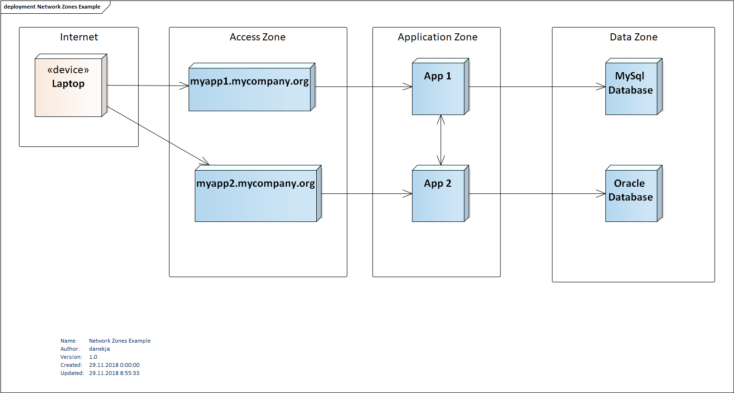
Security – Network Zones Example

Slide 27
Security
Certificate Management
Each certificate consists of public (certificate itself) and private (key) parts
Public part has usually validity period (quite often one or two years)
  After that it needs to be renewed

Slide 28
Security
Certificate Management – New Certificate
Private key is generated as random data
  Can be protected by passphrase, but not recommended for web certificates (you would need to solve the problem of providing the password each time web-server is restarted)
Using the private key, Certificate Signing Request (CSR) is made
CSR is sent to certificate authority (CA) for signing
  CA verifies you own the domain for which you request certificate
Certificate file is received

Slide 29
Security
Certificate Management – Certificate Structure
Public Certificates defined in X.509 standard
When creating CSR, several fields are asked:
  CN = Common Name = Fully Qualified Domain Name of your server
    e.g. myapp1.mycompany.org
    Browsers will reject the certificate if CN does not match the domain from which the certificate came
  Country code, State, Organization, Organization Unit, email
    Important for end-user to get information about your company, technically not necessary
https://www.itu.int/rec/T-REC-X.509/en

Slide 30
Securit y
Server Configuration
Web server needs access to the files with public and private parts
Example: nginx
server {
listen 443 ssl;
server_name www.example.com;
ssl_certificate /etc/pki/tls/certs/www.example.com.crt;
ssl_certificate_key /etc/pki/tls/private/www.example.com.key;
ssl_protocols TLSv1 TLSv1.1 TLSv1.2;
ssl_ciphers HIGH:!aNULL:!MD5;
...
}
Src: nginx.org

Slide 31
Security
Questions?

Slide 32
Monitoring
You require information in order to react/prevent operation problems
  How much RAM has the server left?
  How much free disk space there is?
  Is the server under extensive load?
  Does the web application answer to requests?

Slide 33
Monitoring
Checking manually when problems occur is too late!
  → monitoring application
External
  No special software required on the servers
  Can monitor things like:
    Application can be reached via network and answers requests
    Response times of the application are within limits
    Validity of HTTPS certificates

Slide 34
Monitoring
In-place
  Monitoring software daemon installed on the server
  Can monitor things like:
    CPU load
    Memory use
    Remaining free disk space

Slide 35
Monitoring
All inputs from all servers aggregated at one place
Dashboards with status
Email/SMS/Chat messages if something goes wrong
  If you realize your server is running out of disk space, you can react before users experience any issues
Support for maintenance windows (no alarms are raised if you inform the monitor that downtime is due to planned maintenance)

Slide 36
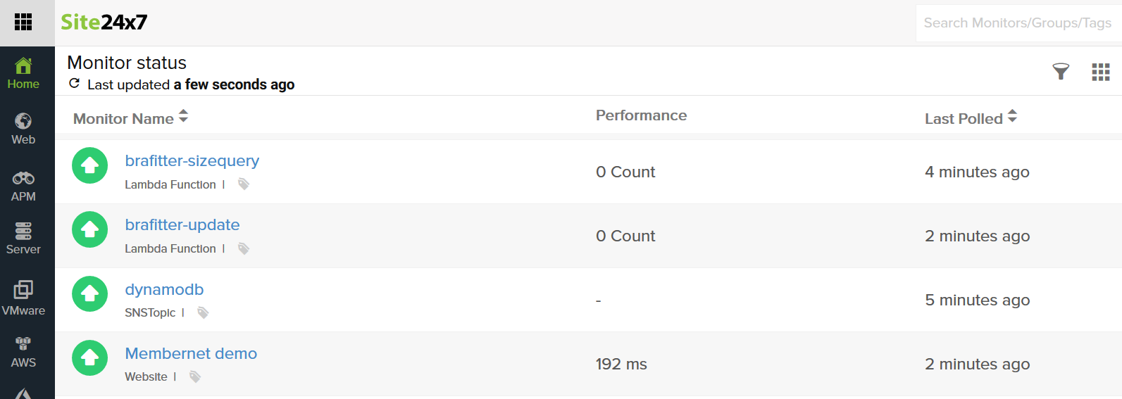
Monitoring

Slide 37
Monitoring
https://www.nagios.org/
https://icinga.com
https://www.site24x7.com/
www.datadoghq.com
https://prometheus.io/
and many more…

Slide 38
Backups (and restores)
Data are the most valuable thing
→ any production system needs to have backup mechanism
In case of error data can be restored without too many losses
  Attack
  Failed upgrade with broken data migration
  SW/HW failure
  User error

Slide 39
Backups (and restores)
Backup properties
  Taking backup must not influence system runtime
  Can restore system to fully consistent state
  Stored at separate location
Full vs Incremental
  Backup vs restore speed
  Space vs consistency threat

Slide 40
Examples

Slide 41
Examples – load-balanced environment
Nginx:
http {
upstream myapp {
server myapp1.intranet.mycompany.org;
server myapp2.intranet.mycompany.org;
server myapp3.intranet.mycompany.org;
}
server {
listen 443 ssl;
...
location / {
proxy_pass http://myapp;
}
}
}
Load-BalancedEnvironment.pdf

Slide 42
Examples – load-balanced environment
HA Proxy:
frontend http
bind myapp.mycompany.org:443 ssl crt /etc/pki/tls/certs/myapp.pem
mode http
default_backend myapp
backend myapp
balance roundrobin
mode http
cookie MYAPPLBSRV insert indirect nocache maxidle 4h
server myapp1 myapp1.intranet.mycompany.org:80 check cookie myapp1
server myapp2 myapp2.intranet.mycompany.org:80 check cookie myapp2
server myapp3 myapp3.intranet.mycompany.org:80 check cookie myapp3
Load-BalancedEnvironment.pdf

Slide 43
Examples – high-availability environment
Load-balancer solves two problems
  Performance: Users can be distributed among multiple application nodes
  Stability: if one node dies, users automaticaly reach another, via same URL
What if load-balancer dies?
  Virtual Router Redundancy Protocol (VRRP)

Slide 44
Examples – high-availability environment
Virtual Router Redundancy Protocol (VRRP)
  Creates Virtual Routers – group of multiple real routers
    1 active, rest backup
  Routers within group communicate with each other
    → if active router dies, new active is elected from the backups
How can we use this on application layer?
  Keepalived (http://www.keepalived.org/)

Slide 45
Examples – high-availability environment
Keepalived – need to configure the following on each node
  Virtual IP (address to which clients connect)
    Always resolves to the active node
  Virtual Router ID (unique VRRP group identifier within the same network segment, 0..255 )
  Check script/command
    Keepalived calls this command regularly to check if the relevant service is running
      In our example it would check e.g. if haproxy process is running
  Priority: used during master elections
  Password: used to secure communications between the instances
High-AvailabilityEnvironment.pdf

