Slide 1
Software Quality
Jakub Daněk (Yoso Czech s.r.o.)
jakub.danek@yoso.fi
Based on lectures for KIV/OKS by Pavel Herout (KIV ZČU)

Slide 2
Software Quality
Software quality can be measured in:
Number of user complaints (does not do what I need)
  → good development process, testing
Number of bugs found in production
  → different testing
Maintenance costs
  → How to find source of problems as soon as possible: debugging, logs
Further development cost
  We have talked about this a lot in previous lectures, good architecture saves money
And many more…

Slide 3
Focus Areas (1)
Validation
  Goal: Show that application does what customer needs
  Best achieved by good development process and communication with customer
    → out of our scope
Verification
  Goal: Show that application does what specification says

Slide 4
Focus Areas (2)
Testing
  Goal: find errors, try to break the application
Debugging
  Goal: find cause of error state
  Relatively easy during development (support of debug tools, ability to modify the code)
  Relatively difficult in production (no debugger, real data, “must not break stuff”

Slide 5
Focus Areas (3) - Web Applications
Very wide set of applications with own specifics
Web Applications change quite often
Commonly a multi-threaded environment
Potentially may face higher load than expected (e.g. DoS attacks)

Slide 6
Verification
Importance grows with system size and pace of development
  Ensuring system works correctly is more important than having a chance of randomly finding an error
  → repeatability
  → done at every step of development cycle
  → automation

Slide 7
Verification
Complex processes and systems are difficult to cover with tests
  → decomposition
  → unit-tests
Unit tests
  Test only small portion of code (code → written by developers)
  Ensure that individual parts of your code behave according to specification
  Should be independent on each other and rest of the application

Slide 8
Unit tests
Ideally one unit-test suite tests one class/file of your application code
All public methods are tested for:
  Correct input → method does what it should do
  Corner cases → method properly correct input which is outside of normal operational values
    Example: sort method needs to work correctly with array of length: 0, 1, 2, N

Slide 9
Unit tests
All public methods are tested for:
  Correct handling of wrong input
    Example: authentication method has to pass on correct credentials and fail on incorrect credentials, both should be tested
  Error input – method needs to handle error input based on its specification
    Example: List<User> findByIds(@Nullable List<Integer> ids) should not fail when ids is null
      Should return empty list instead

Slide 10
Unit tests
→ multiple tests per single method/function
Test coverage should go over 90% of your application logic code (e.g. managers, entity methods)
  Helps during refactoring
  Helps when adding new functions
  Helps when changing behaviour of existing functions
  First you change/write new tests → then you modify methods/functions so that the tests pass

Slide 11
Unit tests - Independence
In order to achieve high test coverage, unit-tests have to independent on each other
  Otherwise you create a data-/dependency-management hell
Two approaches to reach independence when testing your classes
  Stubs
  Mocks

Slide 12
Unit tests - Independence
Stubs
  Special implementations of your dependencies which are used only in tests
    e.g. for your UserDao interface you create an implementation which returns fixed set of data/stores inserts in memory and does not touch persistent storage at all
  Simple to understand
  As application and number of test cases grow, becomes another maintenance nightmare

Slide 13
Unit tests - Independence
Mocks
  Instances of your dependencies which can be configured per test-case
    What should a method return/throw when called with a particular parameter
  Example:
@Test
public void generateId() throws Exception {
Record record = new Record("33");
String date = dateFormat.format(new Date());
//dao is the mocked object
when(dao.getLastNumber(record.getService(), date)).thenReturn(9);
String expected = record.getService() + date + "00010";
String id = idService.generateId(record);
assertEquals(expected, id);
}

Slide 14
Unit tests - Summary
Ensure application code behaves according to specification
Instead of writing complicated tests of a whole, you test small parts
Not enough on their own
  Do not test integration with external systems (e.g. database)
  Do not test the whole system
  But: relatively cheap comparing to other test types

Slide 15
Functional Tests
Test your functional requirements against running (whole) system
Typically follow your use-cases, scenarios
In simpler cases can serve as integration tests
  By testing functionality you test that your integration with external systems works (db, other web-services)

Slide 16
Functional Tests
Test scenarios – step-by-step specification of what tester should do
  Including input data
  Used by testers during manual testing
  → testers do not need to have strong technical skills
  shoud not be written by developers
    Developers suffer from detailed knowledge of the system – create tests based on how system works, not how users are going to use it

Slide 17
Functional Tests
Automated tests
  Scripted test scenarios
  Cheaper in long-term, do not make mistakes
  But can be expensive to write and maintain
    User interfaces tend to change a lot

Slide 18
Functional Tests - Automated
Easier for web-service API
  Standard integration tests – you send a request and get a response
  Validate response codes, check response body is what you expect
  Modern WS API specification languages support basic test code generation

Slide 19
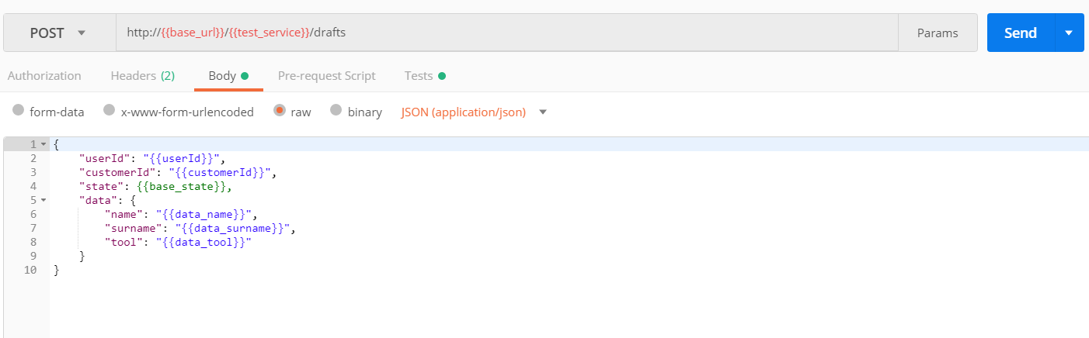
Functional Tests - Automated

Slide 20
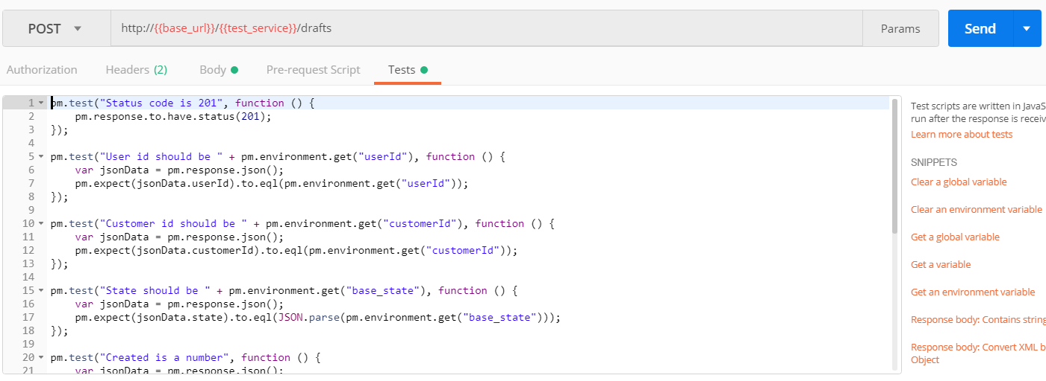
Functional Tests - Automated

Slide 21
Functional Tests - Automated
A bit of challenge for WebUI
Modern testing frameworks know how to simulate browser
  They use real browser core’s
  You can run the same tests against multiple browsers
But the application must be written with such testing in mind

Slide 22
Functional Tests - Automated
But the application must be written with such testing in mind
  You need to be able to locate HTML element you want to test
    id, tag attribute, Xpath
  Xpath tends to change with all sorts of page modifications
  ID is great, it is unique, but…
    Frameworks that generate HTML code tend to auto-generate IDs → for each request the IDs differ

Slide 23
Functional Tests - Automated
But the application must be written with such testing in mind
  Solution: custom attribute
  When writing our HTML, we add custom attribute uiTest=”unique id” to all elements we need to test
  Seems like extra work, but in our experience this is the most maintainable way of writing testable html front-end

Slide 24
Functional Tests - Selenium
Set of test tools for implementing browser tests
  Same test can be run against multiple browsers, ideally without changes
Possibility to record tests
Or write them in editor
Or write them in IDE as Java classes
Basically industry standard for WebUI tests

Slide 25
Functional Tests – Selenium Example
@Test
public void testById() {
  driver.get(baseUrl + "Prevodnik");
  WebElement we = driver.findElement(By.id("cisloVstup"));
  assertEquals("", we.getAttribute("value"));
}
Src: KIV-OKS lectures, doc. Ing. Pavel Herout, Ph.D.

Slide 26
Functional Tests - Selenium
Tests are sometimes tedious to write and difficult to maintain
Yet still a very useful tool to automate UI-based tests
Keep in mind the application must be written with such testing in mind
But it can be even better...

Slide 27
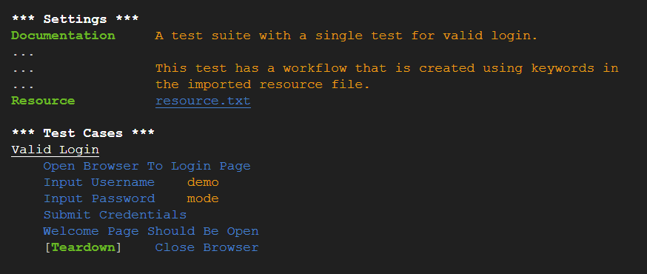
Functional Tests – Robot Framework
Src: http://robotframework.org

Slide 28
Functional Testing – Robot Framework
Robot framework can be used to automate more than Selenium tests (but we will focus on those here)
Uses key-words as function calls
  → easy to read by anyone
Key-words are implemented in code (Java, Python), you can even write your own
For WebUI testing, Selenium is the underlying library

Slide 29
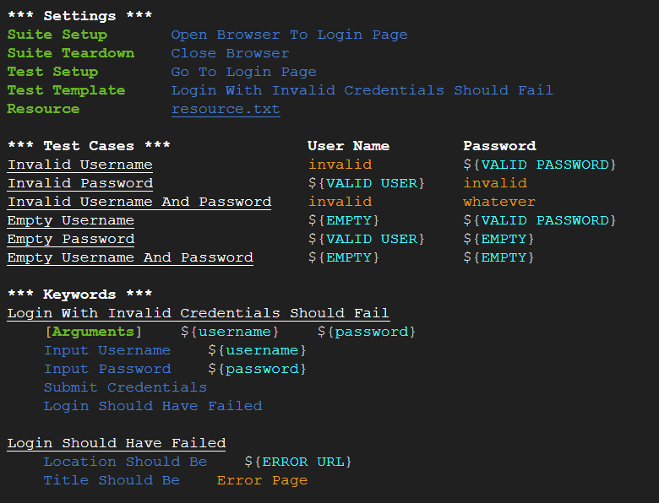
Robot Framework – Data Driven
Src: http://robotframework.org

Slide 30
Other types of tests
Integration tests
  Verify that connection and message exchange between two systems works as expected
    Necessary when you integrate two or more systems (e.g. your invoicing application and accounting application)
    Such integrations are often not triggered by user action, but run periodically → other types of tests wont cover them

Slide 31
Other types of tests
Performance tests
  Several goals:
    Ensure application has sufficient performance under real load
    Check application’s behaviour under high load (e.g. does it recover after it stops responding?)
    Ensure new versions of application do not introduce performance hit
  Should be run against production-like environment

Slide 32
Other types of tests
Smoke tests
  Full functional/integration test suite can take quite some time to run
  Smoke tests are a basic subset of the whole test suite which ensure basic functionality works
  Use: ensure new deployment has been successful and the application is responsive
    Common in production, where you do not want to run other types of tests

Slide 33
Other types of tests
Usability tests
  Tests how easy is your UI to navigate for users without any prior experience with your system (or introduced changes)
  You ask a set of users to perform fixed set of tasks
  Gives you a warning if users are unable to easily perform the task
  Gives you insight on how users tend to use your system

Slide 34
Debugging

Slide 35
Main techniques
Helper prints into console
  Easy, but messy
System of break-points in IDE/Code debug tools
  Great for development debugging
Application logs
  Necessity for production-like deployment debugging

Slide 36
Code Debugging (in IDE)
Basic Terms
  Breakpoint – point in code where you want to pause the execution
  Watch – a variable or an expression you want watch during debugging
    Debug tools show you its current value at every step of the execution

Slide 37
Code Debugging (in IDE)
Basic Control Flow Actions
  Step Over
    Proceed one step ahead with the execution
  Step Into
    Step into a function/method
  Step Out
    Step out of current function/method
  Continue Execution
    Proceed with execution until next break-point or execution finish

Slide 38
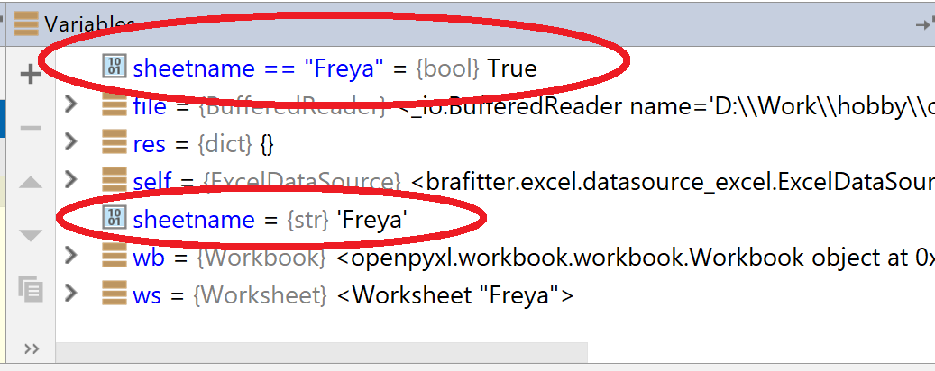
Code Debugging - Useful tips
You can watch not only variables, but also expressions

Slide 39
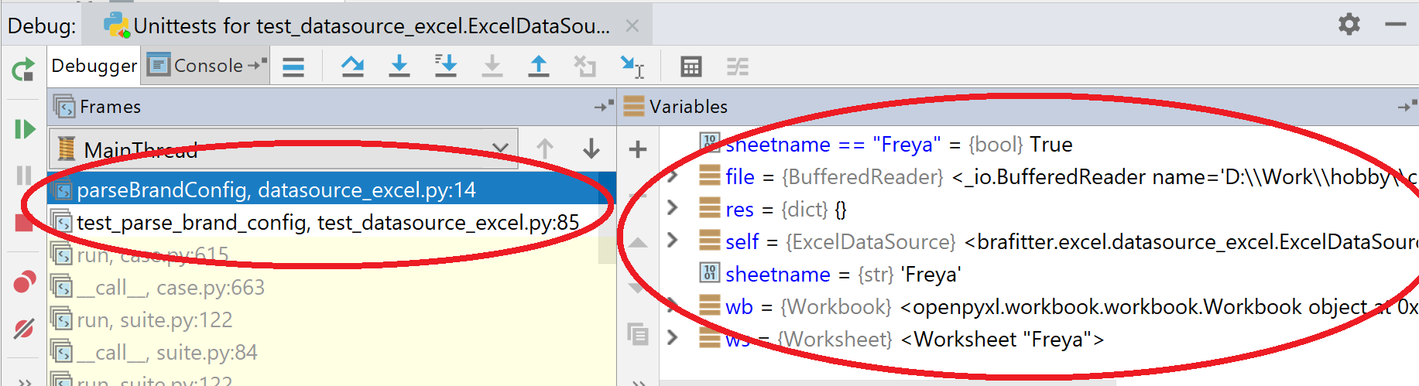
Code Debugging - Useful tips
Most debug tools allow you to traverse stacktrace during pause
  Lets you check variables outside of your current method´s/function´s scope

Slide 40
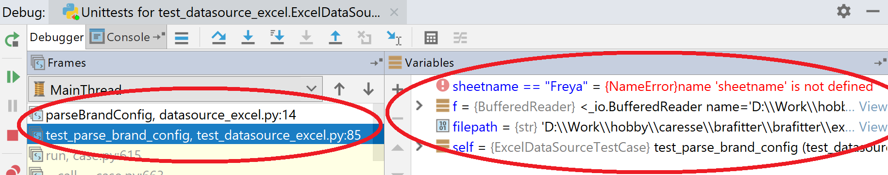
Code Debugging - Useful tips
Most debug tools allow you to traverse stacktrace during pause
  Lets you check variables outside of your current method´s/function´s scope

Slide 41
Code Debugging - Useful tips
Debugger shows type/structure information
  Great help in dynamically typed/untyped languages
You can also debug remote servers
  Must be explicitly enabled when deploying
  Security flaw → use only in controlled environments
All major browsers contain JavaScript debugger

Slide 42
Code Debugging - Summary
Great tool during development
  Use it!
Security flaw during deployments
  Do not use it!

Slide 43
Debugging - Deployment
Finding bugs in production is difficult
  Can’t break service
  Can’t damage data
  Can’t attach debugger
But bugs still find their way into production
  Despite our good test coverage
  → good logs help a lot

Slide 44
Types of Logs
Application logs – messages describing what is going on in the application
08:58:03.021 [http-nio-8080-exec-1] INFO c.y.p.h.c.s.impl.DefaultDraftService - Draft metadata successfully saved.
Access logs – all calls made to the application from the outside world (HTTP requests in our case most of the time)
127.0.0.1 - - [14/Lis/2018:08:58:03 +0100] "POST /tt/drafts HTTP/1.1" 201 163
Audit logs – tracing what particular user is doing

Slide 45
Application logs
Multiple levels:
Info – each successfully finished action should be logged
Warn – Application did not end-up in error state, but something is not as it should be and we should be notified of it
Error – All error situations must be logged
Debug – detailed information of what is going on in the applicaton – messages include data structures etc. Imagine you do not have a debugger.
Trace – should describe every step within app (start and end of method call should be logged, all conditional executions, etc.)

Slide 46
Access Logs
All http requests logs, including:
  RequestId, SessionId
  Request hostname and path
  Request parameters
  Request headers
  Cookies

Slide 47
Audit Logs
When any action is executed (read or update, does not matter)
  What action
  Who (which user)
  When
  Possible context, if we know it

Slide 48
Implementation
All major languages have mature logging support (core or via libraries) with out-of-the-box support for
  Formatting
  Message Levels
  Context information
  Filtering by source
  Various storage options
    Console, file, web-service, message queue, database

Slide 49
Modern Logging
Cloud storage for logs with processing(logstash) indexing (elasticsearch) and good presentation (kibana)
  Same logging libraries, but logs sent to cloud via message queue
  Easy to aggregate all your logs in one place
  Bad for audit logs – does not guarantee delivery
Audit logs can be stored in database
  And cloud storage can then process and index logs from the database to provide advanced search functions

Slide 50
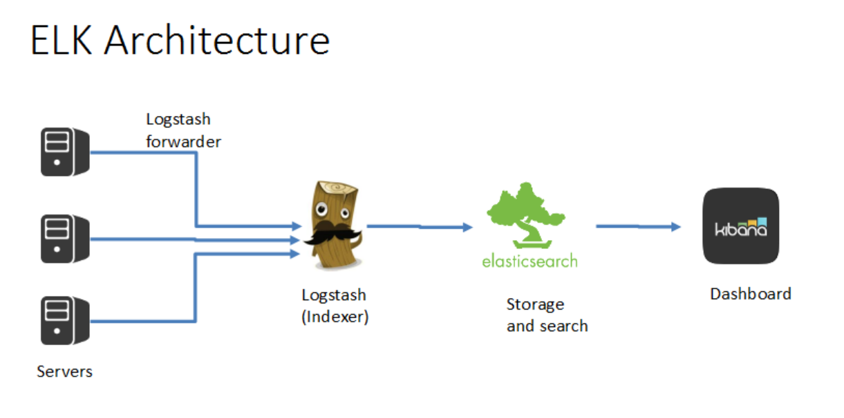
Modern Logging
Src: http://bingoarun.github.io/openstack-log-analysis-elk.html

Slide 51
Logs
Each application should have them
Necessary when you want to know what happened in production
With proper use of log levels do not present a performance issue for application

