Slide 1
Elementary Web Application Security
Jakub Daněk
Yoso Czech s.r.o.
mailto:jakub.danek@.yoso.fi

Slide 2
Motivation
Insecure applications may cause a lot of trouble
  Lawsuits
  Loss of trust
  Financial losses
All eventually leading to end of your business
GDPR

Slide 3
Elementary Security?
Security is complex – attackers are usually one step ahead
This lecture introduces basic security issues every developer should be aware of
If you handle super-sensitive data, hire an experienced security advisor (or become one ;) )
  Governmental services, marketing agencies, health insurance companies
  Banks
  Military

Slide 4
Basic Concepts
Encrypt/hash sensitive data
  Use algorithms considered safe/state-of-the-art
Minimize number of ways users can interact with your system
Use trusted/well-tested/commonly-used libraries
Follow security feeds for system/libraries/software you use
Security through obscurity is pointless!

Slide 5
Types of Security Areas
User Authentication & Authorization
Sensitive Data Protection
  Passwords, credit card information, social security number
  Server configuration, error messages, logs, debugger
Code Security
  Prevent attacker from running malicious code inside your application/page
Data Transfer Security
  Prevent attacker from reading sensitive data on their way from user to your server

Slide 6
Authentication & Authorization Issues
Possible problems:
  User can login with invalid credentials
  User can call a function he is not supposed to call
  User can access a view he is not supposed to see
  Identity hijack

Slide 7
Authentication & Authorization Issues
User can login with invalid credentials
Always force user to input the exact username & password pair
  e.g. no *-case conversion of the login form input
Prevent manipulation of the login query via SQL injection
String query = “SELECT count(*) FROM users
WHERE username = “ + uname + “
AND password = ‘“ + pwd + “’”;
pwd = “0’ OR 1 = 1; ‘”
Notes:
Example01

Slide 8
Authentication & Authorization Issues
User can call a function he is not supposed to call
Common cause: handling authorization only on the UI level
  Why is this bad?

Slide 9
Authentication & Authorization Issues
User can call a function he is not supposed to call
Common cause: handling authorization only on the UI level
  Why is this bad?
    Testability – testing on the UI level is much more difficult
    What if we have multiple access points – webapp, web service API
    Authorization is part of the business logic → belongs into the application layer

Slide 10
Authentication & Authorization Issues
User can call a function he is not supposed to call
Common cause: handling authorization only on the UI level
Prevention: check user´s permissions before calling any restricted functions
  Inside the function
  Using aspects

Slide 11
Authentication & Authorization Issues
User can access a view he is not supposed to see
Common cause: “hiding” the view without restricting access
  e.g. hidden menu item, but if user knows/guesses the URL, he can access the page
Prevention: check user´s permission when changing the view

Slide 12
Authentication & Authorization Issues
Permissions check: application layer vs view/controller
Application Layer
  Ensures only authorized users perform particular actions
  Easy to test with automated tests
  Shared by all callers (UI, web service API, RPC, …)
View/Controller Layer
  Ensures only authorized users can see particular views
  Another layer of security in case there are bugs in the application layer

Slide 13
Authentication & Authorization Issues
Identity Hijack
Attacker gains access to user‘s authenticated session
  Attacker gains access to user‘s workstation with open session
    Workplace, internet cafe…
  Cross-site-request-forgery (CSRF)
    Malicious script on different tab takes advantage of open session in the same browser

Slide 14
Attacker gets access to user´s workstation
Impossible to prevent – we don´t control our users
→ minimizing the probability/damage
For preventing access to already open session
  Reasonable session timeout
  Require extra authentication for sensitive actions
    e.g. for access to administration interface, user must re-authenticate even if logged-in already

Slide 15
Attacker gets access to user´s workstation
Impossible to prevent – we don´t control our users
→ minimizing the probability/damage
For preventing access via credentials stored in browser
  Two-factor authentication
  Note: There are hacks to prevent browser from storing credentials, but they are, to my knowledge, not reliable

Slide 16
Cross-Site Request Forgery (CSRF)
“Malicious code forces browser to perform an action on a trusted site to which user is currently authenticated” (src: OWASP.org)
Basic session-based authentication is shared within browser process (e.g. different tab)
→ Malicious page in another tab can send authorized requests to your site

Slide 17
Cross-Site Request Forgery (CSRF)
Before we start:
What is same-origin policy
  Browser allows scripts in one page access another page only if they have the same origin
  Origin = combination of protocol, hostname and port
What is cross-origin request
  Server can allow access from different Origin by adding special HTTP headers to the response.
  Access-Control-Allow-Origin: http://www.example.com
  Access-Control-Allow-Methods: PUT, DELETE

Slide 18
Cross-Site Request Forgery (CSRF)
Protection 1: Check request Source Origin matches Target Origin
Source Origin:
Via HTTP headers:
  Origin – host from which request originates
  (https://mypage.org/)
  (https://mypage.org:8443/)
  Referer – full path from which request originates
  (https://mypage.org/foo.html)
  (https://mypage.org:8443/foo.html)
  Cannot be manipulated by code → secure

Slide 19
Cross-Site Request Forgery (CSRF)
Protection 1: Check request Source Origin matches Target Origin
Target Origin – depends on whether server is behind a proxy:
No proxy
  From request URL
  From Host HTTP header

Slide 20
Cross-Site Request Forgery (CSRF)
Protection 1: Check request Source Origin matches Target Origin
Target Origin – depends on whether server is behind a proxy:
Behind proxy
  Via application settings (most secure, increases complexity of deployment)
  X-Forwarded-Host HTTP header
    Host header will contain URL of the proxied server, not the one in the original request to the proxy
    Most proxies input original received Host header when forwarding the request into X-Forwarded-Host

Slide 21
Cross-Site Request Forgery (CSRF)
Protection 1: Check request Source Origin matches Target Origin
Scenarios:
Single domain&port deployments
  Source and Target origins must match
  Other pages cannot make requests to your application

Slide 22
Cross-Site Request Forgery (CSRF)
Protection 1: Check request Source Origin matches Target Origin
Scenarios:
Multi-domain/port deployments
  Multiple services, angular app and back-end server
  Only configured (fixed) list of Source origins allowed
  Other pages cannot make requests to your application

Slide 23
Cross-Site Request Forgery (CSRF)
Protection 1: Check request Source Origin matches Target Origin
Scenarios:
Public WebService API
  Public access required
    → No source-target origin check possible
  Have to provide another protection

Slide 24
Cross-Site Request Forgery (CSRF)
Protection 2: Synchronizer (CSRF) Tokens
Randomly generated token on user authentication
  Enough randomness to make it impossible for attacker to guess
  Stored within session server-side
Each request must include the token
  Request parameter
  Hidden form field
Server rejects requests that fail token validation!

Slide 25
Cross-Site Request Forgery (CSRF)
Sidenote: Token in request parameters is potentially insecure
(GET, DELETE, …)
  Token is part of URL → is visible at many places
    Browser history, server logs, Referer header
  Linked site can read the Referer header → can read URL and the CSRF token
    → Malicious or hacked linked sites can perform CSRF attack using the token

Slide 26
Cross-Site Request Forgery (CSRF)
Protection 3: Double Submit Cookie
Randomly generated token on user authentication
  Enough randomness to make it impossible for attacker to guess
  Stored within cookie client-side – attacker cannot modify cookie values (same origin policy)
Each request must include the token
  Request parameter, request header
  Hidden form field
Sent values in parameter and cookie must match!

Slide 27
Cross-Site Request Forgery (CSRF)
Protection 3: Double Submit Cookie
Sidenote: security of this approach fully depends on configuration of the whole system when it comes to sub-domains
  compromised.myapp.com can write cookies for myapp.com domain
  If CSRF cookie for secure.myapp.com is set with domain=myapp.com, then the compromised page can trigger CSRF attack

Slide 28
Cross-Site Request Forgery (CSRF)
Protection 4: Encrypted Token Pattern
Token created by encryption on user authentication
  Encrypted value: userId + timestamp + nonce
  Encryption key stored on the server
Each request must include the token
  Request parameter, request header
  Hidden form field
Server decrypts the token and checks validity
  Inability to decrypt the token signifies attack attempt
Advantage: doesn´t require session or cookies

Slide 29
Cross-Site Request Forgery (CSRF)
Protecting WS Endpoints
If possible, use custom request header with AJAX requests
  commonly: X-Requested-With: XMLHttpRequest
  Based on the fact browsers enforce same-origin policy
    i.e. javascript cannot add arbitrary headers outside of its domain
  Server then validates that the header is present with expected value
    Advantage: does not require state
  But what if the origin is different (e.g. public APIs)?

Slide 30
Cross-Site Request Forgery (CSRF)
Protecting WS Endpoints
For public APIs (same origin doesn´t apply)
  Consumer needs to provide set of allowed origins on registration
  → you can check whether request origin matches the provided one
  → technically replaces the same-origin policy

Slide 31
Cross-Site Request Forgery (CSRF)
Sources
https://www.owasp.org/index.php/Cross-Site_Request_Forgery_(CSRF)_Prevention_Cheat_Sheet
https://developer.mozilla.org/en-US/docs/Glossary/Forbidden_header_name
https://en.wikipedia.org/wiki/Same-origin_policy
https://www.owasp.org/

Slide 32
Unsafe Communication
Most protective & authentication methods rely on sending secret data (passwords, tokens) between client and server.
→ If attacker can read your communication, other protections are useless
→ all communication must be encrypted
→ server/both parties must be verified
    “I know to who I´m sending the data”

Slide 33
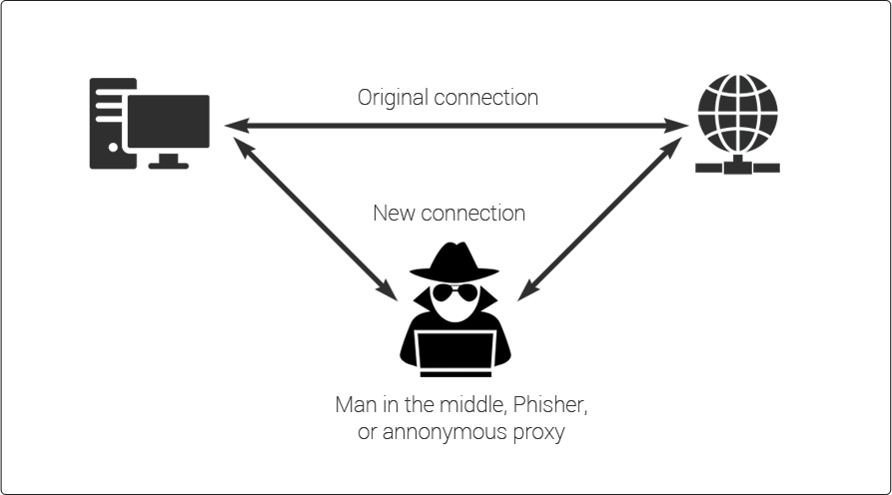
Unsafe Communication
Man-in-the-Middle Attack
Src: https://securebox.comodo.com/ssl-sniffing/man-in-the-middle-attack/

Slide 34
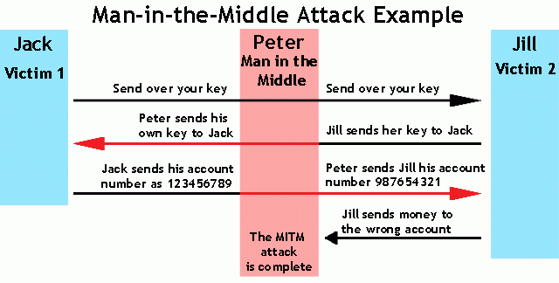
Unsafe Communication
MITM - Example (Mis)use
Src: https://www.veracode.com/security/man-middle-attack

Slide 35
Unsafe Communication
Connection encryption via SSL/TLS
Image would be too large for presentation, here is a link ;)
https://www.ssl.com/article/ssl-tls-handshake-overview/

Slide 36
Unsafe Communication
Connection encryption via SSL/TLS
Asymmetric encryption used to share key for symmetric encryption
Symmetric encryption used to encrypt the transported data
  It is faster than asymmetric encryption
Upper layer protocols (e.g. HTTP or websocket) remain unchanged

Slide 37
Unsafe Communication
Party verification
Any server can use SSL/TLS communication, including malicious ones
Certificates must be trusted by clients (browser, application)
  Having database of all certificates would be too costly
  → several trusted certificate authorities issue certificates
      Certificates issued by a trusted CA are trusted
      IdenTrust, Comodo, DigiCert, GoDaddy, …, Let´s Encrypt (free, use it!)

Slide 38
Unsafe Communication
Party verification
Certificate Authorities are responsible for issuing certificates only to proven domain owners
Whole internet is built on trust
  compromised certificate authorities can cause a lot of trouble

Slide 39
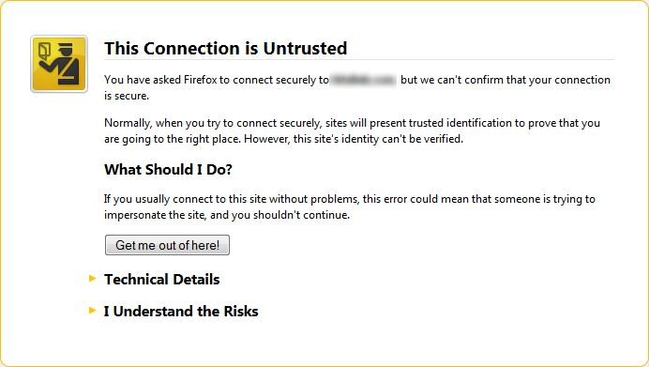
Unsafe Communication
Party verification
Browsers warn you when certificate provided by a site is not trusted
Src: https://support.mozilla.org

Slide 40
Unsafe Communication
MITM - Example (Mis)use – how does this connect to the previous slides?
Src: https://www.veracode.com/security/man-middle-attack

Slide 41
Unsafe Communication
Party verification
Services can create own certificate authorities for internal purposes
  Such authorities can be used to issue certificates for:
    Testing during development
    X.509 authentication – client sends its personal certificate instead of/in addition to username&password pair
    Server then verifies that the certificate has been issued by its own authority

Slide 42
Unsafe Communication
Party verification
Code libraries reject connections when certificate is not trusted
  Many stackoverflow answers recommend turning the certificate verification off.
  → disables the party verification
  → vulnerable to man-in-the-middle attack
  → Never do that!
  Put your own certificate authority in the trusted certificate store for the particular programming library/language to find).

Slide 43
Unchecked User Input
Every way client can interact with your system is a possible attack vector
  Injection attacks
  Cross-Site Scripting

Slide 44
SQL Injection
User provides specially-crafted SQL as form input which is then executed within the database
Goals:
  Get restricted data – trick application into printing arbitrary query results to UI
  Hijack identity – change user passwords
  Cause damage – drop database, delete records, modify records

Slide 45
SQL Injection
String loginQuery = “SELECT count(*) FROM users
WHERE username = ‘“ + uname + “’
AND password = ‘“ + pwd + “’”;
pwd = “0’; UPDATE users SET password = password(“mypass”); ‘”
Now I can login as any user.
How to prevent this kind of attack?

Slide 46
SQL Injection
Always escape all user inputs so that they appear as string literals in the query
Most languages/frameworks provide mechanism for passing parameters to queries which handle that for you
  Use them! - well-tested and (almost :) )bug-free

Slide 47
Cross-Site Scripting (XSS)
Client-side script injection attack.
Another type of injection attack – allows attacker to add arbitrary script into your page
Very dangerous – script is executed by your page (browser) → passes many browser-based protections (e.g. against CSRF)

Slide 48
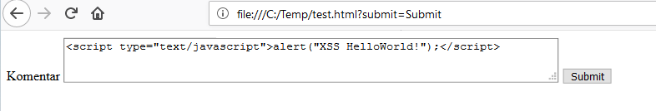
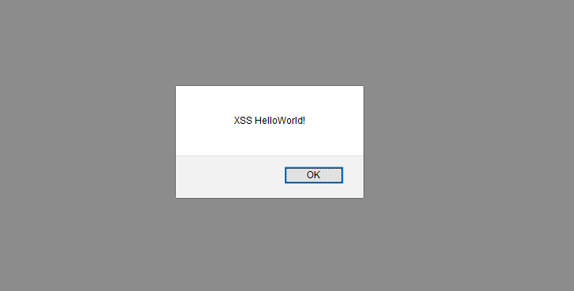
Cross-Site Scripting (XSS)
Example

Slide 49
Unsafe Deployment Configuration
Even well-written application may be unsafe if deployed in unsafe environment and/or configuration
Application Configuration
  Debug/profiling enabled
  Error/Exception printing to browser
  Development mode – often certain protections/checks disabled
    e.g. cross-origin request headers

Slide 50
Unsafe Deployment Configuration
Environment Configuration
  Remote SSH access to root account enabled
  Open unnecessary ports
    e.g. with AWS you need to specifically specify which IP addresses can SSH to server
    With databases – always allow fixed set of servers which can connect remotely
  Outdated system libraries – follow security feeds for your system
  Weak file system access rules for critical files (certificates, configuration files with passwords)

Slide 51
Summary
Security is a complex issue influencing many different areas of application development and runtime → if you have sensitive data, get an expert!
One security vulnerability may negate the others
Limit user access to your system as much as possible (without restricting functionality)
  Do not trust user input.

Slide 52
Questions?
Thank you!

