Slide 1
Web Application Architecture

Slide 2
Motivation
SW development project contains many unknowns from start
  "… with proper design, the features come cheaply. This approach is arduous, but continues to succeed."
    Dennis Ritchie
Many developers made this experience
  → best practices, paths to follow

Slide 3
Contents
Elementary design principles
  Code organization
    Single responsibility, Separation of concerns, Encapsulation, DRY
  Dependencies and their expression
    Inversion of control, Dependency injection
Common Web Application Architectures
  Application layers
  Monolithic/service-oriented application, microservices

Slide 4
Elementary Design Principles

Slide 5
Separation of Concerns
Code dealing with different work should be kept separate
Increases
  Testability
  Reusability
  Readability
Example: for user registration, implementation of input validation is irrelevant
Example files: soc_bad.example, soc_good.example
Same principle applies on class, package, module, universe level!

Slide 6
Single Responsibility Principle
Specifically for object-oriented design:
A class should have one, and only one, reason to change.
  If class has multiple responsibilities
    → each responsibility has own specifications
    → change of one responsibility specification (= reason to change the class) may impact ability of the class to fulfil the others
      → fragile design
Src: Robert C. Martin, The Single Responsibility Principle

Slide 7
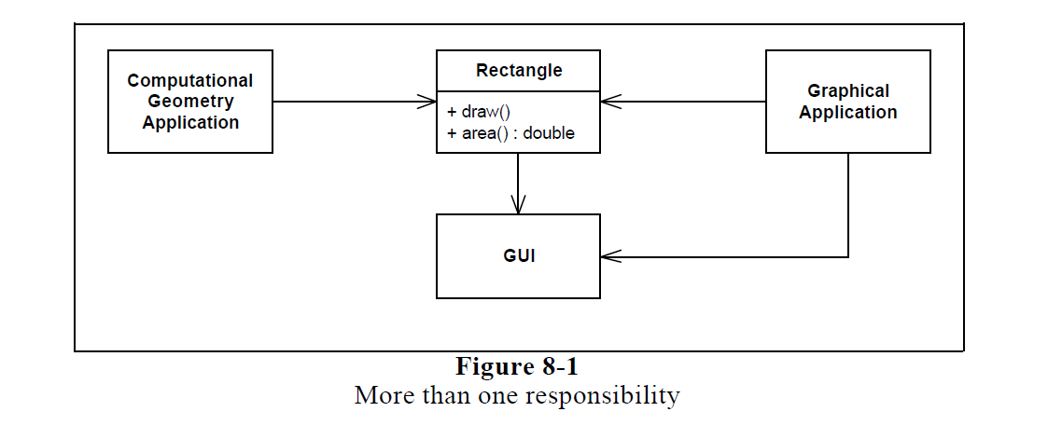
Single Responsibility Principle
Src: Robert C. Martin, The Single Responsibility Principle

Slide 8
Single Responsibility Principle
Problems with this design:
Computational application depends on GUI library through Rectangle
If Graphical application requires Rectangle to change, it may force rebuild (test, deployment) of the Computational application
Src: Robert C. Martin, The Single Responsibility Principle

Slide 9
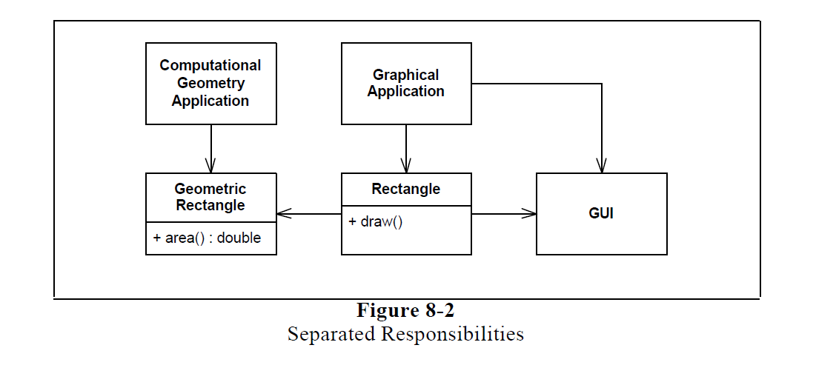
Single Responsibility Principle
Src: Robert C. Martin, The Single Responsibility Principle

Slide 10
Encapsulation
Prevent direct access to internal state of object/module
  Note encapsulation is not an OOD-related principle only
State read/change should happen only through well-defined public interfaces
  Class/module owns its state and should control how it is changed
  Auto-generating getters and setters breaks encapsulation quite often!
Examples: enc_bad.example, enc_good.example

Slide 11
Don´t Repeat Yourself (DRY)
DRY says that every piece of system knowledge should have one authoritative, unambiguous representation.
Dave Thomas
System knowledge consists of
  Code, database schemas
  Test cases and scenarios
  Documentation
  …
Src: https://www.artima.com/intv/dry.html

Slide 12
Don´t Repeat Yourself (DRY)
Multiple representations of single piece of information
  → you have to update them all when changes happen
  → awful lot of work to do
  → or they end up out of sync with each other
Src: https://www.artima.com/intv/dry.html

Slide 13
Don´t Repeat Yourself (DRY)
Authoritative representation = change only that and generate the other required representations automatically, if needed
  Example: Database schema
    Authoritative representation: UML data model
    Derivative representations generated from the UML model: SQL DDL scripts
    Example files: dra_model.pdf, dra_ddl.sql
Src: https://www.artima.com/intv/dry.html

Slide 14
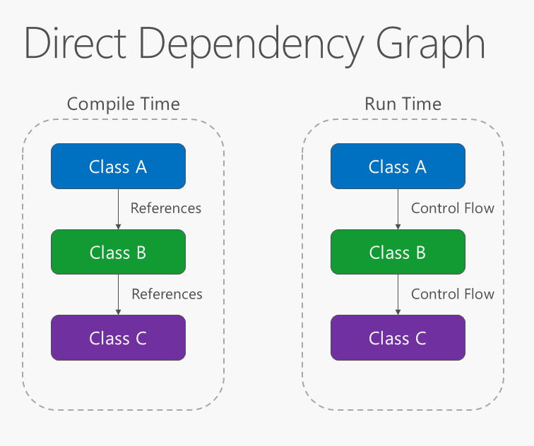
Dependency Inversion – Direct Dependencies
Src: https://docs.microsoft.com/cs-cz/dotnet/standard/modern-web-apps-azure-architecture/architectural-principles

Slide 15
Dependency Inversion – Direct Dependencies
Direct dependencies mean tight coupling between Class A and Class B
  It makes difficult to replace one implementation of Class B with another
    Changes in class A would be necessary
  → Higher level parts of system depend on the lower parts
Higher level abstractions should not depend on implementation details.

Slide 16
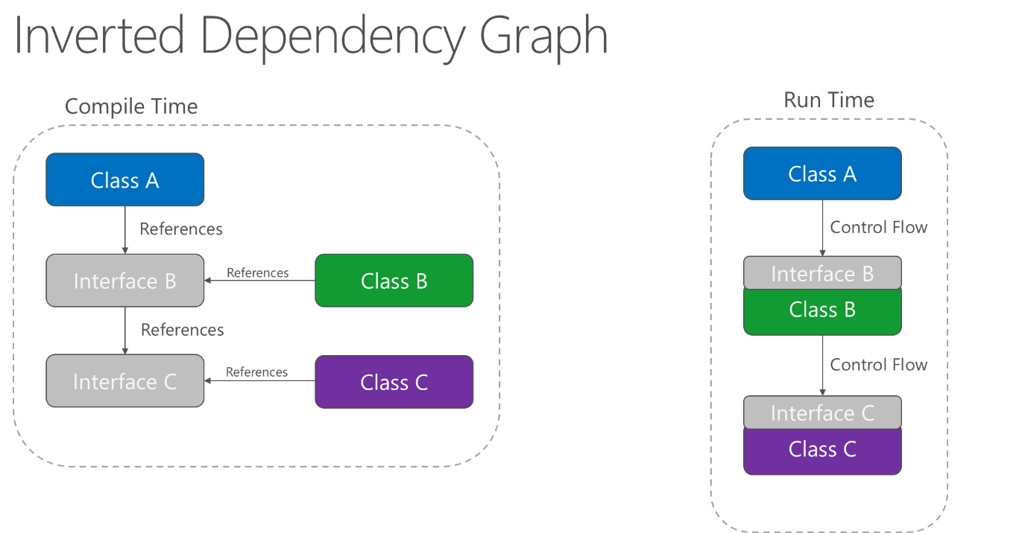
Dependency Inversion
Src: https://docs.microsoft.com/cs-cz/dotnet/standard/modern-web-apps-azure-architecture/architectural-principles

Slide 17
Dependency Inversion
Both high- and low- level modules depend on/implement abstractions (interfaces)
  → loose coupling between modules
  → easy to replace one implementation with another
    Implementation does not impact the world beyond its interface

Slide 18
Explicit Dependencies
Applications/modules/classes should advertise required dependencies for proper functionality
Solutions on several layers:
  Installation – e.g. Linux packaging system
  Build – Maven, Gradle (both Java), npm (node.js), setuptools/pip (python), etc.
  Code – constructor/function parameters

Slide 19
Explicit Dependencies
Explicit code dependencies
  Neither functions, classes nor methods should depend on a particular global state
  Functions should always take all required dependencies as arguments
  Classes should take all required dependencies as constructor parameters
    In other words object must be in initialized, consistent state after constructor call
    Optional parameters can be set via setters, but the class code must be functional even if they remain unset!
Example: explicit_dep.example

Slide 20
Sidestep: Inversion of Control
Generic term expressing whether our code, or some other (e.g. a framework) is in control of program flow (calls)
Common use-cases: dependency injection, window GUIs
Common misconception: inversion of control == dependency injection
  Dependency injection represents the IoC concept, but not the other way around
  See the example by Martin Fowler: ioc.example

Slide 21
Dependency Injection
Main idea: separate code for populating objects with their dependencies
  Configuration either in code or text (XML) file
  This code is commonly provided by so called DI Containers (such as Spring, EJB, PicoContainer)
Result: replacing dependencies requires changes at one place (the configuration) instead of all places of use

Slide 22
Dependency Injection - Constructor
Dependencies are injected via constructor
→ classes have to explicitly declare their dependencies
Preferred for mandatory dependencies
Example: di_constructor.example

Slide 23
Dependency Injection - Setter
Dependencies are injected via setters
→ classes have to provide setters for their dependencies
Preferred for optional dependencies
Example: di_setter.example
  You can see the examples are very similar. The difference is mainly conceptual.

Slide 24
Dependency Injection - Attribute
Dependencies are injected directly to attributes
→ classes don’t have to provide setters for their dependencies
Works with some DI containers, but hides the dependencies from their users
  → consider it to be an anti-pattern and avoid
  Sometimes it can be useful though (e.g. when writing unit tests)
Example: di_attribute.example

Slide 25
Service Lookup
Dependency resolution approach alternative to dependency injection.
Main idea: there is an all-knowing object (service locator) which can retrieve any instance we need.
We still need to keep reference to the service locator
Example with Spring: servicelookup.example

Slide 26
Dependency Injection vs Service Lookup
DI uses Inversion of Control principle, Service Lookup does not
Dependency Injection can be more difficult to debug (more complicated implementation)
Service Lookup forces dependency on the service locator
  That is especially a problem when writing a library which others should use
Service Lookup is less flexible, but easier to implement

Slide 27
Sources + Additional Reading
Robert C. Martin: Principles of OOD http://www.butunclebob.com/ArticleS.UncleBob.PrinciplesOfOod
Microsoft .NET Guide: Architectural Principles
https://docs.microsoft.com/cs-cz/dotnet/standard/modern-web-apps-azure-architecture/architectural-principles
Martin Fowler: Inversion of Control Containers and the Dependency Injection pattern
https://martinfowler.com/articles/injection.html

Slide 28
Monolithic Web Application

Slide 29
Service-Oriented Web Application

Slide 30
Microservices

Slide 31
Application Layers

Slide 32
Presentation Layer

Slide 33
Business Layer

Slide 34
Data Layer

Slide 35
Design Patterns

Slide 36
MVC

Slide 37
MVVC

Slide 38
MVP

Slide 39
AOP

