Slide 1
WebServices & WebSockets
Jakub Daněk (KIV ZČU, Yoso Czech s.r.o.)
WebService and WebSocket basics
http://www.danekja.org (Twitter & LinkedIn links)
http://www.yoso.fi (yep, in Finnish)

Slide 2
Motivation
How to connect different applications?
  Written in different languages
  Deployed on different platforms
  By different people

Slide 3
WebService
W3C definition:
A Web service is a software system designed to support interoperable machine-to-machine interaction over a network. It has an interface described in a machine-processable format (specifically WSDL).
Other systems interact with the Web service in a manner prescribed by its description using SOAP messages, typically conveyed using HTTP with an XML serialization in conjunction with other Web-related standards.
Restricted to SOAP, not meant as generic definition (other things can be webservices too...)

Slide 4
WebService
Way to connect applications on web
  Using standardized open protocols (HTTP, SOAP)
  Using standardized open data formats (XML, JSON)
  → providers do not need to care about their client’s technology stack, platform, etc.

Slide 5
WebService
Example
GET /posts HTTP/1.1
//response
HTTP/1.1 200 OK
{
"id": 4,
"content": "Good morning, we've talked the whole night
through.",
"createdBy": "Duelling Cavalier"
}

Slide 6
WebService
Black box
  Consumers are not aware of implementation of the services they are consuming
Stateless
  In most cases web service calls are stateless
  Simpler design
  Better scalability

Slide 7
WebService – Uses
Reusable components
  User authentication, weather forecast, currency conversion, navigation
Connect existing software
  Independent of programming language (web standards)
  Independent of platform (Unix, Windows, Raspberry PI)

Slide 8
Sources
http://www.w3schools.com/xml/xml_services.asp
https://www.w3.org/TR/ws-arch/

Slide 9
Simple Object Access Protocol (SOAP)

Slide 10
SOAP
Messaging protocol
  Message format
  Encoding rules for datatypes
XML-based
  All messages exchanged in XML format
Actions determined by message content

Slide 11
SOAP - Message
Envelope
  XML element encapsulating the SOAP message
Header
  Means for protocol extension, may provide additional information about the message sent, security, etc.
Body
  The message data
Fault
  Information generated by a processing node on error

Slide 12
SOAP
<env:Envelope xmlns:env="http://www.w3.org/2003/05/soap-envelope">
<env:Fault>
...
</env:Fault
<env:Header>
...
</env:Header>
<env:Body>
...
</env:Body>
</env:Envelope>

Slide 13
SOAP
Advantages
  Flexible
  Extensible
  Uses XML – XSD, internationalization, namespaces

Slide 14
SOAP
Disdvantages
  No standardized API design approach
  Uses XML
    Message size and complexity grows quickly
    → Performance issues

Slide 15
SOAP – Example 1 (request)
POST /InStock HTTP/1.1
Host: www.example.org
Content-Type: application/soap+xml; charset=utf-8
Content-Length: nnn
<?xml version="1.0"?>
<soap:Envelope xmlns:soap="http://www.w3.org/2003/05/soap-envelope/"
soap:encodingStyle="http://www.w3.org/2003/05/soap-encoding">
<soap:Body xmlns:m="http://www.example.org/stock">
<m:GetStockPrice>
<m:StockName>IBM</m:StockName>
</m:GetStockPrice>
</soap:Body>
</soap:Envelope>

Slide 16
SOAP – Example 1 (response)
HTTP/1.1 200 OK
Content-Type: application/soap+xml; charset=utf-8
Content-Length: nnn
<?xml version="1.0"?>
<soap:Envelope xmlns:soap="http://www.w3.org/2003/05/soap-envelope/"
soap:encodingStyle="http://www.w3.org/2003/05/soap-encoding">
<soap:Body xmlns:m="http://www.example.org/stock">
<m:GetStockPriceResponse>
<m:Price>34.5</m:Price>
</m:GetStockPriceResponse>
</soap:Body>
</soap:Envelope>

Slide 17
SOAP – Example 2
Example
  See the attached file WebServices_sovohje_en.pdf
Portion of WS API specification of OP Bank (Finland)
Specifically pages 12 and 13

Slide 18
WebService Description Language (WSDL)
XML Schema for describing WebServices
Not restricted to SOAP
  But commonly used in conjunction
Allows generating of client code

Slide 19
WSDL - Elements
<types>
  defines the (XML Schema) data types used by the web service
<message>
  defines the data elements for each operation
<portType>
  operations that can be performed and the messages involved as input, output, on error
<binding>
  binding of portType to certain protocol (e.g. SOAP)

Slide 20
WSDL Example – OP Bank (www.pohjola.fi) WS API

Slide 21
WSDL - Elements
<types>
  defines the (XML Schema) data types used by the web service
  standard XSD
  <wsdl:types>
  <xsd:schema targetNamespace="http://mlp.op.fi/OPCertificateService"
  elementFormDefault="qualified" attributeFormDefault="qualified">
  <xsd:complexType name="CertificateRequestHeader">
  ...
  </xsd:complexType>
  <xsd:complexType name="GetCertificateRequest">
  <xsd:sequence>
  <xsd:element name="RequestHeader" type="tns:CertificateRequestHeader" nillable="false"/>
  <xsd:element name="ApplicationRequest" type="xsd:base64Binary" nillable="false"/>
  </xsd:sequence>
    </xsd:complexType>
  <xsd:element name="getCertificatein" type="tns:GetCertificateRequest"/>
  </xsd:schema>
  </wsdl:types>

Slide 22
WSDL - Elements
<message>
  defines the data elements for each operation
  <wsdl:message name="getCertificateRequest">
  <wsdl:part element="tns:getCertificatein" name="getCertificatein"/>
  </wsdl:message>

Slide 23
WSDL - Elements
<portType>
  operations that can be performed and the messages involved as input, output, on error
  <wsdl:portType name="OPCertificateServicePortType">
  <wsdl:operation name="getCertificate">
  <wsdl:input message="tns:getCertificateRequest" name="getCertificateRequest"/>
  <wsdl:output message="tns:getCertificateResponse" name="getCertificateResponse"/>
  <wsdl:fault message="tns:certificateServiceFault" name="certificateServiceFault"/>
  </wsdl:operation>
  </wsdl:portType>

Slide 24
WSDL - Elements
<binding>
  binding of portType to certain protocol (e.g. SOAP)
  <wsdl:binding name="OPCertificateServiceHttpBinding" type="tns:OPCertificateServicePortType">
  <soap:binding style="document" transport="http://schemas.xmlsoap.org/soap/http"/>
  <wsdl:operation name="getCertificate">
  <soap:operation soapAction=""/>
  <wsdl:input name="getCertificateRequest"> <soap:body use="literal"/> </wsdl:input>
  <wsdl:output name="getCertificateResponse"> <soap:body use="literal"/> </wsdl:output>
  <wsdl:fault name="certificateServiceFault"> <soap:fault use="literal"/> </wsdl:fault>
  </wsdl:operation>
  </wsdl:binding>

Slide 25
Sources
https://www.w3.org/TR/2007/REC-soap12-part0-20070427/
https://www.w3.org/TR/soap12-part1/
https://www.pohjola.fi/pohjola/corporate-customers/payment-services-and-cash-management/bank-connection-methods/web-services?id=323430&kielikoodi=en
http://www.w3schools.com/xml/xml_soap.asp

Slide 26
RESTful Web Services

Slide 27
Representational State Transfer (REST)
Architectural pattern for web-service design
  NOT a protocol (such as SOAP)
Set of simple guidelines on designing WS API
Goal: create APIs that are easy to use

Slide 28
REST
Resource-oriented
  Endpoints like: /posts, /users, /categories etc.
Explicit use of HTTP methods
  GET, PUT, DELETE etc.
Stateless

Slide 29
REST - Resource
Identified by URI (commonly a link on the Web)
  e.g. http://www.blogysek.com/authors
    “authors” resource
Directory-like structure
  http://www.blogysek.com/authors – all authors
  http://www.blogysek.com/authors/{id} – single author
  http://www.blogysek.com/authors/{id}/articles – all articles belonging to the author

Slide 30
REST - Operations
Use of HTTP Methods
GET – read data
GET /posts HTTP/1.1
//response
HTTP/1.1 200 OK
{
"id": 4,
"content": "Good morning, we've talked the whole night
through.",
"createdBy": "Duelling Cavalier"
}

Slide 31
REST - Operations
Use of HTTP Methods
GET – query data
GET /posts?author=”Duelling Cavalier” HTTP/1.1
//response
HTTP/1.1 200 OK
{
"id": 4,
"content": "Good morning, we've talked the whole night
through.",
"createdBy": "Duelling Cavalier"
}

Slide 32
REST - Operations
Use of HTTP Methods
DELETE – remove data
DELETE /posts/12 HTTP/1.1
//response
HTTP/1.1 204 No Content

Slide 33
REST - Operations
Use of HTTP Methods
POST – create/update data
POST /posts/ HTTP/1.1
{
"content": "Good morning, we've talked the whole night
through.",
"createdBy": "Duelling Cavalier"
}
//response
HTTP/1.1 201 Created
Location: /posts/63636

Slide 34
REST - Operations
Use of HTTP Methods
PUT – create/update data
PUT /posts/12 HTTP/1.1
{
"content": "Good morning, we've talked the whole night
through.",
"createdBy": "Duelling Cavalier"
}
//response
HTTP/1.1 201 Created
Location: /posts/12

Slide 35
REST - Operations
Use of HTTP Methods
PUT vs POST
  POST – when we do not know exact resource location
  POST /posts/ HTTP/1.1
    e.g. when server generates IDs for new resources
  PUT – when we do know the exact resource location
  PUT /posts/12 HTTP/1.1

Slide 36
REST - Operations
Use of HTTP Methods
PUT vs POST
  POST – repeated sending of the same data does not guarantee the same result each time
    e.g. multiple resources are created
  PUT – repeated sending of the same data always has the same result
  → PUT is IDEMPOTENT operation

Slide 37
REST - Operations
Use of HTTP Methods
PUT vs POST
  Both can be used for creating new or updating existing resources
  POST create:
  POST /posts/ HTTP/1.1
{
"content": "Good morning, we've talked the whole night
through.",
"createdBy": "Duelling Cavalier"
}

Slide 38
REST - Operations
Use of HTTP Methods
PUT vs POST
  Both can be used for creating new or updating existing resources
  POST update:
  POST /posts/ HTTP/1.1
{
"id": "12",
"content": "Good morning, we've talked the whole night
through.",
"createdBy": "Duelling Cavalier"
}

Slide 39
REST - Operations
Use of HTTP Methods
PUT vs POST
  Both can be used for creating new or updating existing resources
  PUT create (presuming post 12 doesn’t exist):
  PUT /posts/12 HTTP/1.1
{
"content": "Good morning, we've talked the whole night
through.",
"createdBy": "Duelling Cavalier"
}

Slide 40
REST - Operations
Use of HTTP Methods
PUT vs POST
  Both can be used for creating new or updating existing resources
  PUT update (presuming post 12 exists):
  PUT /posts/12 HTTP/1.1
{
"content": "Good morning, we've talked the whole night
through.",
"createdBy": "Duelling Cavalier"
}

Slide 41
REST - Operations
Use of HTTP Methods
OPTIONS – list of allowed methods
OPTIONS /posts/ HTTP/1.1
//response
HTTP/1.1 200 OK
Allow: HEAD,GET,DELETE,OPTIONS

Slide 42
REST - Operations
Use of HTTP Methods
PATCH – partial modification of a resource
PATCH /posts/12 HTTP/1.1
{
"createdBy": "Gene Kelly"
}
//response
HTTP/1.1 200 OK

Slide 43
REST - Operations
Design notes:
  You do not have to implement all methods for all resources
  Which methods you allow for a resource is up to you
  What if I really need method name in URI?
    e.g. advanced search (too many parameters for URI query parameters)

Slide 44
REST - Operations
Design notes:
  What if I really need method name in URI?
    e.g. advanced search (too many parameters for URI query parameters)
    POST /posts/queries HTTP/1.1
    or
    POST /posts/forms/search HTTP/1.1

Slide 45
REST – Data Format
Any standard data serialization format that suits you (or support multiple)
  XML
  JSON
    JSON takes less space than XML :)
  YAML

Slide 46
REST - HATEOAS
Hypertext As The Engine Of Application State
  Use hypertext to allow clients to traverse your API:
  GET /posts/4 HTTP/1.1
  //response
HTTP/1.1 200 OK
<post id=”4”>
<content>
Good morning, we've talked the whole night through.
</content>
<createdBy>Duelling Cavalier</createdBy>
<link rel=”author” href=”/authors/22”/>
</post>

Slide 47
REST - Summary
Directory-like, resource oriented endpoint structure
HTTP methods for operations
→ all APIs look similar
You do not need to follow all the guidelines for your API to be usable

Slide 48
REST - Sources
http://restcookbook.com
http://www.restapitutorial.com
http://docs.oracle.com/javaee/6/tutorial/doc/gijqy.html
https://apiary.io/

Slide 49
WebSockets

Slide 50
Motivation
Some applications need to notify users of new events “real-time”
  e.g. an auction system
But standard scenario on the web is that server sends information to clients only “on request”

Slide 51
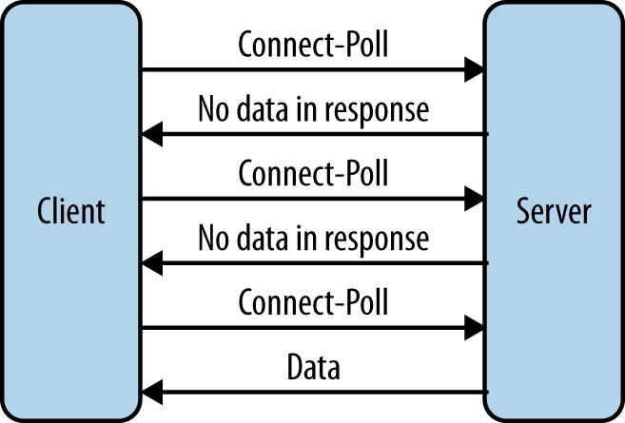
Polling
Clients ask server periodically for new information (“Are we there, yet?”)
  If there is none,
  server response is empty
  Load issues on the server
  side
Img src: http://enterprisewebbook.com/ch8_websockets.html

Slide 52
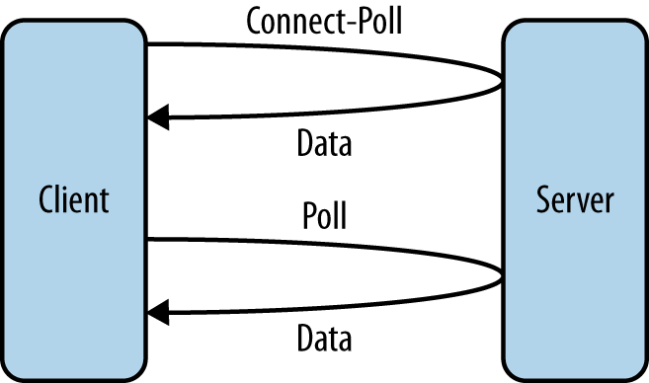
Long-Polling
Clients still ask server periodically for new information
  Server does not answer until
  there are some data to
  return
  Or until specified time
  passes
Img src: http://enterprisewebbook.com/ch8_websockets.html

Slide 53
WebSockets
Messaging protocol for two-way communication
  Messages can be sent simultaneously in both directions
TCP-based
Supported by most modern browsers (HTML 5)

Slide 54
WebSockets
Connection established using HTTP handshake
Use the same ports as HTTP (80 and 443)
ws:// and wss:// URI schemes
  ws://www.myserver.com/chat

Slide 55
WebSockets - handshake
Connection established using HTTP handshake
  Client sends:
  GET /chat HTTP/1.1
  Host: www.myserver.com
  Upgrade: websocket
  Connection: Upgrade
  Sec-WebSocket-Key: x3JJHMbDL1EzLkh9GBhXDw==
  Sec-WebSocket-Protocol: chat, superchat
  Sec-WebSocket-Version: 13
  Origin: http://www.myserver.com

Slide 56
WebSockets - handshake
Connection established using HTTP handshake
  If server supports websocket, the response is:
  HTTP/1.1 101 Switching Protocols
  Upgrade: websocket
  Connection: Upgrade
  Sec-WebSocket-Accept: HSmrc0sMlYUkAGmm5OPpG2HaGWk=
  Sec-WebSocket-Protocol: chat

Slide 57
WebSockets - handshake
Connection established using HTTP handshake
After a successful handshake
  Protocol is switched from HTTP to WebSocket (bi-directional)
    Uses the same TCP connection

Slide 58
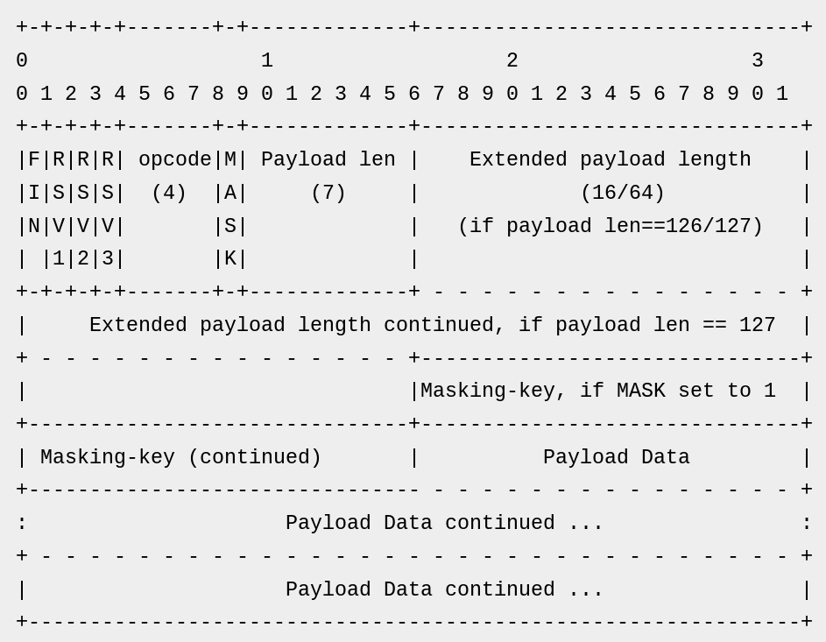
WebSockets - Message
Each message is split into either one or multiple data frames
Img src: http://enterprisewebbook.com/ch8_websockets.html

Slide 59
WebSockets - Message
FIN (1 bit)
  Indicates whether this is the last frame of the message
Img src: http://enterprisewebbook.com/ch8_websockets.html

Slide 60
WebSockets - Message
RSVx (1 bit)
  Reserved bits for future protocol extensions
  always zero for now
Img src: http://enterprisewebbook.com/ch8_websockets.html

Slide 61
WebSockets - Message
opcode (4 bits)
  Frame type
  0x01 – UTF-8 data
  0x02 – binary data
  0x00 – continued payload
  ...
Img src: http://enterprisewebbook.com/ch8_websockets.html

Slide 62
WebSockets - Message
mask (1 bit)
  True if frame is masked
Masking-key
  If mask == 1
  Used to XOR the payload
Img src: http://enterprisewebbook.com/ch8_websockets.html

Slide 63
WebSockets - Message
Payload length
  0–125 indicate the length of the payload.
  126 means that the following 2 bytes indicate the length.
  127 means the next 8 bytes indicate the length.
Payload data
  The actual sent data
Img src: http://enterprisewebbook.com/ch8_websockets.html

Slide 64
WebSockets - Message
First frame states message data type using opcode 0x01 or 0x02
The following frames have opcode 0x00
Last frame has FIN == 1

Slide 65
WebSockets - Heartbeat
Both sides need to be aware if the counterpart is still there
  Ideally before the next “send” attempt
  When asking, “ping” message is sent – opcode 0x9
    May contain application data (up to 125 bytes)
  As an answer, “pong” message is sent – opcode 0xA
    Must contain the same application data as the “ping” message

Slide 66
WebSockets – Closing Connection
Both sides may close the connection
Opcode 0x08
Additional data such as exit code, reason (arbitrary string) or whether the closing was “clean” can be sent

Slide 67
WebSockets – HTML 5 API
//attempt connection
  var socket = new WebSocket(“ws://myserver.com/chat”);
  //handler called on successful connection
  socket.onopen = function() {
    console.log(“Connection successful”);
  }
  //handler called when a message is received
  socket.onmessage = function(msg) {console.log(msg.data);}
  //sending a message
  socket.send(“Ahoj svete!”);

Slide 68
Sources
https://tools.ietf.org/html/rfc6455#page-27
http://enterprisewebbook.com/ch8_websockets.html
https://www.websocket.org/aboutwebsocket.html
http://lucumr.pocoo.org/2012/9/24/websockets-101/
http://docs.spring.io/spring/docs/current/spring-framework-reference/html/websocket.html

Slide 69
Thank You!

