Slide 1
Study Sets
By Team Deepcourse
Justin Barragan, Max Panec, Peizu Li, and Hung Nguyen (Lead)

Slide 2
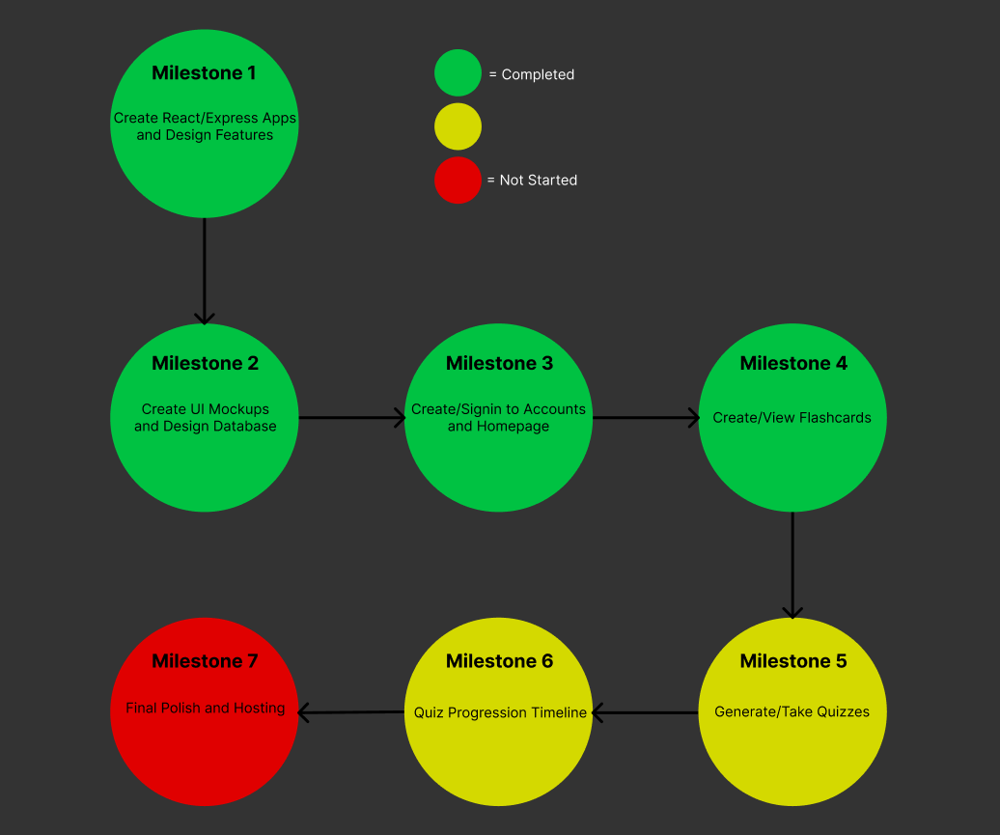
Progress

Slide 3
Progress
Finished Quiz and Score APIs
UI Elements created for taking quiz (just need to connect to backend)
Finished popup prompt for taking a quiz
Seeing past quiz scores still in progress

Slide 4
Bug Fixes
Fixed not being able to signin after signup (now it automatically signs in after signup)
Fixed not being able to create flashcard set (bug above was causing this bug)

Slide 5
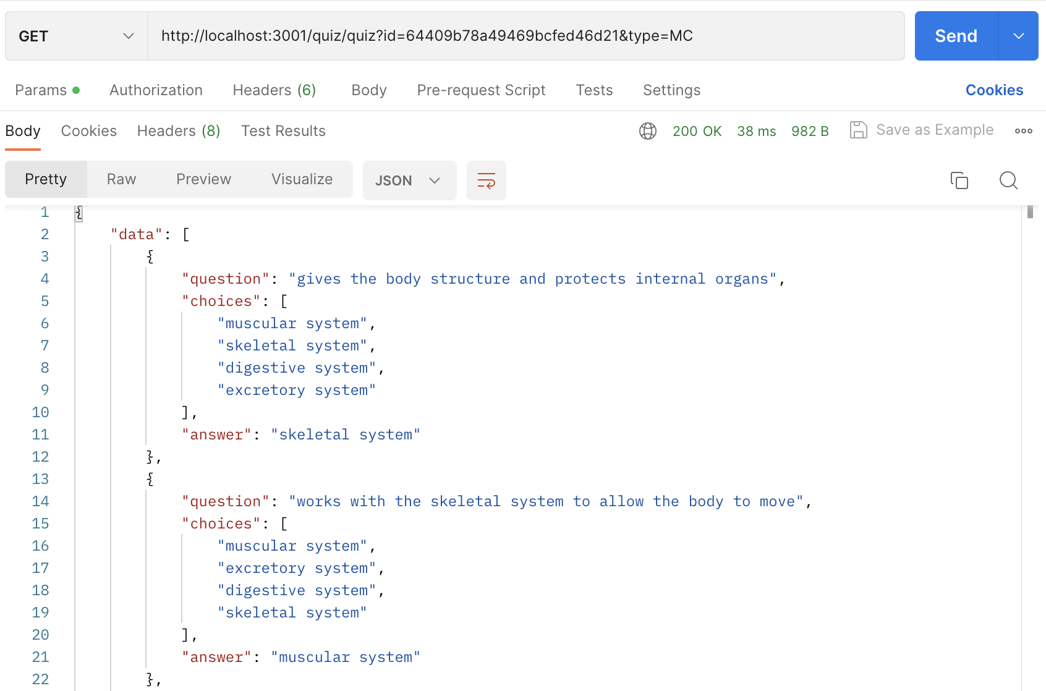
Screenshots: Generate Quiz API

Slide 6
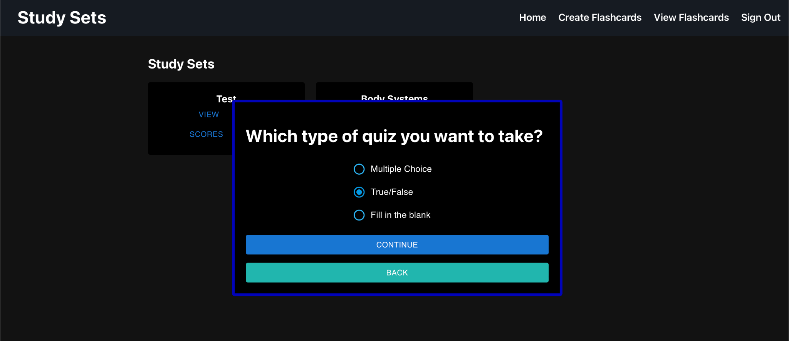
Screenshots: Quiz Type Prompt

Slide 7
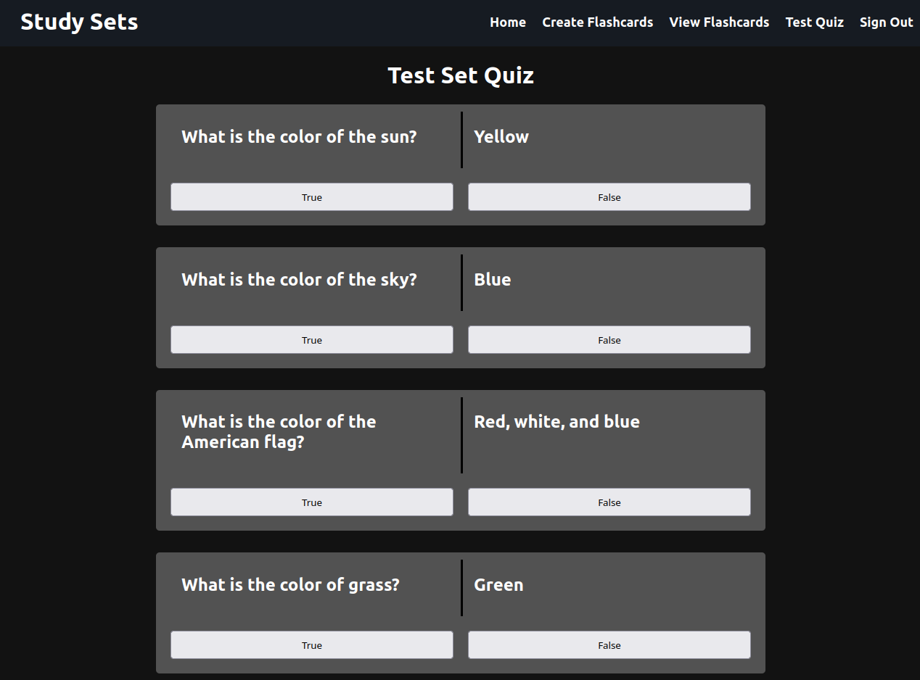
Screenshots: Taking Quiz

Slide 8
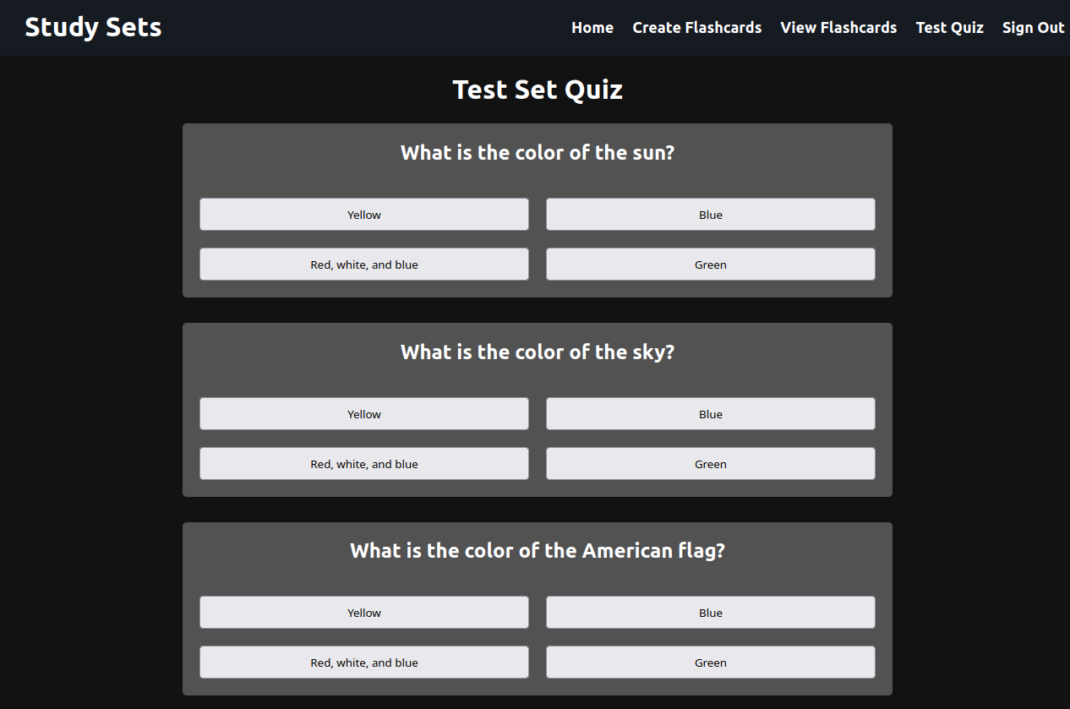
Screenshots: Taking Quiz

Slide 9
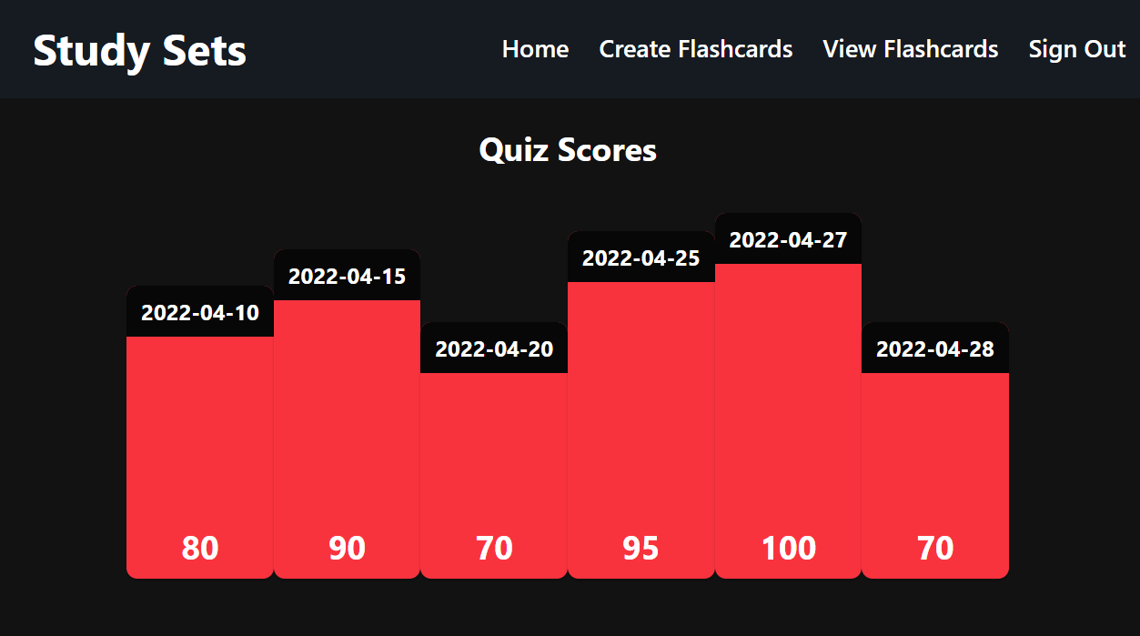
Screenshots: Quiz Performance

Slide 10
Hosting
Looking into hosting frontend on Github pages and backend on Heroku
Need to finish setting up GitHub Student Development package
Want to finish our quiz milestones before setting up hosting
Planning to set up hosting by next week

Slide 11
Demo

Slide 12
Team Feedback/Response
Feedback from Team Luna R:
Clean and organized UI.
The flow of learning is clear and unambiguous
Expert user experience in building/testing the product is easy to follow. We can easy to run the project first try.
Response:
We will continue doing what we’ve been doing

