Slide 1
Study Sets
By Team Deepcourse
Justin Barragan, Max Panec, Peizu Li, and Hung Nguyen

Slide 2
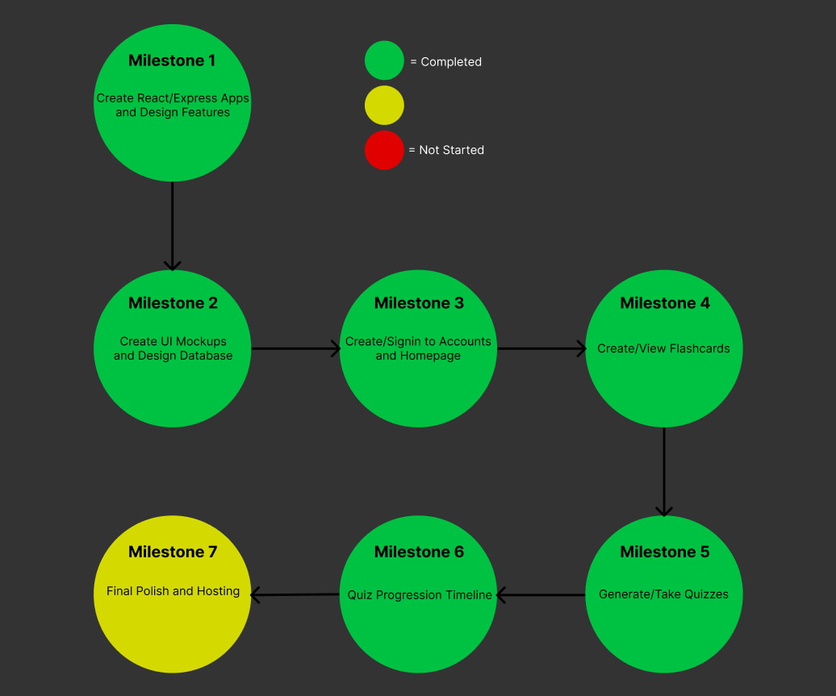
Progress

Slide 3
Progress
Completed our quiz milestones
Need to set up hosting and finish testing
Going to go back and polish some UI/UX

Slide 4
Hosting
Looking into hosting frontend on Github pages and backend on Heroku
Got accepted for Github Student Developer pack so its free
Finished quiz milestones so going to start setting up hosting this week

Slide 5
Demo

Slide 6
Help
Team Audiovision did not need any help

Slide 7
Aggregate Feedback
No bugs
Enhancements
List all password requirements during signup (From Librarians)
Show question/answer label for corresponding side while on deck view mode (From Professor)
Edit flashcards (From Librarians)
Dynamically handle email, username, and password validation on frontend (From Professor) (Will not be adding)

Slide 8
Team Feedback/Response
Feedback from AudioVision:
Successfully built the project based on expert user documentation
Overall good UI/UX
Quiz scores start getting squished when you take too many quizzes
Response:
We fixed the issue with the quiz score display by only displaying 5 at a time

