Slide 1
Study Sets
By Team Deepcourse
Justin Barragan, Max Panec, Peizu Li, and Hung Nguyen

Slide 2
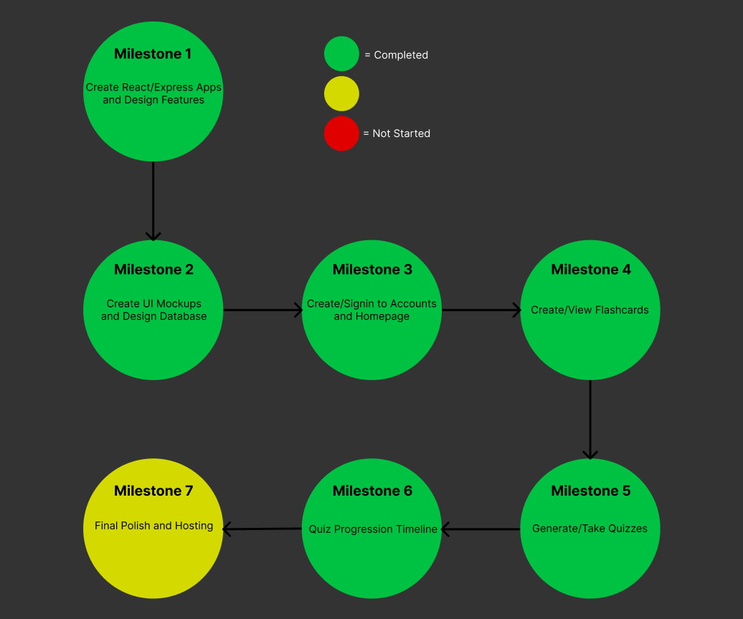
Progress

Slide 3
Progress
Completed all our features
Have accounts
Create/View flashcards
Delete/Edit flashcards
Take different types of quizzes
View past quiz scores
Currently adding final polishes

Slide 4
Hosting
Hosting frontend on Github pages and backend on Heroku
Will be done this week

Slide 5
Demo

Slide 6
Aggregate Feedback
No bugs
Enhancements
List all password requirements during signup (From Audiovision)
Quiz scores are compressed when there is too many (From Audiovision)
Show question/answer label for corresponding side while on deck view mode (From Professor)
Edit flashcards (From Librarians)
Delete flashcards (From Librarians)
Dynamically handle email, username, and password validation on frontend (From Professor) (Will not be adding)

Slide 7
Team Feedback/Response
Feedback from Librarians:
All features work
Add to quiz that you need at least 4 flashcards
Short answer quiz is strict on grading
Response:
We will add the message for needing 4 flashcards
We are unable to change grading of short answer as making it a not 1 to 1 match would require machine learning which is too late to add

