Slide 1
Study Sets
By Team Deepcourse
Justin Barragan, Max Panec, Peizu Li, and Hung Nguyen (Lead)

Slide 2
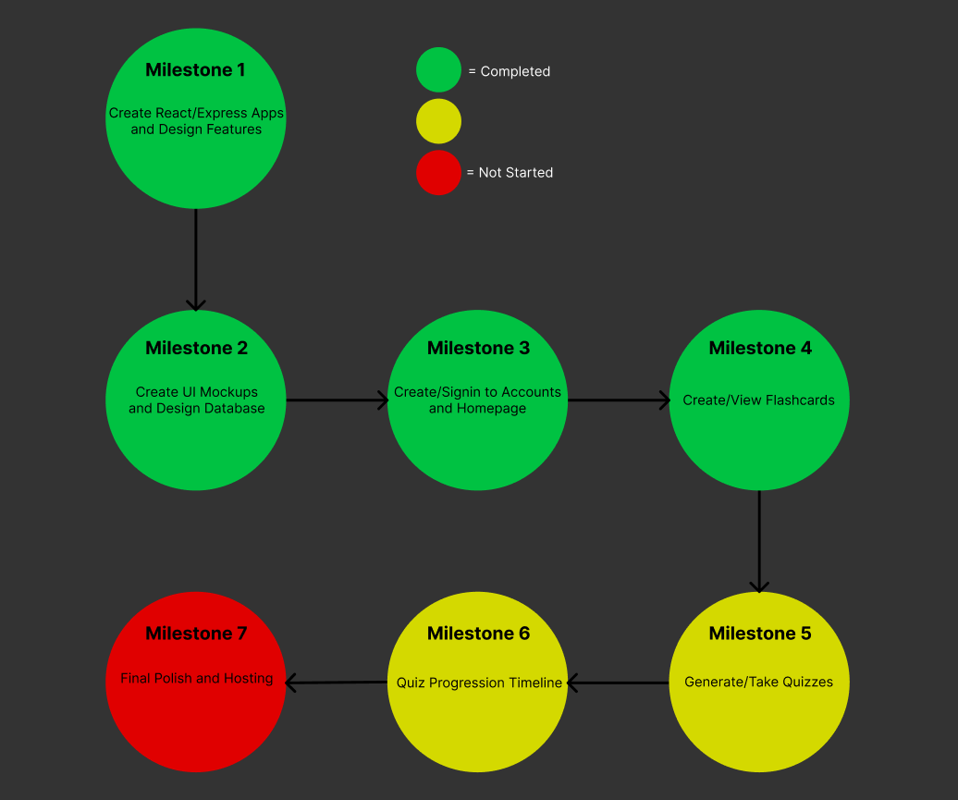
Progress

Slide 3
New and Upcoming Features
Users can now create flashcard sets, select which of their flashcard sets they want to view, view a flashcard set in table or deck mode
Quiz features are now in development

Slide 4
Demo
Show partner team a demo

Slide 5
Hosting
Looking into hosting frontend on Github pages and backend on Heroku
Need to finish verifying if they are compatible with our tech stack and setting up free student use
Want to finish our quiz milestones before setting up hosting
Looking to host around end of April beginning of May

Slide 6
Team Feedback/Response
Feedback from Team The Librarians:
Expert Users Doc was clear and easy to follow
Project built and run with no issues
Errors/Recommendations:
List password requirements
Remove button doesn’t work for flashcards
Default to deck mode or give option for which to default to
When making card, no area to fill out category or description
Add edit feature to flashcards
Response:
Will add clarity/QOL features to signup page & flashcard set view page, including an edit option
Will add additional fields to the flashcard creation page

