Slide 1
Study Sets
By Team Deepcourse
Justin Barragan, Max Panec, Peizu Li, and Hung Nguyen (Lead)

Slide 2
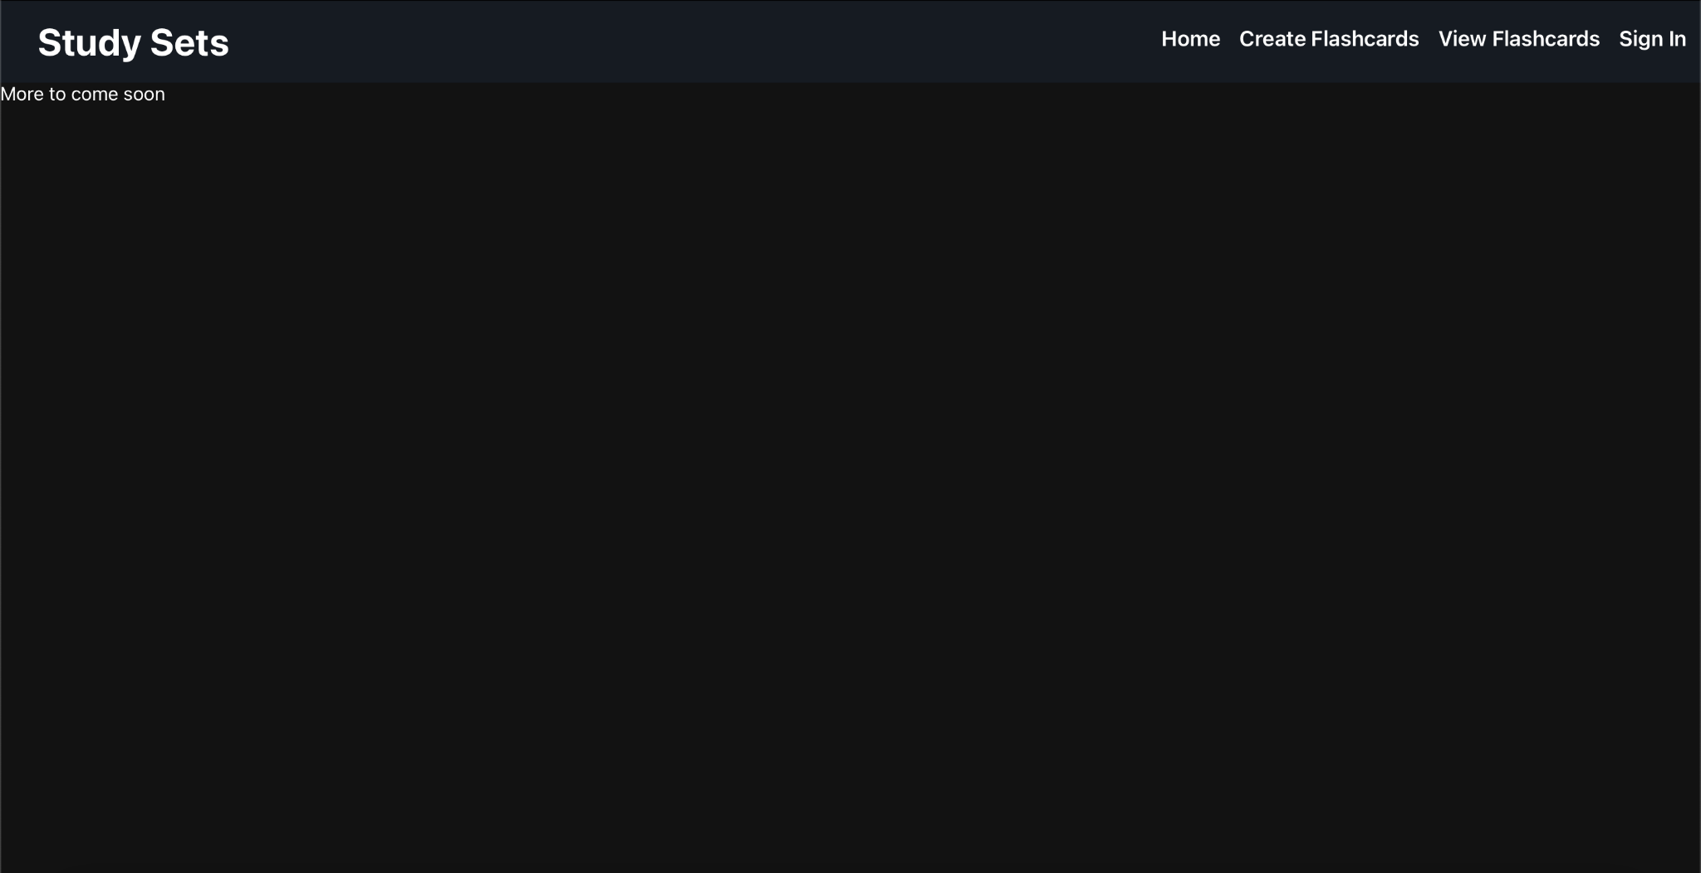
Homepage Skeleton

Slide 3
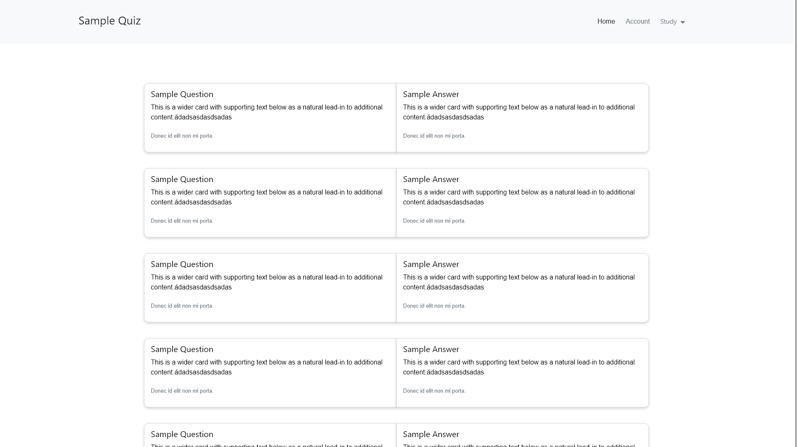
Mockups - Viewing flashcards

Slide 4
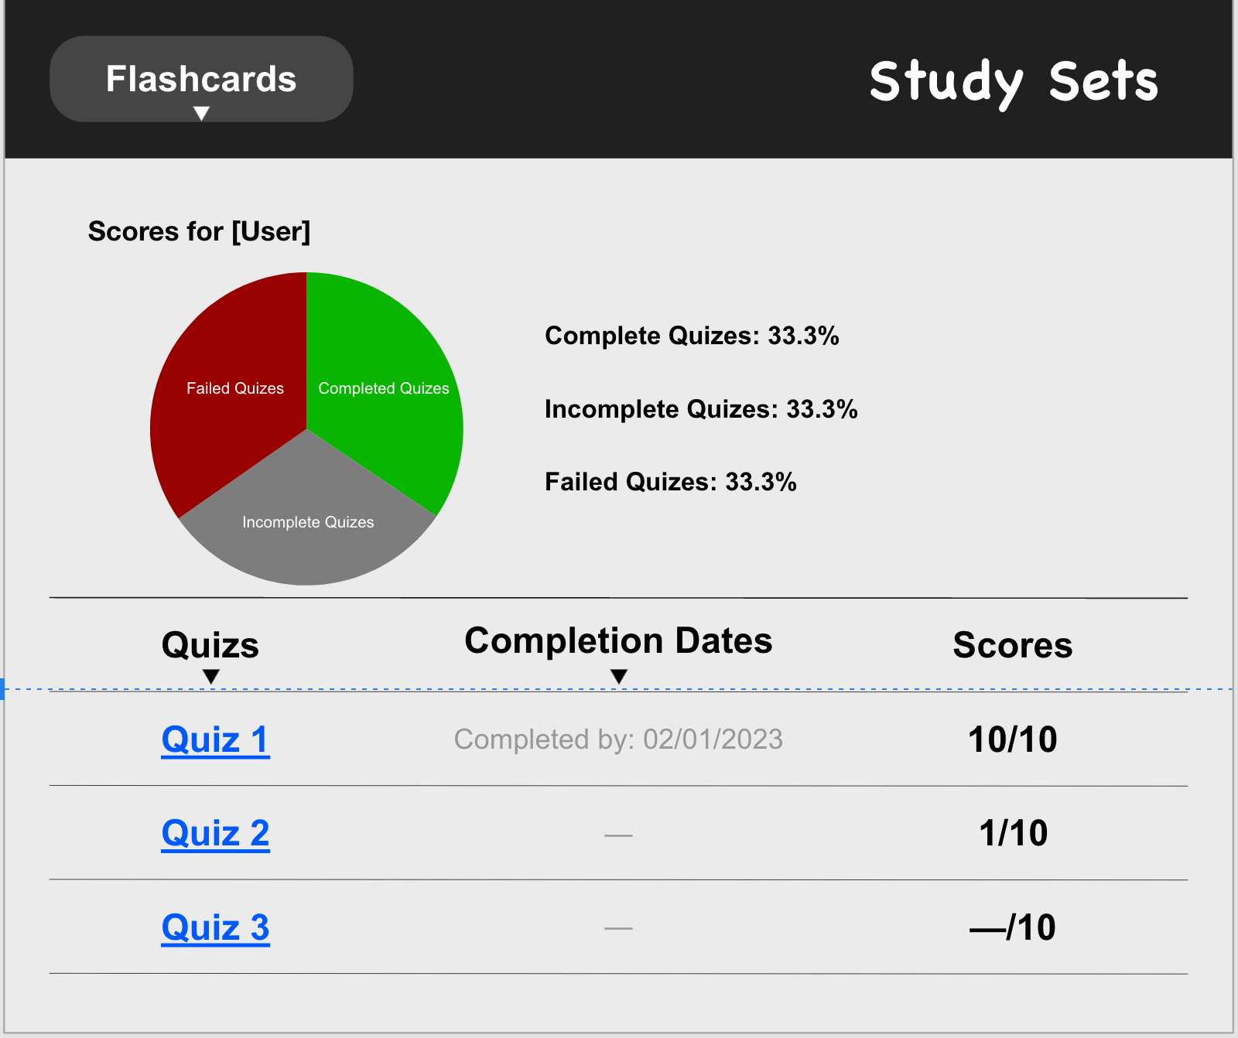
Mockups - Viewing Scores

Slide 5
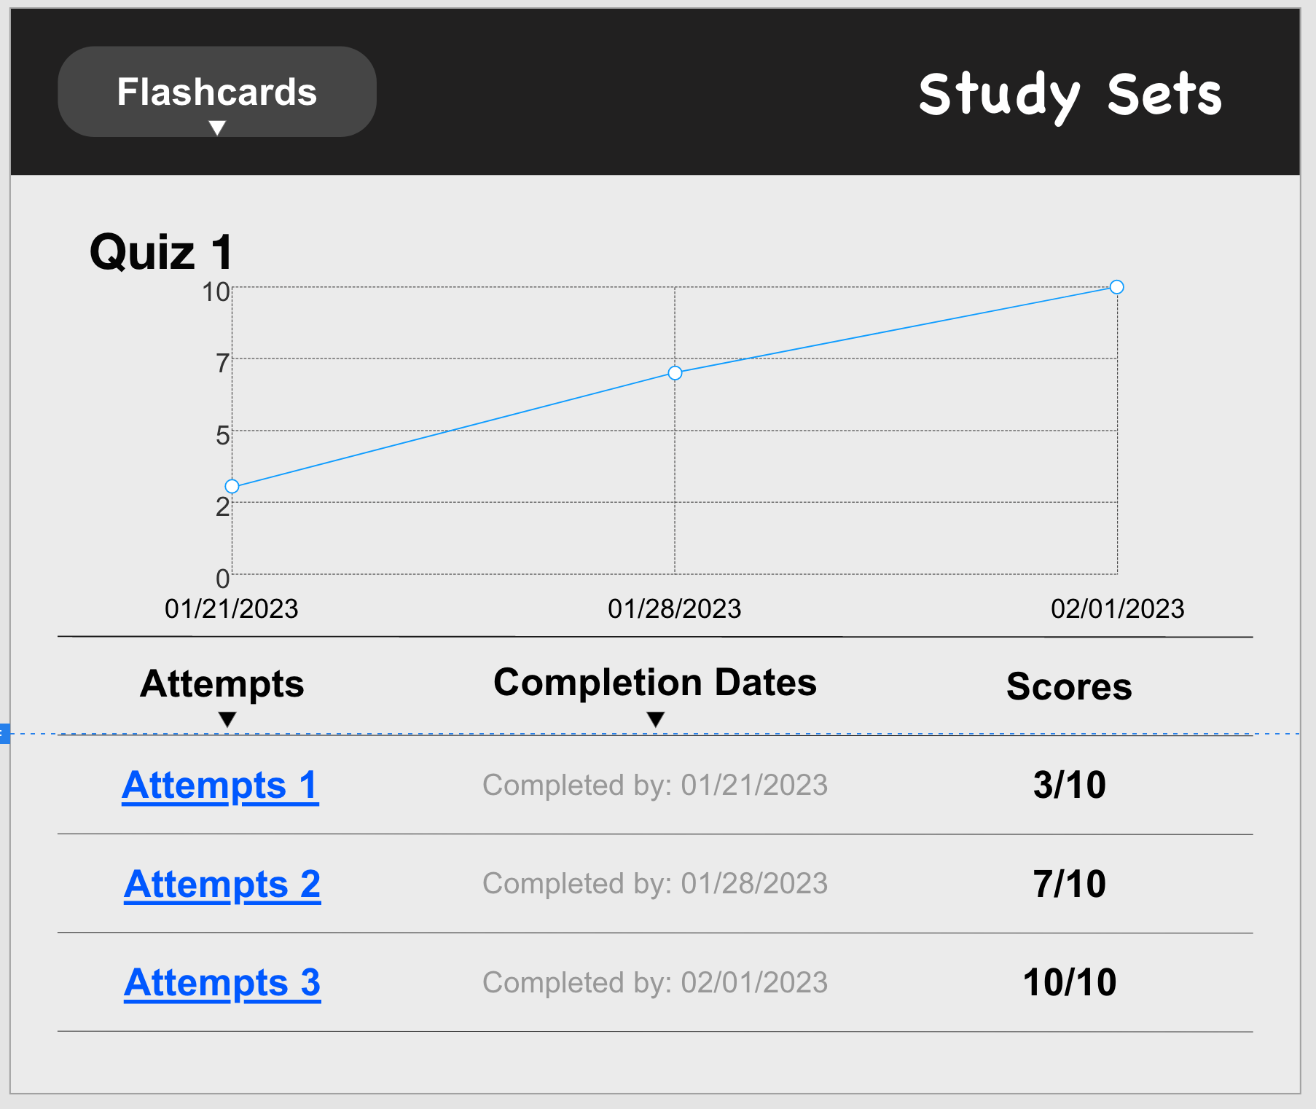
Mockups - Viewing Scores

Slide 6
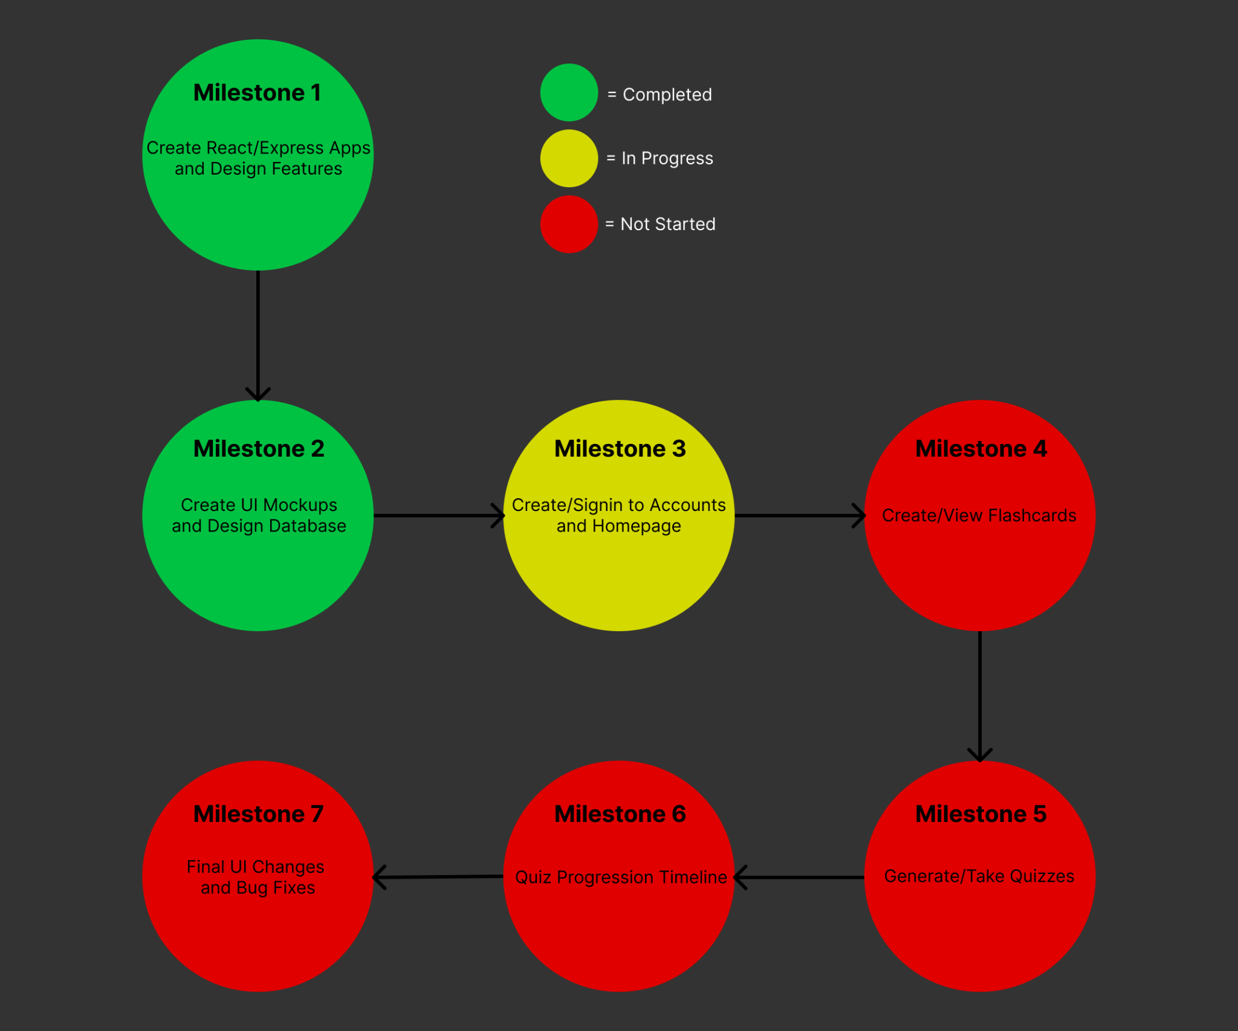
Progress

Slide 7

Testing Plan Simplified
Use Postman to verify the backend APIs create and return the current data
After the APIs for a feature are complete and tested, go through the feature use case. Then make sure the data was created in Database (verify via postman) and data is accurately being displayed on frontend

Slide 8
Features Explained
-create account
-create flashcard set
-view all flashcard set
-view flashcards in a set
-take a quiz on a flashcard set
-view timeline of scores for flashcard set

Slide 9
Team Gladiator feedback to Deepcourse
The documentation was well made. It was really easy to build out the app
The UI mockups are also super thorough

Slide 10
Feedback Response
Documentation: we’ll continue to use a similar format in the future
Mockups: we’ll stick to a similar theme / layout when building the frontend

