Slide 1
Study Sets
By Team Deepcourse
Justin Barragan, Max Panec, Peizu Li, and Hung Nguyen (Lead)

Slide 2
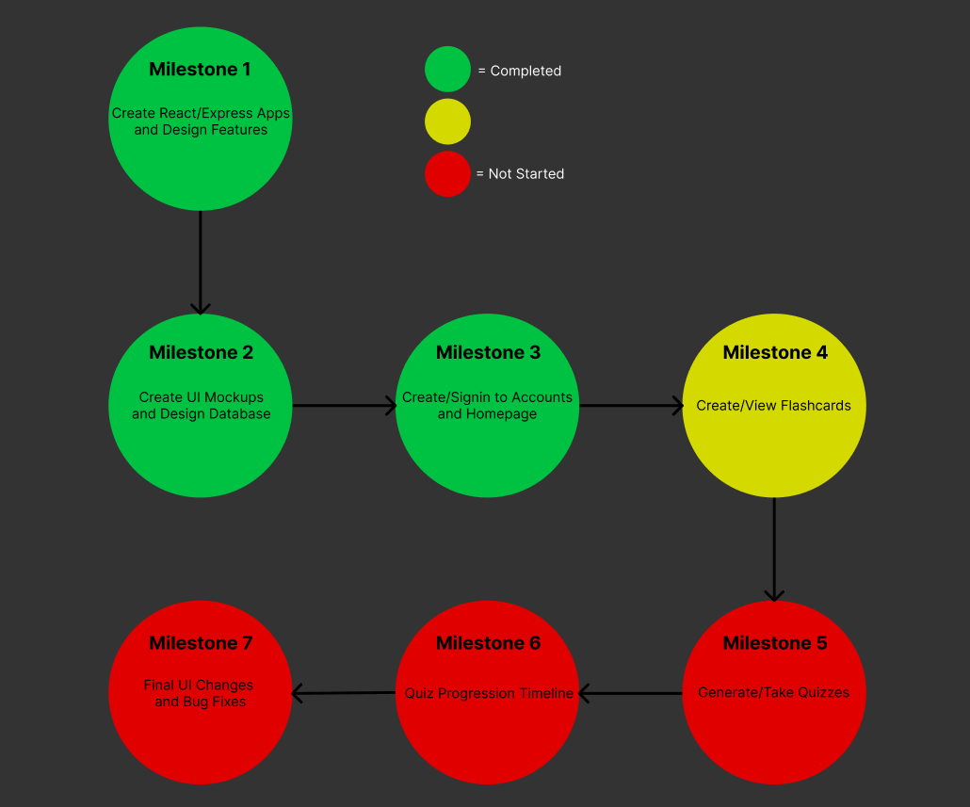
Progress

Slide 3
Current Milestone
Nothing to show so far
Personal tasks for milestone have been set and currently being worked on
Max: API endpoints
Hung: Choose flashcard set
Justin: View flashcard set
Peizu: Create flashcard set

Slide 4
Follow up on Responses/Feedback
Professor suggested adding simple way to reset username/password
This will be added by the end of the week
Nothing else to follow up on

Slide 5

Testing Plan Simplified
Use Postman to verify the backend APIs create and return the correct data
After the APIs for a feature are complete and tested, go through the feature use cases then make sure the data was created in the Database (verify via postman) and data is accurately being displayed on frontend

Slide 6
How to Check Status of Product
Click on the following link for instructions on how to build the product
https://github.com/maxpanec/Deepcourse/blob/main/docs/expert_users/expert_user_guide.md
After building the frontend and backend, navigate to http://localhost:3000

Slide 7
Team Audio Visualizer Feedback/Response
Display all error messages in registration rather than just display one
Error check should be in order for registration (email -> username -> password)

Slide 8
Feedback Response
Thanks for the feedback
We will fixed those issues in this milestone

