Slide 1
Study Sets
By Team Deepcourse
Justin Barragan, Max Panec, Peizu Li, and Hung Nguyen (Lead)

Slide 2
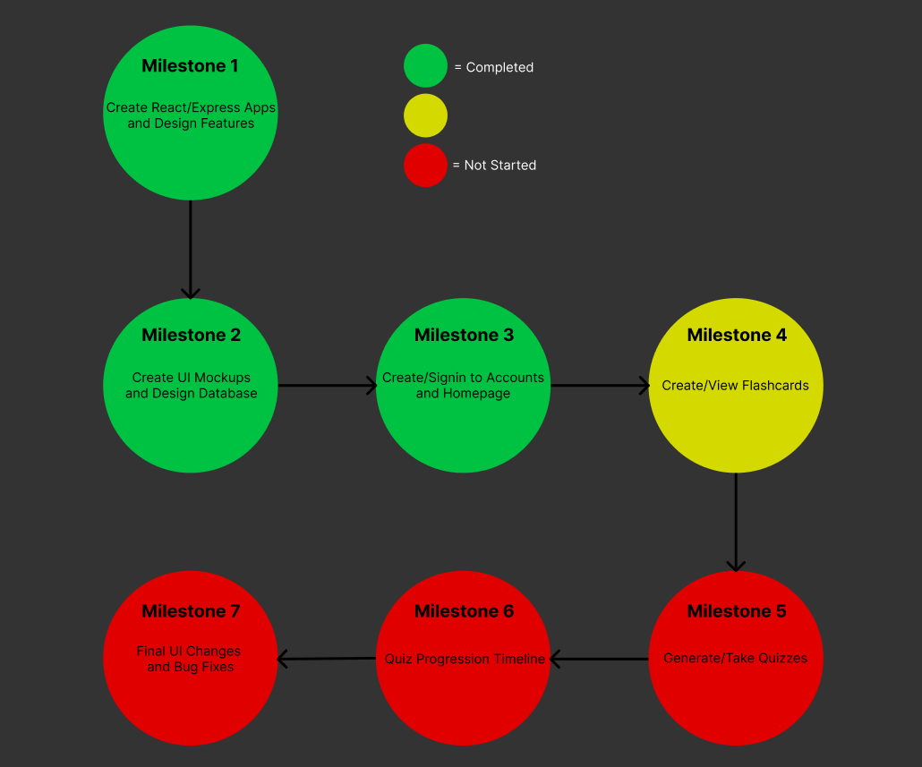
Progress

Slide 3

Application Frontend - Homepage

Slide 4
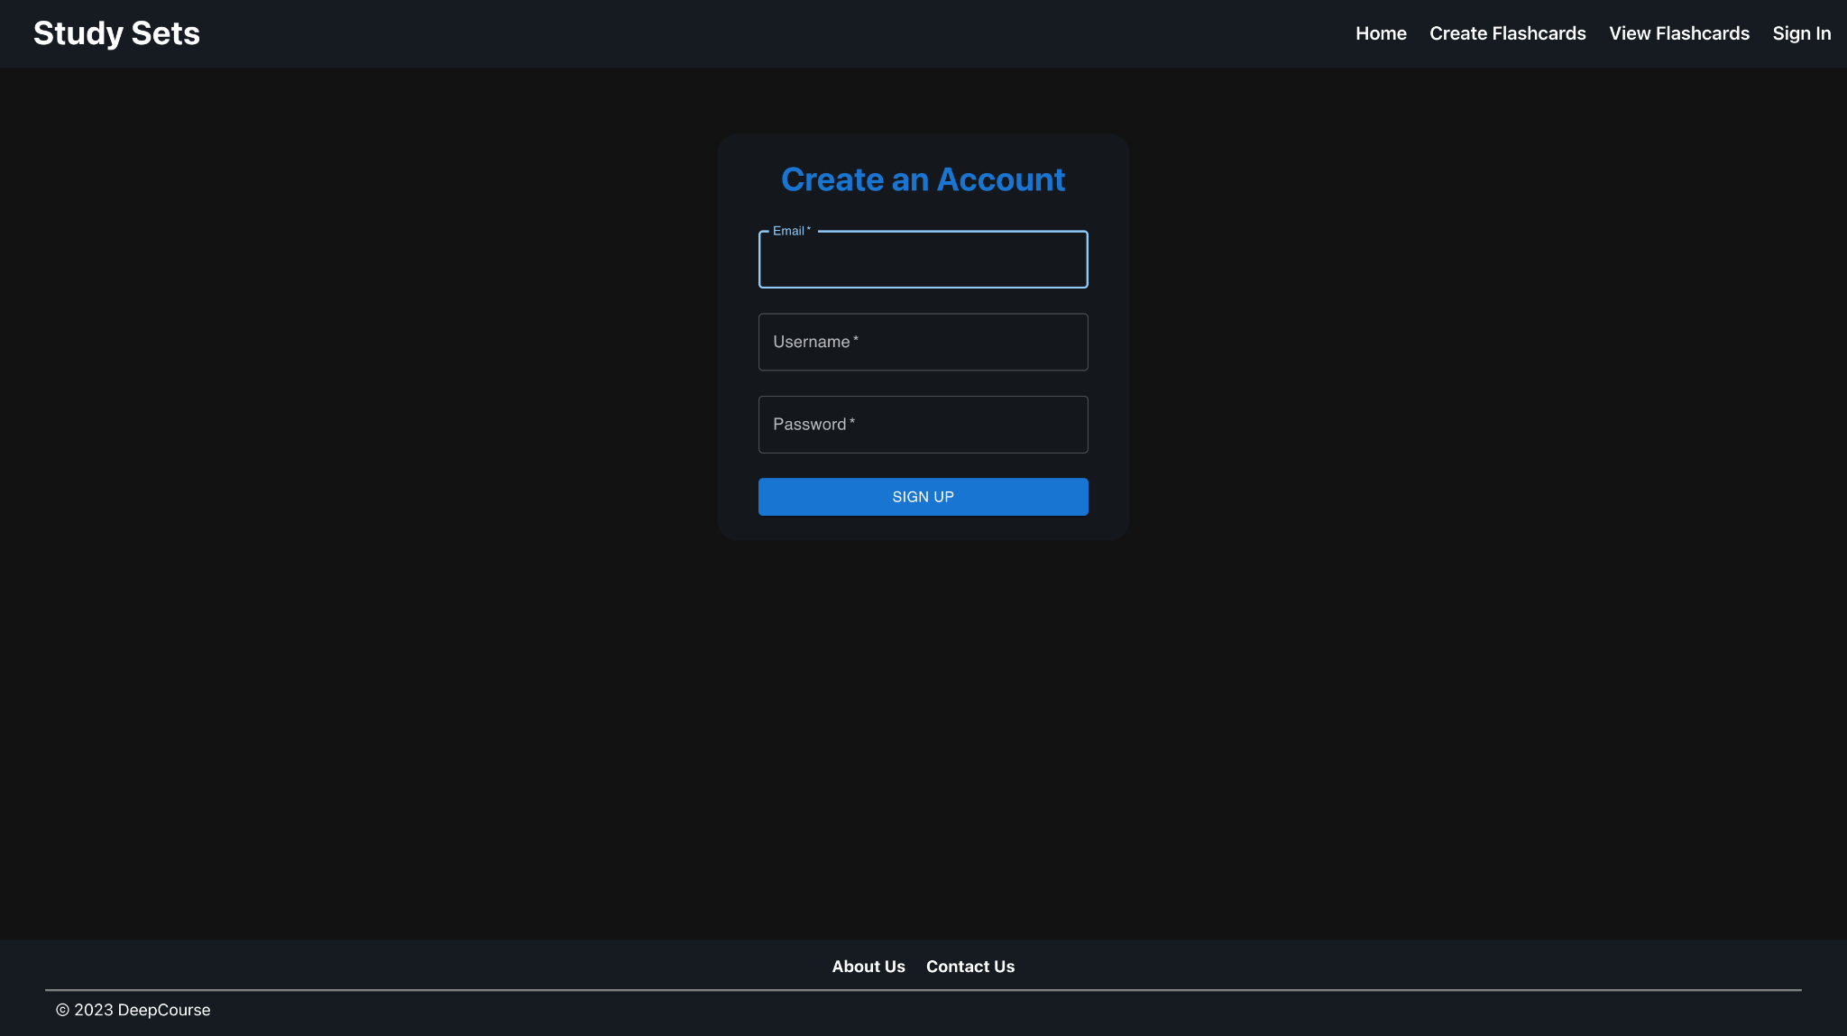
Application Frontend - Sign up Page

Slide 5
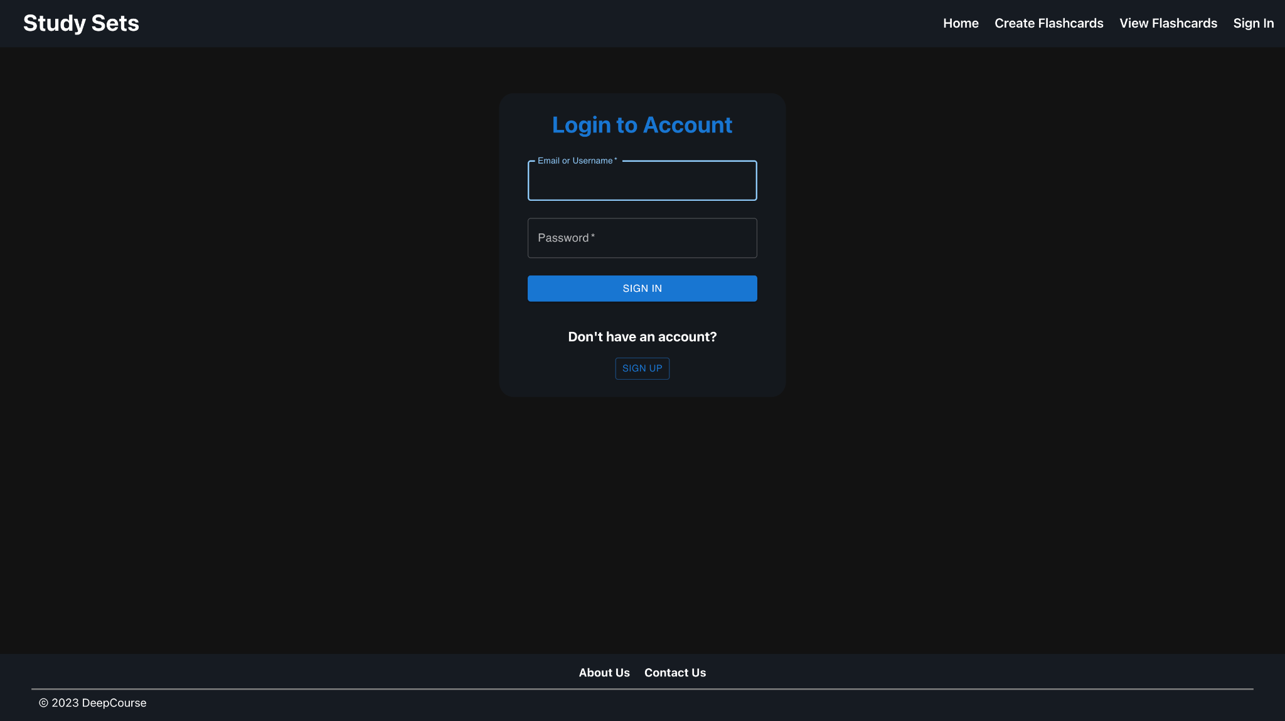
Application Frontend - Login Page

Slide 6

Testing Plan Simplified
Use Postman to verify the backend APIs create and return the current data
After the APIs for a feature are complete and tested, go through the feature use case. Then make sure the data was created in Database (verify via postman) and data is accurately being displayed on frontend

Slide 7
Wanted Feature: Superuser - functionality
List/summarize the individual data of registered users.
Reset users' password
Remove user accounts
Delete inappropriate quizzes, files, and images.
(and have all the capabilities of a regular user?)

Slide 8
Wanted Feature: Superuser - analysis
Amount of time and effort needed to complete:
Time and effort would be significant for most features of the superuser
Some functionality of the superuser might be possible to add towards the end of semester depending on the progress of our last two milestones
Is it a plus to the product?
This feature would not impact the experience of the average user
This feature would provide administrators with a useful tool for content management and site overview

Slide 9
Team ThriveToday Feedback
UI looks great
Testing plan is straightforward

Slide 10
Feedback Response
Moving forward, we will stick to a similar theme for our UI
Goal will be to maintain a cohesive look across the website

