Slide 1
Study Sets
By Team Deepcourse
Justin Barragan, Max Panec, Peizu Li, and Hung Nguyen (Lead)

Slide 2
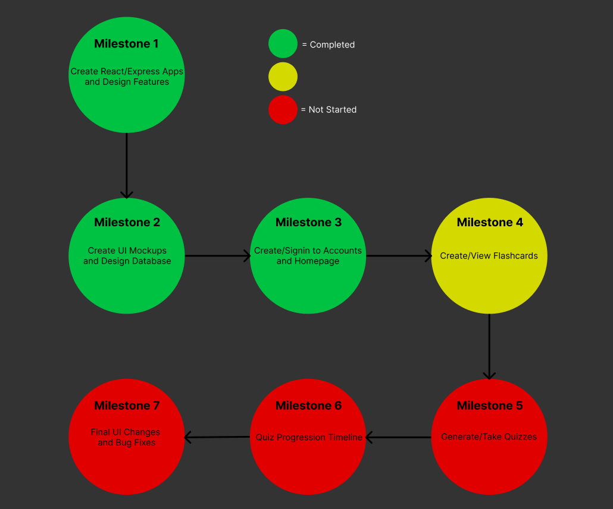
Progress

Slide 3
Milestone Delay
Finished API endpoints for creating/viewing flashcards
Frontend still needs to finish/revise parts of UI and connecting to API

Slide 4
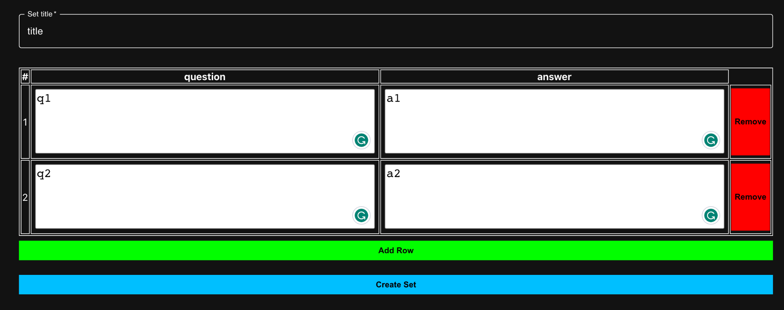
Create Flashcard Set Progress

Slide 5
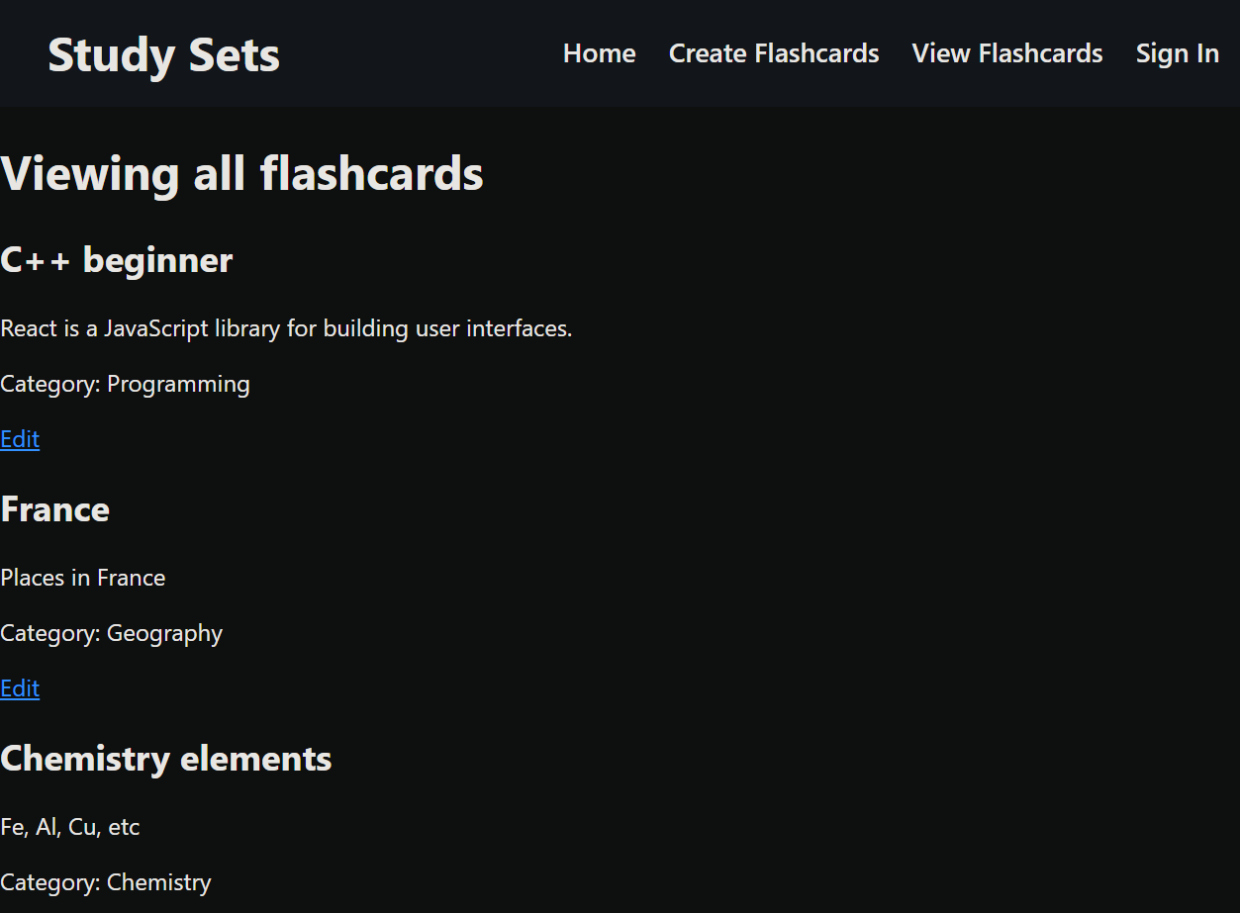
Viewing All Flashcard Sets Progress

Slide 6
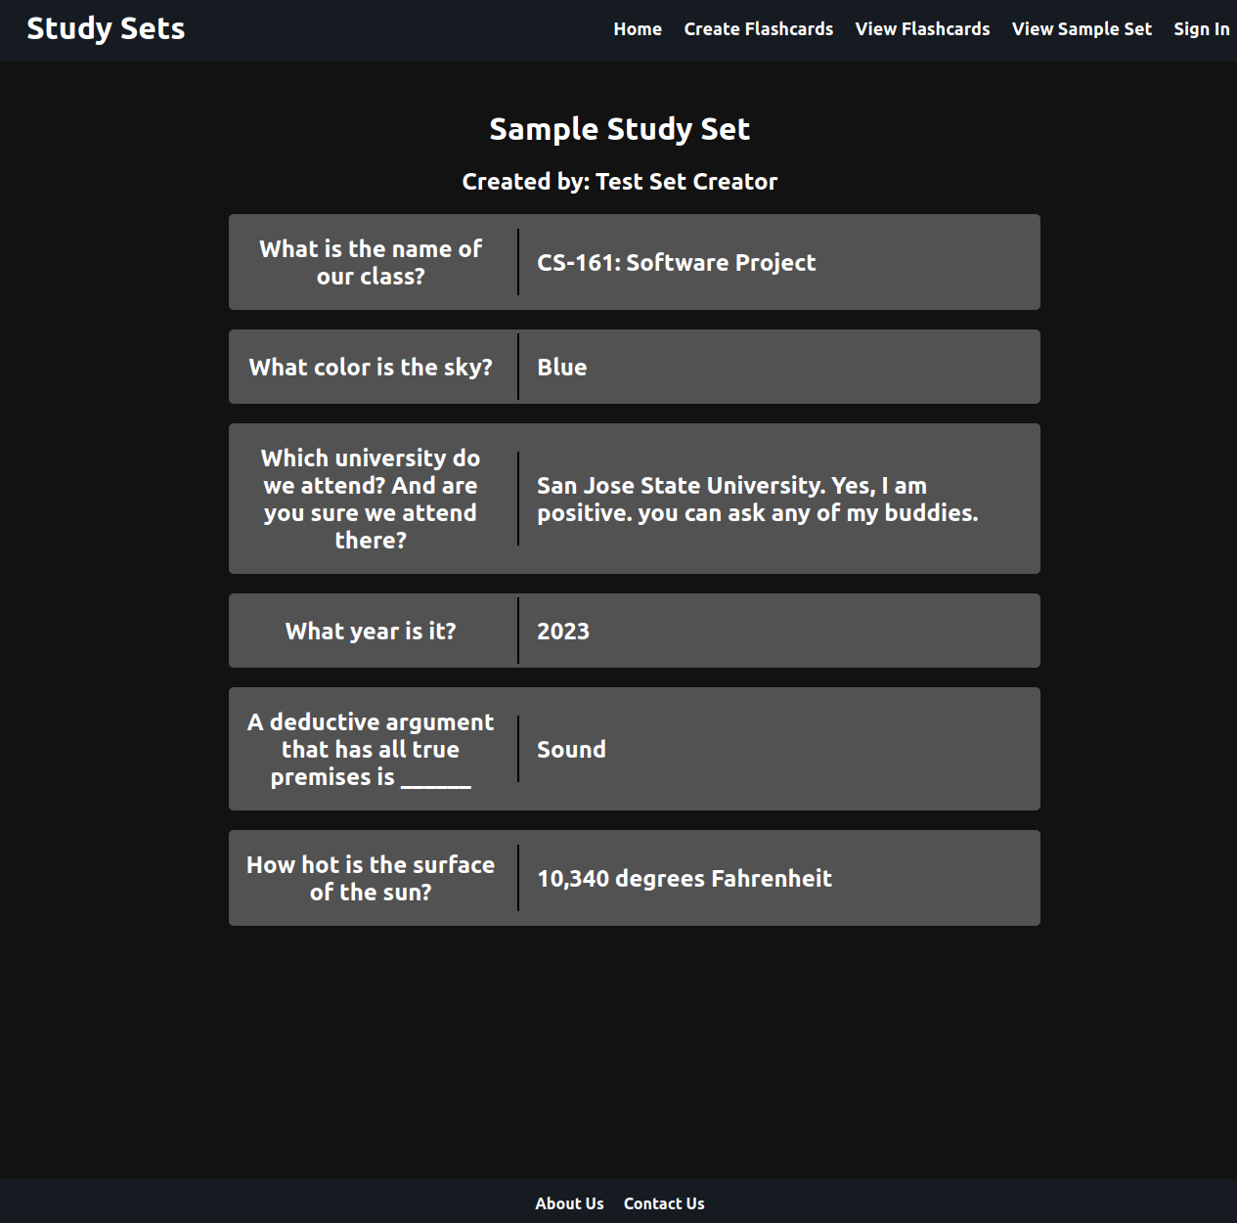
Viewing Individual Flashcard Set Progress

Slide 7

Testing Plan Simplified
Use Postman to verify the backend APIs create and return the correct data
After API endpoints have been tested, go through all feature use cases to verify frontend is creating and displaying data correctly and errors are handled

Slide 8
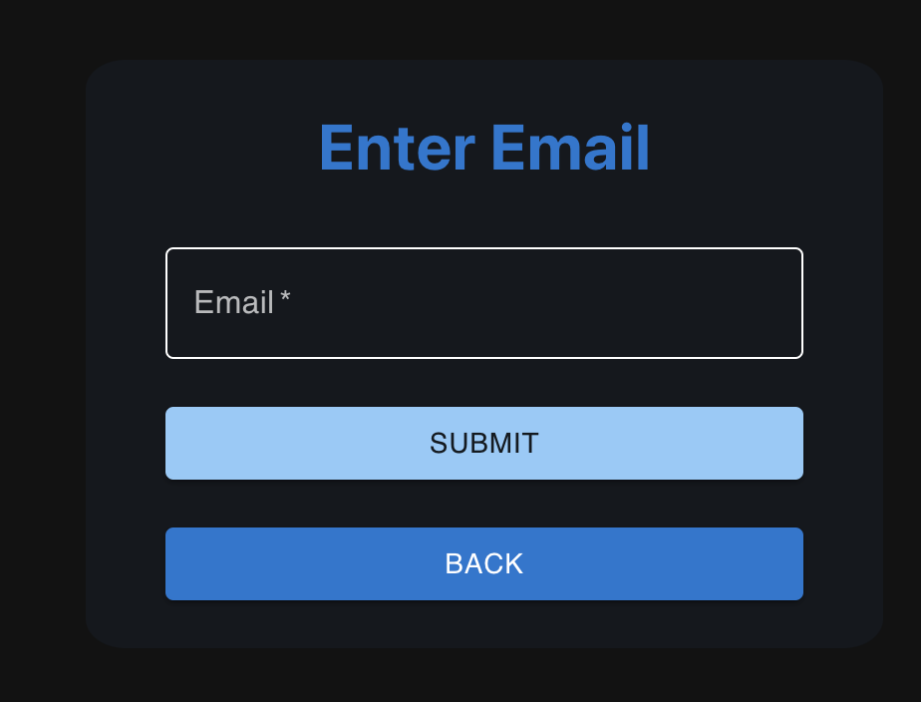
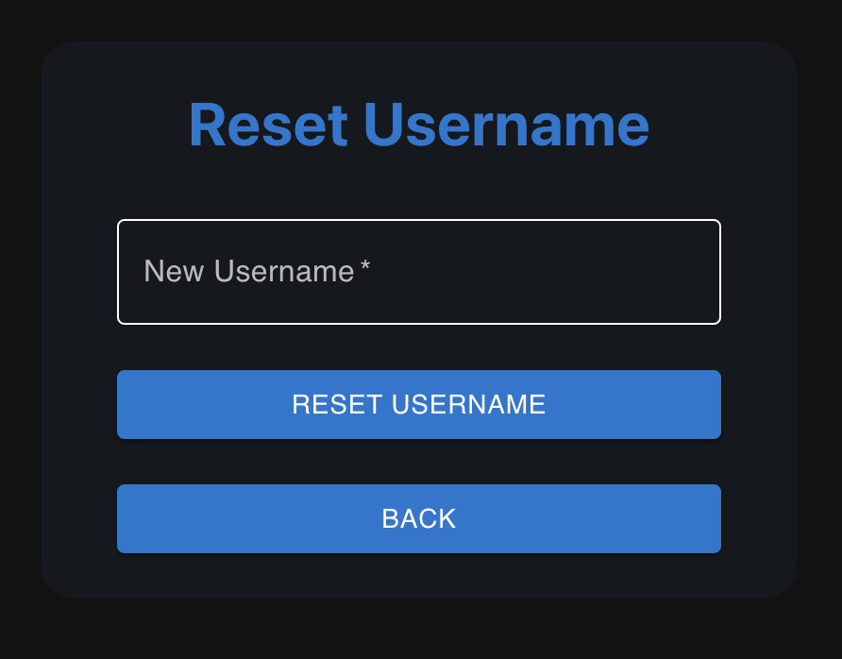
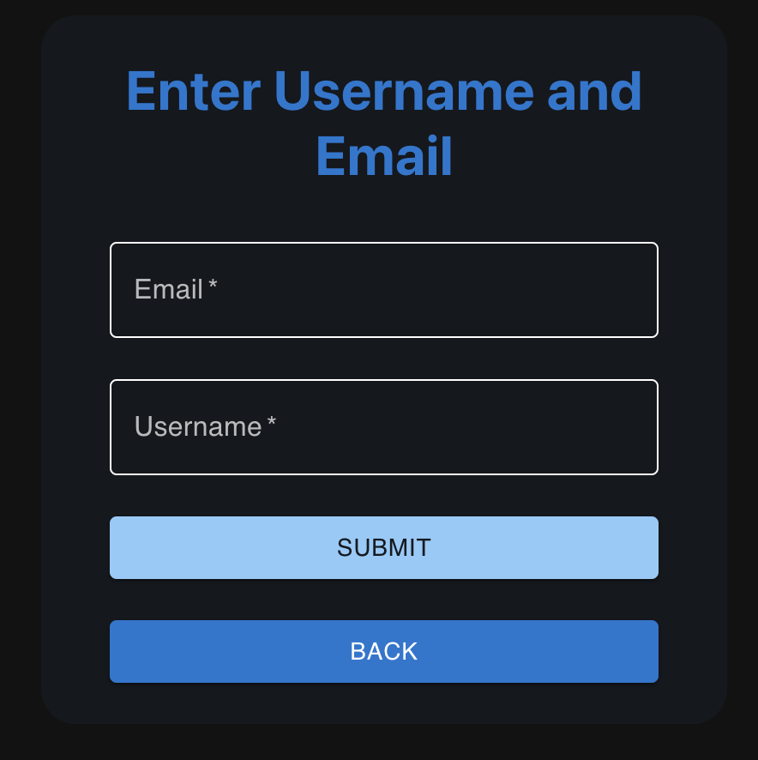
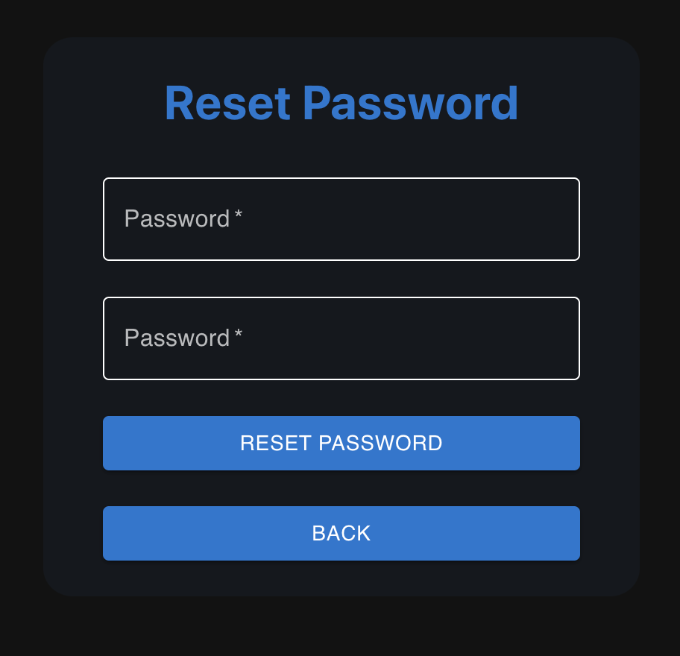
Follow up on Responses/Feedback
Professor suggested adding simple way to reset username/password
Reset Username
Reset Password

Slide 9
User-friendliness
List all error messages after login/signup failure
User guide explaining how to use our application

Slide 10
Team Feedback/Response
Feedback from Team Treehouse:
Create flashcard set UI looks good, colorful and user friendly.
Look into modifying Individual Flashcard Set layout and color scheme
For Viewing All Flashcards page, look into going from a list to separating each card into a visual card-like box
Response:
We’ll continue iterating on the two view page layouts, incorporating the successful aspects from the other interfaces in order to create a cleaner, more cohesive site-wide interface

