Slide 1
Study Sets
By Team Deepcourse
Justin Barragan, Max Panec, Peizu Li, and Hung Nguyen (Lead)

Slide 2
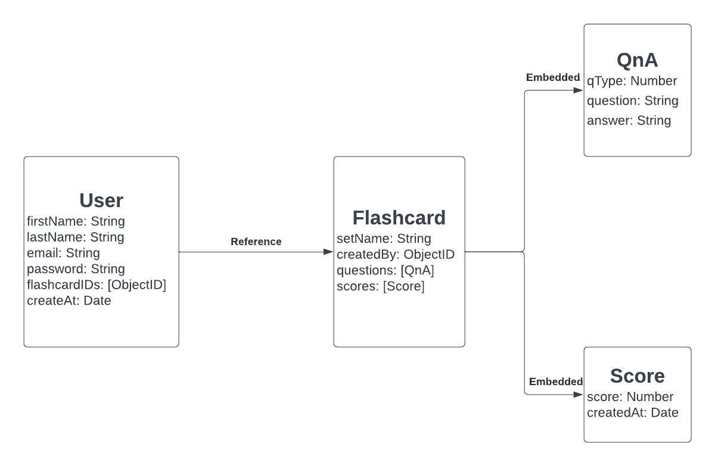
Database Schema

Slide 3
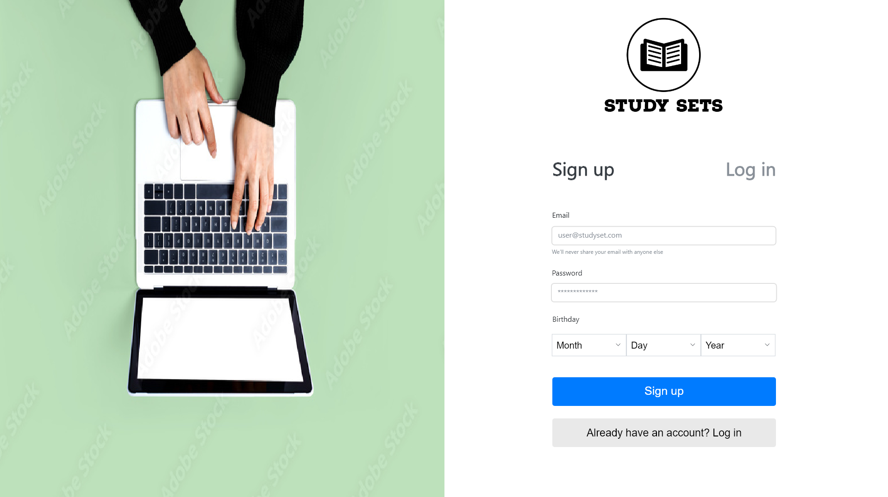
Mockups
Sign up page

Slide 4
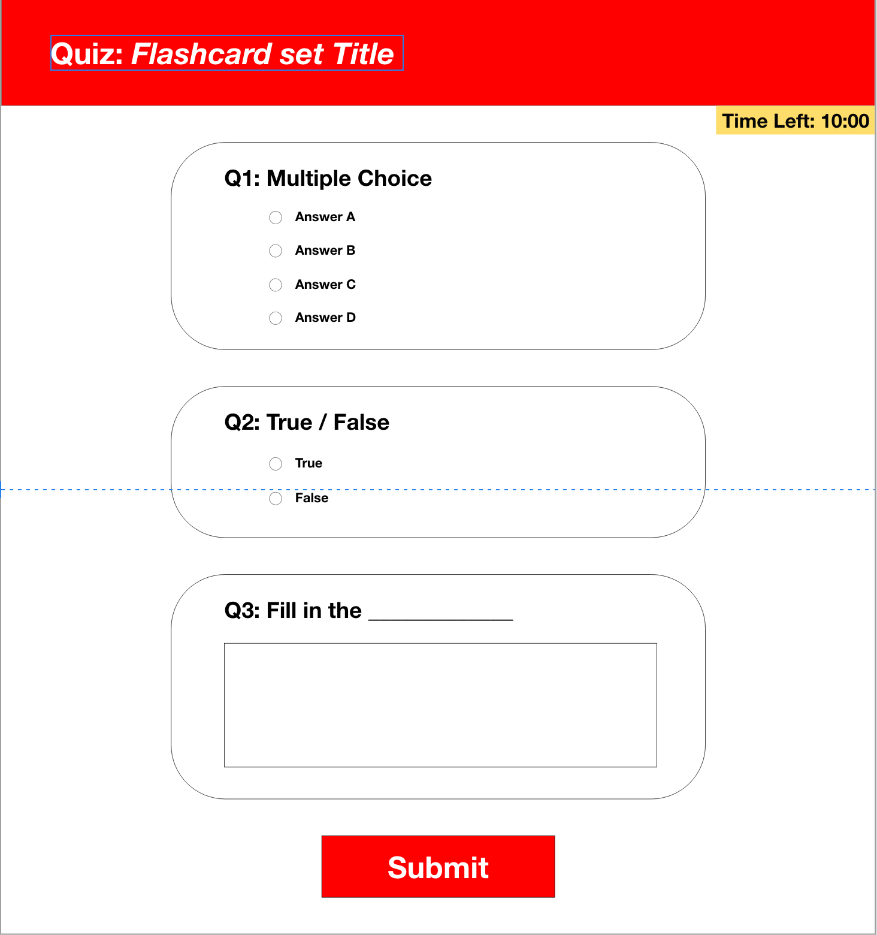
Mockups
Taking a quiz

Slide 5
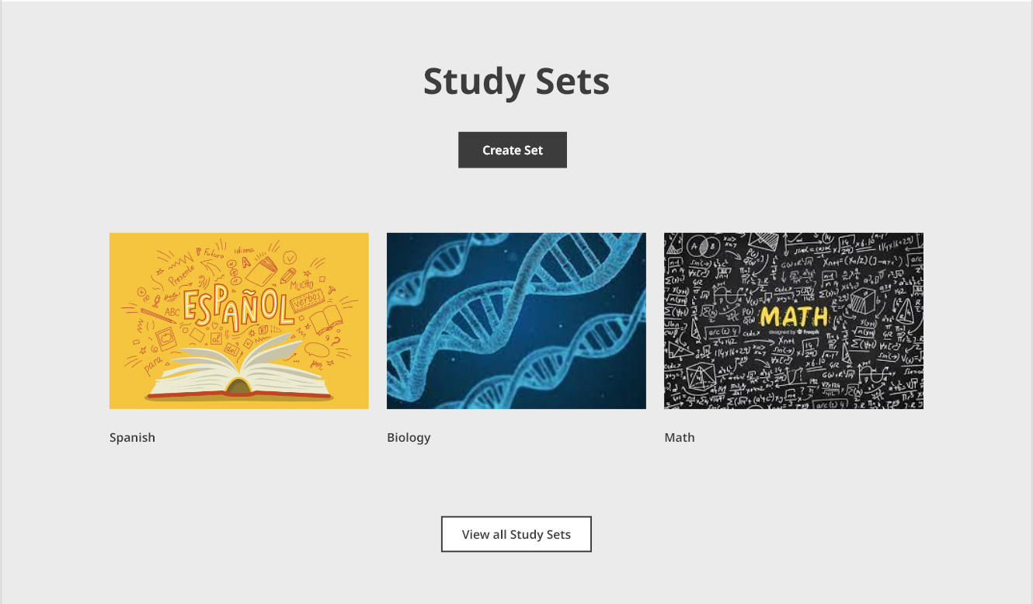
Mockups
Viewing study sets

Slide 6
Documentation for Application Users
User account creation: Allow users to create their own accounts
Flashcard creation and customization: Provide users with an interface to create their own flashcards.
Quiz generation: Create a tool that generates quizzes based on a given flashcard set.
Quiz scoring and tracking: Keep track of user quiz scores and progress for each flashcard set.
Feedback and improvement: Encourage users to provide feedback on the app

Slide 7
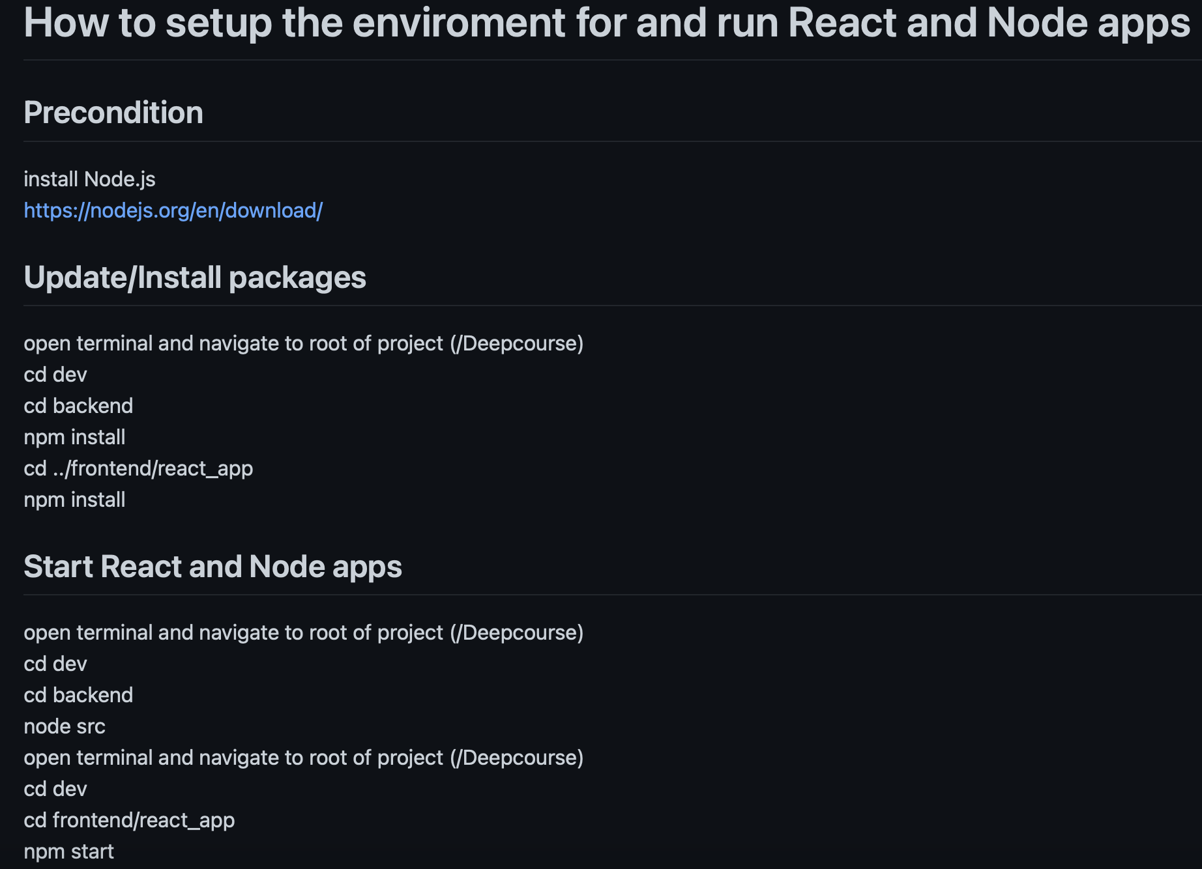
Documentation for Expert Users

Slide 8
Feedback from Team Luna R
By looking at the mockups we felt it was a good project and we were looking forward to seeing the finished product
Learned: they can generate quizzes based on the study sets.
Learned: Set the time limit during the quiz.

Slide 9
Response to Feedback
Suggestion: setting time limits for quiz
Short-term, our focus will remain on untimed quizzes
Will consider adding it as an option in the later stages of the project as an alternative to untimed quizzes

