Slide 1
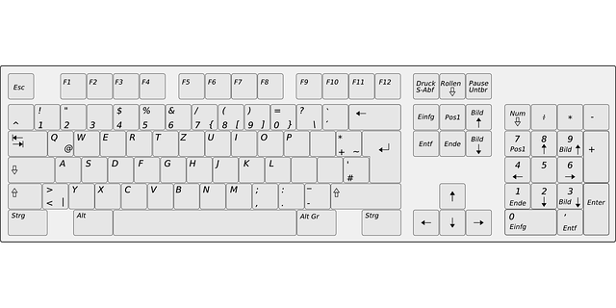
Adaptive Regular Update Stop
Adaptive Update Once
Adaptive Start Script
Adaptive
Next DoFs
Recording Start Manually
Adaptive Regular Update Start
G
Y
G
X
X
Z
Y
Z
Y
Student base Control
Z
Y
Z
X
X
Z
G
Y
G
Y
X
Z
X
Y
Toggle HUD
Connect Jaco
G
= Gripper Opening
STRG + H
Adaptive HUD
X
= Translational Axis
= Adaptive Axes
X
= Rotational Axis

Slide 2
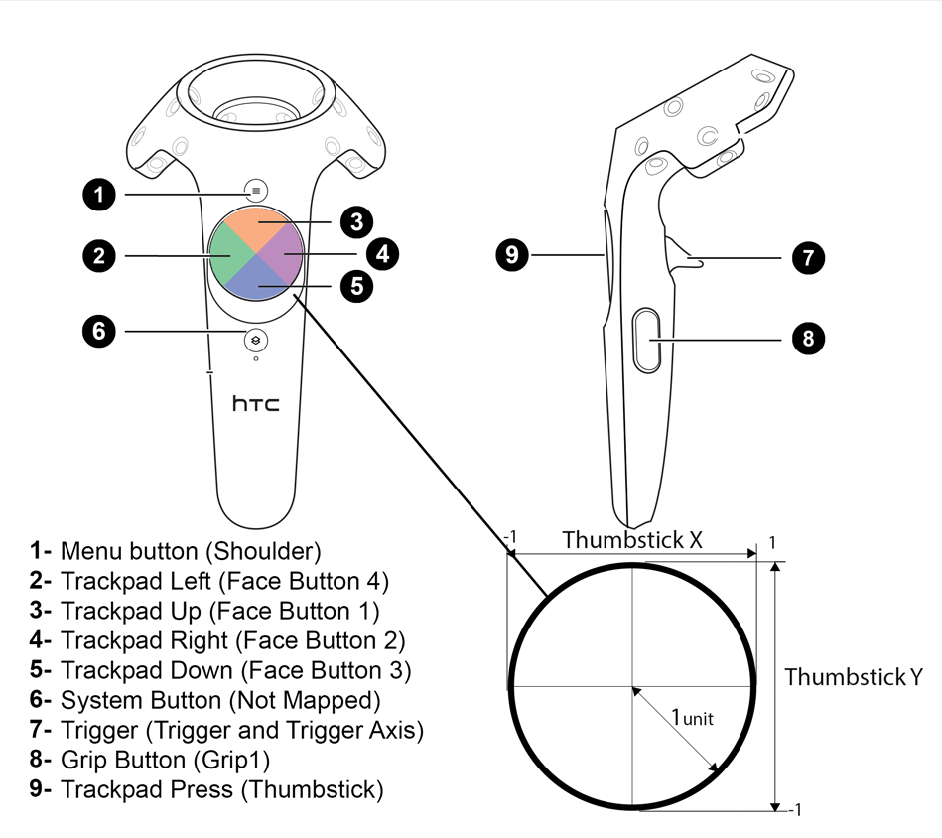
Quit
Connect Jaco
Recording Start Manually
Gripper Opening
Toggle HUD
Image by mitchemmc - Unreal Engine Forums

Slide 3
Quit
Connect Robot
Gripper Opening

