Slide 1
SmartConnect Module for OEM Smart Line-interactive UPS
Max Peng @ Taipei Design Center
Last update on Jun 13th
Notes:
This is an example of a Title Slide. We need to convey Life Is On in everything we do, so try to lead with compelling images that are vibrant, authentic, and human. The human element should be apparent and within the context of a segment that we touch.
To keep this PowerPoint template file size reduced, we included a small library of image choices in the Slide Master (under View). You can also get them from the SE Asset Library: https://schneiderelectric.telescopeondemand.com

Slide 2
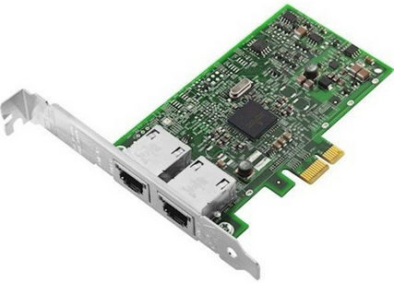
Background
OEM Smart Line-interactive UPS – Adding An Attractive Feature
Adding SmartConnect feature to OEM Smart Line-interactive UPS:
  Product Offer Team – a great feature to have for OEM products.
  Building a card (or module) for supporting different OEM families.
Notes:
This is an example of a Text Slide. Reference the different layout options in the Slide Master (under the View tab) for different variations. Remember, our new Brand Guidelines call for clean and simple messages and design. Reference the PowerPoint Guidelines on the Brand Book for tips and useful information on creating effective presentations.

Slide 3
SmartConnect – How does it work
Smart UPS with SmartConnect
How does SmartConnect work:
  UPS proactively connects to LwM2M server.
  UPS status/information are represented in Microlink data; All the Microlink data of UPS is called a Microlink map.
  UPS reports UPS status/information in Microlink data to LwM2M server.
  Each family (Amarok, SMX Refresh, Mink..) has different Microlink ID & Microlink map.
  SmartConnect web portal can show UPS status/information and control UPS remotely.

Slide 4
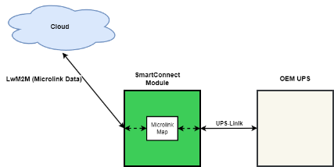
Requirements Analysis – Firmware Perspective
1. Microlink <-> UPS-Link
Facts about Microlink & UPS-Link:
  Microlink protocol is an APC proprietary/confidential protocol. We don’t want to share outside APC.
  OEM products only use UPS-Link.
To make OEM products to support SmartConnect, the SmartConnect module need to convert the UPS-Link data/commands to Microlink data/commands.

Slide 5
Requirements – Firmware Perspective
SmartConnect Module for OEM UPSs
Requirements of SmartConnect Module:
  Implements a bi-directional converter of Microlink and UPS-Link protocols.

Slide 6
Requirements Analysis – Firmware Perspective
2. One firmware fits all?
Have SmartConnect Module firmware to support all OEM UPSs:
  Different families of OEM UPSs could have different features and configurations.
  Cloud needs to differentiate different families of OEM UPSs.
    Different Microlink IDs for different families.
    Different Microlink Map for different families
SmartConnect Module needs to have different firmware for supporting different families of OEM UPSs

Slide 7
Requirements – Firmware Perspective
SmartConnect Module for OEM UPSs
Requirements of SmartConnect Module:
  Implement a bi-directional converter of Microlink and UPS-Link protocols.
  Develop different firmware for supporting different families of OEM UPSs.

Slide 8
Requirements – Firmware Perspective
SmartConnect Module for OEM UPSs
Requirements of SmartConnect Module:
  Implement a bi-directional converter of Microlink and UPS-Link protocols.
  Develop different firmware for supporting different families of OEM UPSs.
  Other…
  Communication Timing
  Firmware Upgrade
  …

Slide 9
Thank You
Notes:
Closing slide

