Slide 1
Experiment Management and Analysis with perfbase
Joachim Worringen
C&C Research Labs, NEC Europe Ltd.
December 1st, 2004

Slide 2
Situation: Work of a (Computer) Scientist
  Specification of an experiment
    Parameters: What influence do they have on the outcome?
    Results: Represent metric that qualifies the outcome
  Performing series of this experiment
    Each run is assigned a set of parameters
    Output data (results) are collected in some way
  Experiment analysis
    Try to answer the question above
    Need to do cross-run analysis for deeper insight
  Experiment documentation
    “What have I done when?” “What was the result?”
    Create statistically valid data
    Plot charts or create tables

Slide 3
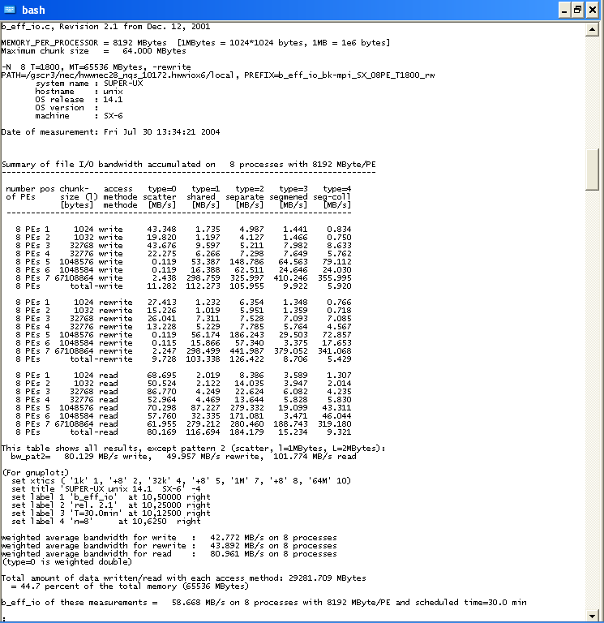
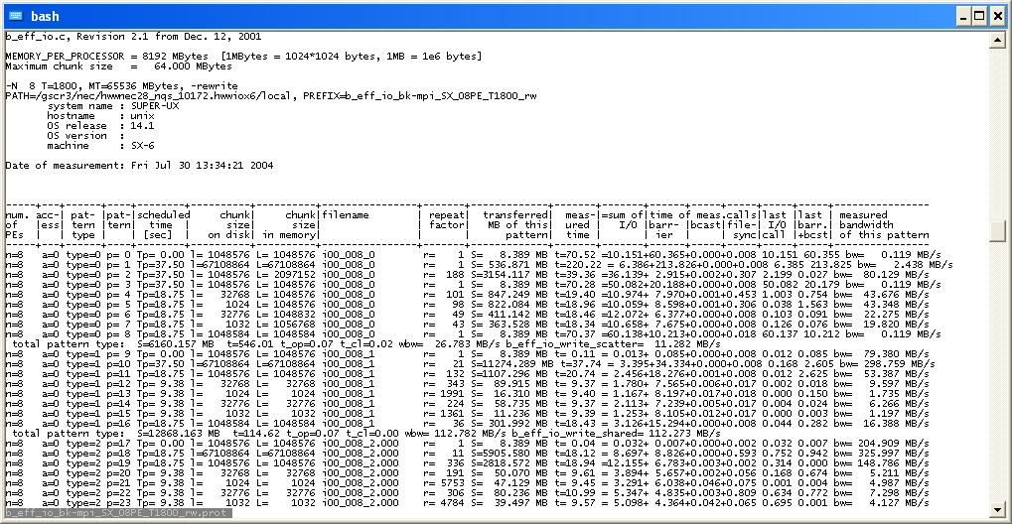
Example: Performance of Parallel I/O
Use established benchmark b_eff_io
  Output is stored in two text files
  Complex set of parameter & result values
Characteristics
  Large number of parameters, imposed by:
    Benchmark, depending on system type
    System configuration (file systems & I/O setup)
    Design alternatives in the I/O software
  Significant result variation between runs with identical parameters
Large number of runs required! How to handle?
Notes:
How to handle? Means:
How to organize all measurements? If done manually, will end up in a vast amount of directories and files.
How to find a specific measurement?
How to track the development of the overall, or every single performance aspect?
How to compare different variations of the experiment?

Slide 4
Existing Approaches
Commercial solutions (few exist!):
  Targeted at special applications (mostly bio)
  Windows-based
  Expensive & inflexible
Research projects:
  ‘ZOO’: dead since 2000, no software available
  ‘PPerfDB’ (now ‘PPerfGrid’): uses Paradyn for automatic instrumentation
  ‘ZENTURIO’: collects data via directive-based Language ZEN
  ‘CUBE’: targeted at detailed analysis of a parallel application; specific (hierarchical) data model

Slide 5
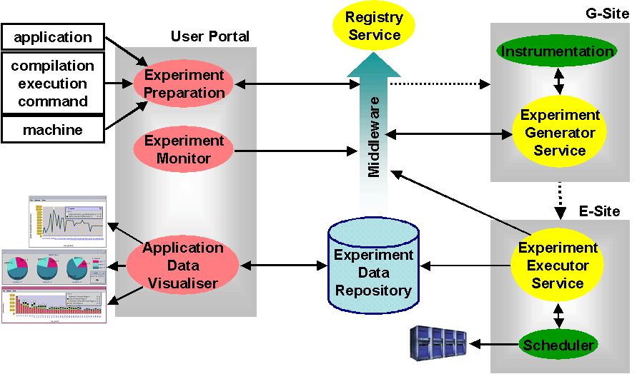
Why not use the Research Projects?
Software is not publicly available – and it’s state and future is unknown
All approaches depend on specific input data, acquired by modifying the source code or the executable
Complex setup: web portals, grid services, compilers, trace libraries, dynamic instrumentation, directive language, …
Great scientific approach – but:
Realistic scenario – or too complex? Usable? Reliable?
ZENTURIO Architecture

Slide 6
Proposed Solution: perfbase
Simplicity
  Based on Python scripts and a SQL database
  Every user is able to set up his own environment in seconds
Usability:
  Can be applied to every tool, application, library,… that generates text output
  Conduct experiments anywhere - only capture text output for processing at workstation (“at home”)
Flexibility:
  Every kind of ASCII-based data can be processed.
  Perform queries, relate data, generate plots, …

Slide 7
perfbase Workflow
Define ‘experiment’ (XML ‘experiment description’):
  Parameter & result values: name, data type, unit, scaling, …
  Meta-information: name, synopsis, description, …
  perfbase setup --desc=exp_desc.xml
Execute ‘runs’ & import data into the experiment:
  Requires knowledge of input file format: simple XML based parser description
  perfbase input --desc==input_desc.xml run*.txt
Perform queries on the experiment data:
  Specify data sources & filters, data operators and output format (again, via XML formatted description)
  perfbase query --desc=query_desc.xml
Eventually: Change experiment definition as required:
  Only need to provide changed/added/deleted parameters/results/ meta information (like XML experiment description)
  perfbase setup --update --desc=exp_update.xml

Slide 8
More perfbase Commands
info: Gather information on perfbase database, experiments and runs
find: Find a specific experiment or run via a range of search criteria
plot: Directly plot data (variation of query)
datamine: Data mining within an experiment to determine “anomalies” or trends
delete: Delete single runs from an experiment, or a complete experiment
dump: Dump a complete experiment (and import it into another database)

Slide 9
Parser Specification
‘explicit location’:
  Line number specified explicitly
  Value in line by position or keyword/regular expression
‘named location’:
  Line triggered by keyword/regular expression
  Again, value by position or keyword/regular expression
‘tabular location’:
  Table start triggered by keyword/regular expression
  Processes lines as table (fixed number, or by delimiter)
‘fixed value’: definition of a constant value
Parser extracts numeric information, depending on data type
Values can be defined as ‘defined only once’, or ‘changes during a run’
Single input file can contain data for multiple runs; or multiple input files can contribute data to a single run.

Slide 10
Query Processing
‘outputs’ to store the data to files
in a data format usable for post-processing
‘combiners’ to combine datasets
from operators
‘operators’ perform arithmetic
operations on the datasets
‘source’ filter & extract
datasets from the runs
Experiment database with
a number of runs

Slide 11


