Slide 1
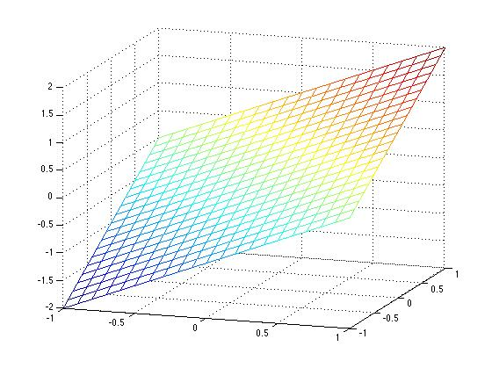
Origin
Gradient arrows of f(x,y) function (flat on x-y plane)
Points of f(x,y) that are along constraint g(x,y)
Gradient arrows of g(x,y) function (flat on x-y plane)

