Slide 1
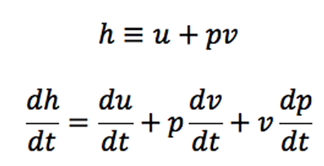
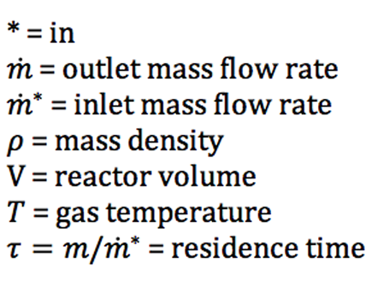
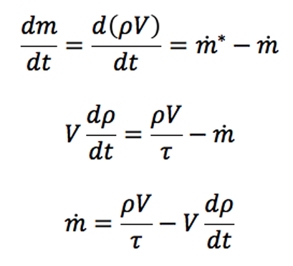
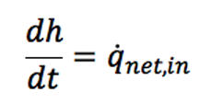
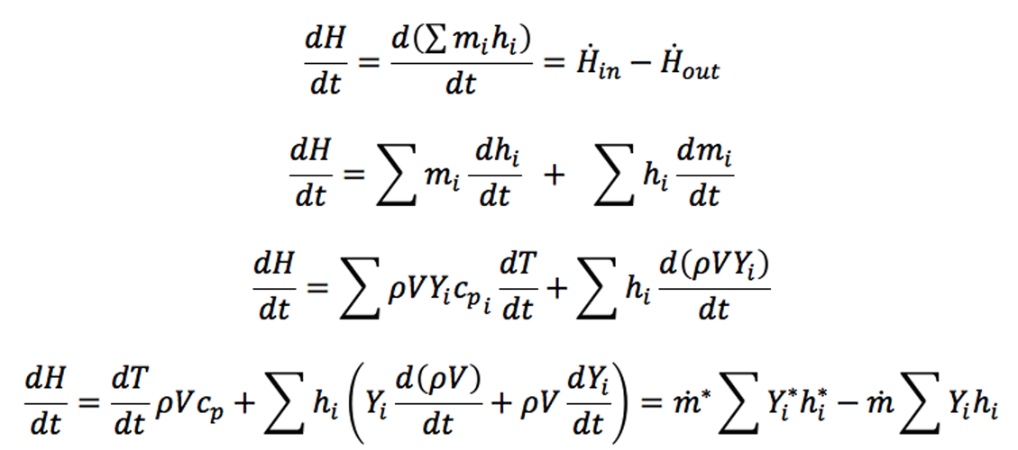









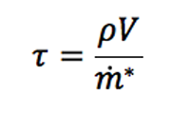


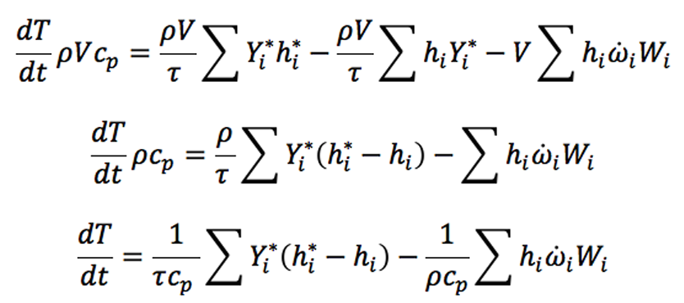
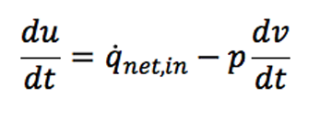
Derivation for Time Dependent Gas Mixture in a Perfectly Stirred Reactor
An open system with constant pressure and volume, assumptions: ignore surface reactions and heat loss
Mass Conservation
= 0 because constant pressure, substitute into equation terms cancel
We can conserve enthalpy instead of energy, energy is still conserved but would need an additional equation from ideal gas law to calculate
Species Equation
Substitute continuity
Substitute continuity
Expand terms
Cancel terms
Expand terms
Substitute species equation
Expand terms
Cancel terms
Cancel terms
Energy Equation, specific volume not constant
Substitute
Definition of enthalpy

