Slide 1


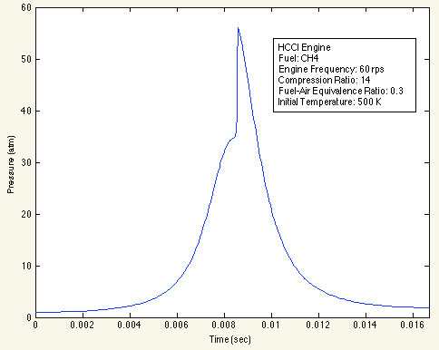
Software to Calculate Reaction Rates in Clean Energy Fuels Using High-level Programming Language
Reverse Engineered from Industry Software.
Goal: To simplify software to make easier to understand and facilitate collaborate, and to create an educational tool to promote learning.
Max Plomer
CombustionHelp.com
maxplomer@gmail.com
Software Flow Chart
Read fuel mechanism, stores values into intermediate variables
Print code to calculate reaction rates, can stand alone as it’s own program
Reactor simulations call reaction rate functions
Mechanism file includes NASA polynomials for thermodynamic data, where 7 numbers are used to calculate quantities such as specific heat, enthalpy, entropy, etc.
This is called the “create hardcode” step because the code generated is specifically for a certain fuel, for example methane (CH4) or hydrogen (H2). This code will be available for free download under the GNU General Public License at CombustionHelp.com
This part of the code is very easy to understand, more so than the industry code, better for learning/collaborating/experimenting.
Here is code of the same O+H2<=>H+OH reaction
kf=kfarray(3);
fwdk(3)=kf*Y(1)*Y(3);
Kc=exp( -(+g(1)*-1+g(2)*1+g(3)*-1+g(5)*1) / T );
revk(3)=kf/Kc*Y(2)*Y(5);
How to call function to get molar production rate
wdot = getwc ( C , T )
Temperature
Units of Kelvin
Vector of molar production rate
Units of
Vector of molar concenration
Units of
The most basic type of reaction is a modified arrhenius equation of the following form.
HCCI engine – Premixed fuel and air injected into cylinder, ignition occurs from compression just as in diesel engine
Mixture compressed until it ignites
It uses 3 coefficients, A the pre-exponential factor, B the temperature exponent, and E_{A} the activation energy
This is how the reaction appears in the mechanism file
O+H2<=>H+OH 3.870E+04 2.700 6260.00
Y(1) is the mole concentration of hydrogen (H2), Units of
Volume is a function of time
This means the reaction is both forward and reverse
A the pre-exponential factor
Unit depends on reaction
B the temperature exponent
Dimensionless
E_{A} the activation energy
Units of Calorie
fwdk(3) is the forward reaction rate of the 3rd reaction, Units of

