Slide 1

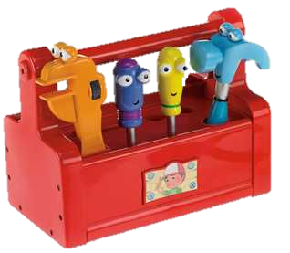

Slide 2
Symfony2 app
PDF
Documentation
Users
i18N
Blog
Serializer

Slide 3

Symfony2 request workflow
Router
Model Beer
View ShowBeer
URL : /beers/42
Controller : ConsertoBeer:Get(42)
HTTP Request GET /beers/42
Symfony2 Kernel
Controller ConsertoBeer:Get($id)
HTTP Response beer-42.html
Front controller
App.php / app_dev.php

Slide 4
A Beer Object
Table: beer
id: 42
Name: Kwak
Alcohol: 8,4 Description: Pauwel Kwak is an amber ale brewed since the 1980s (…)
Id | name | alcohol | description
42 | Kwak | 8,4 | Pauwel Kwak is an amber ale brewed since the 1980s (…)
43 | St Bernardus Tripel | 10,5 | This beer, with high fermentation, has a pale amber colour
… | … | … | …
Doctrine

Slide 5

Service Container logger mailer translator …

Slide 6
