Slide 1

Decentralized Data Sharing System based on Secure Multiparty Computation
Midterm presentation :
27th November 2017
Max Premi, Master Semester Project (12 credits)
David Froelicher, Juan Ramon Troncoso-Pastoriza

Slide 2
Goals of the project
Analyse Decentralized Privacy-preserving data sharing system
  Unlynx with Homomorphic Encryption (ref)
  Prio using Secret Sharing Scheme and Multiparty Computation (MPC) (ref)
Compare and evaluate what is the main difference and which is most efficient/scalable ?
Design a solution that combine both of the solutions

Slide 3
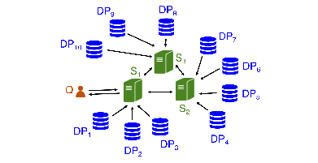
What is Unlynx ?
Collective authority (arbitrary number of servers)
Based on Elliptic Curve El-Gamal
Query answered by Data Providers
Collectively aggregate the data
Properties :
  Proof of correctness
  not for input validation
ref , legend for Q ,Dps and S

Slide 4
What is Prio ?
Each data provider holds a private value
Privacy if one server is trusted, same as Unlynx)
Properties with proof
Based on Secret Sharing ,Aggregation using MPC / Use SNIPs proof
Not encrypted, private values of data-provider splited into number of servers shares in Field F
Ref

Slide 5
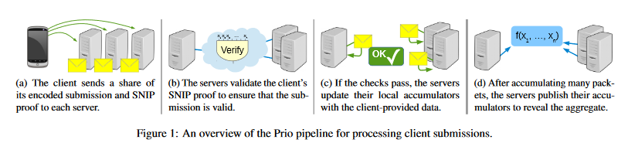
More about Secret shared Non Interactive Proofs
Each server evaluates its share in an arithmetic circuit with M multiplication gates
Construct 3 polynomials from wire (f,g and h)
Send Share h[i] of polynomial h (where f (point )g = h), along with share x[i] to server i
Server reconstruct from shares, do consistency check ; polynomial identity test. Detect fraudulous input with p =
Use Beaver MPC to multiply shares and get final result
(Figure split and small explanation)
$1−\frac{\left(2M−2\right)}{card\left(F\right)}$

Slide 6
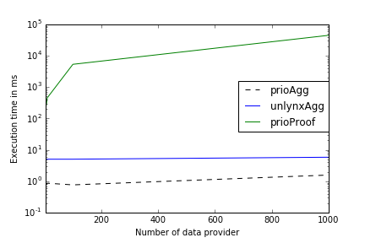
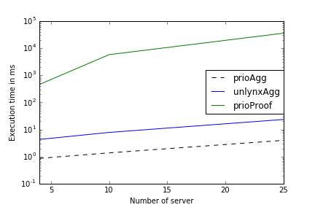
Preliminary Results
Title of test to explicit the curves, implemented on github
Add for 7-8 servers, 25 -50 clients
Title to the plots, size of the fonts bigger
Test ran on VMWare, Ubuntu64 bits v17.10, 6.1 GB RAM, 2 cores intel I5-4590 @3.3Ghz, 10 runs

Slide 7
Status & Next Steps :
(Add the ticks, and status from here) more explicit
Implement the service for prio in the framework
Implementing El Gamal Input range Validation (ref)
Compare both systems with input validation and aggregation
Compare the bandwidth used by protocols
Design a hybrid solution

Slide 8
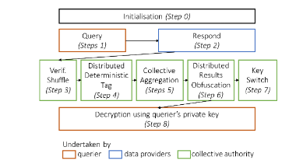
Technical Slide Unlynx
Server i Pair private-public Key (ki,Ki), collective public key K sum of public from each server.
Zero knowledge proof, with discrete log y1, y2 by doing A1y1 + A2y2 = A, for DDT, publish for Agg.
Support Differentially private queries
Confidentiality, Unlikability, Corectness, differential priv -acy.

Slide 9
Technical Slide Prio
Data-provider splits private value x in d shares, evaluate circuit Valid(x).
From wire of circuits derive polinomials f,g and h, f(dot)g = h, send [h]i and [x]i.
Server reconstruct share [f]i and [g]i from wire share [h]i and share of [x]i, with polynomial interpolation
Need to check that f*g = h, pick random r, publish [f(r)]i * [g(r)]i – [h(r)]i should be 0
MPC triple, a.b =c shared, each compute : [d]i = [f]i – [a]i and [e]i = [g]i – [b]i, broadcast these to reconstruct d & e.
[z]i = de + d[b]i + e[a]i + [e]i , check [z]i – [h]i = 0

